Slide 1
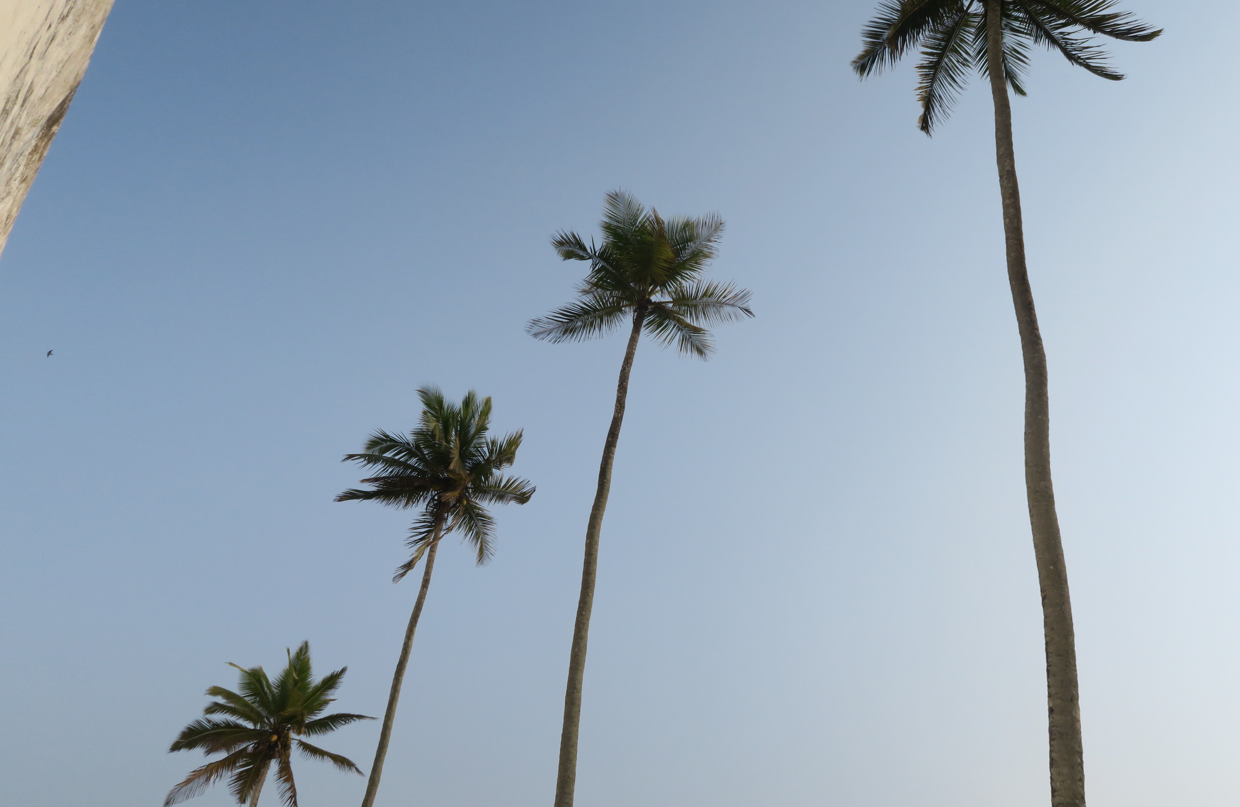
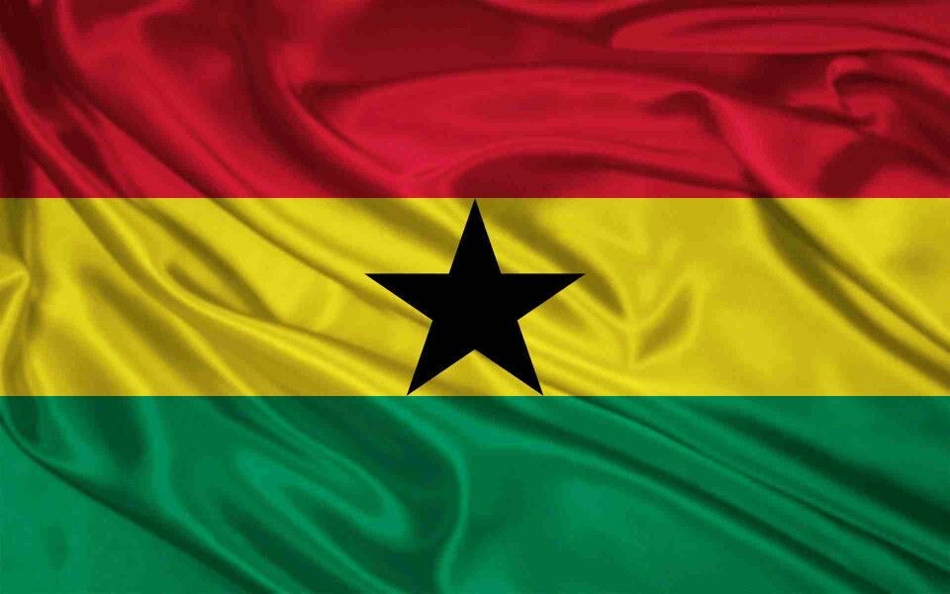
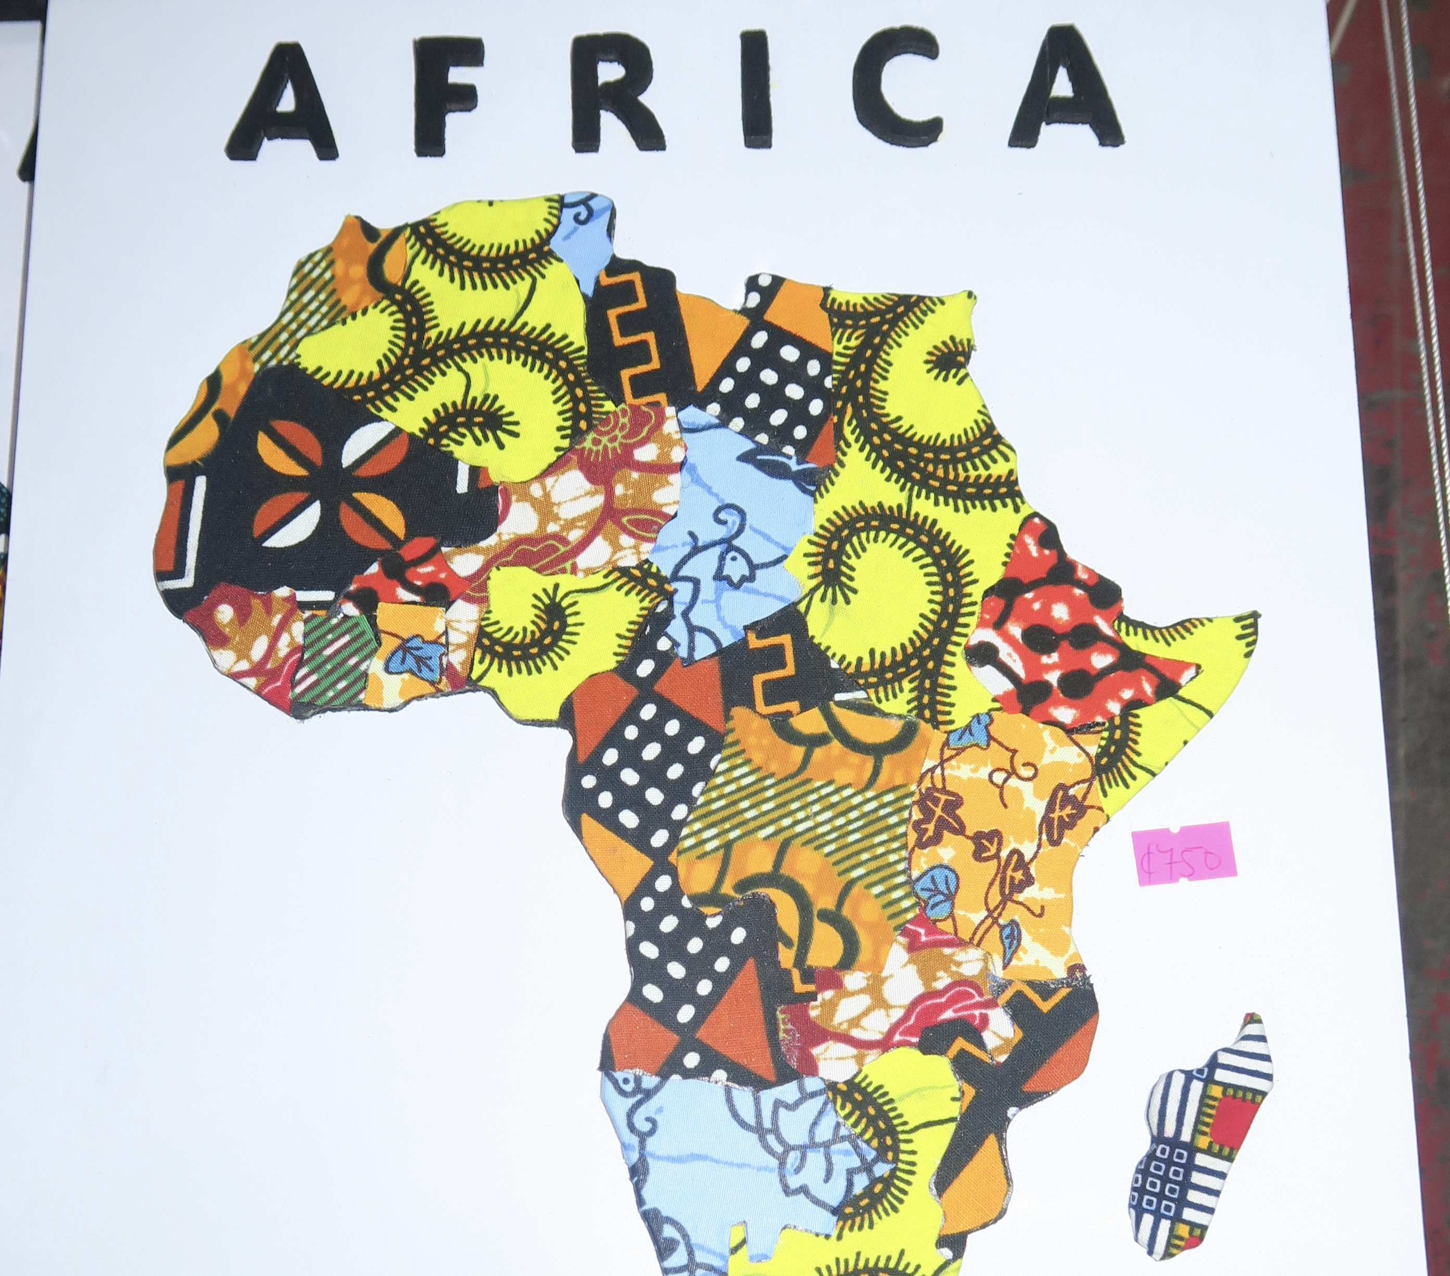
CROSS CULTURAL EXPERIENCE
CLDV – CULTURAL DIVERSITY
PROFESSOR REMI ALAPO
BY VANESSA BOATENG

Slide 2
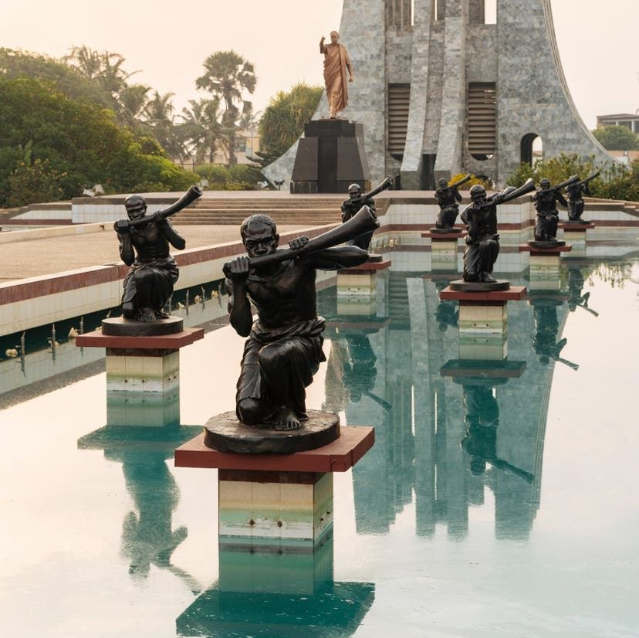
INTRODUCTION
Today, I will be delivering a presentation on my Cultural experience and cultural interaction outside the United States (Ghana).

Slide 3
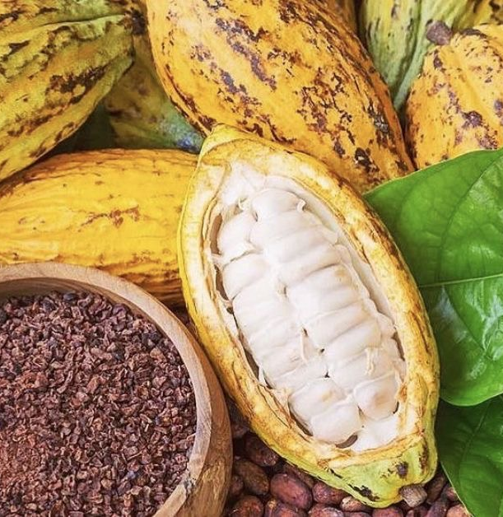
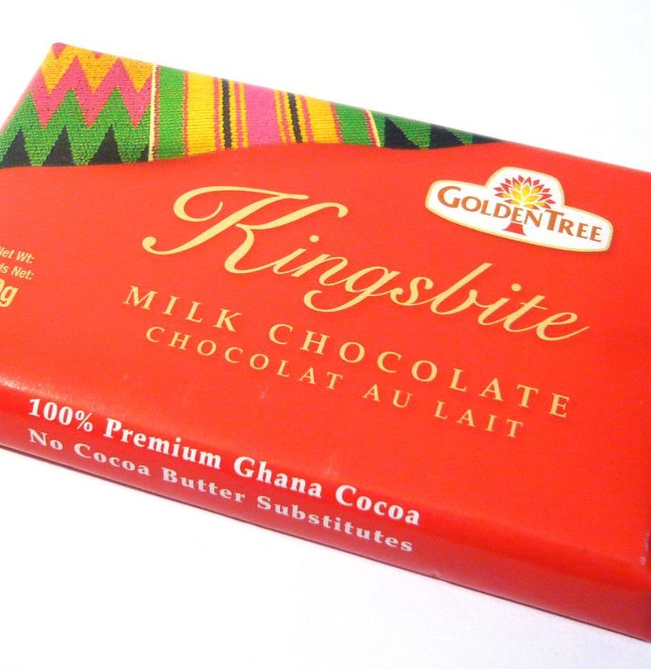
BACKGROUND INFORMATION
Ghana is recognized as one of the leading countries in Africa, largely due to its abundant natural resources. Formerly referred to as the Gold Coast, Ghana achieved independence from British colonial rule in 1957, marking the first sub-Saharan nation to do so. The country's economy is primarily driven by industries such as gold, cocoa, and more recently, oil. The name "Ghana" pays homage to the medieval trading empire that existed in the region prior to the 13th century.

Slide 4
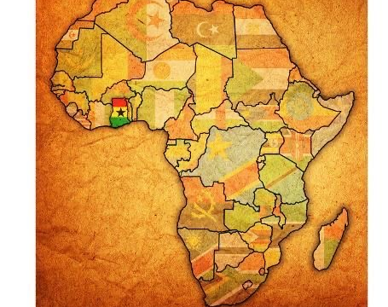
LANGUAGE
Ghana is a diverse country with a variety of ethnic groups and languages spoken across the region. The official language of Ghana is English, which is used in government and education. Many Ghanaians are fluent in English, although it is not the first language for most. Native languages play a significant role in Ghana's linguistic diversity, with over 70 different languages spoken, including Akan, Ewe, Ga, and Dagbani, among others. Akan Twi is the most widely spoken indigenous language, used by nearly half of the population in Ghana.
Thank You – Medaase
What’s your name – Wo din de S3n

Slide 5
SHOWCASING GHANAIAN DANCE CULTURE These videos highlight the traditional Adowa dance from Ghana, specifically originating from the Ashanti region. This dance, performed by the Ashanti people, is a graceful and intricate form of expression that honors their ancestors.

Slide 6
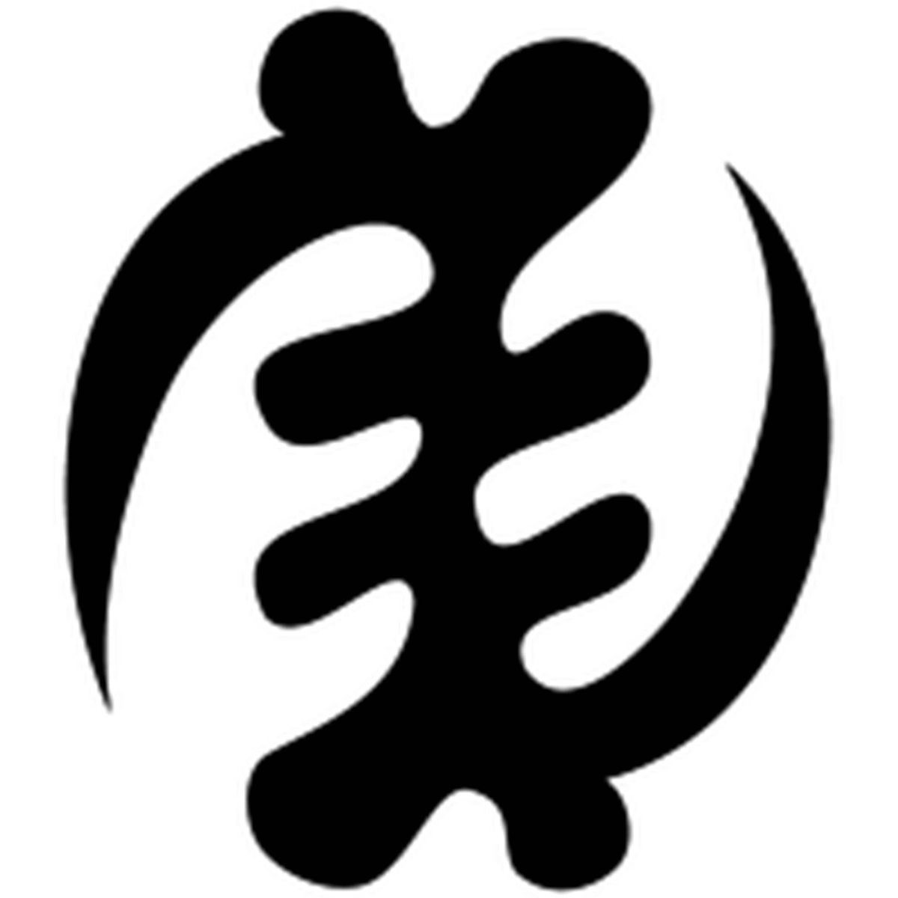
GYE NYAME SYMBOL (ADINKRA SYMBOLS)
The GYE Nyame symbol, which translates to "except for God," represents the belief that one should only fear God and his unlimited power. Originating from Ghana, the GYE Nyame is an adinkra symbol that has been passed down through generations by the Akan and Asante people. Its significance lies in the acknowledgement of God's supremacy, making it a cherished and distinctive symbol in Ghanaian culture. Ghanaians commonly incorporate this symbol into clothing, decorations, and artwork, as it reflects their deep religious convictions. Adinkra symbols, including GYE Nyame, hold great cultural importance for the Ashanti people and are widely recognized and utilized throughout West Africa. Serving as a visual means of communication, these symbols effectively convey ideas and values and remain a vital component of traditional Ashanti art and craft.

Slide 7
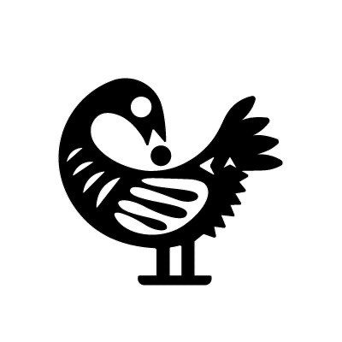
SANKOFA (ADINKRA SYMBOL)
Sankofa originates from the Twi language of the Akan Tribe in Ghana, and it signifies the concept of “go back and get it”. This phrase embodies the Akan proverb "Se wo were fi na wosan kofa a yenkyiri”, which conveys the idea that there is value in revisiting and retrieving what has been overlooked or forgotten. Sankofa is a phrase that encourages learning from the past to inform the future, reaching back to move forward, and lifting as we climb.

Slide 8
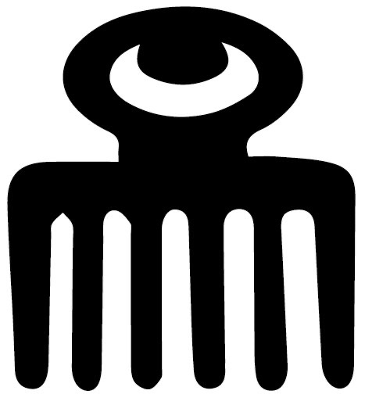
DUAFE (WOODEN COMB)
The term "Duafe" translates to "wooden comb" and symbolizes feminine qualities such as patience, prudence, fondness, love, and care. It is a combination of the English words ”dua" meaning wood or wooden, and ”afe" referring to a comb. The Duafe held significance as an essential grooming tool for women.

Slide 9
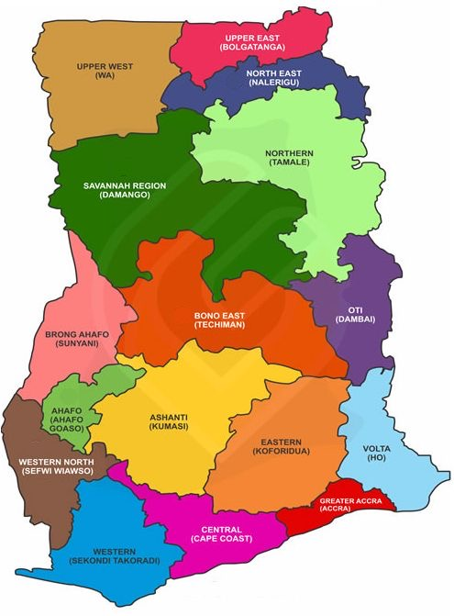
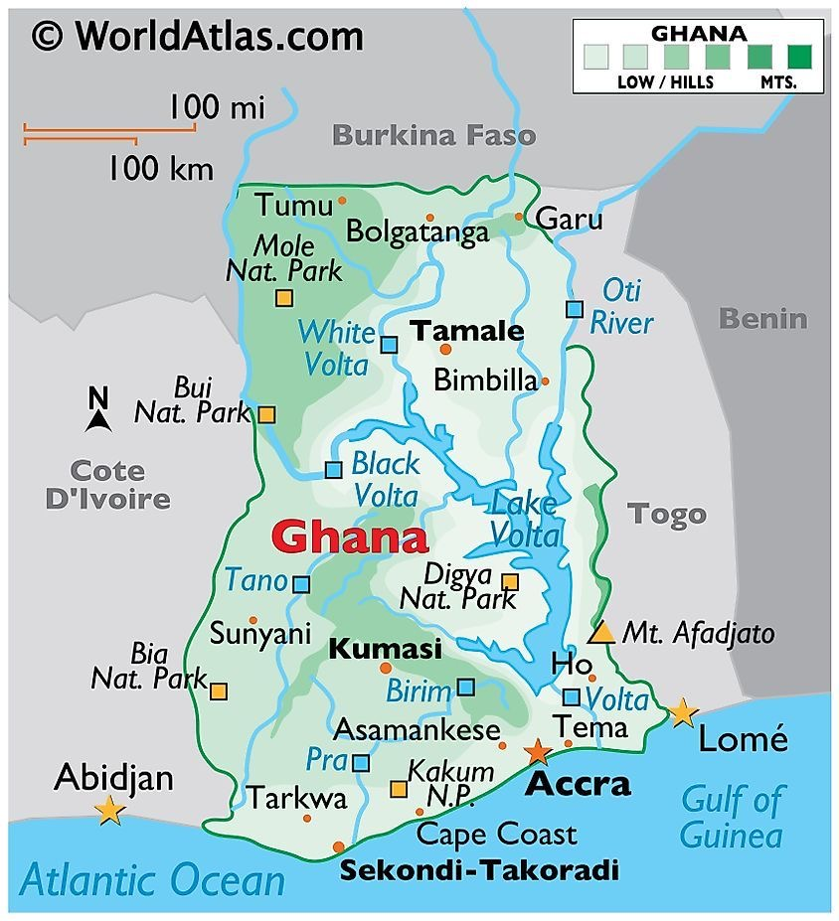
GHANA MAP
Ghana is divided into 16 regions. The 16 regions of Ghana are Ahafo, Ashanti, Bono, Bono East, Central, Eastern, Greater Accra, North East, Northern, Oti, Savannah, Upper East, Upper West, Volta, Western, and Western North. The national capital of Accra is located in the Greater Accra Region.

Slide 10
GHANA CUISINE
This traditional African dish, known as "Ampesi ne konkomire stew," features a combination of green plantains, yams, yuca (cassava), and eddoes. The stew is prepared with ingredients such as red palm oil, onions, peppers, tomatoes, salted tilapia, smoked fish, and eggs.

Slide 11
This is a picture I captured in Cape Coast when I was visiting Elimina Castle

