Slide 1
My cross-cultural experiences
MIDTERM PRESENTATION
ASIYA ALLIHOSEIN
PROF. ALAPO
CLDV 100

Slide 2
INTRO TO MYSELF
My name is Asiya.
I’m Muslim. I’m from Brooklyn, NY but my family is from Guyana.
Guyana is a country in South America. The official language in Guyana is English but most of them, including my family, use Guyanese Creole to communicate with one another. Guyana is known for the widest, largest waterfall in the world, called Kaieteur Falls. Guyana means “the land of many waters.” Guyanese culture consists of a variety of cuisines, ethnicities, religions, and performance arts.
My culture, specifically, is mixed with both Guyanese culture and the beliefs or values taught by Islam.

Slide 3
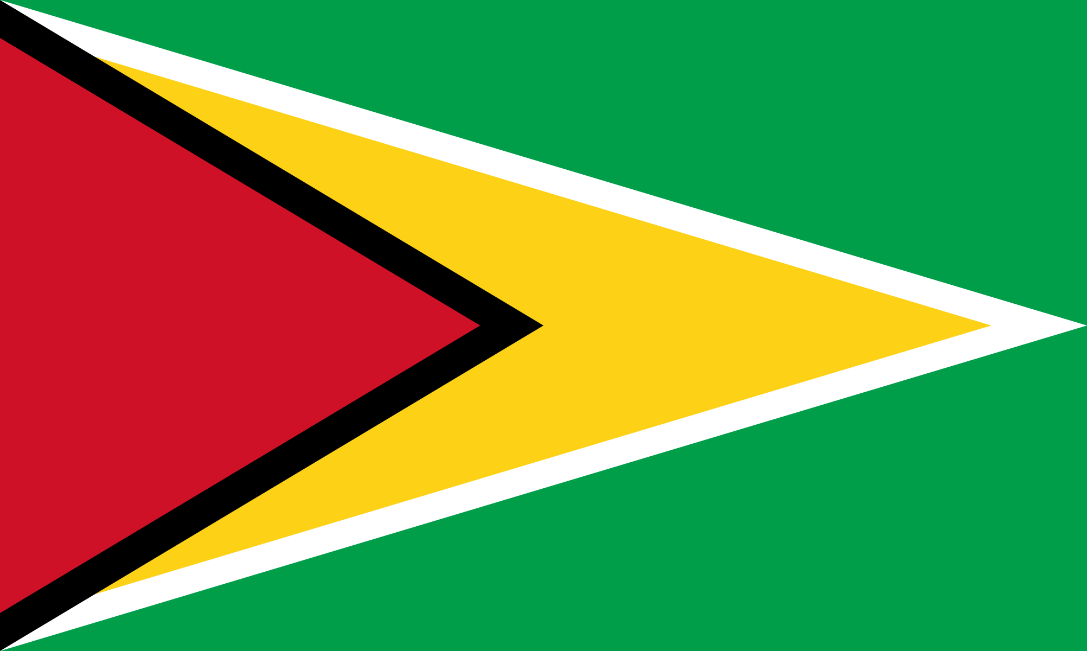
My Cultural & religious norms, values, and beliefs
One cultural norm for Guyanese people is addressing our elders as "Aunty" or "Uncle" even if they aren't really related to us. A value of ours that is similar to this norm is respecting our elders. This is something that I've grown up with as a Guyanese and Muslim kid. In Islam, respecting your parents is valued and it is a part of your duty as a child to do so.
Taking care of orphans, feeding the poor, & donating to charities are both cultural norms in Guyana and values or beliefs in Islam. Giving to charity is one of the five pillars of Islam.
Another value and belief in Islam is to avoid being greedy and putting the interest of yourself above others.
As Muslims, we also value and believe in keeping peace and forgiving others. Another belief in Islam is prioritizing saving lives. As the Quran states, "And whoever saves one -- it is as if he had saved mankind entirely" (5:32).

Slide 4
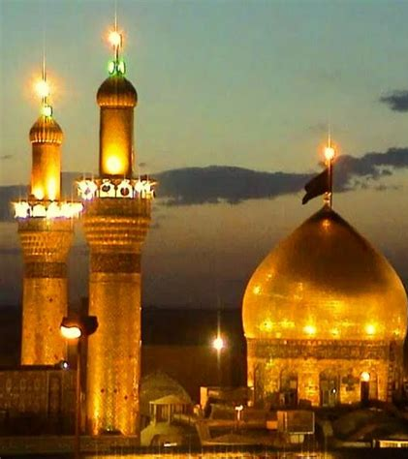
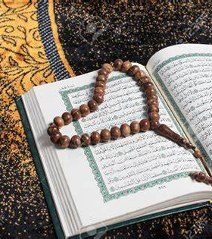
My traditions, religious practices, & foods
Our traditions consist of celebrating Eid twice a year., Eid Al-Fitr that occurs at the end of Ramadan, a month of fasting, and Eid Al-Adha. Eid translates to "feast" or "festival." The first Eid is celebrated because as this period of fasting ends, Muslims take this as an opportunity to feast with family and friends along with participating in joyous activities. Some Muslims also donate to the less fortunate or ask for forgiveness from others. On the second Eid, it represents sacrifice and our devotion to God. On these days, Eid prayers usually take place in the morning which are specific to these celebrations.
In Islam, there are five pillars. This includes believing in one God, completing your five daily prayers, giving charity, fasting, and completing a pilgrimage to the holy city of Mecca. This is a trip that every adult Muslim must make at least once in their lifetime. It is an emotional, mental, and physical challenge that provides Muslims an opportunity to erase their sins, strengthen their faith, and cleanse themselves.
Guyanese culture consists of different types of cuisine. Some important dishes are pepper pot, curry and roti, bake and saltfish, cook up rice, fried plantain, etc. I've gotten very comfortable eating this type of food, and I personally prefer it over American food despite being born here.

Slide 5
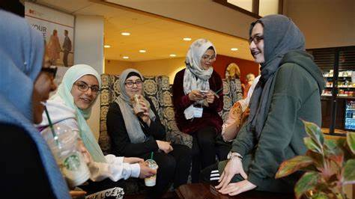
Socialization
In Guyanese culture, it's quite often that their gatherings consist of playing music, eating food, drinking alcohol, dancing, etc. However, my culture is mixed with both my religious beliefs along with Guyanese culture. We don't drink alcohol or blast music like many Guyanese families do when they gather or celebrate on occasions. So, my family gatherings consist of eating food, making jokes, watching movies, playing games, and just having fun with each other.
In the sense of where individuals acquire the values, habits, and norms of a society during childhood, it is different than the socialization I just discussed. As a child, I was taught the values and norms of Muslims by my mother and siblings. I was taught how to read Arabic writing and some verses in the Quran, how to pray, and significant beliefs of Islam like the belief in one God, being kind to others, and believing in the Day of Judgement or the Last Day. Concerning Guyanese culture, I picked up the small habits common to our society like eating without spoons or forks, stepping into rooms with your right foot, and religiously using the products, Limacol and Vick's, whenever I'm sick.
As a young kid, I learned about many beliefs, values, and norms that are essential to the community I grew up in. While this process is important to creating an identity for yourself, you always have to make sure that you continue harboring these beliefs and values because you want to.

Slide 6
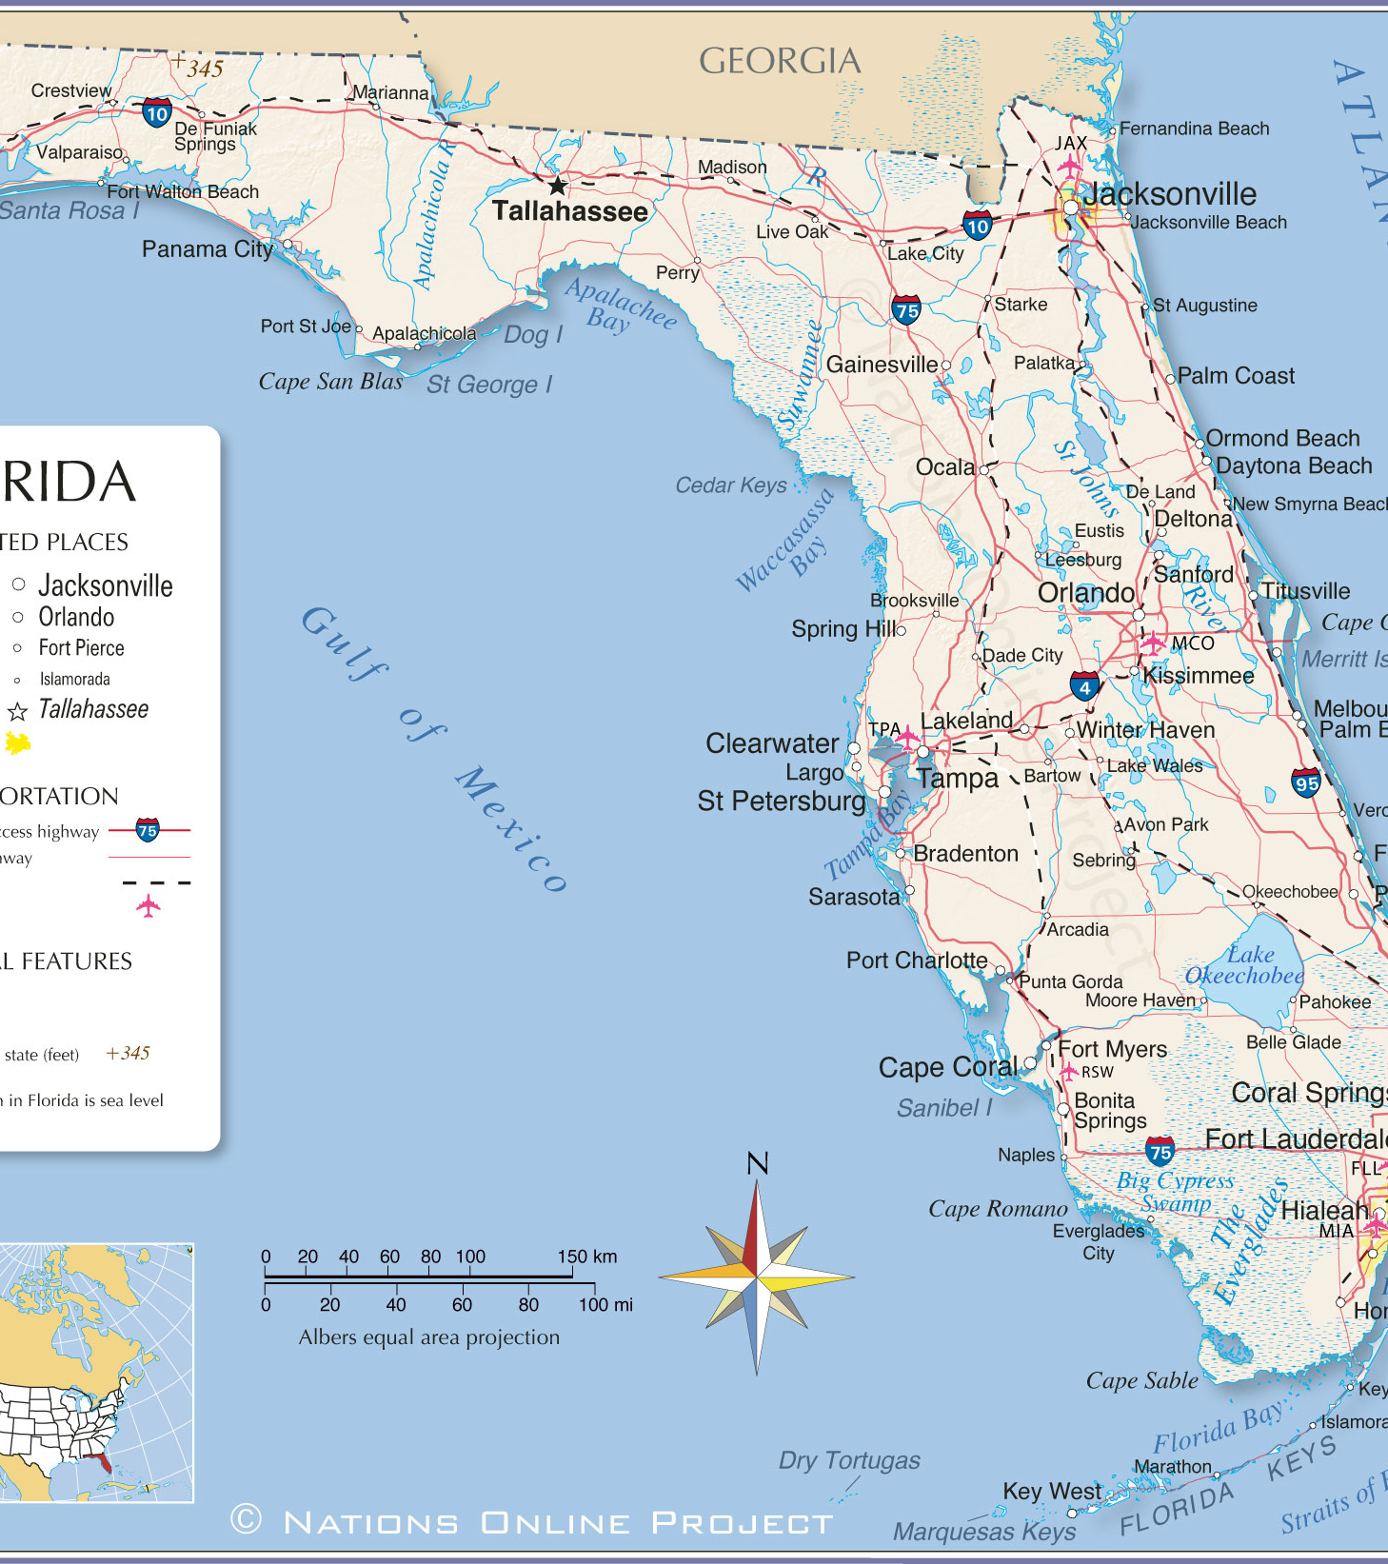
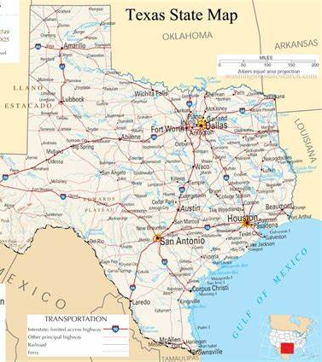
My travels
I have never traveled outside of the US, although I want to visit places in the Middle East and Guyana. I would want to see where my family came from in real life. Within the United States, I have only traveled to Florida and Texas. I didn’t do many tourist activities and visit sites around the state. I only went to Houston and Orlando.
From my visits to these states, I did get a glimpse of how it is to live there. The climate, the people, and the environment look different from New York. There was less diversity than in our boroughs in NY. Many people did have political beliefs that were distinct to the state. These are red states meaning many people are Republicans. They had more conservative beliefs and were more patriotic. The environment was very clean and taken care of in both Florida and Texas. The climate was very humid and hot. This contributed to my Cross-Cultural Experiences because I was able to see the differences (mentioned above) between cultures in my home state versus cultures in other U.S. states.

Slide 7
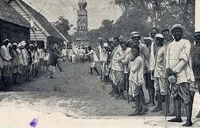
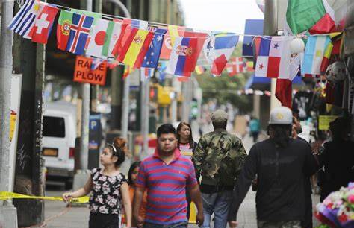
My heritage & origin آسية
My nationality is American and I was born in New York. This plays a vital role in my Cross-Cultural Experiences because there are so many cultures to learn from in NY. I have interacted with diverse races and cultures within the Hispanic, Asian, and Black groups. I was generally taught that we all share a state but coexist with similar, yet so different, beliefs, norms, and cultural values.
My name has Arabic origins. According to Islam, I was named after the wife of Pharoah and the mother of Prophet Moses, Asiya. She is one of the Ladies of Paradise and an influential figure in the Qur’an. My name means to “nurture” or “heal.”
In Guyana, many Indian slaves were brought over by the Dutch. Therefore, my ancestry does originate from a long line of Indian people even though Guyana is not geographically in Asia or India.

Slide 8
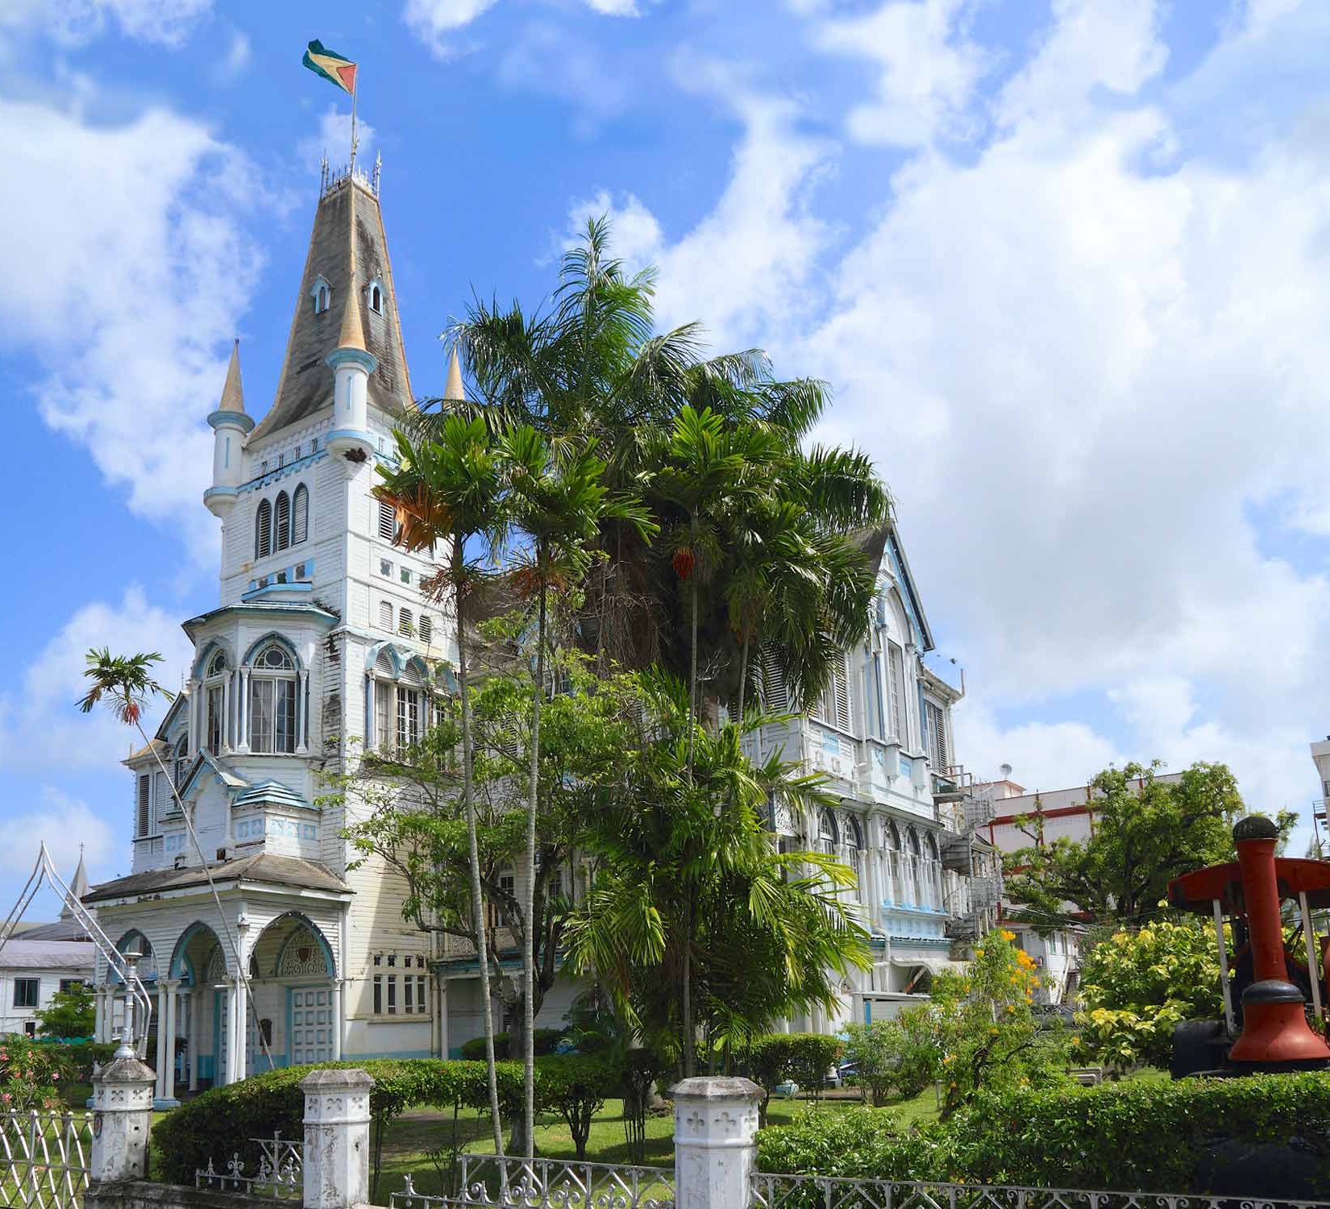
HOW DID WEEK 1 IMPACT MY CROSS-CULTURAL EXPERIENCES?
Week 1: This week impacted my cross- cultural experiences because I was able to discuss cultural diversity and learn about the ethnic/cultural roots of my peers. I got to communicate with diverse individuals in this class for the first time. I gained more knowledge about how people of other ethnicities get their names mispronounced and that it makes them feel disrespected and belittled. This is a universal feeling for minorities all around the world. This was our primary opportunity to establish a sense of togetherness within our Multicultural classroom.

Slide 9
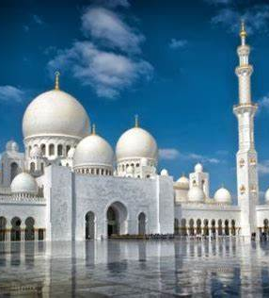
HOW DID WEEK 2 IMPACT MY CROSS-CULTURAL EXPERIENCES?
Week 2: I got a deeper understanding of what culture means to different people. We spoke about artifacts that are essential to our culture. I learned that people hold very different items dear to their heart and to their identities. There is a great sense of diversity within each other, yet we are all similar in the aspect that we find pride in cultural items. For example, people value their flags while others value their prayer beads. I experienced pieces that are significant to other people’s puzzles. This changed my perspective because different cultures have different valuable artifacts that all complete us.

Slide 10
How did week 3 Impact my cross-cultural experiences?
Week 3: I obtained knowledge about culture shock experiences and how cultures have different do’s and don’ts. Some of us can be surprised with others because we aren’t used to such customs or practices. It takes time for us to adjust but leaves us shocked at first. I learned through our discussion board in Week 3 that several cultures that follow Islam might have similar do’s and dont’s due to the religion even if we aren’t from the same country. This is essential to my cross-cultural experiences because we discussed how we all get similar feelings of surprise when we face something unfamiliar. People in other cultures might feel the same towards my culture and I can have a shock experience towards others. Different cultures can have similar beliefs or values connected by their faith. I also learned about pop culture and how it shapes the minds of young people across many cultures. Countries around the world also share similar economies and political systems yet different customs, like celebrating Thanksgiving vs. Chinese New Year.

Slide 11
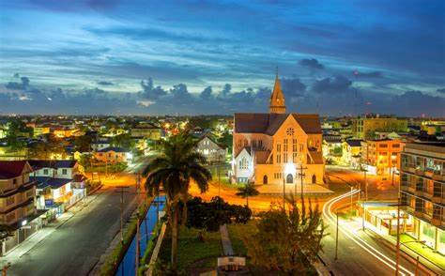
HOW DID WEEKs 4 & 5 IMPACT MY Cross-cultural EXPERIENCES?
Week 4: In Week 4, I demonstrated how norms and beliefs are important and how taboos play a role in societies among a variety of cultures. This taught me that things might be acceptable in someone else’s culture but might not be in mine. I observed Socialization and how it shapes us as humans. We learn beliefs and skill sets from people that help us become an independent individual. Different cultures also have roles and status that vary. This gave me an experience that illustrates that we are not all the same.
Week 5: This week helped me illustrate my views of US Immigration and get a glimpse of how my peers perceive Immigration. We went over suggestions to make Immigration laws better, the obstacles stopping us from implementing them, and how the US sends mixed messages to them. Considering the diversity of my peers in this class, we are all able to notice the bias within the Naturalization system. Immigrants looking for asylum in America are often denied and treated unfairly. Therefore, this contributed to my cross-cultural experiences because I got to interact with other ethnic people about a topic that affects us all.

Slide 12
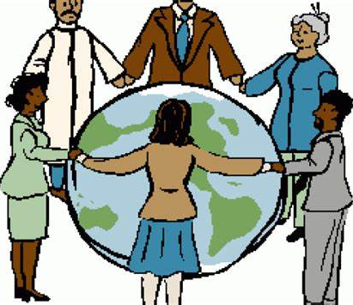
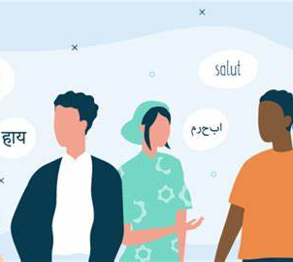
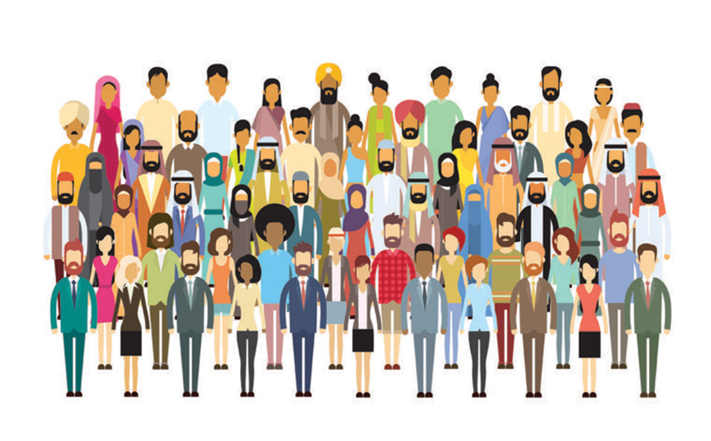
HOW DID WEEKs 6 - 8 IMPACT MY CROSS-CULTURAL EXPERIENCES?
Week 6: This week allowed me to track the social stratification of my family tree. I learned that the social standing of the parents in my family doesn’t differ much over time. The roles remain the same and doesn’t change based on wealth, achievements, or opportunities. I also learned about how my peers’ families viewed the American Dream. Across different cultures, many see it as more opportunities and chances for their children. We discussed developed vs. underdeveloped countries. This shapes how we view citizens there. This impacted my cross-cultural experiences because I can now see that us individuals can have families that might follow meritocracy systems or originate from either developed or underdeveloped places.
Week 7: I talked about the difference between race and ethnicity, and how majority groups affect individuals with great influence. I also learned about how prejudices, stereotypes, racism, and discrimination affected the different cultures presented in our classroom. This impacted my cross-cultural experiences because although we have separate backgrounds, we are all discriminated against and degraded by others due to our beliefs, heritage, traditions, races, and cultures.
Week 8: I discussed why racial inequalities exist, my observations of discrimination towards women, and my suggestions on how to fix the inequalities affecting minorities. This week impacted my cross-cultural experiences because I was able to acknowledge why different cultures face the challenges they do and focus more on how to resolve that.

Slide 13
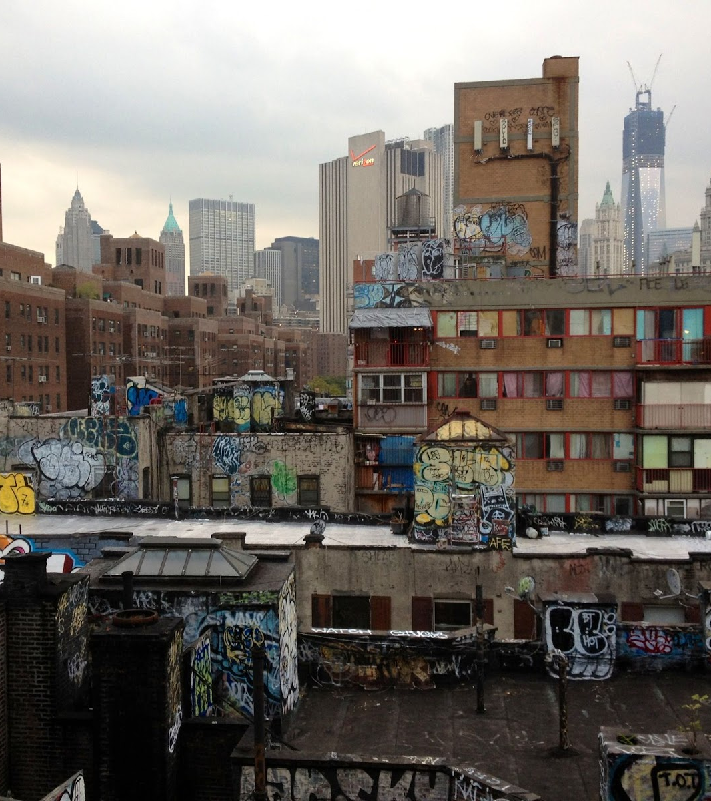
DAY TO DAY INTERACTIONS
On a day-to-day basis, I’m transporting between the boroughs of Brooklyn and Queens to attend my classes. Not to mention, I’ve lived in Brooklyn my entire life. All New Yorkers know that Brooklyn is vastly diverse and consists of many cultures. If it weren’t my place of birth, I wouldn’t have many cultural experiences with others.
I usually have interactions with people of other ethnic groups due to this melting pot existing in Brooklyn and Queens. These interactions have MAINLY shaped my cross-cultural experiences because I’ve taken that these people have different etiquettes, cultural norms, and beliefs from the way they talk to me. For example, Americans find it respectful to keep eye contact during conversations while some Asians might not do so as a sign of respect for the other person.

Slide 14
OBSERVATIONS OF OTHER CULTURES
One of the biggest similarities between cultures, outside of American culture, is that they have gender roles and gender stereotypes. Many cultures under the South Asian and African umbrella believe in gender roles. Women are “supposed to cook, take care of the children, and do housework” while men go to work and financially provide for their family. My culture nor my religion necessarily follows rules according to gender roles like these. What I got out of this observation connects to my cross-cultural experiences because what others value as cultural norms might not be the same for us.
I noticed that African Americans, Asians, and Hispanics all value respecting their elders. In cultures like these, treating your elders nicely and respectfully is essential. As opposed to American culture, elders don’t get that much respect. The rich, government leaders, and social media influencers get more admiration than older adults do. Some cultures find that appreciating ones who are wiser than us is more significant than appreciating those who are wealthy and popular. Different beliefs exist in different areas of the world.
In ethnic cultures almost everywhere, mental health is a stigma and is often ignored by minority parents and families. This is another big similarity because most Immigrant parents tend to live in a different time and are uneducated on mental illnesses. They can imply that they aren’t important or it might be “crazy” to be affected by poor mental health. African Americans, Asians, Hispanics, and many other races/ethnicities in every part of the world deals with mental health issues like anxiety, depression, BPD, and more. Some parents just aren’t supportive enough. This taught me that different cultures have different taboos/topics that are stigmas.

Slide 15
INDEPENDENT RESEARCH ON “CULTURAL DIVERSITY”
WHY IS IT IMPORTANT?
Cross-cultural experiences are a direct result of cultural diversity. Cultural diversity is a variety of cultures that surround us. It upholds the idea that everyone can contribute to society in a positive way despite their dissimilarities. Without this, it would be quite impossible for us to interact with other ethnic people. Cultural diversity is essential because it helps us understand each other better, respect people’s identities, and create a society that accepts and welcomes everyone.
Cultural diversity allows us to rid ourselves of any internal biases or stereotypes of other groups. By providing us a deeper understanding of the beliefs, norms, values, and traditions in other cultures, we can accommodate for each other and educate ourselves on topics we weren’t caught up on before.
Multiculturalism can aid us to be more respectful towards others and give us a glimpse in the worlds our neighbors or peers might live in. It provides us perspectives that are not our own. We can learn what people go through, overcome, and their ways of life. From this, we gain skills necessary to keep relationships with people like sympathy, trust, and communication.

Slide 16
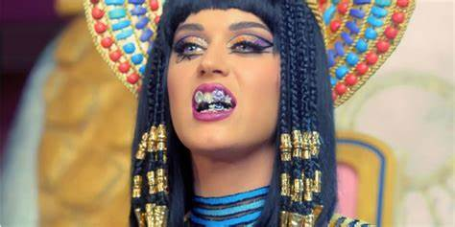
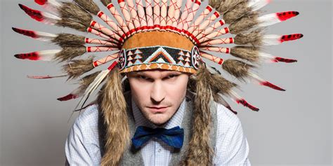
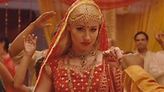
INDEPENDENT RESEARCH ON “CULTURAL DIVERSITY”
WHY IS IT IMPORTANT? (CONT’D)
In school spaces and workspaces, cultural diversity can promote creativity. With people coming from different parts of the world, they are bound to think of a variety of ideas. This can improve environments for students and employees by making it more fun, diverse, and interesting.
It encourages cultural appreciation and prevents cultural appropriation. Cultural appropriation is quite offensive, especially to minority groups that can’t advocate enough for themselves. This occurs when members of a majority group wrongfully adopts customs, traditional clothing, and practices that belong to a minority group. For example, someone that doesn’t belong to the South Asian culture wearing bindis and headdresses for Halloween. With diversity and cross-cultural experiences, we can understand why it’s offensive to “dress up” in a group’s cultural clothing for a fun holiday. We can then start to appreciate other’s backgrounds without stepping on their toes.

Slide 17
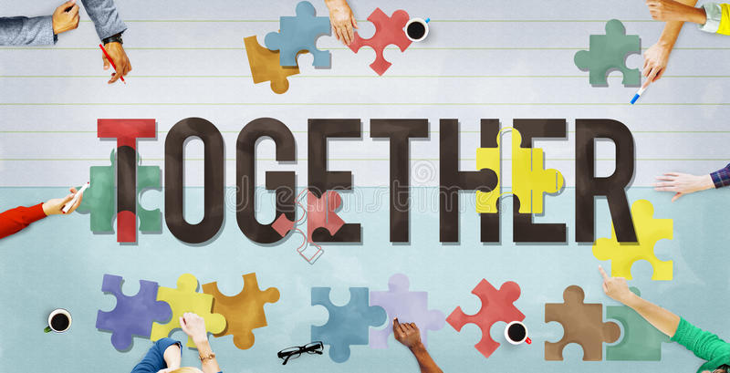
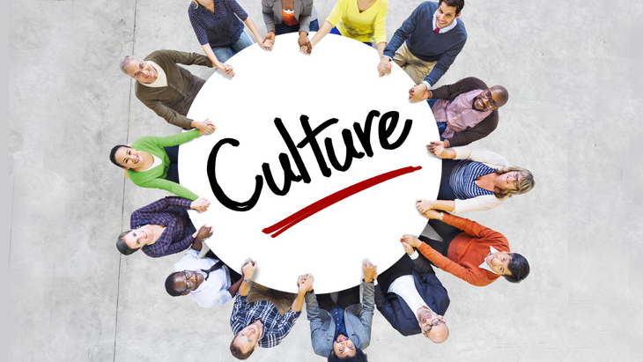
Prompt: Apply your cross-cultural experiences to the topic below that you are working on for your final paper. How have your cross-cultural experiences been shaped by the topic below? Final Paper Topic: Stereotypes and Discrimination of Muslims in the US: Observations - how to stop the hate.
Cross cultural experiences are interactions with different cultures that can improve your understanding of others. Stereotypes and discrimination of U.S. Muslims have shaped my cross-cultural experiences because Muslims that either are American-born or travel to the US have faced racist experiences and microaggressions, just like me. We are oppressed together: whether it is Muslim men who are profiled due to their beards, Muslim women who are singled out because of their hijabs and burkas, or Muslims who are discriminated because their religion is merely obvious to others. This has taught me that most minority groups, like us Muslims, are all challenged with false assumptions, hate-crimes, and the unjustified prejudices harbored by other people. Minority groups are alike in the treatment that we endure yet so different in the backgrounds we have and the norms and beliefs we are used to. Given this brings us together, it makes my cross-cultural experiences with other ethnicities much more understanding and lighthearted. For example, I was able to share with my Black and Hispanic peers the insults that I’ve heard, the times I’ve been underestimated due to my religion and skin color, and the times I’ve almost been hate-crimed. They were able to do the same and this creates a safe, peaceful environment for us to get to know each other's cultures.

Slide 18
Continuation of previous slide
They were able to relate and share their own experiences with me which further created a space for us minorities to come together and feel safe with one another. This causes us to know more about each other’s food, language, religious beliefs, norms, and traditions. I’m inclined to share more about my culture and religion with others when they do the same and when we both want to do so. This topic has shaped my cross-cultural experiences because it has made my interactions with people of different cultures more pleasant and prevents us from being misunderstood. It provides me with empathy because I can find a sense of how someone might feel about getting stereotyped or discriminated against. When people of various ethnicities feel comfortable sharing with others that understand, it makes our experiences more colorful with our similarities. I can become further intertwined with other cultures since we are alike in the stereotypes and prejudices we must overcome. This subject has given me the knowledge that we all undergo similar difficulties in life that we are forced to defeat to be successful. Therefore, my cross-cultural experiences are brighter and extensive because both parties can discuss the challenges in our lives, as a Muslim and as another U.S. immigrant who belongs to another culture. We can take this information to create better communities for one another now that we comprehend that we aren’t so separate after all.

Slide 19
CONCLUSION BASED ON COURSE CONTENT
Overall, my mind has expanded vastly throughout the first half of this course. I have taken the time during each week to take a step back and look at multiculturalism, my experiences with other cultures, and how they’ve shaped how I view the world. The course content has generally taught me several things: ethnic roots, artifacts important to different ethnicities, culture shock experiences, cultural do’s and don'ts, the similarities and differences between groups, norms, taboos, values, socialization, roles, different views on Immigration policies, stratification systems, majority groups, minority groups, and why inequalities exist. This positively impacted my mindset and identity because I became more welcome to accepting other cultures, learning about them, and putting that knowledge to use. With this content, I am now able to play my part in creating a safe and understanding community for the other minority groups that surround me.

Slide 20
References
Murekian, O. (2020). Why Understanding Cultural Diversity is Important? Toucan Insights. https://www.toucaninsights.com/post/why-understanding-cultural-diversity-is-important#:~:text=Why%20is%20Cultural%20Diversity%20Important%3F%20Cultural%20diversity%20is,our%20own%20is%20made%20easier%20by%20cultural%20diversity.
Why Is Cultural Diversity Important? https://www.partnershipinternational.ie/why-is-cultural-diversity-important/. Retrieved from Partnership International. n.d.
Understanding cultural differences in the U.S. https://usahello.org/life-in-usa/culture/cultural-differences/. Retrieved from USAHello. n.d.
Why is accepting cultural diversity important? https://sage-advices.com/why-is-accepting-cultural-diversity-important/#:~:text=Why%20is%20accepting%20cultural%20diversity%20important%3F%20It%20helps,of%20being%E2%80%9D%20that%20are%20not%20necessarily%20our%20own. Retrieved from Sage-Advices. (2020)
Why Is Cultural Diversity Important: Three Advantages At The Workplace. https://www.getimpactly.com/post/cultural-diversity-important. Retrieved from impactly. n.d.
“Understanding cultural differences in the U.S.”
Why Understanding Cultural Diversity Is Important?
Why is Cultural Diversity important?
Why Is Cultural Diversity Important: Three Advantages At The Workplace
Why is accepting cultural diversity important?

