Slide 1
My Cross Cultural Experience
Kellie Johnson

Slide 2
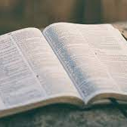
Origin
- I am from the U.S (Queens, NY). My mom is from the U.S and my dad's family is from Guyana, which I have never been to. We celebrate holidays like Thanksgiving and Christmas. My family and I identify as Christian. Our family is not religious to the extent that we go to Church every Sunday, but we bless and pray over the food before we eat, and we carry the bible in our household. We believe in GOD.

Slide 3
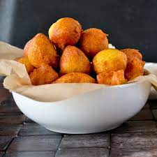
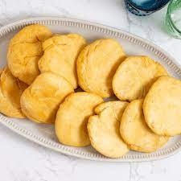
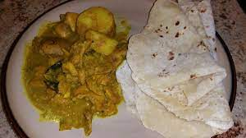
My Experience
My experience with food is not limited because of living in New York. There are many cultures and people that live here, which means I get to explore different foods and gain knowledge of cultures. The types of food I eat in my house because my dad is from Guyana is Pholourie, Bake, Curri and Roti, and more. Because I live in New York I have eaten Chinese, Japanese, Indian, and Spanish food, to name a few.

Slide 4
My Travel Experience
I've traveled to the following states within the U.S: Pennsylvania, Maryland, Florida and Texas. I've never been outside the United States. I have recently applied for a passport so I will be able to travel outside the U.S to countries like Italy, Scotland, Iceland, and France. These places that I wish to see have very nice architecture and is different to the U.S.

Slide 5
Norms And Values
Norms in culture is something that is normal and usual for people to do or act. Norms that seem to be popular in many cultures are that men are providers to the family and women are care takers to the children. This norm has stopped with my parents. Values are beliefs or something that hold significant for us. Something of value to my family is the Bible. Having Norms and values are important to me because it helped me grow. And told me what is acceptable and what is not. One of the norms for me is being respectful to elders.

Slide 6
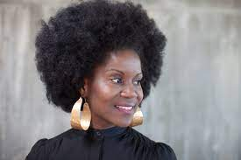
African Culture
Many African American express themselves through their hair. Braids are an important factor in African American culture throughout time. Braids can signify new confidence and also be a part of someone’s identity. Certain Braids in Africa was a was a way to signify which tribe you are from. Braids has a long history behind it with Black people having the confidence to accept our natural hair and move on from damaging/straightening. We express ourselves through a hair and it is very beautiful.
Some styles we do to our hair: Braids, Afro, passion twist, locs, and more.
My experience with my hair is having it permed all throughout elementary and middle school and then going natural in high school and so on.
What many people have done is straighten or perm hair because it was seen as unacceptable and unprofessional.

Slide 7
The N-Word
The N-word, although seen as a vulgar, is a part of African American culture in the US. The word used many years ago as a racial slur to make black people feel inferior during slavery or Jim crow and even now. Being in New York, you the word a lot used between Black people, and not in a way to offend someone. We hear the word in many songs. And it really is controversial because some believe it should not be used at all, other believe it's a way that we turned a derogatory word and used it to greet each other. Although I hardly use the word, I support Black people using it.

Slide 8
Socialization
Socialization is the social process where we develop our personality and learn about society and culture. Agents of socialization is our parents, school, and media. Media like tv and tik-tok has helped me to adapt in the world to interact with different race, nationalities, and ethnicities. Socialization is important because it affects how we see the world and affect how we act. When we don’t socialize we can say things that might be insensitive. When we don’t learn about types of cultures through socialization, it can lead to assumptions and negative communication.

Slide 9
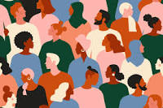
Cross Cultural
Cross culture is relating to different cultures and understanding how they're different and similar. Cross culture is important because it allows us to be less bias and avoid miscommunication and misinterpretations that can impacts people. I have experienced being bias and making assumptions, and I have found that I was wrong and learned by interacting with cultures.

Slide 10
Cross Culture In New York
New York is very diverse and contains people from all backgrounds. Living in New York is a good experience to interact with others from different backgrounds and experience different food, values and cultures. In other part of the world, places are not as diverse as New York. I have encountered many people from all around the world including people from Jamaica, China, Columbia, Mexico, India and more. Other countries aren't as diverse and the populations consist mostly of one type of Ethnicity, Religions, and nationality. I learned a lot be interacting with cultures in New York.

Slide 11
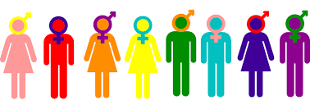
Gender/Sexual Inequality
Gender and sexual inequality is not a new topic and is shown across the World. Throughout the last couple decades, sexual orientation have become more accepting, but there is still a long way to go for equality. In my opinion, the United States is one of the countries that have come a long way with gender and sexual equality. I have learned that Gender inequality is different in other part of the world where there is a low education rate for women, and they don’t have many rights.
Sexual orientation is also rarely expressed in other parts of the world where it is dangerous to be Gay or attracted to something that is not the norm. This hugely reflected by religion, where people believe that it is not right.

Slide 12
Thank you
Kellie Johnson
Multicultural Studies
Fall 2022

