Slide 1
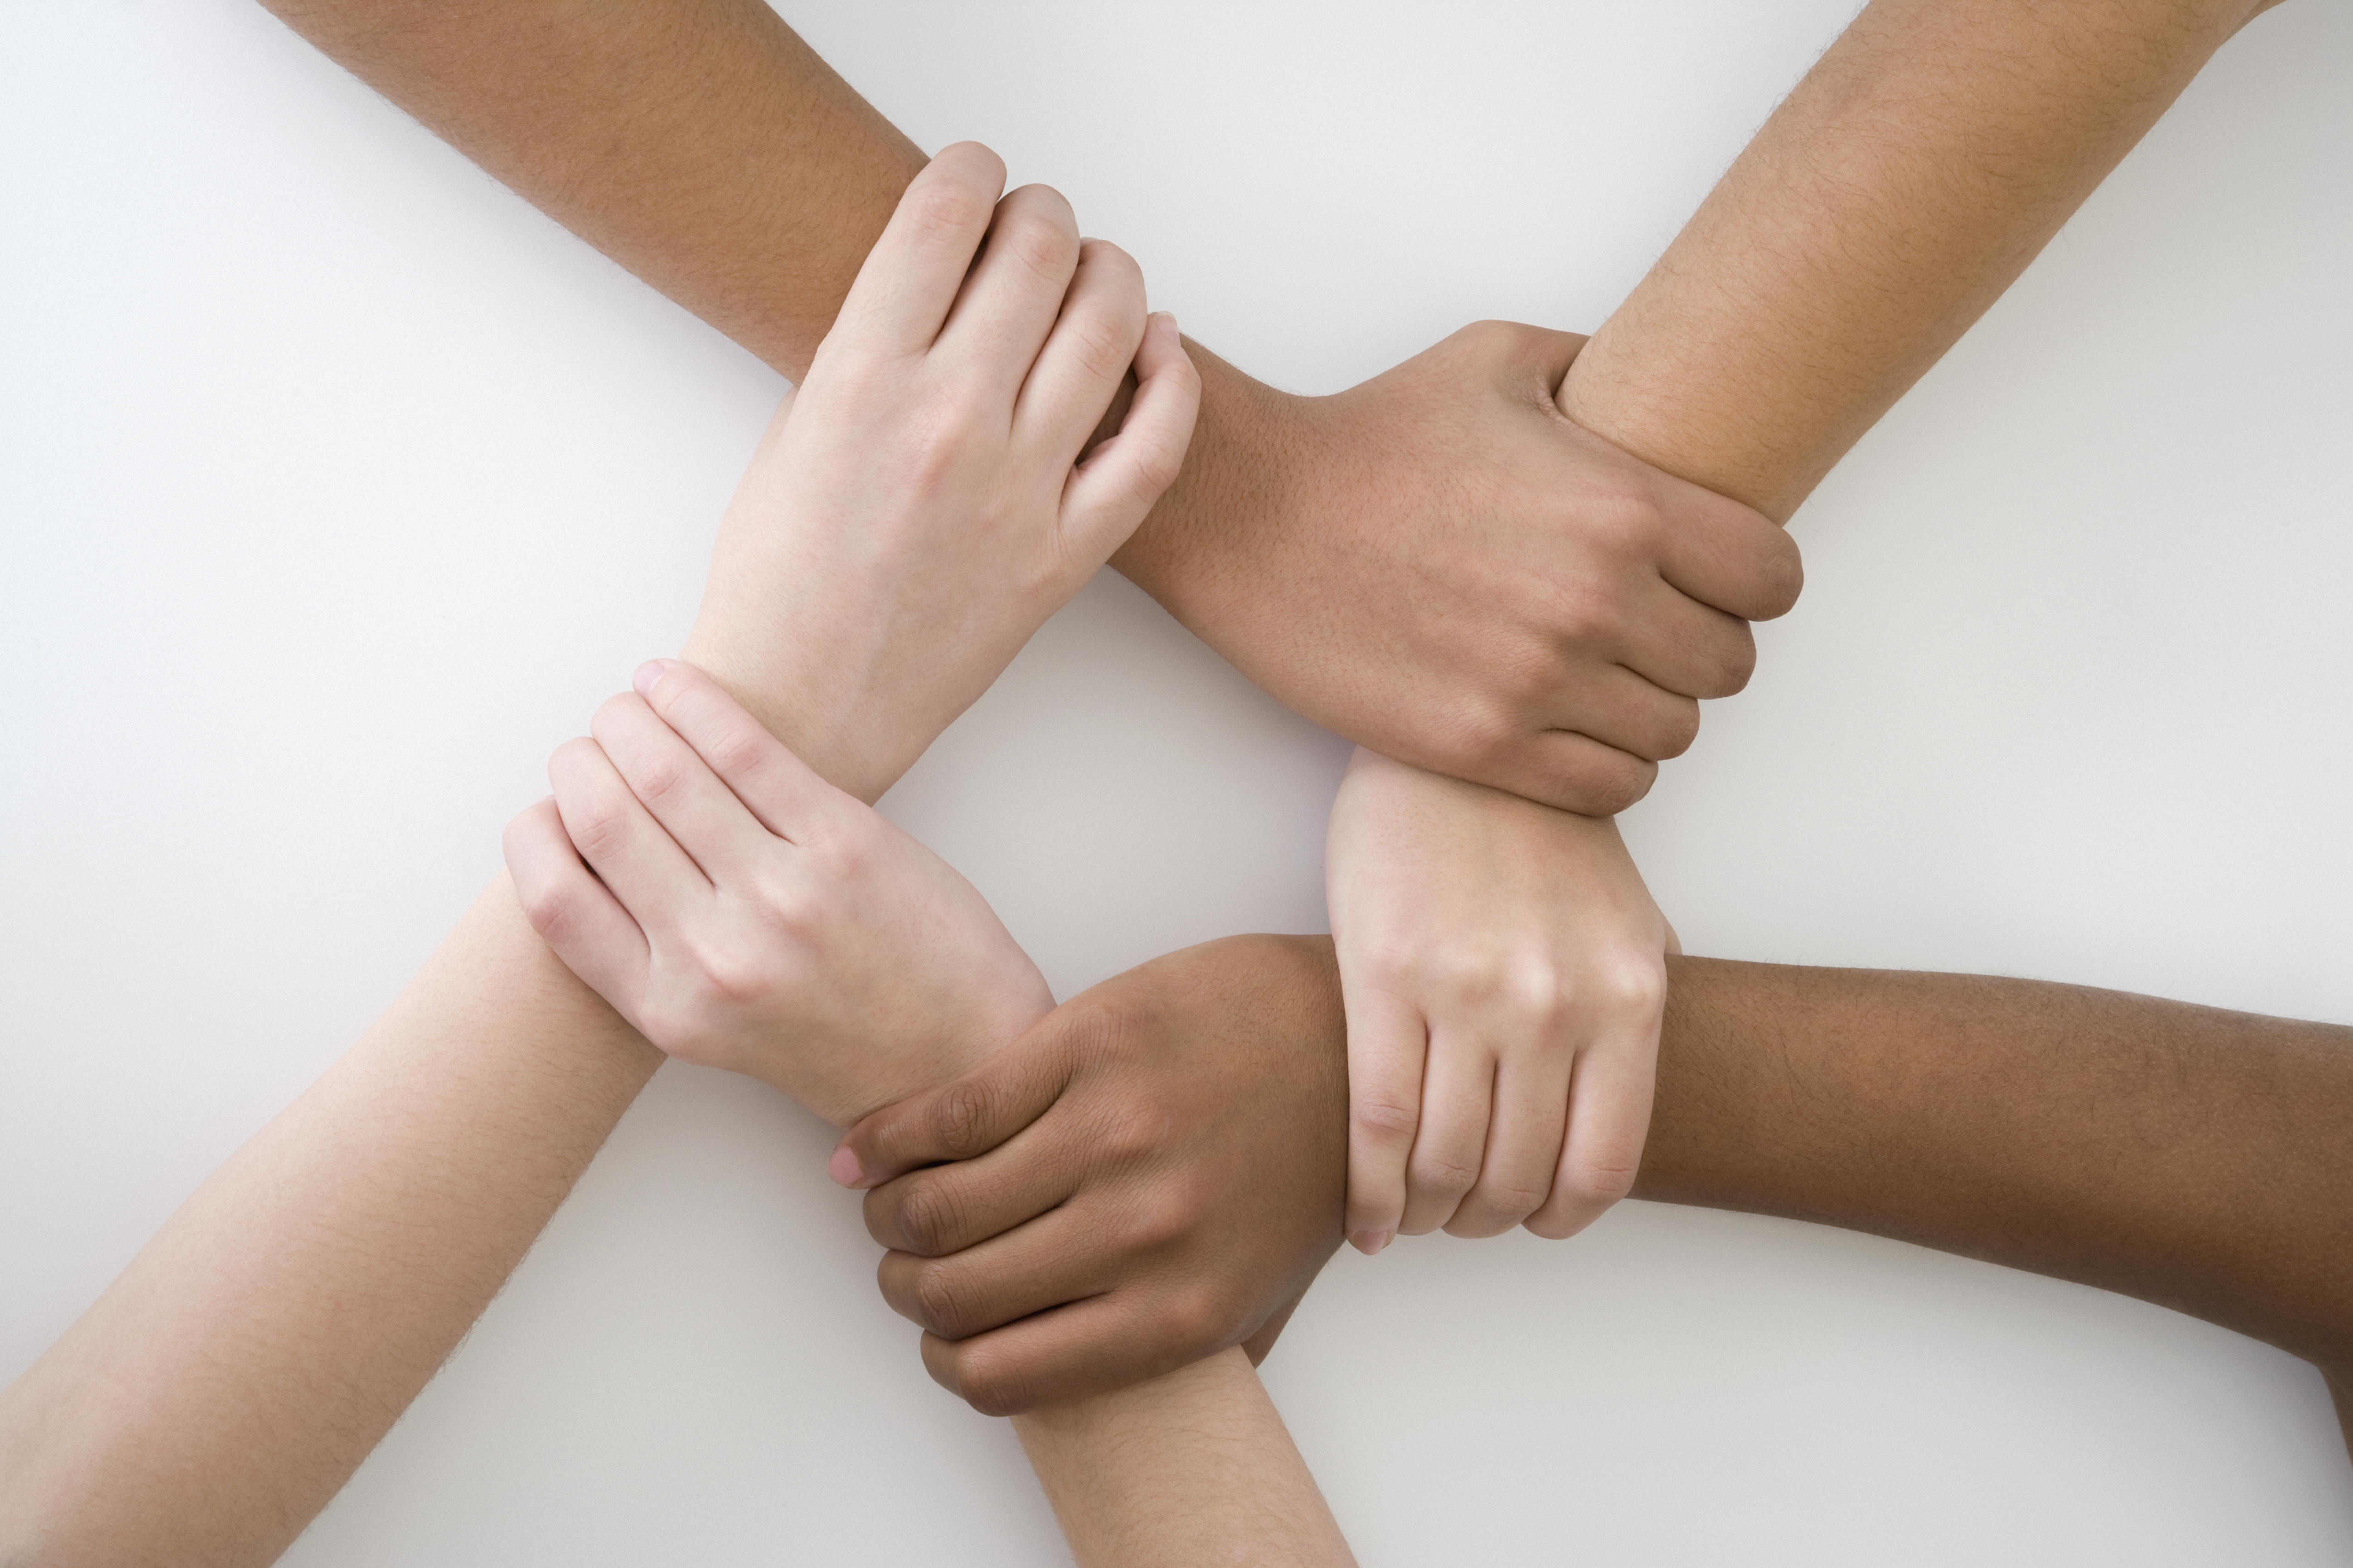
My Cross Cultural Experience Mid Term
By Travis O. Holland

Slide 2
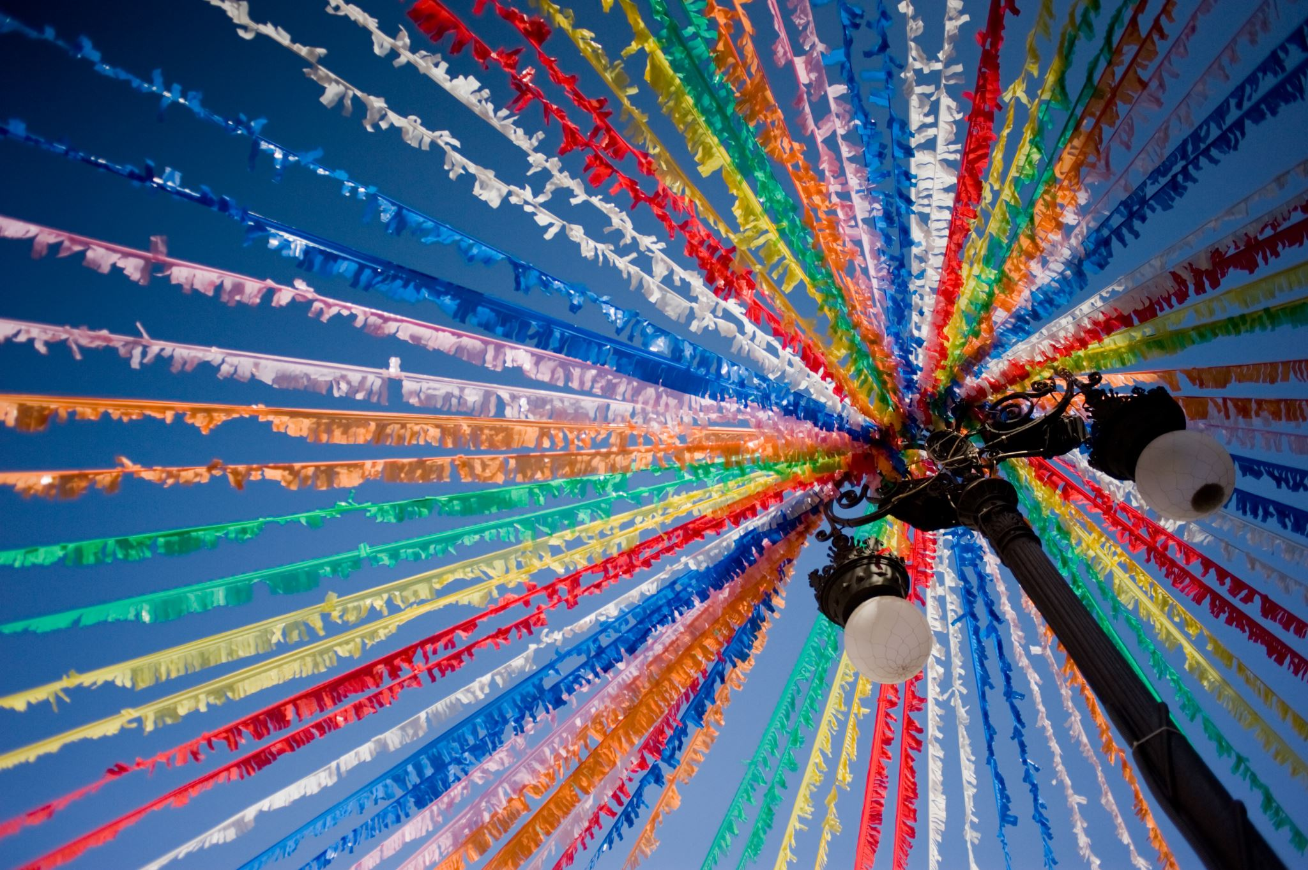
TO START, THE PEOPLE OF JAMAICA: The people of Jamaica are usually friendly and free from anxiety. They are unique from other people from the cultural diversity that surrounds the island with people who are apart of different nationalities

Slide 3
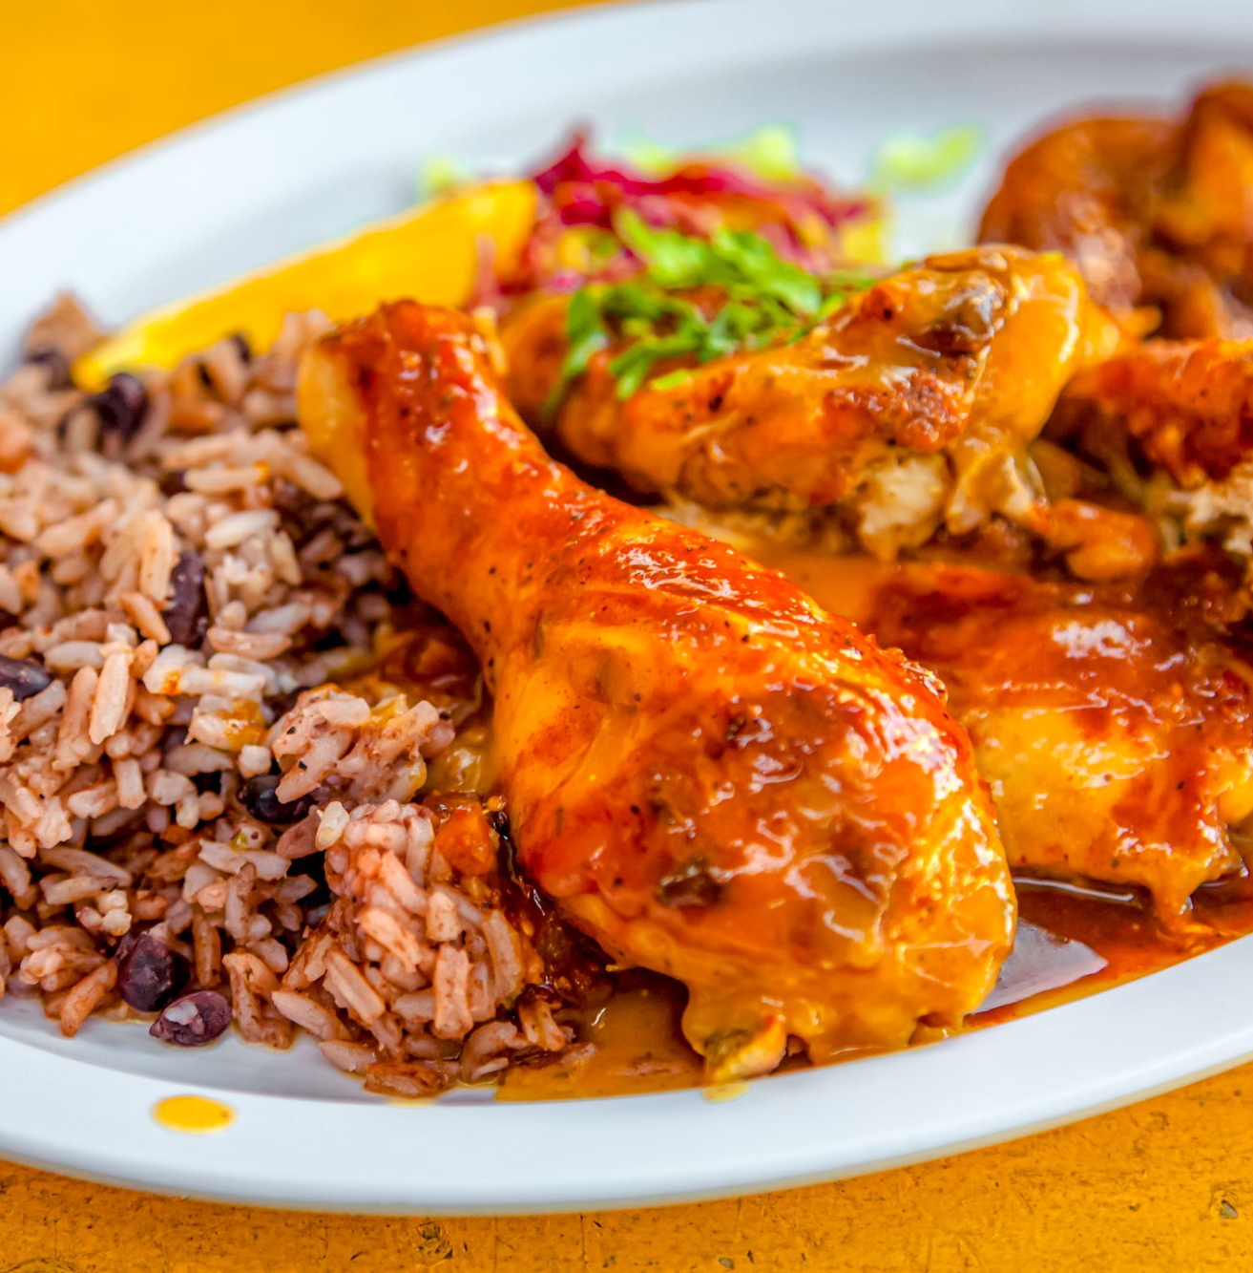
Meals that are made on the island are considered to be delicious and healthy. The Jamaican Cuisine is a healthy dish because of unprocessed food, smaller portions of meat, high content of fish, beans, vegetables, and a mix of African, European, Indian, and Chinese cuisines.
The Food of Jamaica

Slide 4
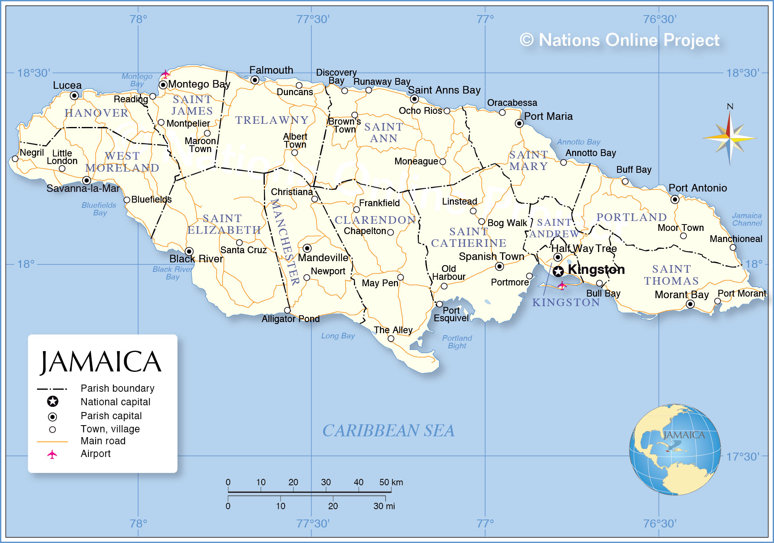
Maps
Since Jamaica is an island nation in the Caribbean Sea that is southeast of Cuba and southwest of the island of Hispaniola, containing the Dominican Republic and Haiti, the map of Jamaica shows parish boundaries, the national capital Kingston, parish capitals, major cities, main roads, and major airports. The island has a population of 2.7 million in 2019. The largest city and capital is Kingston.

Slide 5
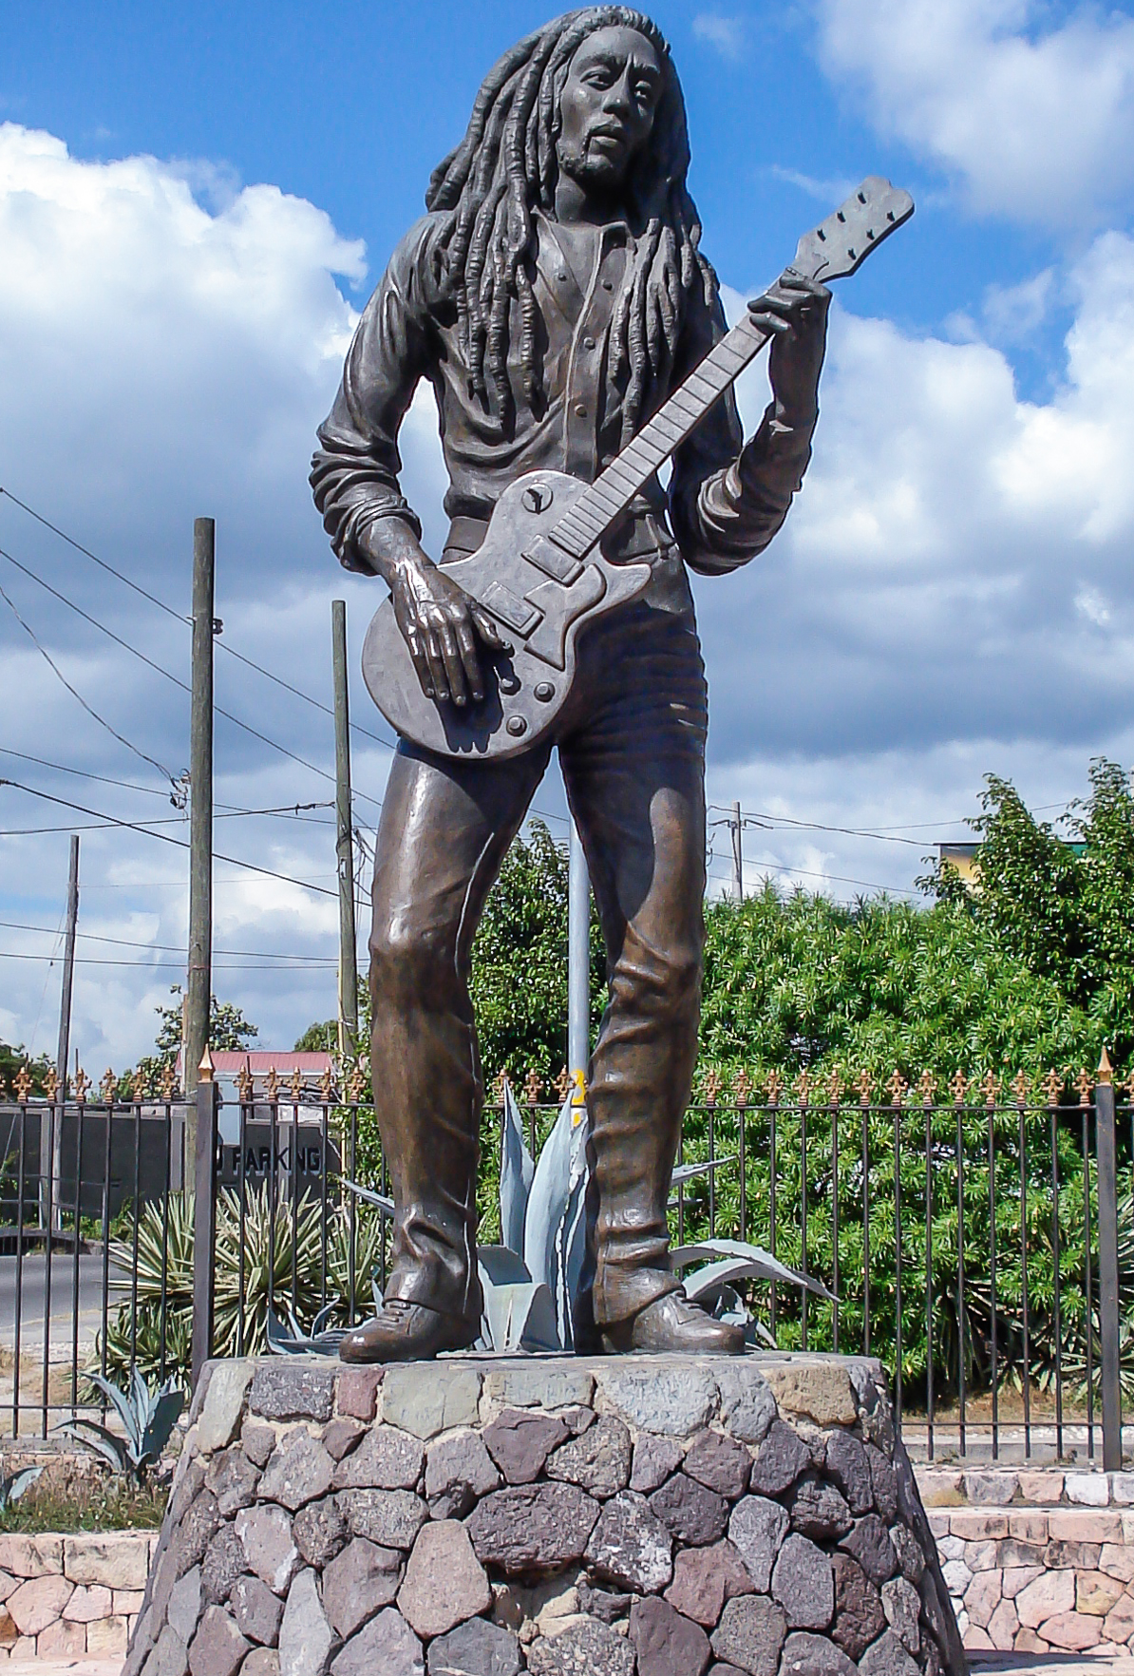
Musical Preferences of Jamaica
The music of Jamaica contains Jamaican folk music, mento, ska, rocksteady, reggae, dub music, dancehall, reggae fusion and other related styles. Performing artists that influenced the genre to become something greater is Bob Marley, Damian Marley, Beenie Man and Peter Tosh

Slide 6
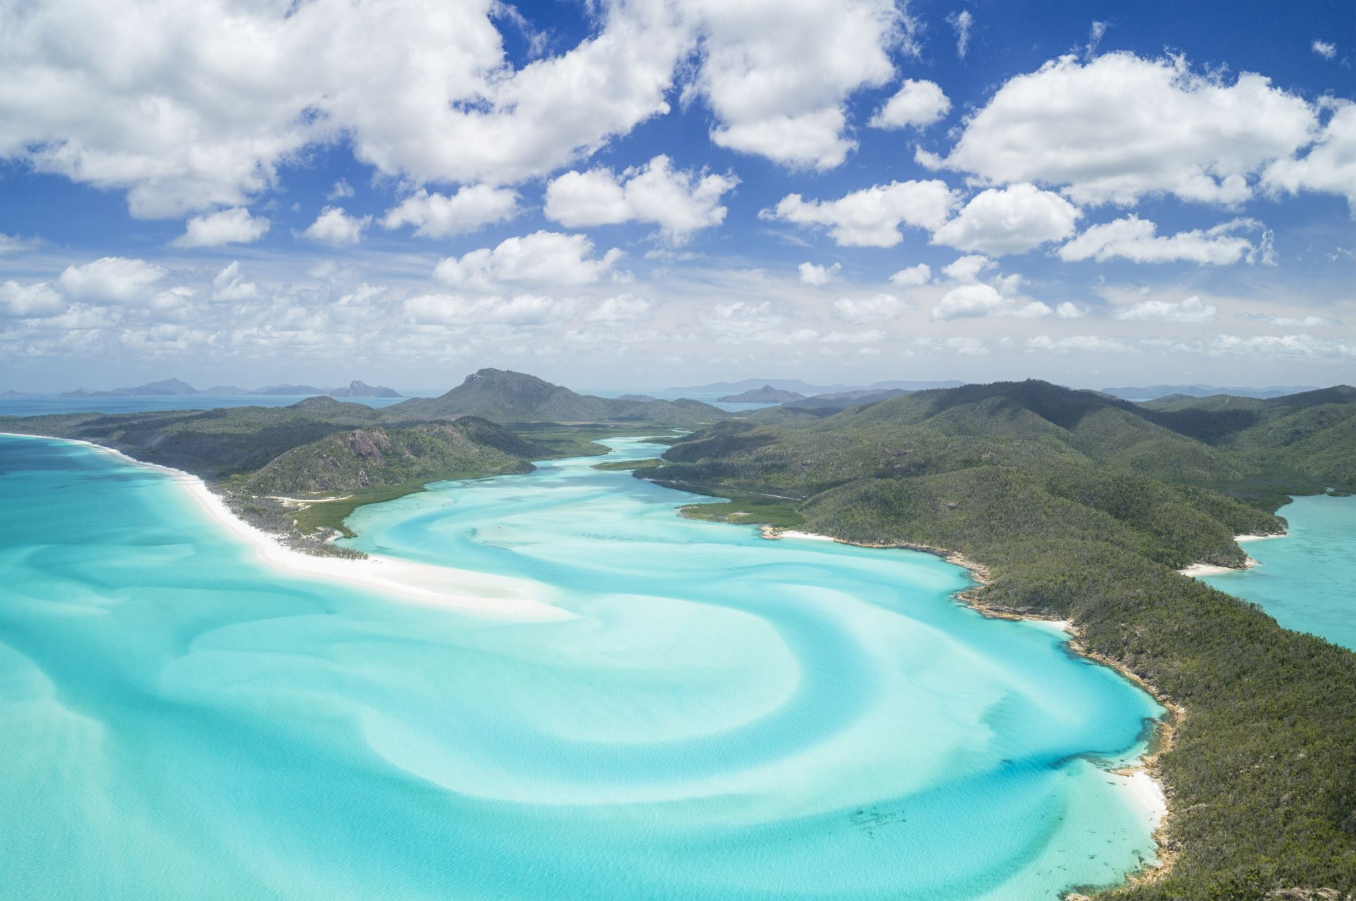
Traveling outside of the U.S.
Traveling to Jamaica from New York is 3 hours and 56 minutes. Despite the long flight time, I think it is worth the wait. Looking at the changes outside of the plane is aesthetically pleasing to those who are interested in seeing the island when they land.

Slide 7
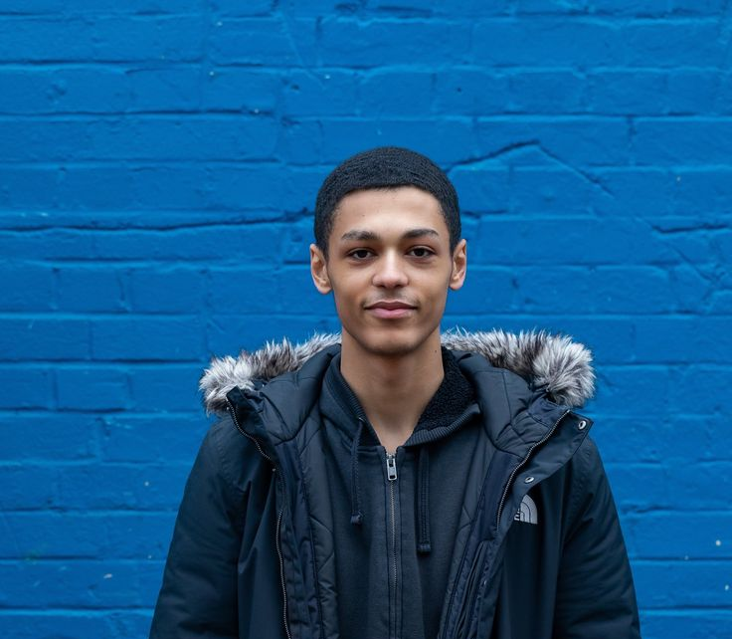
My country of origin Example of this would be a Scottish Jamaican
I am not from Jamaica. My mother gave birth to me in the United States, in New York. But my mother is from Jamaica which is why I am half Jamaican

Slide 8
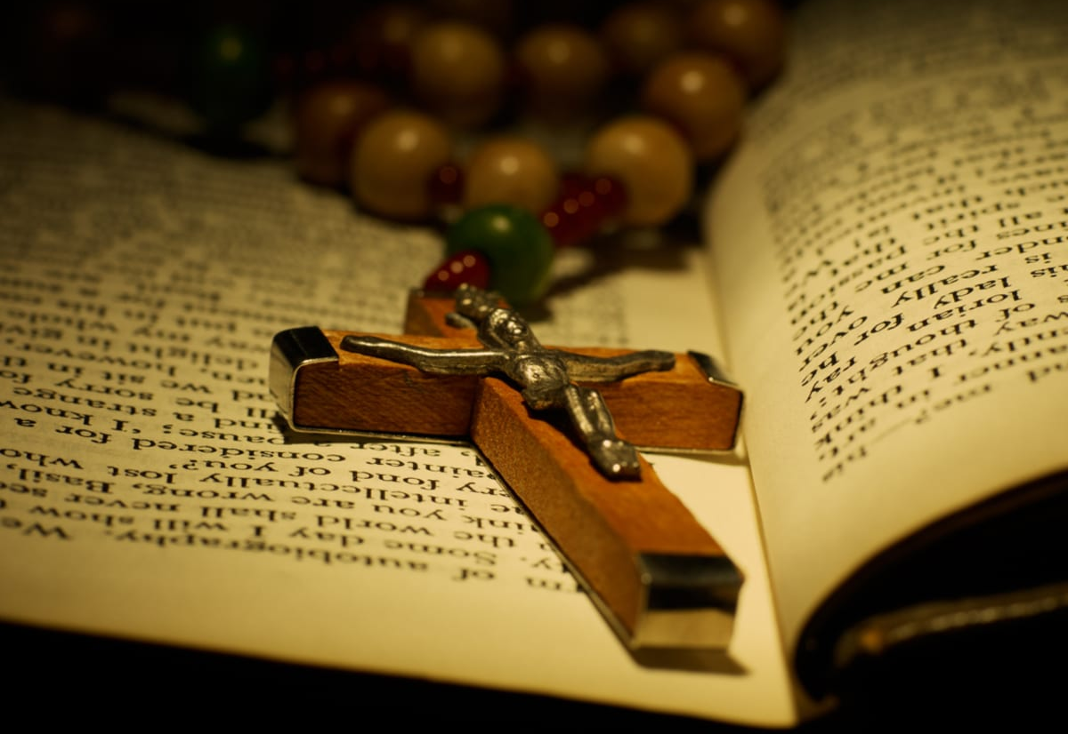
Religious Beliefs
My family is entirely Christian. Both of my parental guardians go to church to praise Jesus. They read the scriptures and pray to show faith in the God they believe in. I am entirely agnostic about Jesus since I think there is a higher power, a god that shaped the world it is today but how would the human race have any comprehension of that happening?

Slide 9
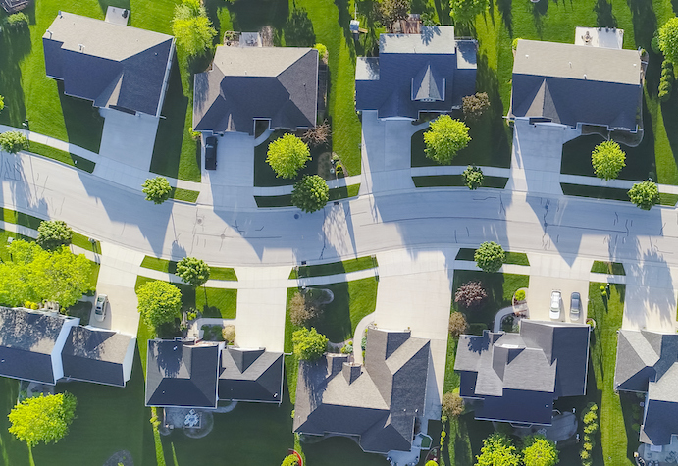
Neighborhoods around me
When it comes to the neighborhoods around me, most of them are Caribbean. My neighbors that are the closest to me organize parties and celebrations that are apart of Jamaican heritage and culture.

Slide 10
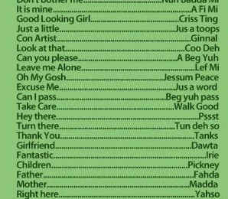
Language
The language that Jamaican people use to speak to each other is called patois. Patois is called Jamaican Creole by linguists that is an English-based creole language with West African influences. Patois is spoken among the majority of Jamaicans because it is a native language.

Slide 11
References
Slide 2- John H. Stone, Ph.D., Director Center for International Rehabilitation Research Information & Exchange (CIRRIE)
Slide 3- The international guide to Jamaican restaurants and Caribbean restaurants @eatjamaica.com page 1
Slide 4- By the Nations Online Project on the website NationsProject.com
Slide 5- Wikipedia, the free encyclopedia
Slide 6- (Travel Time) is from Google Flights
Slide 10- Wikipedia, the free encyclopedia

