Slide 1
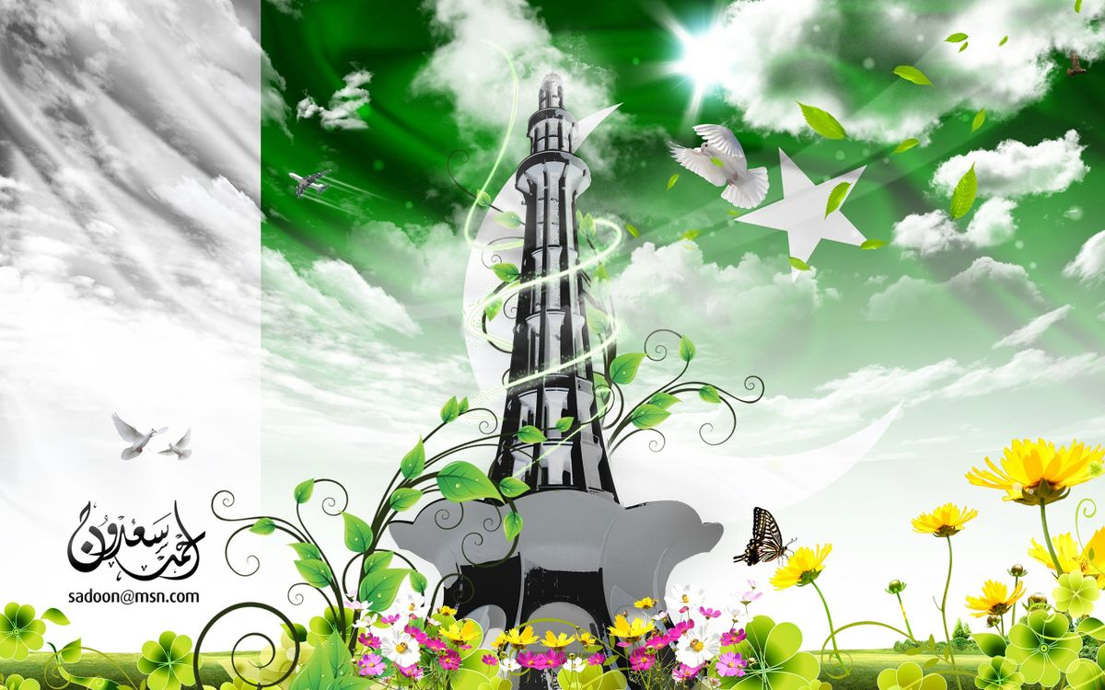
My Cross-Cultural Experience
Hamid Maqsood
CLDV100
Prof.Alapo
November 2022

Slide 2
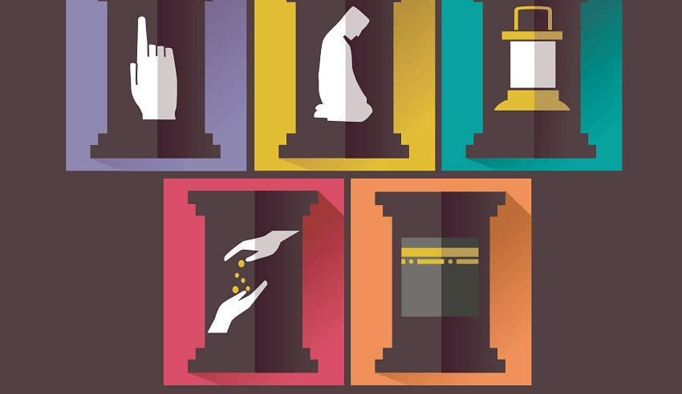
Religious Beliefs/Ethics
Pakistan is an Islamic Republic, meaning Islam is the official religion and laws are written to be consistent with its teachings. The state religion is central to daily life in Pakistan.
In the last census, 96.4% of Pakistanis identified as Muslim. It is estimated that around 4% of Pakistanis belong to a non-Muslim religious minority.
Islam has 5 pillars as the foundation of faith
1. Faith (Shahada) (which includes belief in Allah, the Angels, the Afterlife, the Message and the Messenger)
2. Prayer (Salat)
3. Charity (Zakat)
4.Fasting (Sawm)
5. Pilgrimage (Hajj)

Slide 3
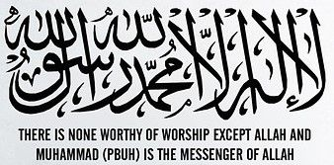
Religious Beliefs/Ethics Cont.
The Quran is the holy book of Islam and is considered its constitution and Prophet(sws) is the man to whom the final book was revealed.
The Prophet(sws) like all the other prophets of the previous scriptures before him was human, so we respect and follow the prophet but do not worship him, only Allah.
We learn about our faith through the Quran and the Hadith(narrations) of the Prophet, anything not mentioned in the Quran has been answered in the actions and behaviors of the Prophet

Slide 4
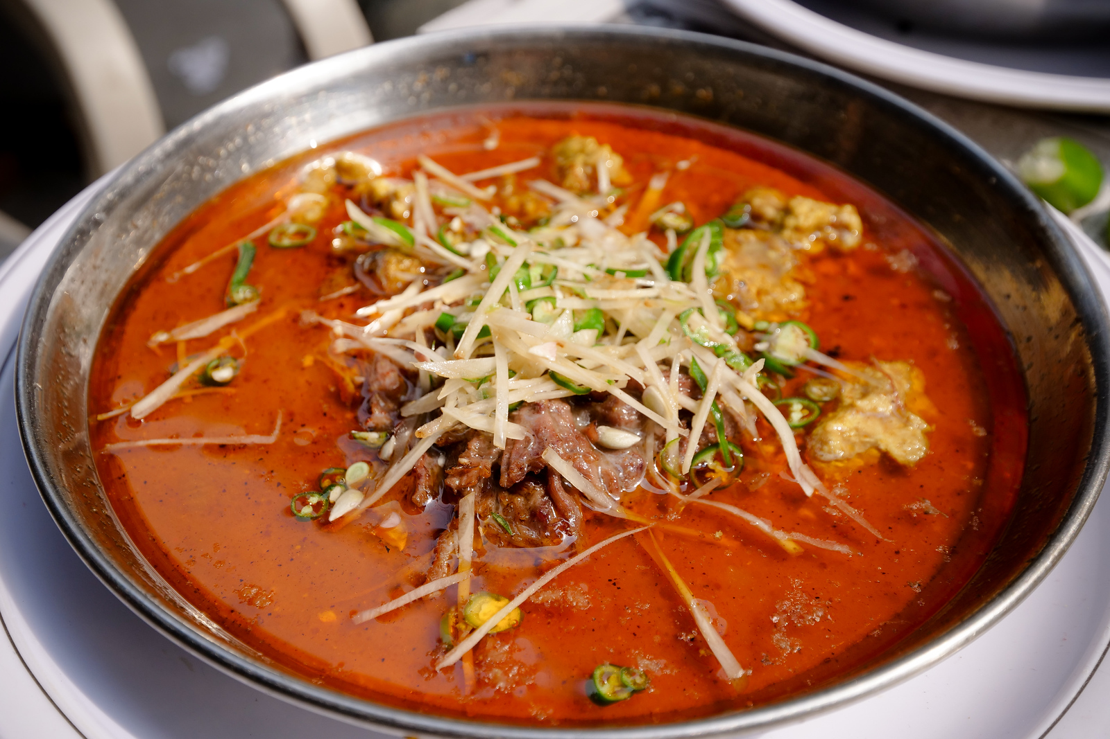
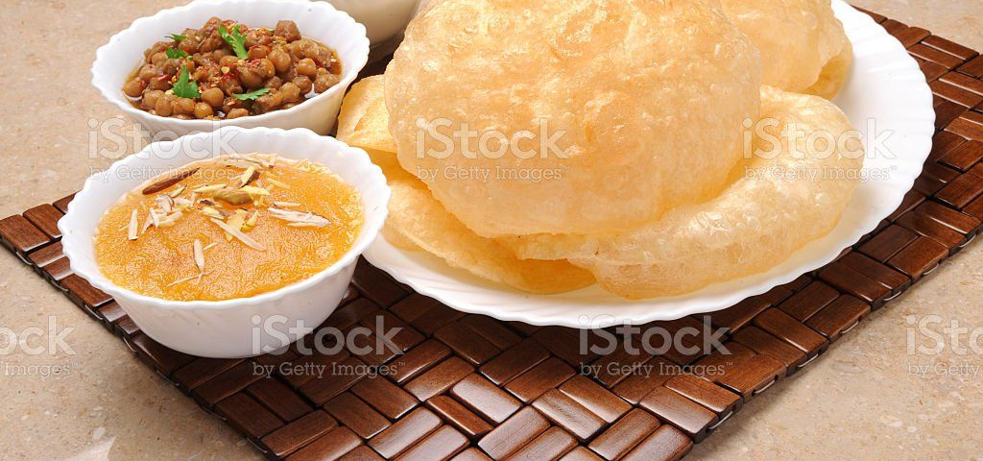
Types of Foods
Nihari
-It begins as a heap of dry spices frying in vegetable oil and animal fat with meat ingredients following such as beef shank, and a very healthy portion of Desi Ghee (home-made local clarified butter). The slow-cooking stew is then stirred altogether.
Hawla Puri
- Puris are thinly rolled dough, forming endlessly ultra-crispy layers, the folding style of which causes it to puff up immediately when submerging in boiling oil or desi ghee. It is eaten with a sweet pudding like dish made from semolina and a chickpea curry.

Slide 5
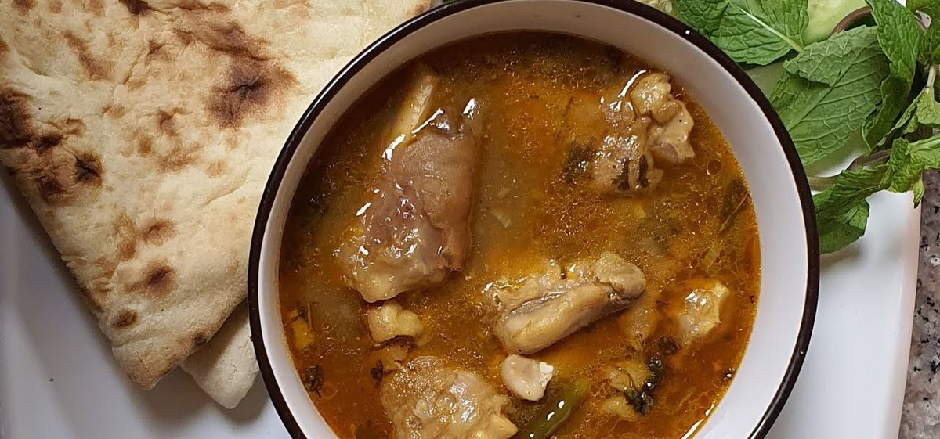
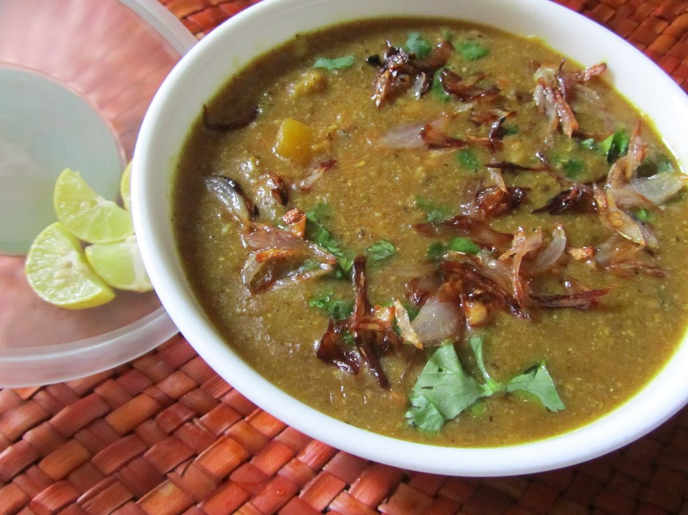
Types of Foods Cont.
Paya (or Paaya)
It is a dish with ingredients including onions, red oil with curry spices, and bowls-full of bone-in goat legs and feet. It is stewing for hours causing the tendons and cartilage surrounding the joint to become juicy and easily chewable and submerged in red curry and is always eaten with a pile of fresh, hot roti bread.
Haleem
-It is a dish made with a combination of barley, local wheat varieties, and chana (chickpeas).Onions (fried separately), mint leaves, both green and dry chilies, and then some masala spices go into the mother-pot, and a final garnish comes from generous squeezes of lemon juice at the end.

Slide 6
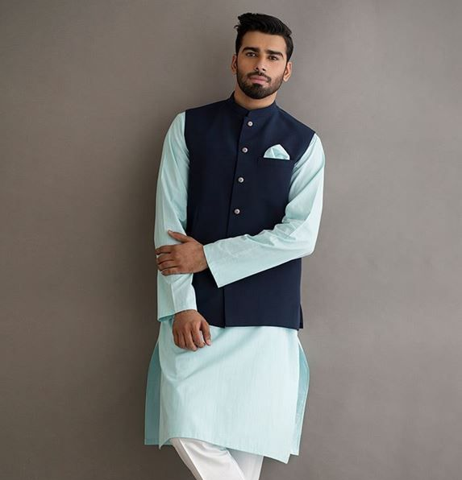
Traditional Clothing
The shalwar kameez or the salwar Kameez is one of the most popular traditional Pakistani outfit, comprised of two pieces
The kameez is a tunic that comes along to the knees, neck and shirt sleeves. It is decorated with buttons down the front and at the wrists. There are also two discreet pockets on the sides and one on the left side of the torso.
The shalwar or salwar is a loose fit pants at the top and tight at the ankles. It has many folds at the waist which are hidden by the kameez. The shalwar may be as well worn off as tight. In the upper part of the trousers is located a Nala ( cotton cord ) or a rubber band, to bend and hold the pants.

Slide 7
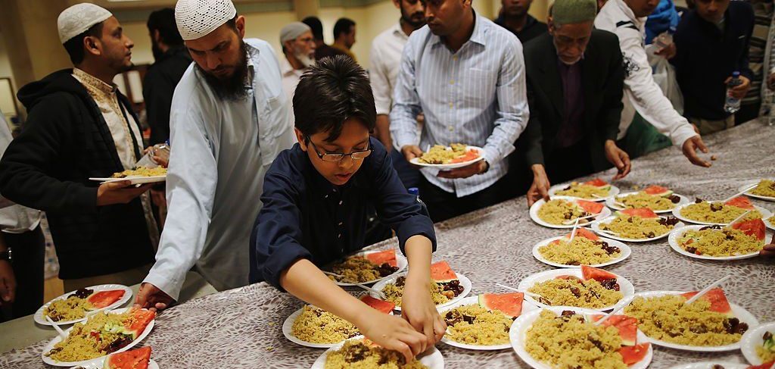
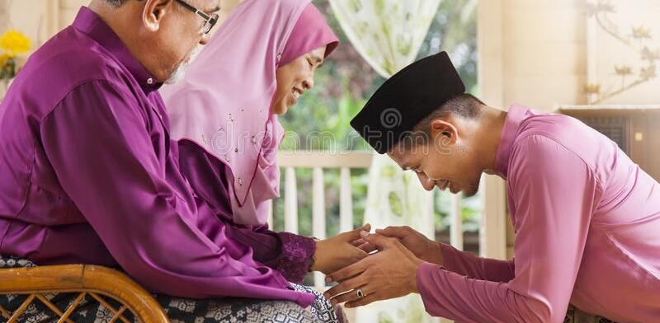
My Cultural Norms
Some of my cultural norms include praying 5 times a day and reading or learning about the Quran everyday
Another thing is that the first time you see someone after waking up you give Salam to them and in my family I hug my parents and lower my head to my grandparents to show them love and respect.
One funny norm for all Pakistani’s that I have met is that in Ramadan everyday for iftar, we all sit together with our families and eat fruit chaat, fried foods called pakora, with a sweet milk drink called rooh afsa
Somethings that our culture finds unacceptable is dating before marriage and not being monotheistic as these are two things that Islam warns against and had carried over to our practices

Slide 8
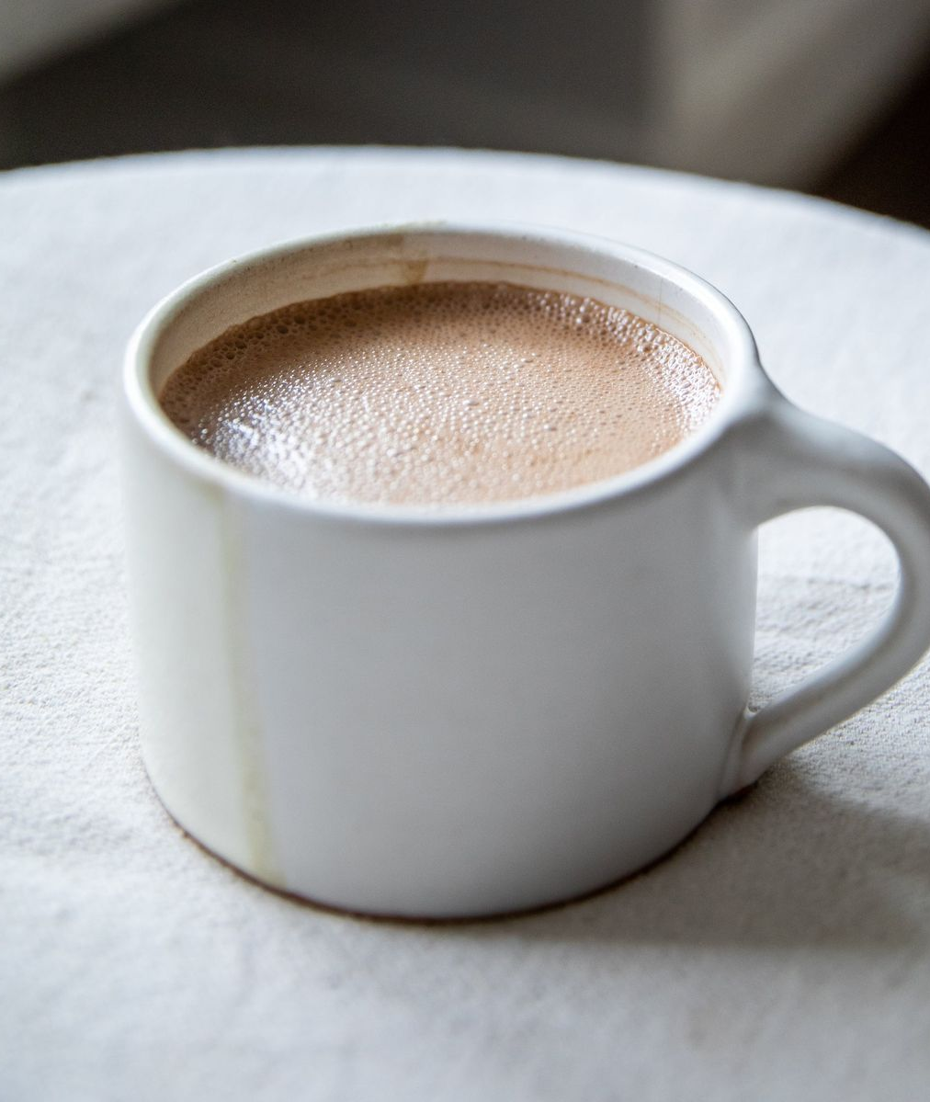
My Cultural Norms Cont.
Two things that all Pakistani’s absolutely love is Chai and Cricket
Chai tea, is a spiced, sweet and unique blend originating in India and usually contains some mix of black tea with cardamom, cloves, ginger and cinnamon.
Pakistan is the third-largest importer of tea, although some tea is grown locally too. Pakistanis make their tea strong and sweet in either milk or diluted milk depending on their preference.
A sport that was introduced to Pakistan by the British, but now it's been made our own Pakistani's take cricket games very seriously especially against our neighbor India where there is a hostility nationally and that passion transferring to game day.
To where even I know when Pakistan vs. India matches happen all the way over in America.

Slide 9
Language
The official language of Pakistan is Urdu but the most common language is Punjabi at 48%.However both are basically the same language someone who speaks Punjabi can mostly understand an Urdu speaking person.
My grandparents considered Urdu to be a more formal language while the Punjabi was an informal and more spoken by the common man.

Slide 10
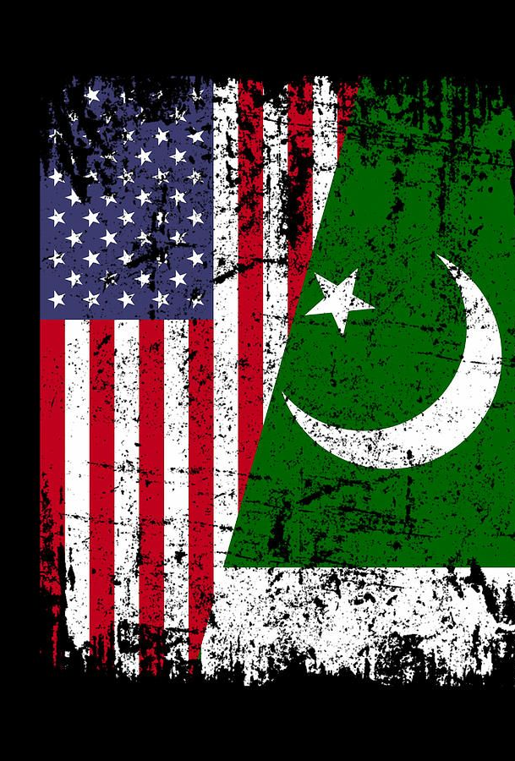
Culture Shock
A cultural shock that occurred to me was that people from Pakistan were not as religious as I thought and were more Americanized than I was and I live in America.
I went to a family gathering one time to meet my family from Pakistan who came to visit in America, all my American relatives were wearing traditional clothes while the Pakistani relatives were wearing jeans and t-shirts.

Slide 11
Connection to my final paper
Colonization and Westernization of Pakistan and the South Asia area and suppression of cultural beliefs and forced of people to act western and dress western will have issues with the Europeans so the cultural importance was lost and copying the colonizers was romanticized
With every generation less and less people know about the original culture and eventually it becomes extinct.
I know less Urdu and cultural practices than my parents because I grew up in America not Pakistan and then my children will know even less than me.
An example is when a Islamic speaker I knew was talking to a student group in Pakistan in urdu, they asked him to include more English words in his speech because when he spoke the urdu he was taught, and they were not understanding.

Slide 12
Reference Page
https://migrationology.com/pakistani-food/
https://culturalatlas.sbs.com.au/pakistani-culture/pakistani-culture-religion
https://zamzam.com/blog/pillars-of-islam/
https://www.custom-qamis.com/en/blog/presentation-du-blog/traditional-dress-of-pakistan
https://theculturetrip.com/asia/pakistan/articles/13-things-you-should-know-about-pakistani-culture/

