Slide 1
My Cross Cultural Experiences
Ahmed Haroun CLDV 100
Prof. Oluremi Alapo

Slide 2
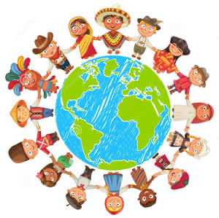
What is Culture?
Culture is the characteristics of a particular group of people.
Culture can consist of
Attire
Language
Food
Music
Holidays
Religion

Slide 3
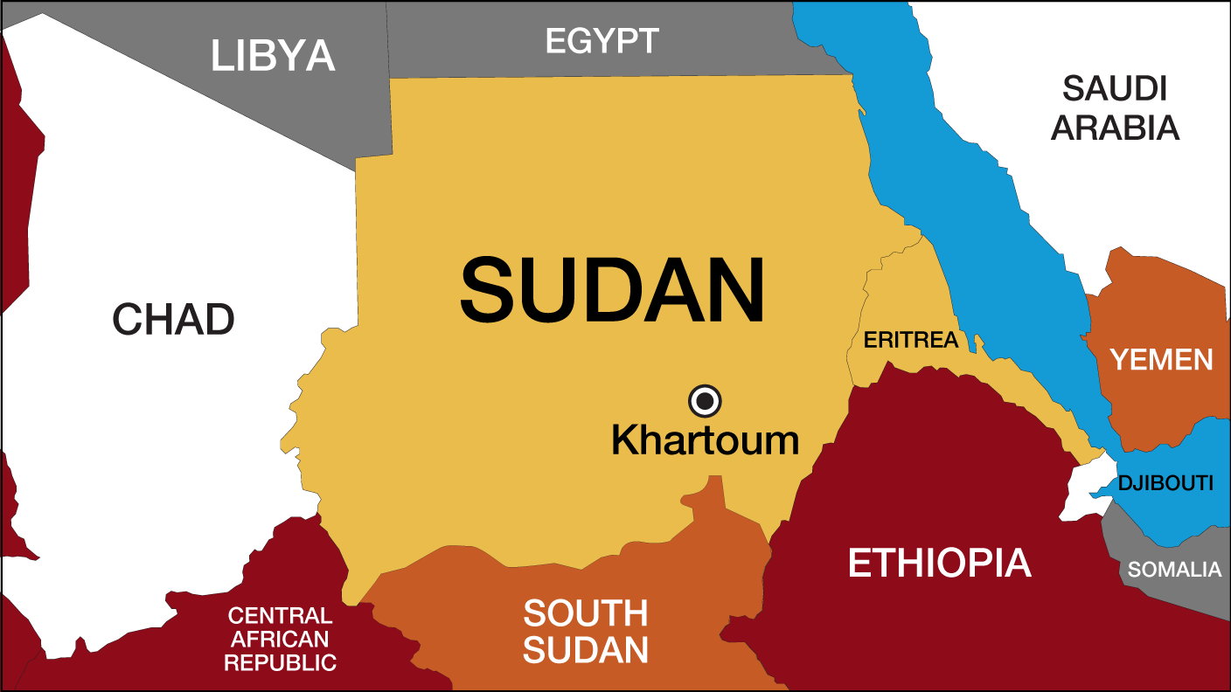
Sudanese Culture
Sudan is a country in northern africa
Sudan is home to many different ethnic groups, which are mostly made up of the original Inhabitants of the Nile valley and Migrants from the Arab Peninsula
Sudanese Arabs are the largest ethnic group in Sudan and are predominatly Muslim
There are also several other ethnic groups such as the Nubians, Copts and Beja.

Slide 4
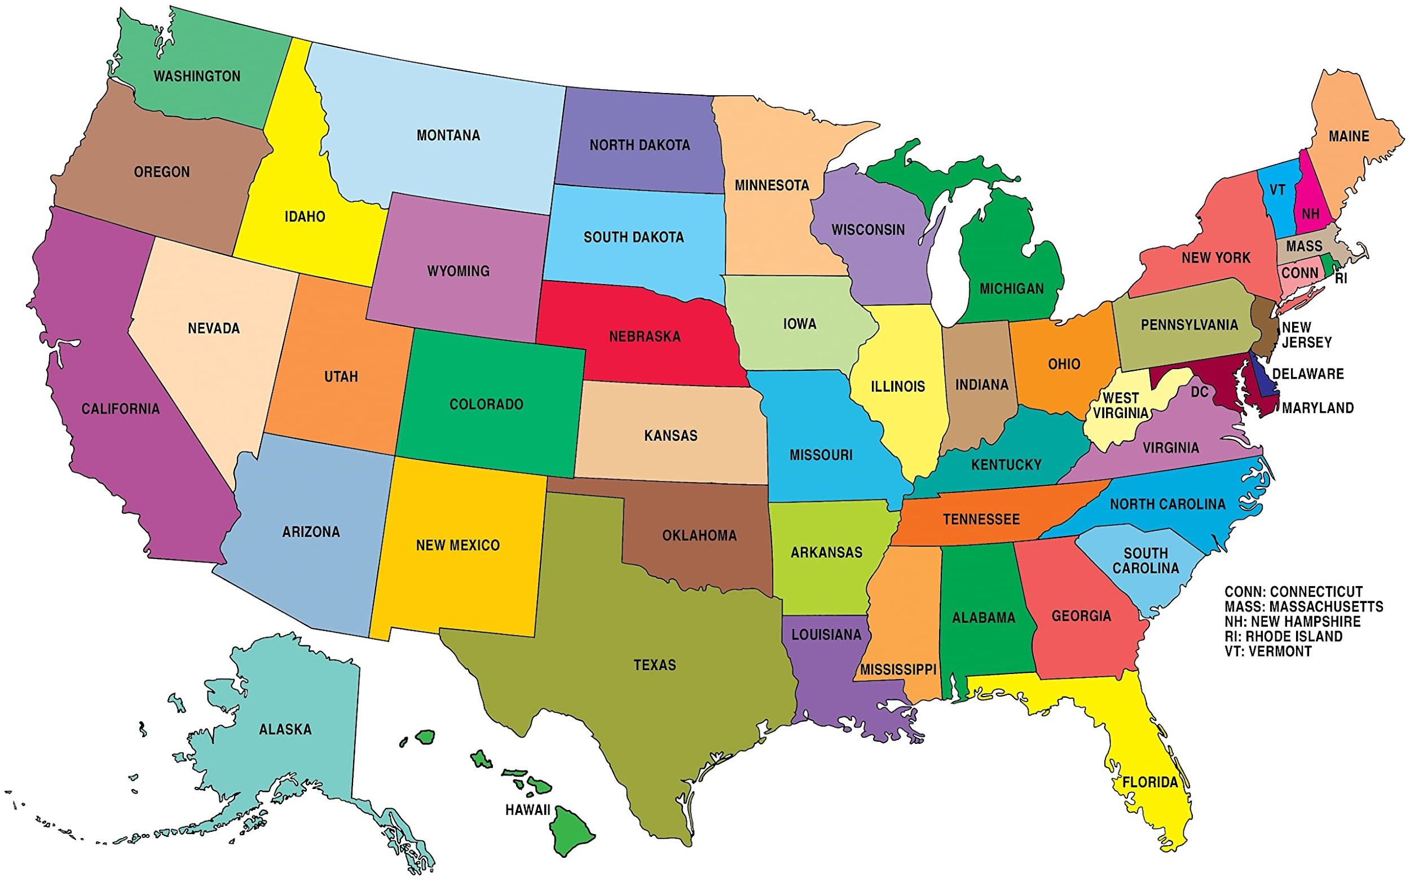
American Culture
American Culture is hard to identify because there isn’t one clear identifiable culture. American culture is the product of Immigrants from around the world coming together and bringing their culture with them. That is why America is often referred to as a Melting pot
English is mainly spoken in america but there are also specific places where mandarin, arabic, spanish etc are exclusively spoken as well.

Slide 5
Sudanese Flag
The modern Sudanese Flag was a result of the Mahdist War with the British Empire
Sudan Gained Independence in 1956
Each color of the Sudanese flag has a symbolic value
Green Represents the nations Agriculture, White Represents the dominate religion Islam, Black Represents the Mahdist Revolt aganist the british, and the Red Stripe represents the people who have died and sufferred for Sudan.

Slide 6
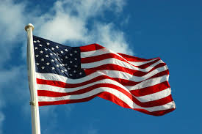
American Flag
Established in June 14th, 1777
The American Flag is a symbol of freedom and liberty
The Flags Alternating red and white stripes represents the original 13 colonies, and the 50 white stars represent the 50 states

Slide 7
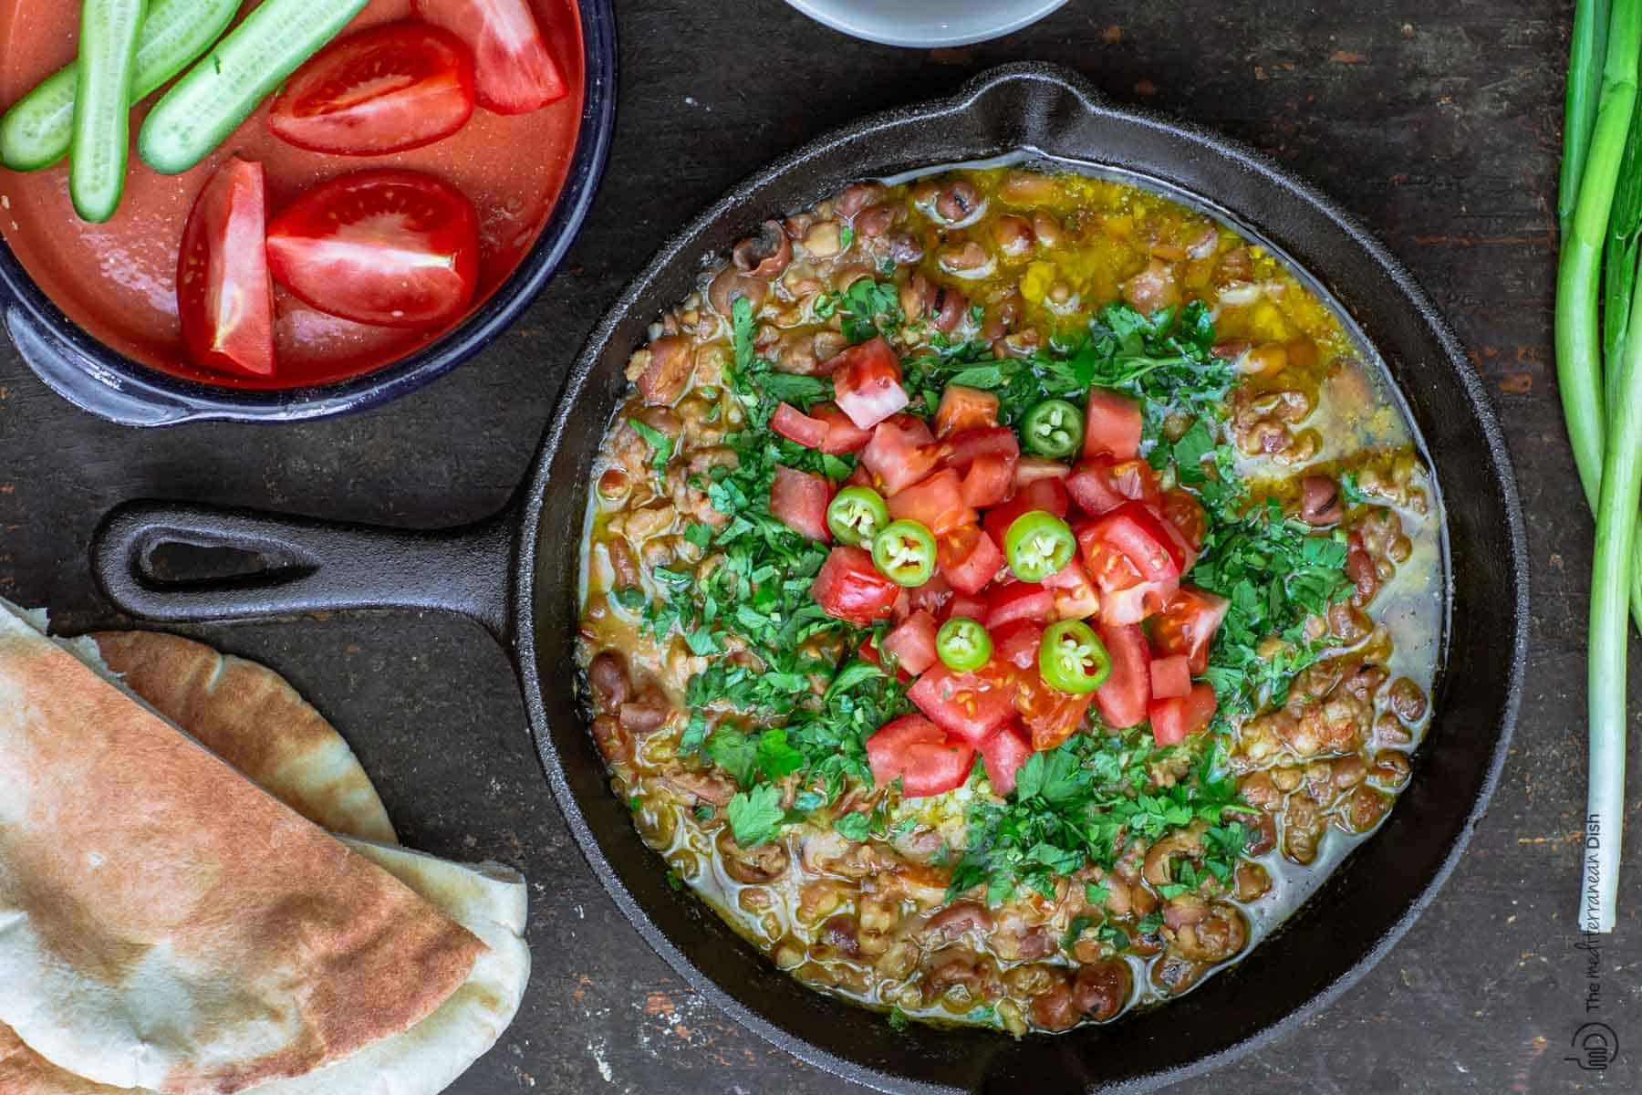
Sudanese Food
Typical Sudanese Breakfast Consist of Fava Beans, boiled eggs and pita bread
For Lunch a Beef Stew flavored with tomates, cardamom, green pepper and served with pita bread
Usually Dinner is not served because breakfast and Lunch is served late and meals are very heavy, Although desert can be served on occasion.

Slide 8
American Food
Breakfast: Often Consists of Cereals, Pancakes, Waffles and Toast
Lunch: Can vary greatly from Cheeseburgers, Sandwiches, to Pizza
Dinner: Typical dinner consists of a meat such as Chicken or Steak and a side of vegetables

Slide 9
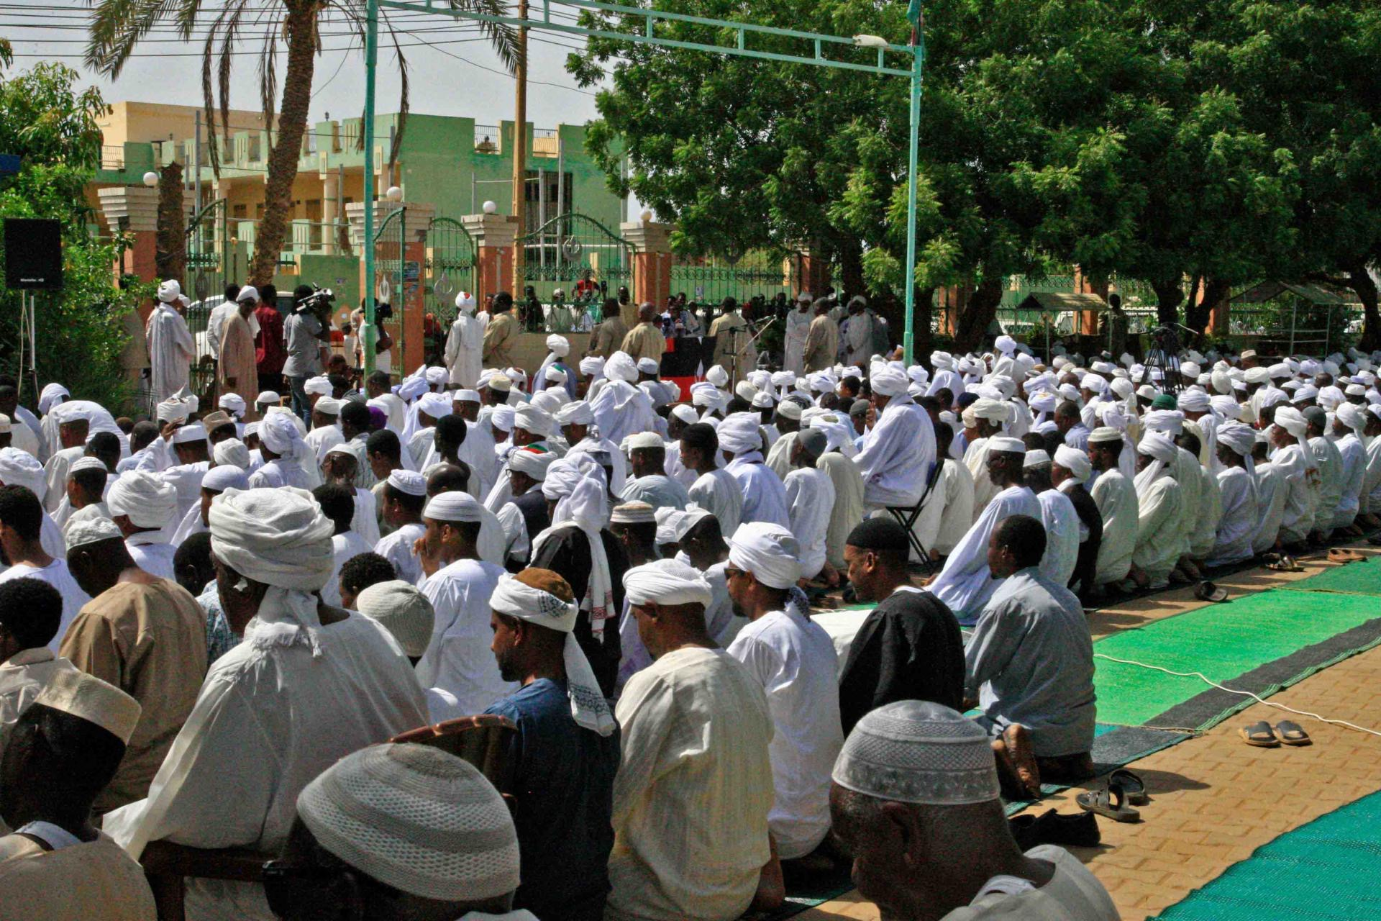
Holidays Celebrated in Sudan
Holidays Celebrated in Sudan are also islamic holidays
Both Eid al-Fitr and Eid al-Adha are celebrated in Sudan and typically last for a week

Slide 10
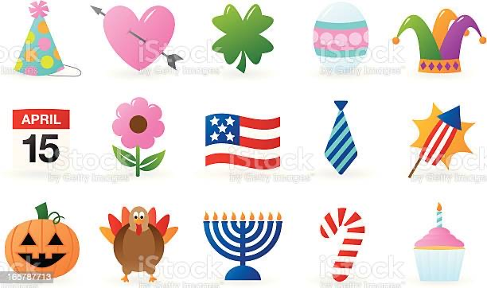
Holidays Celebrated in America
Since there are many ethnic groups in America almost every holiday is celebrated in America in some way
There are 10 Federally Recognized Holidays

Slide 11
Conclusion
Sudanese Culture and American Culture are both unique in their own ways but share the fact that they take cultural influence from around the world. While Sudan takes cultural influence from its surrounding Arab world America is more Universal.

Slide 12
Reference Page
https://www.gettysburgflag.com/flags-banners/sudan-flags
https://www.worldatlas.com/articles/the-ethnic-groups-in-sudan.html
https://www.usa.gov/flag#:~:text=The%20American%20Flag%20and%20Its%20Flying%20Rules,-The%20Flag%20of&text=The%20flag's%2013%20alternating%20red,Red%3A%20valor%20and%20bravery

Slide 13
Voice Link
https://voicethread.com/myvoice/thread/21192004/133980210

