Slide 1
MIDTERM PRESENTATION:CROSS CULTURE
Prof. Oluremi Alapo
Oct.31.2022
Tenzin Rigzin
CLDV 100

Slide 2
CULTURE
Culture is all the ways of life including arts, beliefs and institutions of a population that are passed down from generation to generation. Culture has been called "the way of life for an entire society." As such, it includes codes of manners, dress, language, religion, rituals, art.
We were taught by our parents and they were taught by theirs, we observe the teachings.
It influences who you are and how you see the world.

Slide 3
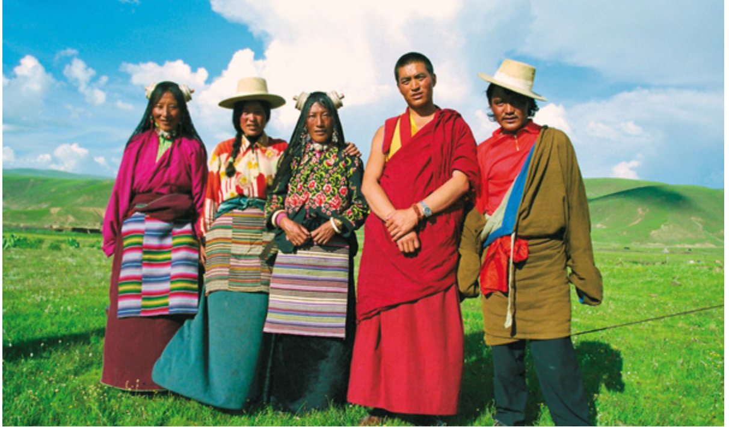
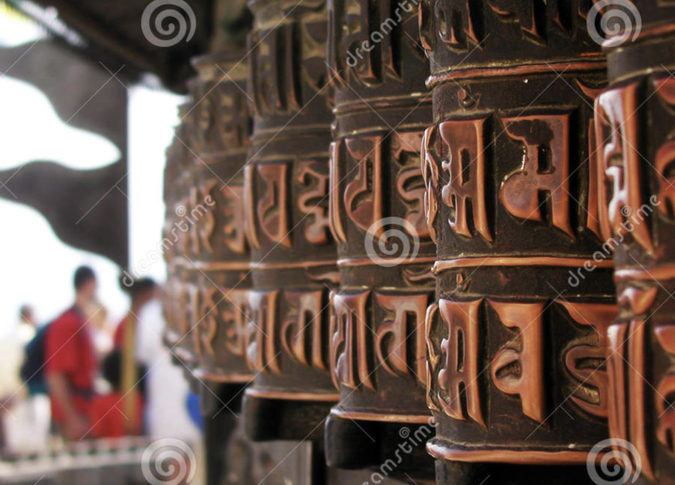
MY CULTURE
Notes:
1950

Slide 4
NATIONAL FLAG OF TIBET
In the center stands a magnificent snow-clad mountain representing the Land surrounded by Snow Mountain.
The six red bands across the blue sky represents six tribe; Se, Mu, Dong, Tong, Dru, and Ra.
the sun rays shinning brilliantly in all directions represents the equal enjoyment of freedom, spiritual and material happiness and prosperity.
a pair of snow lions stand proudly, blazing with the manes of fearlessness.
radiant three-colored jewel, represents Buddha, Dharma and Sangha
Notes:
In the center stands a magnificent snow-clad mountain, which represents the great nation of Tibet, widely known as the Land Surrounded by Snow Mountains.
The Six red bands spread across the dark blue sky represent the original ancestors of the Tibetan people: the six tribes called Se, Mu, Dong, Tong, Dru, and Ra which in turn gave rise to the (twelve) descendants.
At the top of the snowy mountain, the sun with its rays shinning brilliantly in all directions represents the equal enjoyment of freedom, spiritual and material happiness and prosperity by all beings in the land of Tibet.
On the slopes of the mountain a pair of snow lions stand proudly, blazing with the manes of fearlessness, which represent the country’s victorious accomplishment of a unified spiritual and secular life.
The beautiful and radiant three-colored jewel held aloft represents the ever-present reverence respectfully held by the Tibetan people towards the three supreme gems, the objects of refuge: Buddha, Dharma and Sangha.
The two colored swirling jewel held between the two lions represents the people’s guarding and cherishing of the self discipline of correct ethical behavior and the 16 humane modes of conduct.

Slide 5
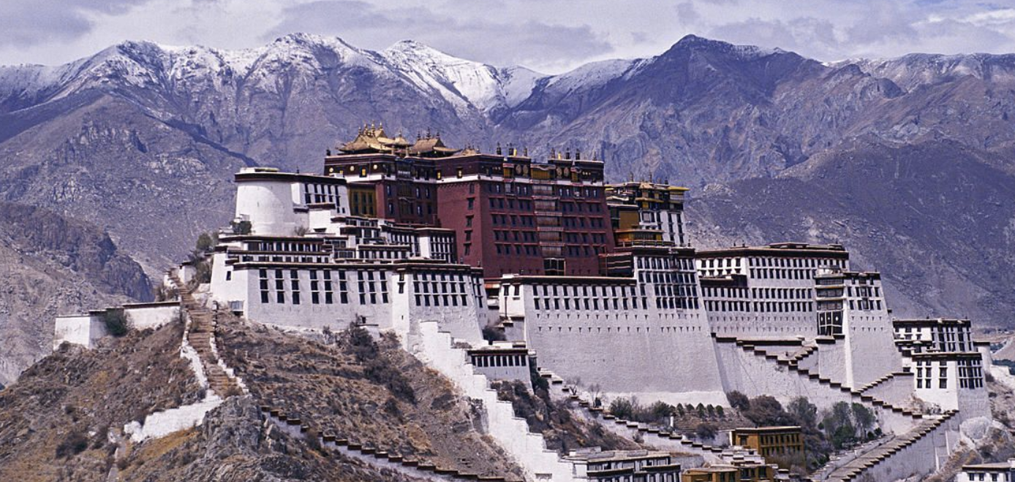
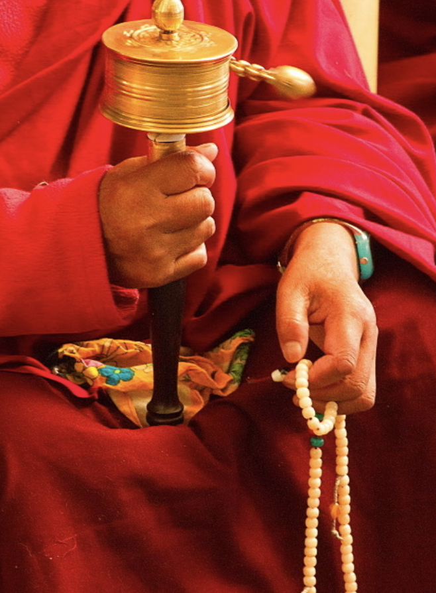
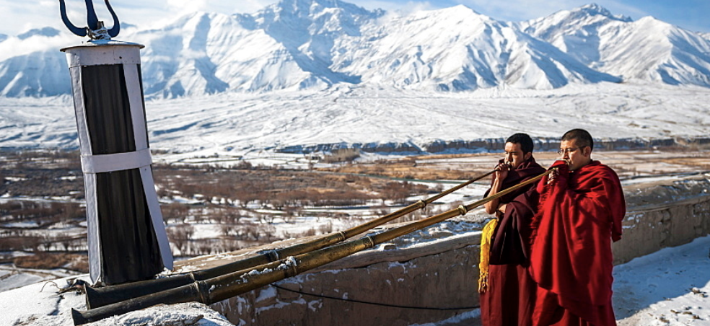
TIBET

Slide 6
NATIONAL FLAG OF NEPAL
The world's only national flag that is non-quadrilateral in shape.
Its crimson red is the color of the rhododendron, the country's national flower.
The blue border symbolizes the peace and harmony
The two triangles symbolize the Himalaya Mountains and represent the two major religions, Hinduism and Buddhism.
The moon symbolizes that the Nepalese are soothing and calm, while the sun symbolizes fierce resolve.

Slide 7
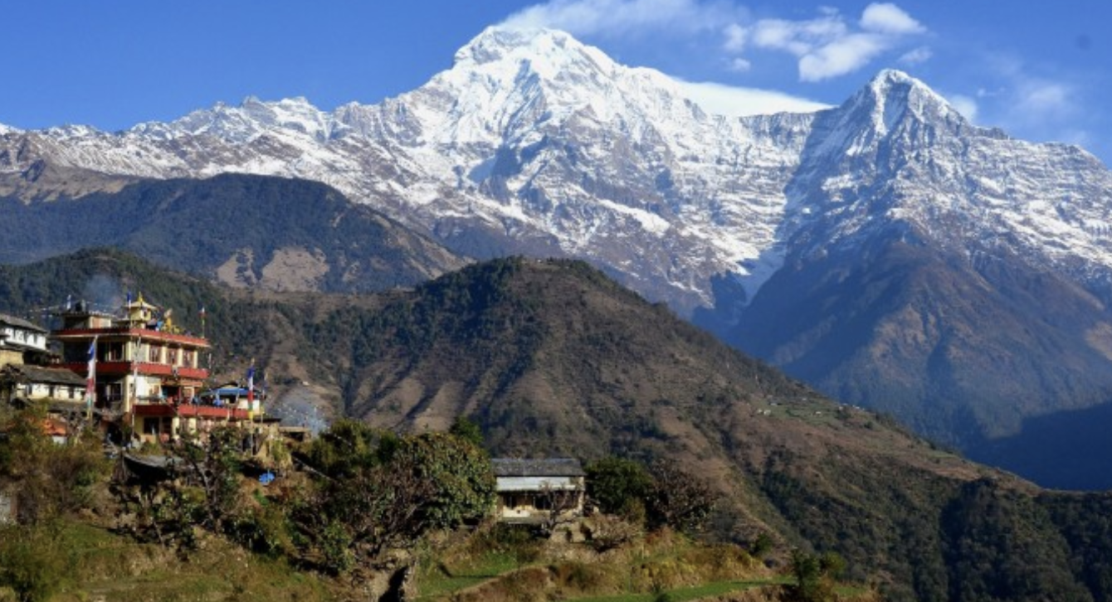
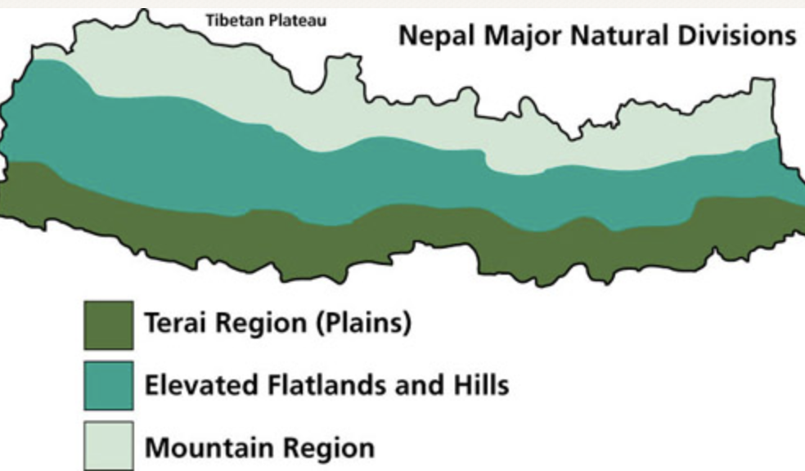
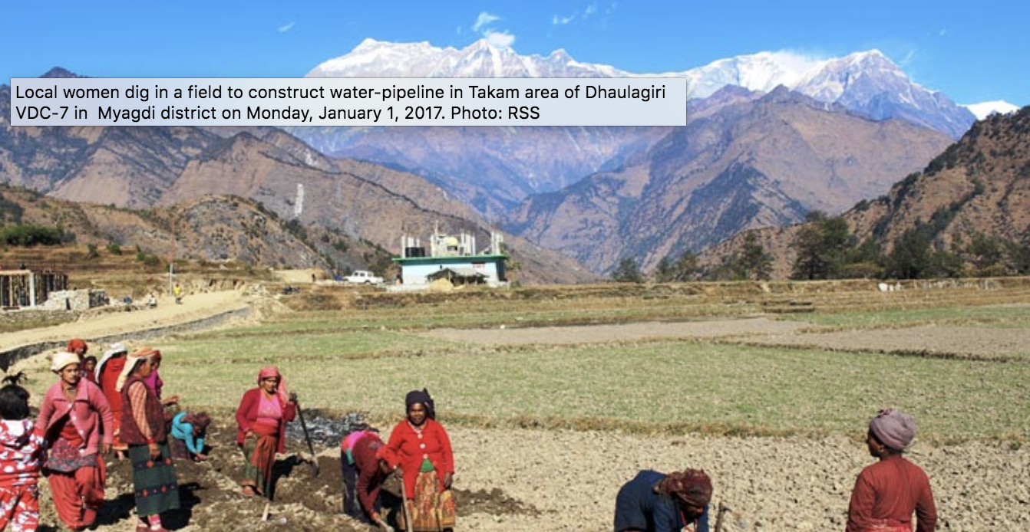
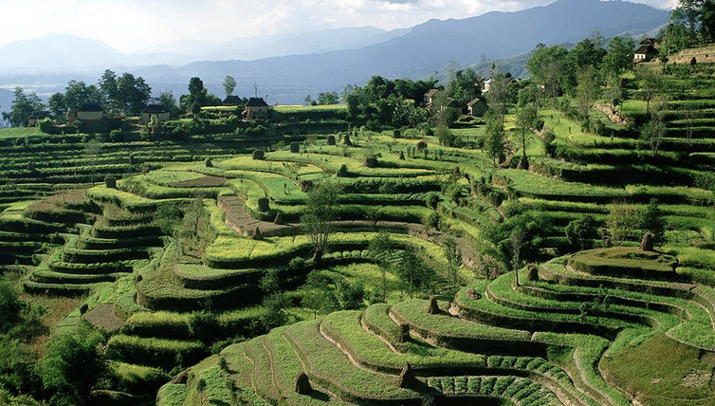
Notes:
Nepal is the birth place of Lord Buddha.
World’s highest peak, Mount Everest (8848m) is located at Nepal.
Nepal has 8 of the world’s 10 tallest mountains.
Nepal has extraordinary landscape.
Nepal has the densest concentration of the world heritage sites.
Nepali flag is the only triangular flag in the world.
Momo: is the most popular fast food.
About 80% of the Nepalese population is Hindu.
Nepal is rich in diverse culture and language.
over 80 ethnic group and over 120 languages.
Cow is worshipped as goddess Laxmi, it is illegal to kill a cow in Nepal.
People in nepa eat Dhal bhat (lentils and rice) every day

Slide 8
Norms and beliefs
Greet saying Namaste (Nepali) or Tashi delek (Tibetan).
Respect and kindness to the elders and all beings.
People are not addressed by personal names, but rather by the use of the title of kinship within the community.
Shoes off before entering the monastery or temple or home.
Notes:
People are not addressed by personal names, but rather by the use of the title of kinship within the community, whether or not there is bond of blood. If someone communicates with someone little older than them, they are referred to as an older sister, or, older brother. If someone is a generation older, then they are referred to as aunty or uncle.

Slide 9
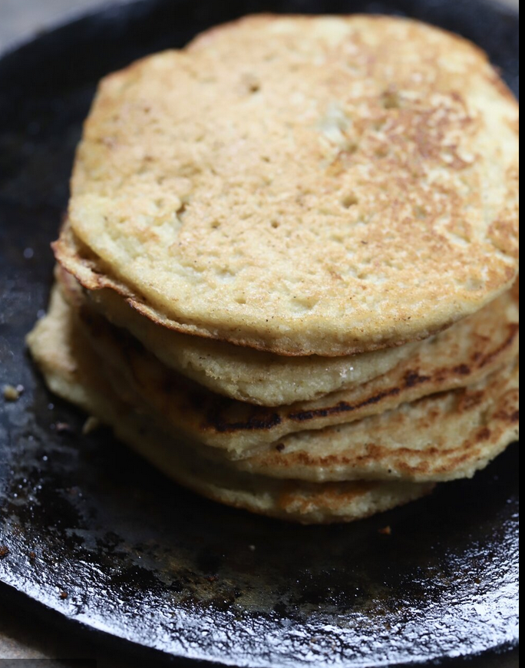
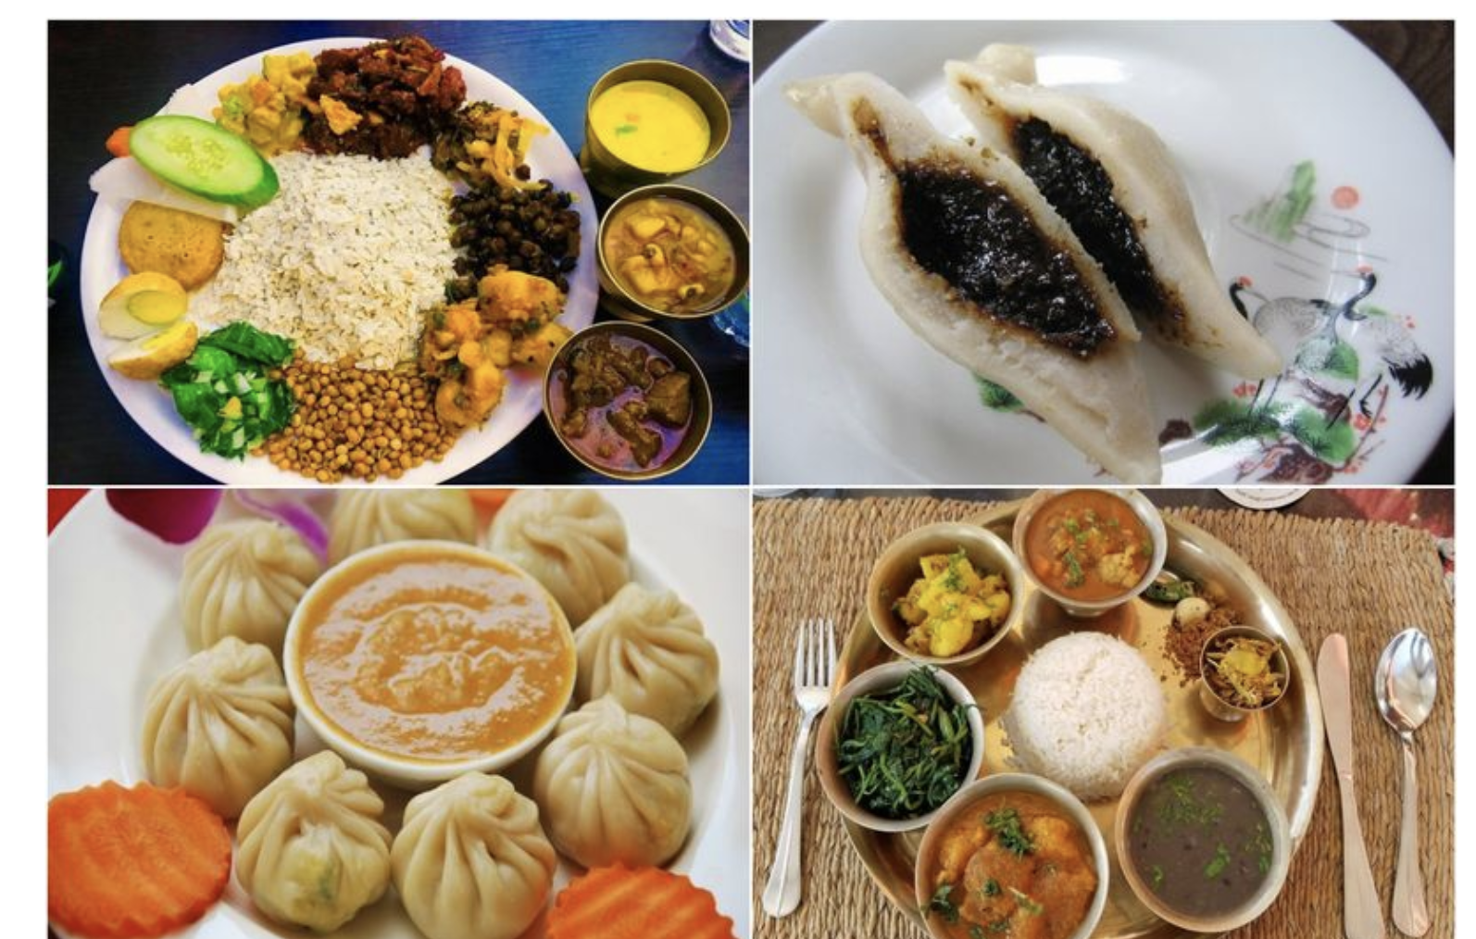
Nepali Food
Bara (lentils pancake)
Yomari
Dhal bhat (rice and lentils)
Dumpling (momo)

Slide 10
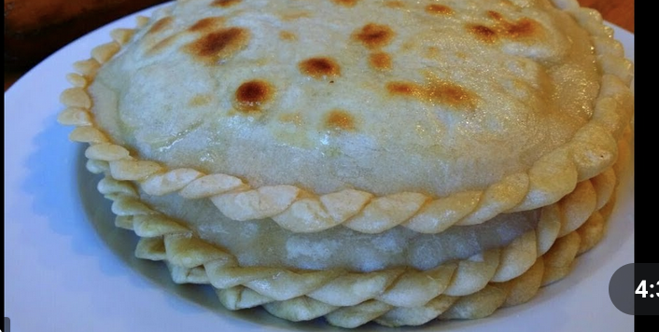
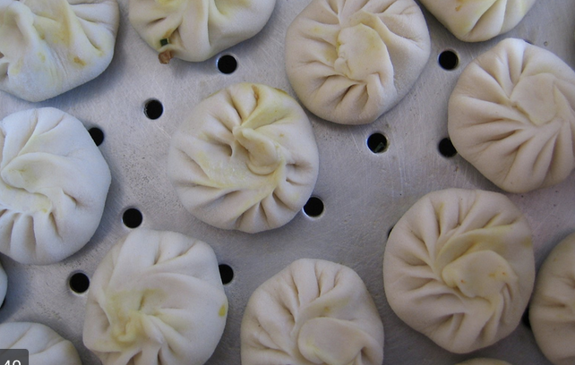
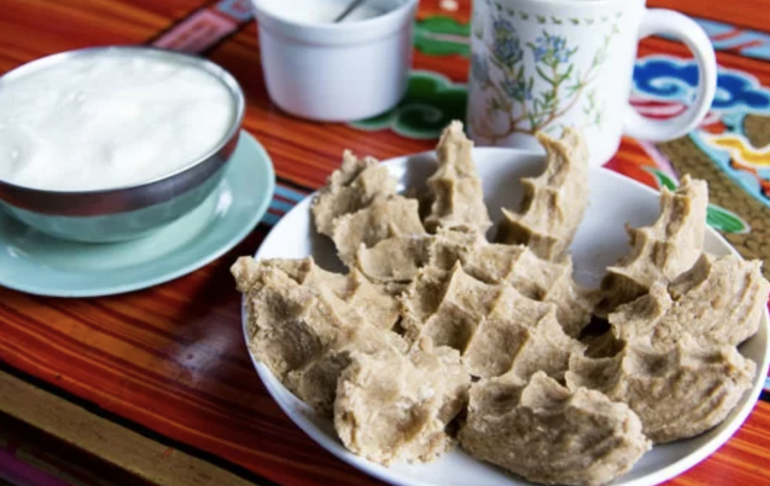
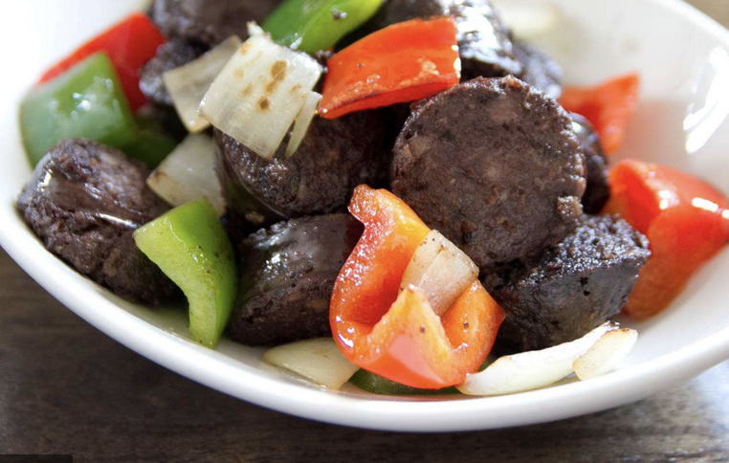
Tibetan Food
Dumpling (momo)
Shabaley (Tibetan Empanada)
Gyuma (Tibetan sausage)
Tsampa (powdered barley)

Slide 11
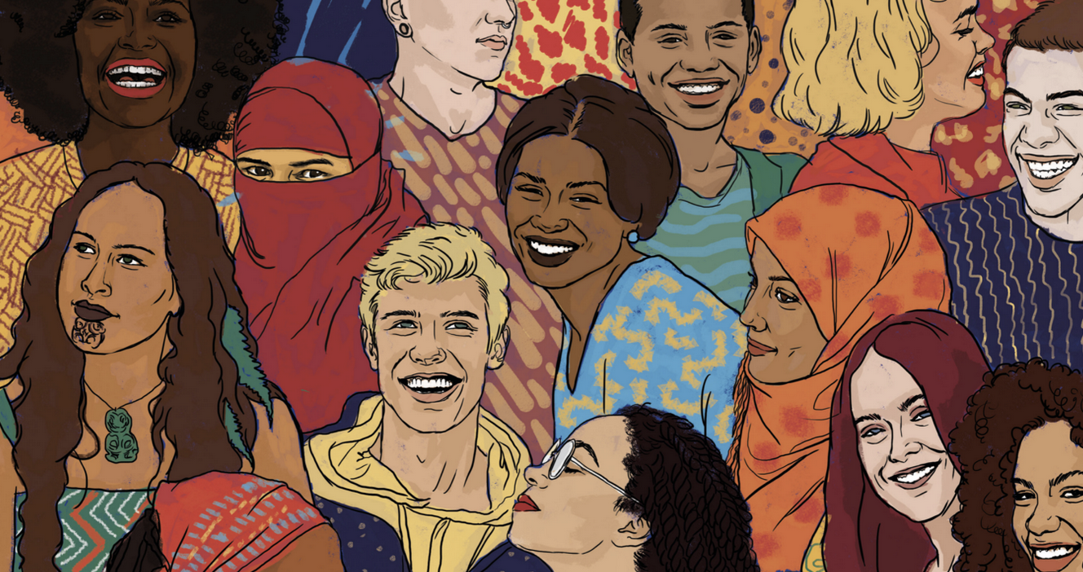
Why cross-culture is important?
Become literate
Understanding culture
Improving communication skills
Developing/building relations
Culture exploration

Slide 12
CULTURAL SHOCK
younger person talk to their elder.
Public High schools were free.
Schools provide commute food expenses.
No school uniforms.
Saturday and Sunday’s are considered weekend.
The drivers seat on the left.
Notes:
The way students or any younger person talk to their elder is totally different than how it was back home.
Public High schools were free where as we have to pay to go to school in Nepal.
School provide you with commute expenses and food whereas we pay from our pockets.
Most schools don’t require school uniforms.
Saturday and Sunday’s are considered weekend here in US whereas in Nepal only Saturday is considered weekend.
The drivers seat is set up on the left side here whereas in Asia driver seat is on the right side.

Slide 13
How week 1-8 impacted you?
More aware about how others lifestyle is.
Why and how they view the world.
What other culture eat and wear.
What people worship.

Slide 14
REFERENCE
https://tibet.net/about-tibet/the-tibetan-national-flag/
https://www.montana.edu/everest/facts/flag-of-nepal.html
https://sphweb.bumc.bu.edu/otlt/mph-modules/PH/CulturalAwareness/CulturalAwareness2.html
Notes:
New York city, united states of America “the land of the free” is a very diverse city. All types of ethnicity, and its culture can be experienced; from its food to its language.

