Slide 1
“Oh, the places you’ll go…”
CUNY York College
Cultural Diversity 100
Prof. Alapo
Introduction​
Race/Ethnicity –wk7
Cultural Origins
​Daily Interactions
Observations
Experiences
My Travels
​Independent Research /Cultural diversity
cult leadership/popsub cult&cult change.
symbols values norms taboos/soc
Language, Immigration and Geography
Culture, Class and Social - Economic Status
Other Minorities
Bibliography
My Cross- Cultural Experiences
By: Jessica Gooden

Slide 2
About me
Born in Harlem, New York, in December of 1993 to a family of 10. I had the same dreams as any lower class African American family of upward mobility. Born to two parents, us born Parents, one a baby boomer, the other from the silent generation, they instilled values of respect for age/authority, working hard and acquiring financial success. My upbringing included home cooked meals, enrichment programs, Sports, and occasional family trips to Virginia, North & South Carolinas to visit family, where my Grandparents are from. Taking advantage of many City programs for youth, I spent most of my time volunteering, interning or participating in enrichment programs. I enjoy traveling and taking advantage of all the culture the city offers.

Slide 3
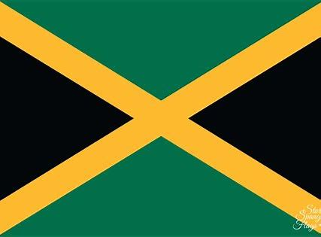
Race / ethnicity
African American
Jamaican
American
Native American Indian | Cherokee
Irish
“Black” – Race
race is a grouping of humankind based on shared physical or social qualities that can vary from one society to another while ethnicity describes shared culture but is not exclusive based on physical features or ancestral origins.
Week 7
“African-American – Ethnicity
Ethnicity is more about lifestyles, where race is a combination of lifestyle and shared physical characteristics and ancestral lineage.
Other Nationalities in my Ancestry:
Irish
Jamaican
Native American
White

Slide 4
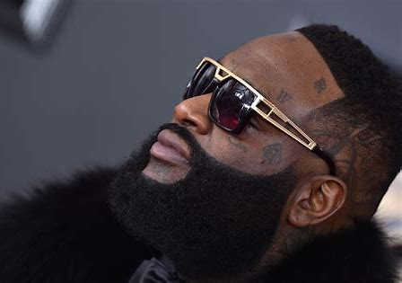
African-American Culture
About The Culture
African Americans are an ethnic group consisting of Americans with partial or total African ancestry.
This group gradually gained citizenship, social benefits and participation inspiring much of the culture.
Norms & Values
Include reverence and respect among the family members and essential non-relatives, upward mobility, and financial security. Lifestyles reflecting upper class luxuries is highly valued- home car business ownership, assets
Mine include, prayer, respect toward my elders, belief and fear of god, the use of manners and the importance of education.
Rap Lyrics Often Respect Biblical Principles
Major Symbols of African-American Culture:
Music, Southern/Caribbean/African Food & Urban Fashion
A Major Cultural Artifact:
“The Holy Bible” KJV
Previously used for religious guidance, observance and reverence, it connects people together based on a shared belief and faith. all members of Black culture may not identify as Christian, they can confirm their upbringing was connected to biblical principles. Our constitution and many of its laws, our music, even our money, tributes a respect for god, and the word.
“I think I'm Big Meech, Larry Hoover Whippin' work, hallelujah One nation, under God Real n*** gettin' money from the f****' start” – Rick Ross “B.M.F”
Pictured Below : Rapper Rick Ross

Slide 5
Do’s & Don’ts of African-American Culture
Do’s
Don’ts
Obtain Employment/ Income Earning Source
Engage in upward social mobility
Obtain assets (car, home, life goals)
Dress & Groom Well
Partake in Black culture
Support the advancement of Black People
Celebrate life goals and milestone achievement
Use of the N* word or cultural appropriation by other races
Disrespect of family and essential non-relatives
Both Unemployment & lack of income source
Invade Personal Space
Encourage Police involvement
Support Social inequalities affecting the ethnic group
Unsolicited Hair Touching

Slide 6
Daily interactions
School Environment (Jamaica, Queens)
Cultures / Nationalities: Majority Middle Eastern, Muslim, North, East, South, and West African, South American and Caribbean Hispanic, Afro-Latinos, Caribbean African, Asian, pacific islanders, African American and few White or European groups.
Languages: English, Spanish, Urdu, Arabic, French, Chinese, Other
Class: Majority Middle Class, Working Class, working Poor
Daily Commute (Harlem-> Manhattan->Queens)
Cultures: White, African- American, Latino, Middle Eastern, Asian, Pacific Islander, European, other
Languages: English, Spanish
Classes: Middle Class, Working Class, Working Poor, Underclass
My Neighborhood ( Harlem / Upper Manhattan, NYC)
Cultures: Majority African-American, African, & Latino, fewer White & other
Languages: English, Some Spanish
Class: Upper Middle, Middle, Lower middle, Working Class, working poor, underclass

Slide 7
Significant Cross-cultural experiences
Marjana
Jessica
Muslim, Indian, 18, Female student
Similar feelings of discontent toward cultural courtship & Marriage trends, inequalities for women, and Academia Versus traditional gender roles.
Experienced Described:
Her two cousins are to be married via familial arrangement, and she was lucky to have academia as a valid option to excuse her from being considered. Culturally women as pressured to engage in traditional courtship and marriage practices, despite freedoms America offers. Although being of diff cult, both desire marriage, & family, but do not agree with some cultural norms for our personal lives. In Black culture, marriage is not as expected as child-bearing, but due to the social climate, timing and sequence are not in our direct control.
Catholic, White, 31, Female student
Similar feelings of alienation, culture shock, and social acclimation.
Experienced Described:
Her first semester was horrible due to racially insensitive teachers, and culture shock experienced after transferring from a predominantly White college in a suburban upper-middle class area, to a majority ethnic community in a working-class neighborhood. After a semester online, she is acclimating socially and becoming more comfortable being the only White Student in most of her classes. As an African American in many Academia or the professional world I also experience culture shock and had a similar experience despite being of different cultures.

Slide 8
MY First cross cultural Trip to: Western Germany & Colmar, France
15 Day Cultural Immersion Trip – September 2009
The holocaust Burial site where mass graves hold thousands of victims, but less than 10 names for the deceased.
Their Police vehicles are even different, and they drive on the opposite side.
Lodged at Burg Hohenzollern, in Hechingen, Germany.
The Schvimbat, their local swimming pool is the equivalent to a united states indoor waterpark, and spa.
Just landed! First Photo inGermany.
An interesting 7.5 hours and a layover for the journey.
Their Transit system is fast, affordable and very neat and clean compared to NYC’s Subway System.
Pictured with Tripmates, German Students and Prince Georg of Burg Hohenzollern in September 2009.
Views for the north tower at the top of the Castle at Burg Hohenzollern.
Group Pictures Outside the Holocaust Museum.
Check out his Google Search! Still Unreal
Day trip to Colmar France, Where the first draft of the statue of liberty was built, before major modifications were made .

Slide 9
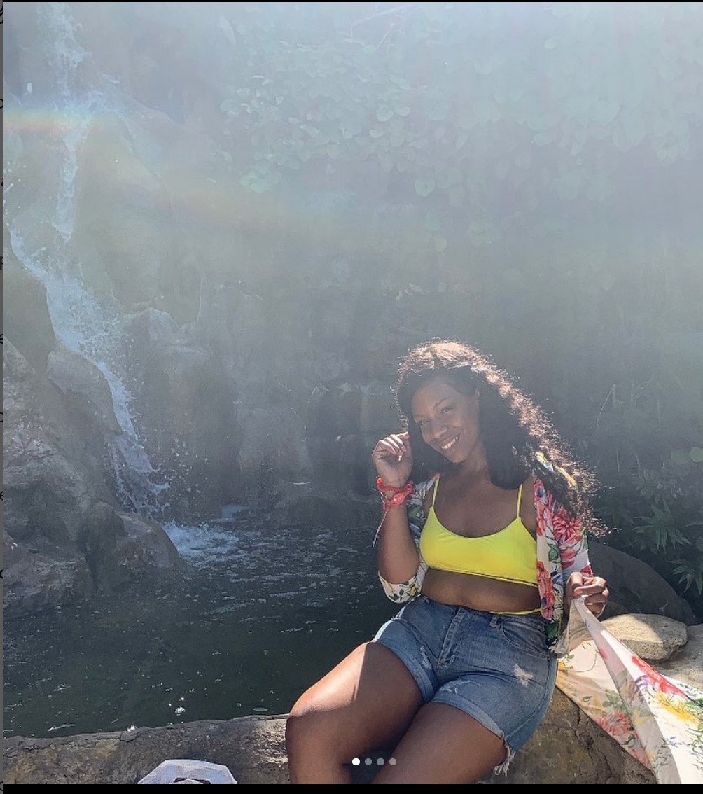
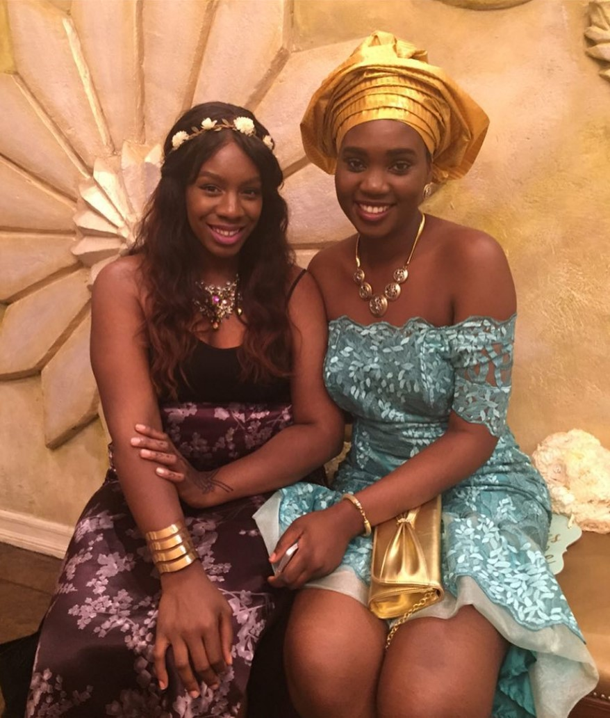
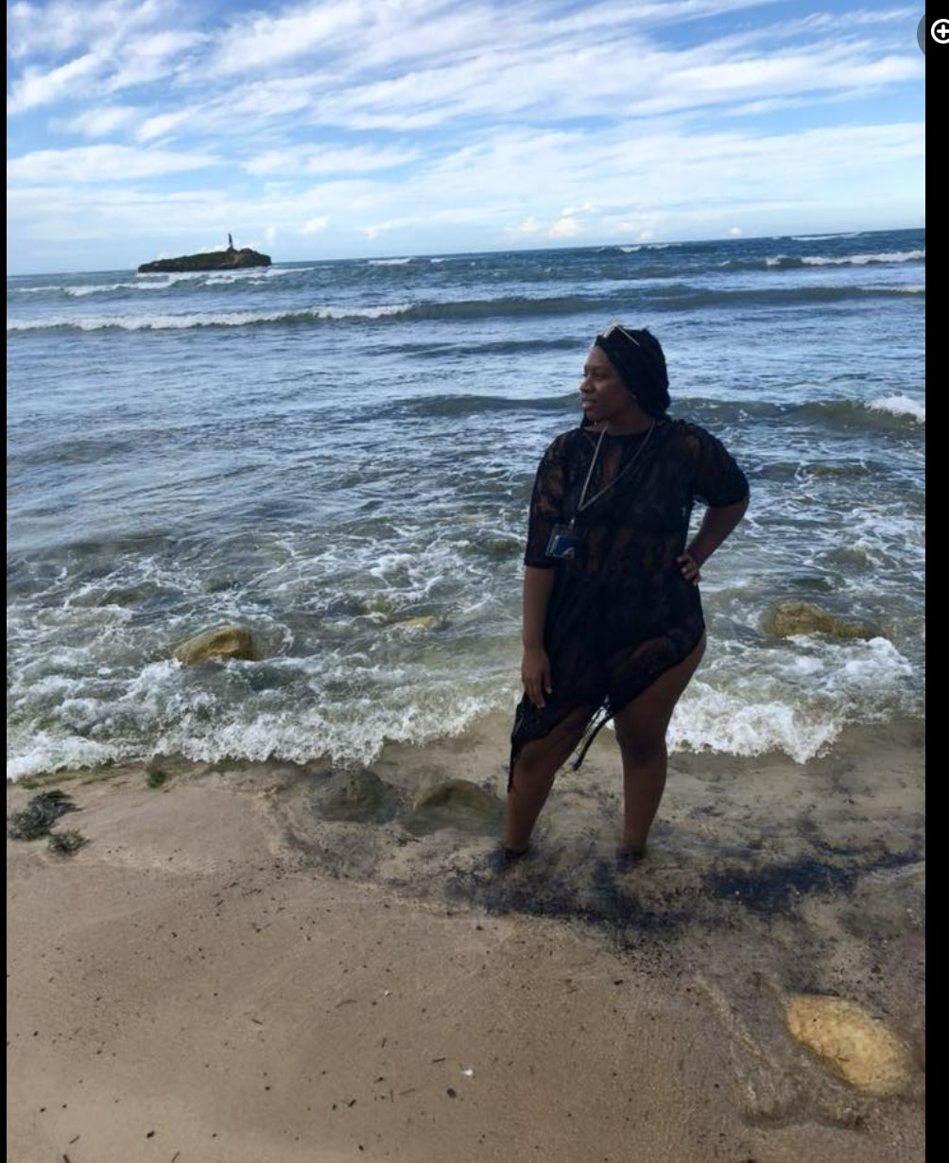
MY TRAVELs
St. George, Grenada
Grenada
Angel Cove, D.R
Nigerian Wedding in Brooklyn
Puerto Vallarta, D.R.
Dunn’s River Falls, Jamaica
Negril, Jamaica
Miami, FL

Slide 10
Independent research on cultural diversity
“Richard Wright as Educator: The Progressive Structure of Simone de Beauvoir's Account of Racial Hatred in the United States”
By: Robert BERNASCONI
“Wright attacked those Whites who visited Harlem, drawn to Blacks because they are projecting onto them, what they would like to be but are not”. (Bernasconi, 2018)
“What emerges… is the initial exoticizations of the lives of African Americans as revealed in the clubs and in the churches and her subsequent discovery that her attitude was problematic”( Bernasconi, 2018)
“The obvious differences… comes from differences between the two castes in their historical, economic, social, and cultural situations and these could… be abolished.” (Bernasconi, 2018)
“But When… she heard Wright denounce the way Mezzrow preferred Blacks to Whites but lived in such a way as to maintain the gulf between them, she seems to have been ready to recognize that she herself was implicated.” (Bernasconi, 2018)
“…Only when she publishes the book does she explicably argue for radical social change”. (Bernasconi, 2018)
Subject’s Account before Cultural Socialization
(Key Quotes)
“…Is underlined by… his reference to the widespread stereotypes about Blacks as magnificently gifted in music and dance, full of animal instincts… carefree, thoughtless, dreamers, poets, given to religious feeling, undisciplined, childish”. (Bernasconi, 2018)
“Beauvoir’s experiences in the southern United States enabled her to see beyond the surface impressions… all exoticism had vanished for her. On her First visit to Café Society… she was struck … he was able to express his ideas about race relations, although Blacks would not be served there if they came to listen”. (Bernasconi, 2018)
“She also recorded her discomfort at the fact that the black musicians know very well that they don’t have the right to sit in the audience… in another letter she showed that she still fell victim to discrimination”. (Bernasconi, 2018)
Subject’s Account After A period of Cultural Socialization (Quotes)
Results: Cultural Socialization Aids in Preventing Racial Discrimination
“She wanted those of her readers … to learn for themselves the dangers of responding positively to such exoticizations and she wanted them to learn it, as she had done, at Wright’s hand”. ( Bernasconi, 2018)

Slide 11
cultural leadership styles and cultural change
The Black Upper Class Leads Black Culture
African-American individuals who have high disposable incomes and high net worth; apart of 1%. Represent persons of high social status, power and political influence. Due to social issues, “Jack and Jill” formed to create a space for the upper class, that celebrated their affluence and Blackness.
Positions Held Include:
Highly paid white-collar professionals such as engineers, lawyers, accountants, doctors, politicians, business executives, venture capitalists, CEOs, celebrities, entertainers, entrepreneurs and heirs
Keys Factors for Upper Class Members
Marriage, education, work, & military service are factors that significantly increases one’s chances toward upper class mobility.
Culture Changes
Occur based on ones’ ability to maintain social sponsorship, class-based authority, public admiration and respect, one can inflict social change.
“Jack and Jill” Event Pictured above.

Slide 12
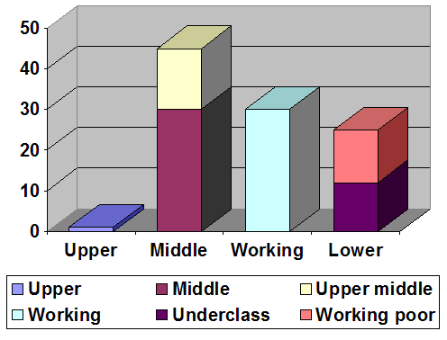
African-American Culture & The Class System
Upper Class
Top 1% of Black families
$1Million+ yearly in income
Major source income: Assets
Occupations typically held: Investors, corporate executives
Education: 4+ years college
Working Class
25-30% of families
$30,000–$45,000yearly in income
major source income: wages
occupations typically held: Operatives; clerical, retail sales workers Lower-level service workers; unskilled operatives
education: High school graduate to Some high school
Working Poor
12-15% of families
15,000–$30,000 in income yearly
Major income source: Wages
Occupations held: Operatives; clerical, retail sales workers & Lower-level service workers; unskilled
Education: Some highs school
Underclass
9-12 % of families
<15k yearly in income
Major source of income: public assistance
Occupations: unemployed or underground economy
Education: some high school
Upper | Upper Middle | Middle Class
Upper Middle
18-20% of families
$80,000–$1,000,000 in income yearly
Major income source: Salaries
Occupations held: Upper-level managers; professionals; some business owners
Education: 4+ years college;
postgraduate training for many
Middle Class
25-30% of families:
$40,000–$80,000 yearly
Major income source: Salaries and wages
Occupations held: Lower-level managers; semi professionals; small business owners; craftsperson
Education: At least high school graduate; often some college
Working | Working Poor | Underclass

Slide 13
African-American culture & Social inequality
Economic: Income & Wealth Inequality, underfunding of education and public institutions, & employment discrimination
Social: System does not benefit African Americans the same as counterparts in terms of social prestige, respect, inclusion or protections. Ex include Mass incarceration, unequal life chances, limited social justice, and inadequate health, education and public service systems
Housing: insecurity, lack of affordable housing, unsafe housing conditions, Gentrification, zoning, “steering”, Credit requirements, Transportation and commute issues, & discriminatory attitudes
Political: Limited political participation, Access to voting, adequate political representation, and exclusions
History of Social inequalities in United States
Social Inequality in African-American Culture
Systemic barriers to building economic wealth, an erosion of voting rights, Poverty, income inequality, wealth inequality, food insecurity, and the lack of safe, affordable housing, over-policing and imprisonment; a progression from previous history of enslavement and targeted oppression.
Reasons African-Americans Experience Social Inequality In The U.S.
With The U.S. Economy dependent on slave labor, colonists needed a sufficient low-cost workforce. Native American slaves proved insufficient due to fear of overworking and death from European diseases. Africans were experienced in agriculture, livestock and raising crops, and were easier to import than slaves from other continents. From slavery, to segregation, to social reform, the effects of this are represented in the social inequality faced by this group today. The existence of social inequalities sustain the current class system.
Effects of social inequality

Slide 14
African American Minorities – Gender, Sex, Sexual Orientation
LGBTQI+
Cisgender Women
Intersex
Biracial / multiracial
Black LGBTQI+ individuals experience heightened discrimination, from other non-black persons in healthcare, housing, education and many other aspects of social life. These individuals are marginalized from society and also within their ethnic communities.
Intersections of sexism and racism are the cause of the marginalization of Black Women. Many suffer from Double discrimination, which occurs when African American Women face biases unique to their racial or ethnic background in addition to their gender.
Making up for 10% of the population, (AIS) results in a more ambiguous physical appearance with atypical development of secondary sex characteristics. Individuals often face more social exclusions, lack of representation, racial based injustices, body dysmorphia, but also the ill-informed medical care and forced surgeries on infants.
Due to the ongoing struggle to maintain all ethnic and racial identities, these individuals experience double discrimination, stereotypes, denial or rejection of ethnic identity from within group, idealization, and other forms of marginalization. The reap both the social benefits and disadvantages of each group.
“Black women consistently work for a better country, but our country is not working for them.“ (Guha. 2021)

Slide 15
Best Aspects of African American Culture
Resilience from overcoming widespread inequality.
Hard Work
Dreams and aspirations of upward mobility as motivation
Religious observance, or reverence
Celebration of Black Culture & life achievement

Slide 16
Thank You for tuning in to:
CUNY York College
Cultural Diversity 100
Prof. Alapo
A Tribute to My African American Culture
My Cross- Cultural Experiences

Slide 17
Bibliography
BERNASCONI, R. (2019). Richard Wright as Educator: The Progressive Structure of Simone de Beauvoir’s Account of Racial Hatred in the United States. Yale French Studies, 135/136, 151–168. http://www.jstor.org/stable/45284681
Auditi, Guha. 2017. Report: Black Women Face Inequality in Every Part of Society. Power. Rewire News Group. https://rewirenewsgroup.com/2017/06/07/report-black-women-face-inequality-every-part-society/
Pictures
https://www.pinterest.com/pin/135178426295504317/
https://www.nbcnews.com/feature/nbc-out/outfront-unapologetic-black-voice-intersex-community-n674161
https://www.pinterest.com/pin/346706871286135307/
https://www.usatoday.com/in-depth/life/2021/06/17/slang-comes-from-black-lgbtq-communities-not-honoring-that-racism/7639721002/
https://www.rollingstone.com/music/music-news/rick-ross-hospitalized-after-caller-reported-him-unconscious-124754/
https://kscequinox.com/2017/02/the-importance-of-black-history-month/

