Slide 1
My Cross Cultural Experience: Brooklyn edition
Madison Plaza
CLD 100
Prof. Alapo

Slide 2
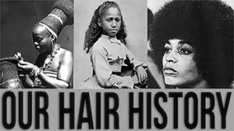
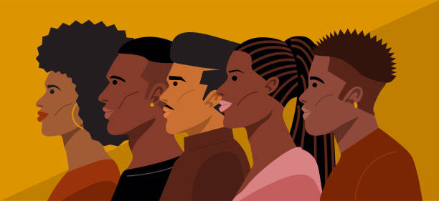
What is culture?
Culture is the social “norms” of a given group
A group that share common beliefs and practices, and languages.

Slide 3
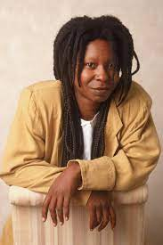
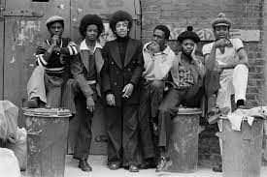
Culture behind Hair
- Hair has always been a very important staple growing up as a black woman.
- I was always told “don’t let people touch your hair” because of how sacred and magical it was made to be. Back then it was your identity.
- In African societies, hair could identify your age, religion, and even your wealth!
- Spiritually, it was believed that braided hair could send messages to the Gods. This was seen in Yoruba cultures.
- When we were captured and enslaved, the first ting the white men did was shave off everyone’s hair.
- With hair being a way to have identity in these African cultures, it was as if their identity was being stripped away from them.

Slide 4
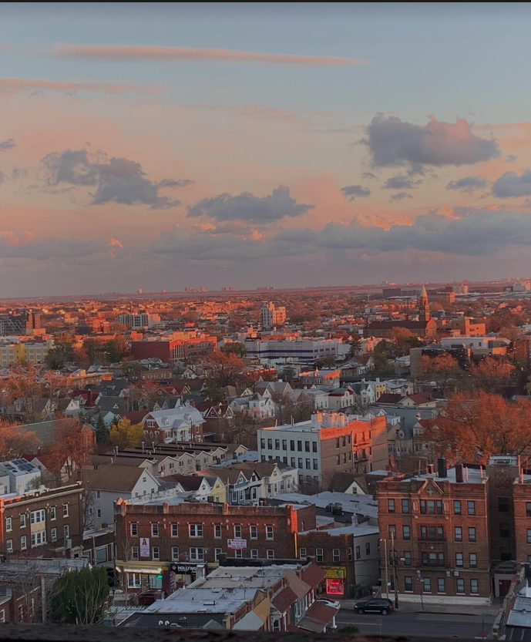
Growing up/ Family/ Where I come from
- I grew up in Brooklyn, New York. East New York. I live in a Spanish/ Black community. Sports are heavily participated in my neighborhood. Since birth I've been surrounded by African American culture, learning and being included into my Carribean friend's cultures.

Slide 5
My Cross Cultural experience
I haven't had "shocks," but I've learned about how different my family celebrates events vs. How my Carribean friends celebrate. Their parties are very welcoming, and it's very fun and vibrant. The dancing is also different from any other party. I've also been introduced to different holidays like Labor day.

Slide 6
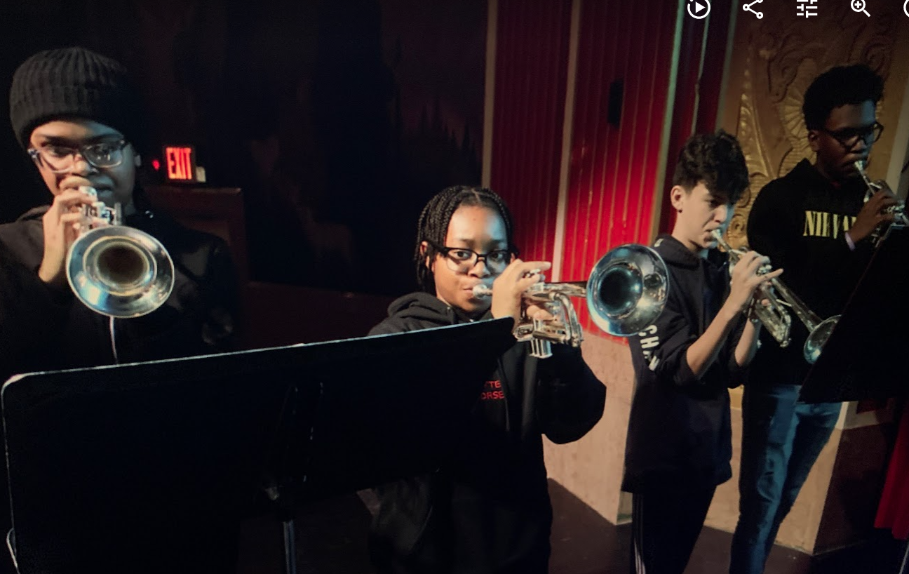
Music
- Growing up my heritage was based around music, but most importantly learning about the origin of the music that's played day by day. I was surrounded by gospel and jazz music, learning the importance of having different emotional outlets.

Slide 7
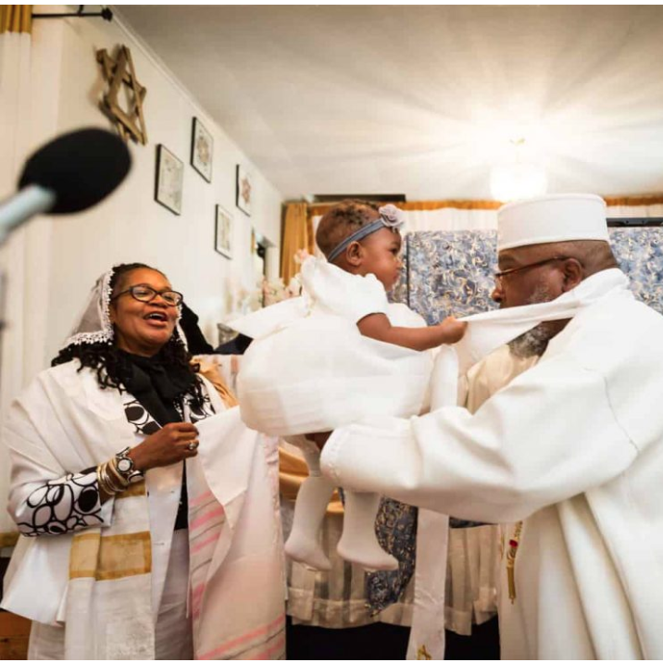
Religion
When I was a baby, I went through a ceremony called "Christening" where I was made a member of the church. Growing up my life was predominantly school and church because getting an education and God were the top two priorities that my parents made sure I had at a young age.

Slide 8
Food/Celebrations
Mainly growing up, we celebrated thanksgiving, Christmas, and the 4th of July. Being Christian we made sure to include God in being thankful for what we have, and celebrating his birth during Christmas time. For the fourth of July we gather around ad mostly celebrate having family.
Food that is traditional in my family is soul food. We eat dishes like Collared greens, mac and cheese, candied yam, etc. We ate this because of my grandmothers heavy southern influence in my family.

Slide 9
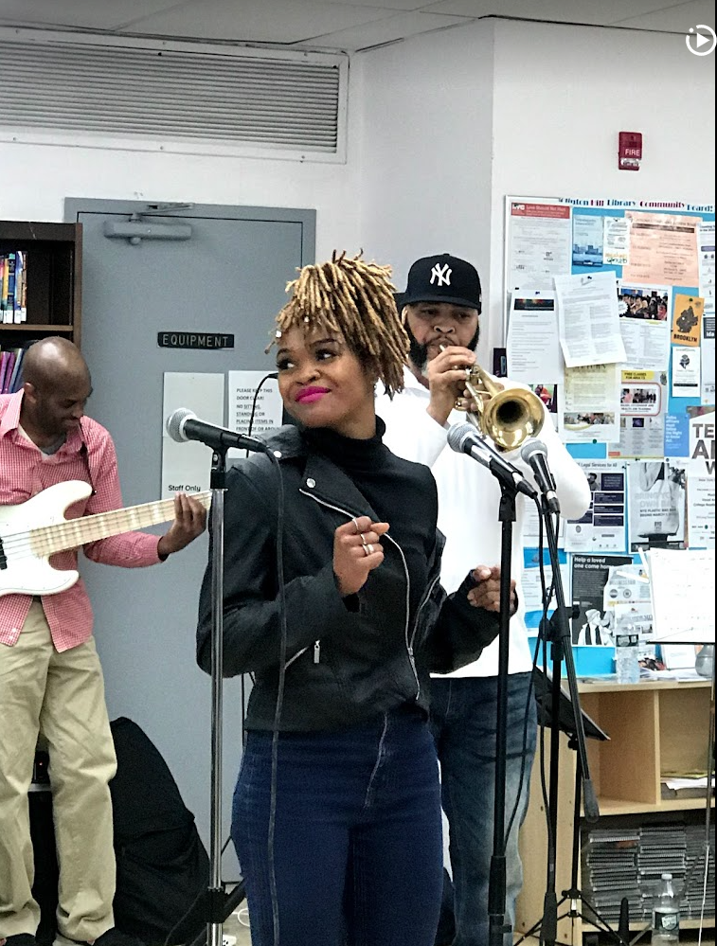
Participating in the Arts
Because of learning about the importance music has in my life, I naturally drifted towards participating in the arts. My family either plays an instrument, sings or acts. We also use music to bond.

Slide 10
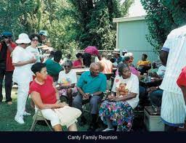
Travels
I have gotten more in touch with my culture when I would visit my family in North Carolina.
Because I grew up mostly around my grandmother, I have picked up a lot of southern mannerisms and characteristics from her.
When I was younger my slang was very southern, because of the time spent around my grandmother.
I was always willing to try different southern cuisine that my grandmother made like chitterlings (Pig intestine) or chicken liver.

Slide 11
Summary
My culture is everywhere! I've met friends that share similar southern experiences and see trends in cuisine in other cultures that I've been around, I have realized that I'm not as in touch with my culture as I used to be, I would like to expand my knowledge on it.

Slide 12
References
https://odelebeauty.com/blogs/the-rinse/black-hair-history-facts

