Slide 1
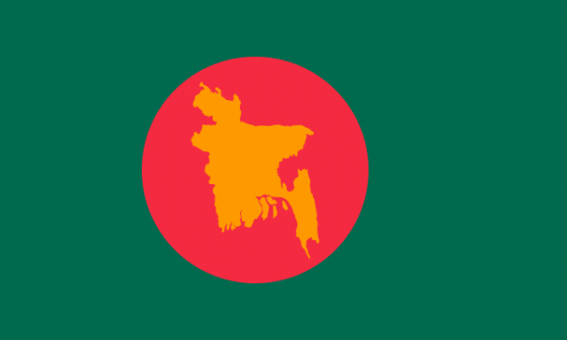
Cross Cultural Experiences as an American Bengali
Cross Cultural Experience in Bangladesh and in New York City
By Mohammed Haque CLDV 100 03/25/2024 Spring 2024

Slide 2
The Country and Language
Bangladesh is in East Asia.
Was formed in 1971 after gaining independence from Pakistan.
Was known as East Pakistan before 1971.
Independence war occurred because of language. Bangladesh did not want to give up their language Bengali. War lasted for 9 months. Our language is very important to us
Primary language is Bengali, although there are many different dialects depending on which part you live in
Bengali is known to be one of the sweetest sounding languages in the world
The capital is called Dhaka city also where my mother grew up.
Estimated 90% of the population is affiliated with the religion of Islam.

Slide 3
My First Time in Bangladesh
I went to Bangladesh twice in my life once when I was a baby around 1999 and another time was more recent in 2010.
I visited all around Bangladesh including my mother’s hometown and my fathers. They were in Dhaka and Tangail respectively.
It was a very different experience than in New York. It wasn’t no where near as culturally diverse, the roads were different, traffic was abhorrent, animals roaming the street. It was extremely crowded.
People were very nice to me because I came from America.
Food was amazing and some places I visited were very beautiful.
The plane ride was abysmal totaling 18 hours to get there and unfortunately there is no one way flight so we had to take 2 planes to get there.

Slide 4
Pictures of Bangladesh
Dhaka City
Tangail
A bustling city crowded with people
Similar to NYC however Dhaka is more disorganized with extreme traffic and over population
Tangail is nothing like the city where most of the area is just covered in lush jungle

Slide 5
Islam
Islam is the main religion of Bangladesh with an estimated 90% of the population. The remaining 10% consists of Hinduism, Buddhism, and Christianity.
We believe in one god, Allah (swt), and believe in the prophet Muhammad (pbuh)
Praying 5 times everyday is required
We fast once a month every year for the month of Ramadan.
Dressing modestly is required in Islam
We can only consume halal food
Drugs including alcohol, gambling, lying, cheating, interest are all not permissible in Islam. Also known as haram.

Slide 6
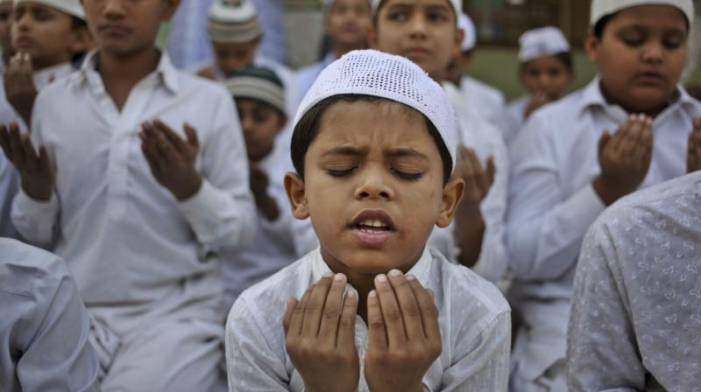
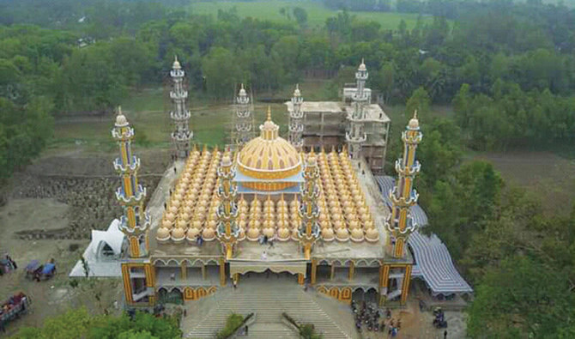
Pictures Of Islam in Bangladesh
Islam is very powerful in Bangladesh. Most Bengalis are Muslim, and our Culture heavily derives from it.
A Bengali boy and many others praying making dua to our God
A beautiful masjid in Bangladesh surrounding by vivid greenery

Slide 7
Bangladeshi Food
Rice is the most eaten dish in Bangladesh and is eaten with just about everything.
Fish is very popular being the most consumed meat in this country.
Popular snacks include, samosa, shingara, dhal puri, and fuchka.
Some popular street food are jhal muri, chai, and sugarcane juice.
Curry is very popular here and is often eaten with rice and/or roti
Plain white rice, fried rice, pulao, and biriyani are some ways rice are prepared.

Slide 8
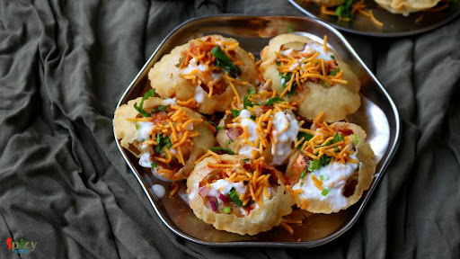
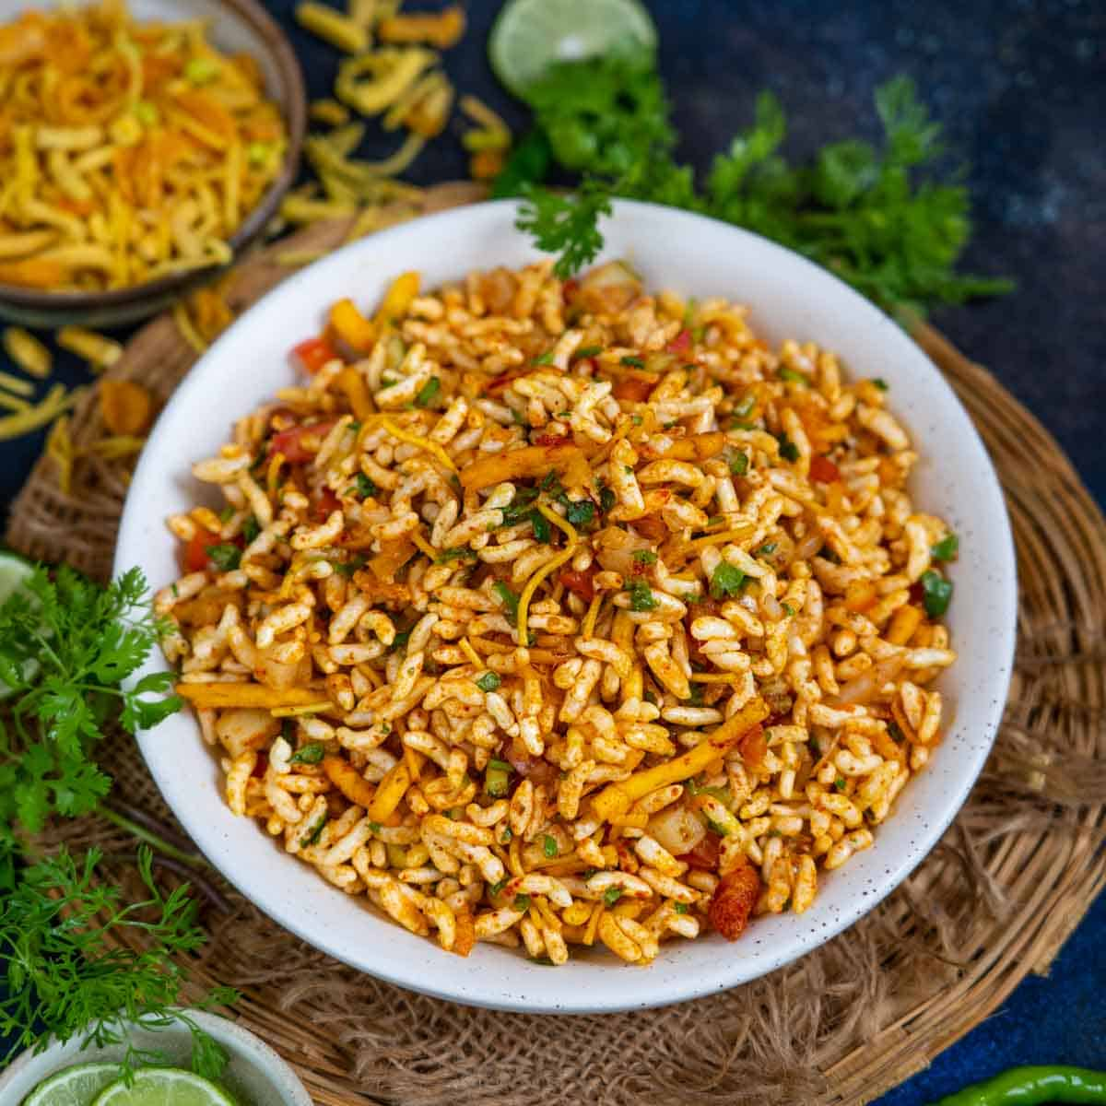
Pictures of Food of Bangladesh
Dhal Puri
Made with lentils fried with a soft dough
Fuchka
Fried crackers with chickpeas, cilantro, tamarind sauce and peas
Jhal Muri
Puffed rice with tomatoes, cucumbers, salt, China chur which is many fried chips with peanuts

Slide 9
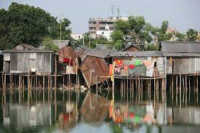
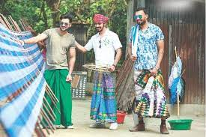
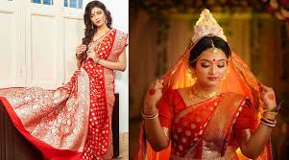
My Culture and Norms
Bangladesh’s culture is heavily influenced by religion.
Houses were made up of tin especially in poorer areas and are elevated from water where people tend to live nearby.
Rickshaws are the primary way of travel since it so overcrowded.
Traditionally women wear sarees, and the men wear lungis.
In my culture you can’t speak to your elders disrespectfully and must be addressed accordingly.
People are respected by their position in power and age.
People dress modestly for the most part not revealing skin usually.
Usually we do not use utensils, instead we use our hands to eat, specifically the right hand.
Arranged marriages is common.
Can marry up to 4 wives although its mostly frowned upon.
Staring openly at someone is not considered impolite.
Eye contact means sincerity.

Slide 10
New York City
I was born here in Jamaica, NY.
Grew up seeing so many cultures and races I lost count.
I made many friends here with races such as Trinidadian, Guyanese, Indian, African, Italian, Japanese, Chinese only to name a few.
Main language is English although my parents taught me Bengali from the day, I was born making me bilingual.
Grew up in a culturally diverse area.
Visited many cultural areas such as little Guyana, Chinatown, and even little Bangladesh which is in Jackson heights. Food and people reminded me a lot of Bangladesh.
Able to wear anything without any judgement.

Slide 11
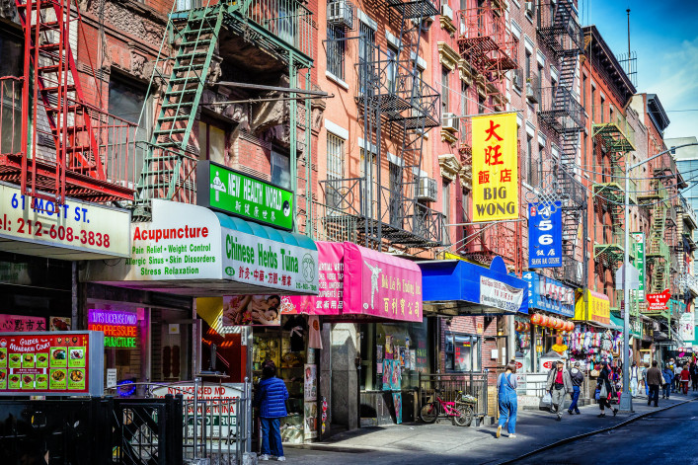
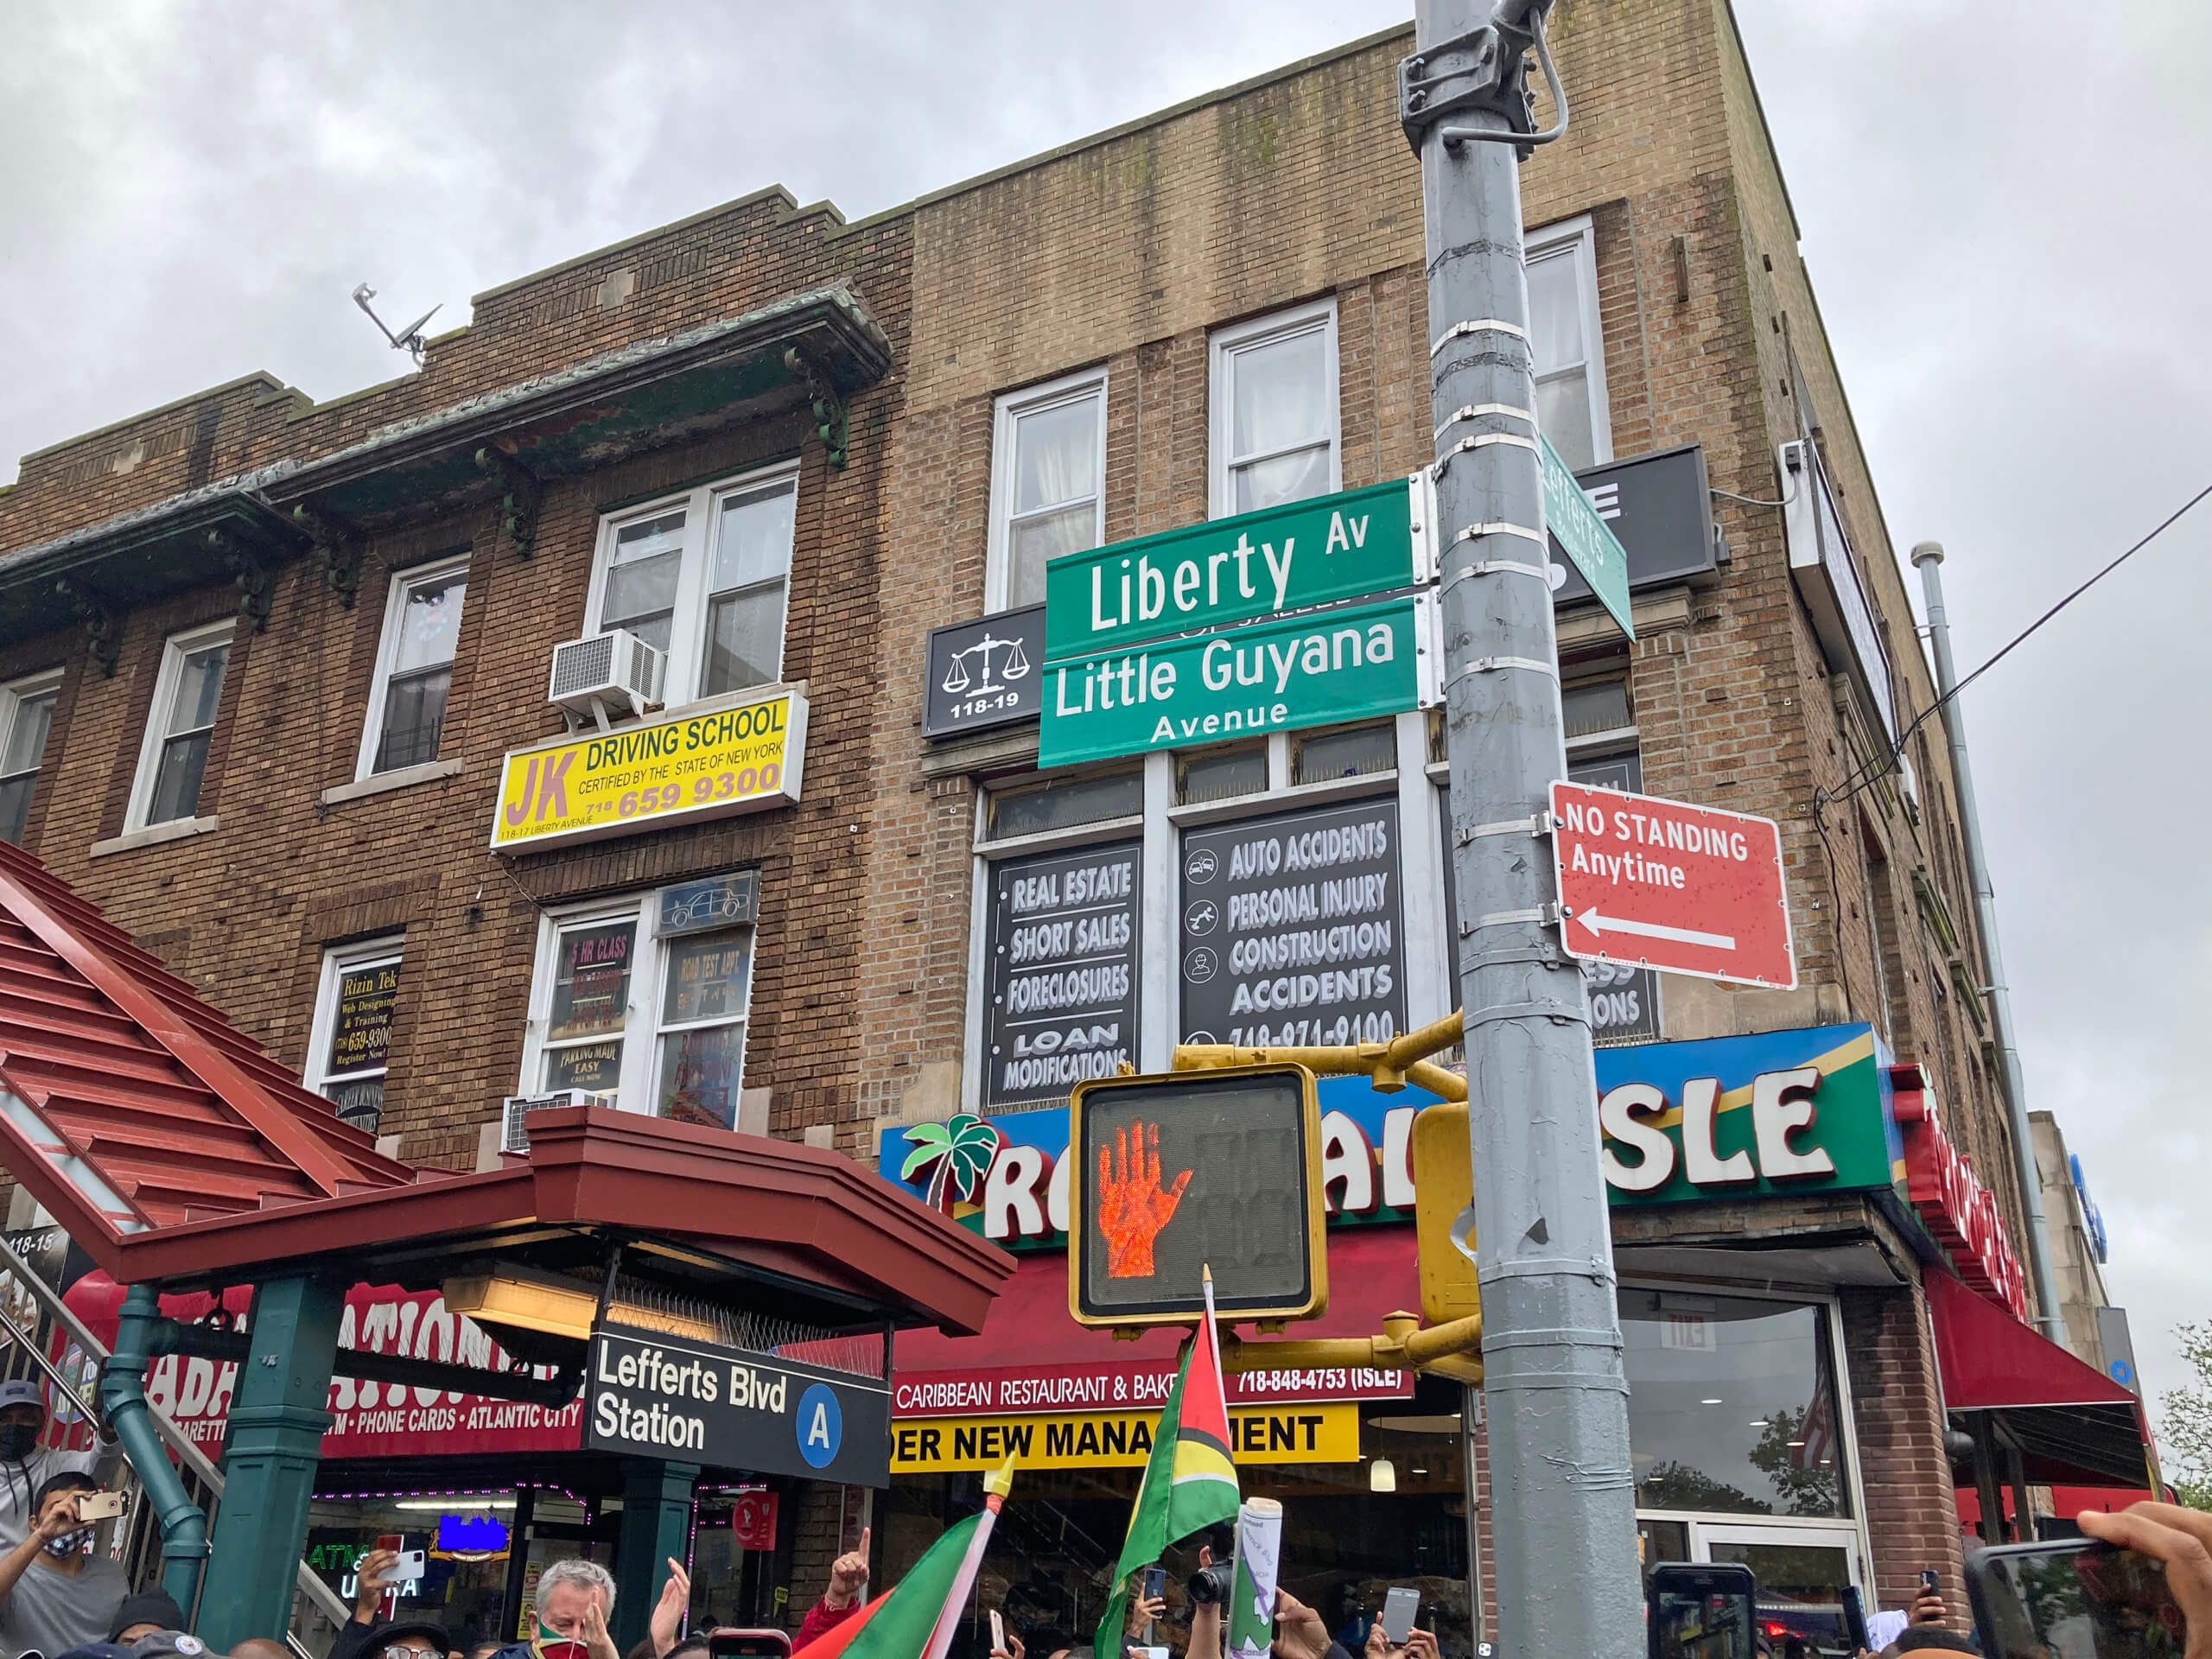
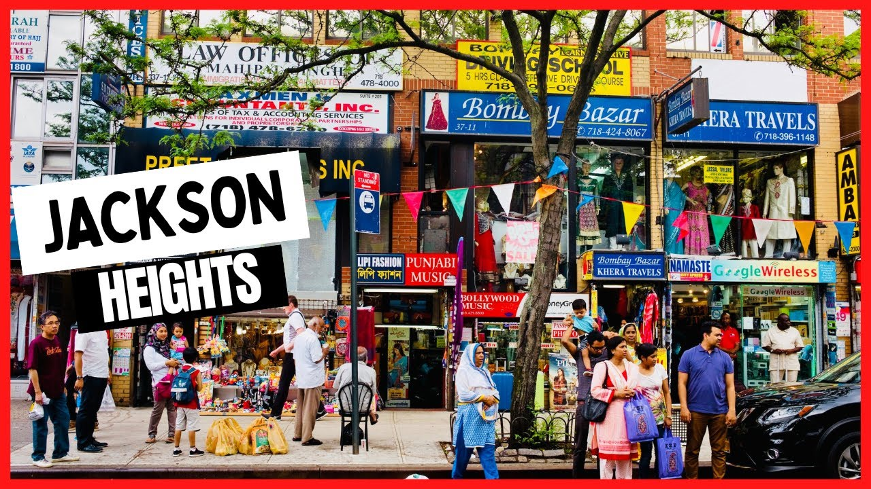
Pictures of places in NYC representing Cultural Diversity
Chintatown in NYC
My family comes here to do a lot of shopping
Little Guyana located near where I live
Gives a good idea of Guyana’s culture
Little Bangladesh located in Jackson Heights
Makes my family feel like home with familiar food, people, and store fronts

Slide 12
Bangladesh Vs. New York City
Experiences in Bangladesh
Experiences in New York City
Must dress appropriately and the woman can’t show skin.
Not culturally diverse, most people I encountered were from the country
People think of me as a king because I came from America.
People tend to judge you more often and more openly including strangers.
People tend to not engage in people of the opposite sex unless they a valid relationship such as husband and wife.
Religion is taken very seriously there, and prayer is a must.
People tend to stare which is considered not to be impolite
You can dress however you want here with no limitations due to gender or age.
One of the most culturally diverse places in the world.
I'm treated very normal here with no crazy expectations.
People tend to mind their own business.
You can engage with anyone here without any repercussions.
Religion is not taken seriously here although I personally still take it seriously.
Staring is impolite.

Slide 13
Clothing Comparison of Bangladesh and NYC
Bangladesh
New York City
Bengali women tend to cover themselves out in public or when there are guests in the house
Women in NYC have more freedom and can wear anything they want whenever or wherever they please.

Slide 14
My Parents Immigration Story
My mother and father got married in 1992.
My father came to the U.S first in 1993. Although 6 months prior he was in Korea for some work.
My mother came to the U.S 2 years later at around 1995.
I was born on May 24th, 1997, and my mother and father got their citizenship around 2000.
When my father first came here finding work was very hard and even though he had a B.A in business, it was not creditable here in the states. So, his first job was a Sower.
My mother also had to work to make ends meet so she worked at a nearby Dunkin donuts.
Even with both working, it was hard to make ends meet barely being able to pay the rent.
Eventually my parents had 2 more children my brother and sister
We were all living in a studio apartment.
Even though times were tough, they were still very hopeful in the future
That hope eventually blossomed and my mother got a job in the city and my father became a taxi driver.
They both worked very hard and managed to get a house they can call their own.
And to this day we still live in this house as a happy family.

Slide 15
Conclusion
Bangladesh is a beautiful country very different from America.
Norms in Bangladesh are not the same as the norms in America.
Bangladesh culture is heavily influenced by Islam.
I was fortuitous enough to be born in America where society is much freer.
I am grateful my parents worked very hard and came to this country for better work opportunities.
As a 1st generation man in America, I have the responsibility for the well being of my family. The ordeals of my parents is a remainder of how I need to work very hard to make sure they are happy which means I am happy.
NYC and Bangladesh are very different culturally.
Bangladesh may not be so culturally diverse however experiencing the culture allowed me to have new perspectives on how people embrace their culture through clothing, etiquette, food, religion, etc.

Slide 16
References
https://www.britannica.com/place/Bangladesh
https://nijhoom.com/top-bangladeshi-food/#:~:text=Rice%20is%20the%20main%20Bangladeshi,from%20rice%20and%20cow%20milk.
https://www.bangladesh.com/culture/
https://culturalatlas.sbs.com.au/bangladeshi-culture/bangladeshi-culture-religion

Slide 17
Thank You The End

