Slide 1
Cross Cultural experience visiting Dublin Ireland
Matthew Trepeta
CLDV 100
Professor Alapo
11/10/22

Slide 2
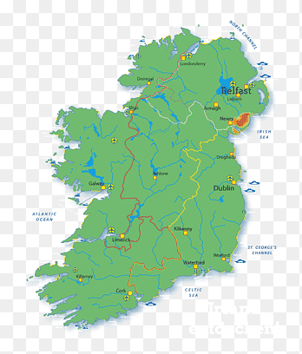
Notes:
Dublin is a culturally significant city that challenged me to be more diverse in my views. I found the city to be very welcoming and the people to be very friendly. I was also able to learn a lot about the history and culture of the city. Dublin, Ireland is a city rich in culture and history. From its ancient castles to its vibrant nightlife, Dublin has something to offer everyone. I was challenged culturally while I was visiting Dublin, as I had to be open-minded and accepting of new things. I was also able to learn about different cultures and how they interact with each other. This was a great experience for me, as it helped me to be more open-minded and understanding of others.

Slide 3
Culture
One of the most significant aspects of culture that I experienced was the importance of family and community (Jones et al., 2019).
I was constantly surrounded by large groups of people who were all incredibly welcoming and supportive.
This sense of community was really inspiring and it made me feel very connected to the people and the place.
I also gained a better understanding of the Irish language and culture through my interactions with locals.
Notes:
Visiting Dublin helped me know my culture from the west and how it differs from Dublin Culture. I was able to learn about the culture and the people, and I was also able to learn about myself. I was able to grow and develop as a person, and I was able to understand my own values and beliefs. I was also able to understand the importance of respecting other cultures and customs.

Slide 4
Food is a central part of Irish culture and is often used as a way to connect with others and create bonds. I was able to interact with the Irish stew Irish stew is a hearty and filling meal that is perfect for a cold winter day. The stew is made with a variety of meats, including beef, lamb, and pork, as well as potatoes, carrots, and onions. The food in the region interacted with my values of enjoying good food and I partook in the meals and got to know the culture in-depth
Notes:
Interacting with Dubliners in a travel experience was an in-depth of understanding to intercultural growth and development especially their food. I was able to learn about the different foods that they ate and how they prepared them.
I also learned about their culture and how they interacted with each other while eating and communing. I found that they were very friendly and hospitable. I also learned that they had a strong sense of community and responsibility to everyone on the table.

Slide 5
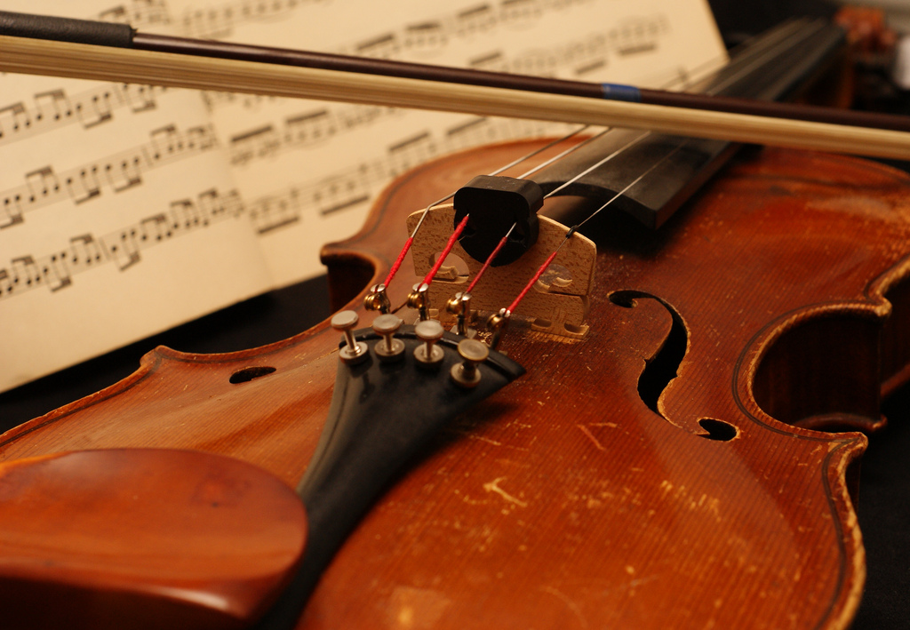
When traveling to Dublin, Ireland, I was able to learn about their music and how it is good for cultural diversity.
The fiddle is a great instrument for cultural diversity because it is so versatile.
It can be played in many different styles of music and is also very popular
I was able to learn about their music culture and how they use music to interact with their community.
I also learned about how their music is good for intercultural growth and development.
I was able to learn about how their music helps to bring people together and how it is good for cultural diversity.
Notes:
I was able to see how music is such an important part of their culture when I attended a traditional Irish music session.
The music was lively and upbeat, and everyone in the room was dancing and having a great time. I was also able to see how music is used as a way to connect with others. I was struck by the fact that everyone in the room knew the words to the songs, even though they were in a different language. This showed me how music can be a universal language that can connect people from all walks of life.

Slide 6
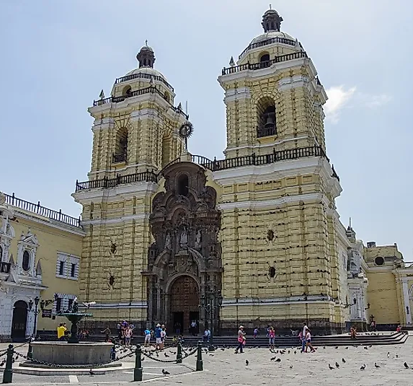
Religion
The dominant church in Dublin is the Catholic Church, and I was interested to learn more about this faith.
I was impressed by the level of religious diversity in the city, and the way that the Catholic Church encouraged cultural diversity.
I felt very welcome in the city, and I was able to learn a lot about the Irish culture.
Notes:
In my experience, interacting with Dubliners was an in-depth look into the Irish culture and how their religion plays a significant role in their everyday lives. I was able to learn about their customs, beliefs, and values, which I found to be very interesting and eye-opening. I also found that the Irish people are very welcoming and hospitable, which made my experience all the more enjoyable. One of the most significant aspects of the Irish religion that I learned about is their belief in reincarnation. This belief encourages cultural diversity because it teaches that everyone has the opportunity to come back and experience life in a different form. I found this to be a very inspiring and uplifting message.

Slide 7
Clothings and culture
I felt like the clothing really encouraged cultural diversity. I saw people from all different backgrounds and cultures wearing traditional Irish clothing.
It was a great experience, and I would definitely recommend it to anyone looking for an in-depth understanding of intercultural growth and development.
Notes:
Interacting with the people of Dublin, Ireland was an in-depth experience of understanding intercultural growth and development. Their clothing was significant in encouraging cultural diversity in me. The colors and patterns of their clothing were so vibrant and beautiful. It was a great experience to be able to see and learn about the different aspects of their culture.

Slide 8
Family and intercultural integration
One of the things that I found most interesting was the family structure.
I was able to learn about the different roles that each member of the family plays and how they work together to support each other.
Notes:
I had the opportunity to travel to Dublin, Ireland and it was an amazing experience.
I was able to learn so much about the culture and the people.
This was a great experience for me because it showed me the importance of family and how they can help you grow and develop as a person. I also found the Dubliners to be very friendly and welcoming. They were always willing to help me with anything I needed and made me feel like I was part of their family. This experience was a great opportunity for me to learn about other cultures and to grow as a person.

Slide 9
Recreational Activities
I was struck by the diversity of the people I saw in Dublin.
I saw people of all ages, races, and ethnicities. I also noticed that there were a lot of international students in the city.
Interaction is a great opportunity to learn about other cultures and to practice my language skills (Zhang & Zhou, 2019).
Notes:
I was struck by the number of people out and about in Dublin on a Sunday afternoon. While in the U.S. many stores and businesses are closed on Sundays, in Dublin many were open and busy. I also noticed that people were dressed more formally than I was used to seeing in the U.S. on a weekend. I had the opportunity to visit a few of the city's parks, including Phoenix Park, which is one of the largest urban parks in Europe. I was impressed by the size of the park and the number of people using it for recreation on a Sunday afternoon. I saw people of all ages playing games, walking and running, and picnicking. I also noticed that the park was very well-maintained.

Slide 10
The People
Dublin is riddled with friendly individual who speak different from everyone,I was also able to understand the importance of respecting other cultures and customs.
I was able to learn about the importance of open-mindedness, and I was also able to learn about the importance of tolerance.
I was able to learn about the importance of understanding, and I was also able to learn about the importance of communication.
Intercultural understanding can be enhanced by learning about the history and traditions of a population (Zhang & Zhou, 2019).
Notes:
As such, intercultural understanding can be fostered by simply engaging with Irish people in conversation and sharing one's own culture with them. Additionally, it can be helpful to learn about Irish culture and customs before visiting, as this will make it easier to connect with people and understand their way of life.

Slide 11
References
References
Jones, C. T., Welfare, L. E., Melchior, S., & Cash, R. M. (2019). Broaching as a strategy for intercultural understanding in clinical supervision. The Clinical Supervisor, 38(1), 1–16. https://doi.org/10.1080/07325223.2018.1560384
Zhang, X., & Zhou, M. (2019). Interventions to promote learners’ intercultural competence: A meta-analysis. International Journal of Intercultural Relations, 71, 31–47. https://doi.org/10.1016/j.ijintrel.2019.04.006

