Slide 1
Cultural Assimilation of Bangladeshi Students in America: social, economic and political factors
By Mohd. Rafinur Rahman Lamim
B

Slide 2
Table of contents
Definition
Statistics
Reasons
Challenges
Strategies
Benefits
My Experience
Conclusion

Slide 3
What is cultural assimilation?
Cultural assimilation is a process by which individuals or groups from one cultural background adopt the customs, norms, language, and behaviors of another cultural group.
Cultural assimilation can occur voluntarily as individuals seek to adapt to a new environment or society, or it can be enforced through various social, political, or economic mechanisms.
Cultural assimilation can also be a contentious issue, as it may involve the loss or suppression of one's original cultural identity, language, traditions, and values.

Slide 4
Bangladeshi students in USA

Slide 5
Over 13,000 Bangladeshis currently studying in the US
The number of Bangladeshi students studying in the United States is at an all-time high.
The current number of Bangladeshi students in the United States represents a 28% increase from the previous academic year (2021-2022)

Slide 6
The top reasons Bangladeshi students choose the us to pursue their higher education
Quality of Education
Diverse Academic Programs
Research Opportunities
Networking and Career Opportunities
Quality of Life

Slide 7
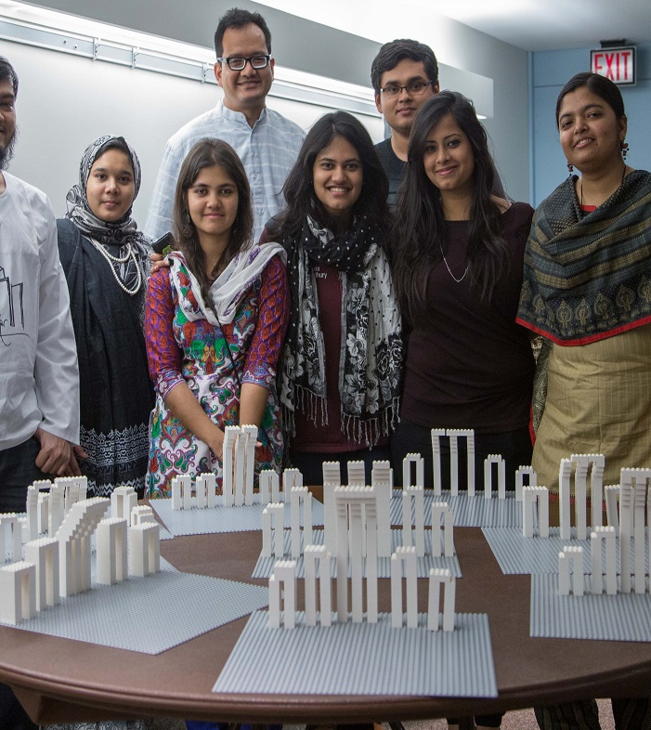
Challenges of cultural assimilation
Language barriers
Cultural differences
Cultural shock
Adapting to fast paced lifestyle

Slide 8
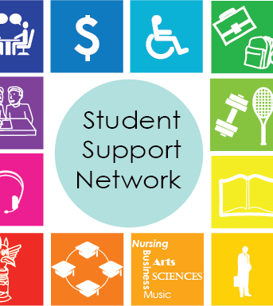
Strategies to overcome them
Engaging in cultural exchange programs, student organizations and extracurricular activities
Seeking support from international student services, academic advisors and counseling centers
Language acquisition also plays a crucial role
This Photo by Unknown author is licensed under CC BY-SA.

Slide 9
Benefits of Cultural assimilation
Academic achievements
Cross-cultural competencies
Global perspectives
Interpersonal skills

Slide 10
My personal experience
Transferring to New York City
Harsh weather
Commute
English proficiency course
Getting in York College

Slide 11
Conclusion
Cultural assimilation of Bangladeshi students in the United States is a complex process marked by difficulties, adaptation, and enrichment. We can overcome the initial obstacles and cultural shock by being resilient, persistent, and open to trying new things in order to successfully overcome the challenges of cultural adjustment. We can achieve the American dream and education through participating in cross-cultural exchange, developing language skills, and upholding cultural pride.

Slide 12
Thank you

