Slide 1
CLDV 100
Tanveer Siddiqui

Slide 2
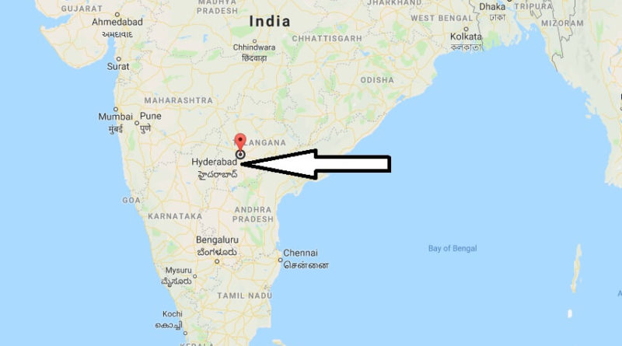
About me
My name is Tanveer Siddiqui. I am junior in york college and I am majoring computer science. I was born in India, I moved to United states of America in 2011 with my family.

Slide 3
Why coming to America?
I left all my friends and relatives behind when coming here. I came to America for a better life purpose and a better education. Schools in India were expensive and you have to pay to go the school in the India.
For more opportunities.

Slide 4
Week 1
In the first week I got to know some people and why they are taking this course.
Got to know what they are looking forward to learn in this class
I also got to know what cultural diversity is.

Slide 5
Week 2
I've made a video about our artifact.
My artifact was about my prayer mat.
I got to know so many new things about people artifact and why and how is very important to them. How do does it affect them.
Also talk about my culture experiences

Slide 6
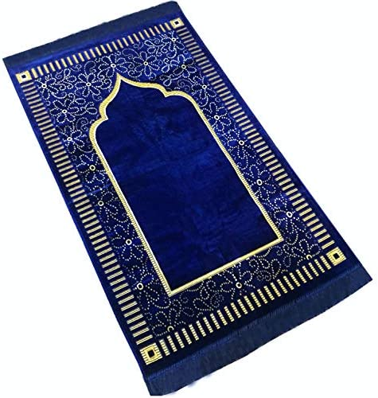
My artifact
This is a prayer rug, I use this daily in my life and A lot of a muslim people use the rug to pray. Even though we have a carpet at our home but as a muslim we are supposed to pray at a very clean place and that is why we mainly use our praying rug.

Slide 7
Week 3
I got to learn more about cultures.
similarities and differences between about culture
One of the biggest similarities is how almost every culture gathers up for their events.
One of the biggest difference is that how the holidays are celebrated and the food.
We also shared traveling experience to talk about how it might showed the other culture expertise.

Slide 8
Festivals
In a muslim culture there a 2 big holidays.
Eid and ramadan.
Ramadan latest for a month and in that whole month we have to fast. From sunrise to to sunset.
In this both special holidays the kids gets money from the realities and the whole family gathers together and celebrate.
Growing up in my family taught me that ramadan is a very hoy month and we should take it very serious
We believe that Ramadan teaches us to practice self-discipline, self-control, sacrifice, and empathy for those who are less fortunate, thus encouraging actions of generosity and compulsory charity.

Slide 9
Week 4
I got to learn about Norms, values and socialization.
Norms are rules where you might follow your beliefs. Values are basically principles that help you to decide what is right and wrong
Socialization is learning about society and culture.
Socialization is important because it help you to communicate with different races

Slide 10
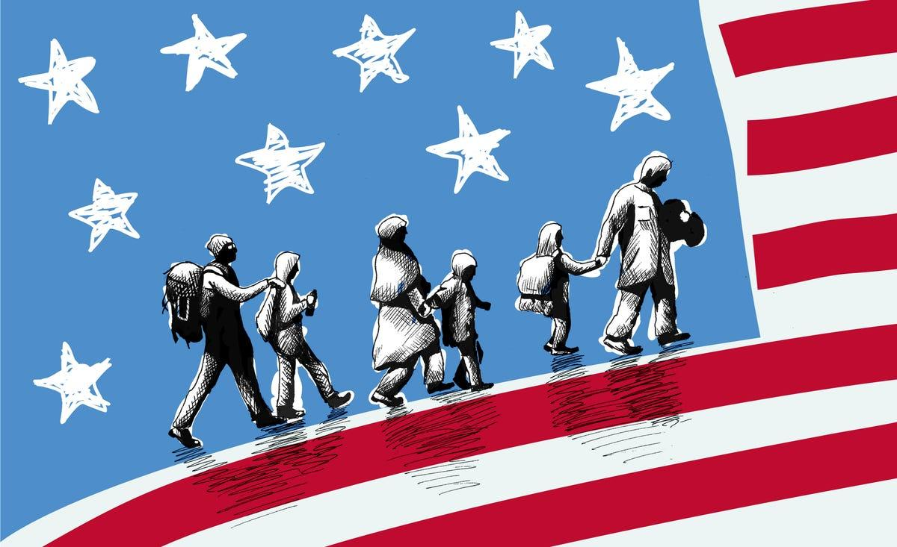
Week 5
In the week 5 I got to express myself about why I came to the USA.
I chose the first picture because when I came to America I was an immigrant and The second shows how I left everything back in my country, I have never been back to my country and I miss every memory of it. Third picture talks about the main reason why we came here is because of the education.

Slide 11
Week 6
In the week 6 I got to talk to my parents about their parents. I got to know more history about my grandparents.
my parents and grandparents had a little different life. My grandparents didn't really have the money for the education and you have to pay to go to school. As my parents they both graduated from college. My great father is from turkish and my grandmother is Indian.

Slide 12
Week 7
In the week 7 we discuss what is the difference between race and ethnicity?
Race defined as a group sharing outward physical characteris and commonalities of culture and history.
Ethnicity refers to a social group that has a common national.

Slide 13
Week 8
In the week 8 we talk about why does racial and ethnic inequalities exist?
I think it's mostly comes from the past which has moved from generation.
Not having the equal access to anything that will benefit them lack of opportunities to them is huge disadvantage.

Slide 14
Overall
I am learning a lot of new stuff in this class about different cultures and also learning more my culture history. There was so many similarities between so many cultures that I learned and I never knew about it. I am getting close to my goal where I wanted to explore more about different cultures.

