Slide 1
My Cross cultural experience
Aissatou Sidibe
CLDV 100
Midterm 2022​

Slide 2
Backround
I'm 19 years old​
I was born in the U.S but my family is from Cote'd ivoire
​I am Muslim
My major is psychology

Slide 3
Cote d'ivoire info
Located in West Africa
They were colonized by the French
Lower-middle economy
They speak french
Surrounded by water so main food is fish
They regained independence from France in 1960
Capitol is yamoussoukoro
Climate is very humid
This Photo by Unknown author is licensed under CC BY-NC.

Slide 4
This Photo by Unknown author is licensed under CC BY-SA.

Slide 5
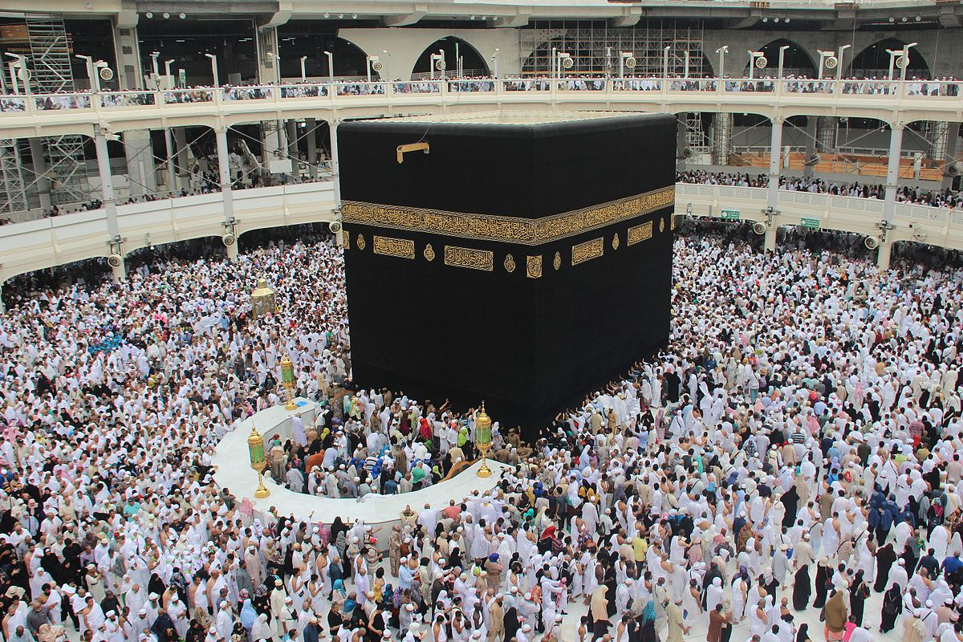
Most of the population's religion is Islam and is 42.5 percent of the population
Christianity makes up 39.8 percent of the population
We pray five time a day towards the kaaba in meeca.
Ramadan is a holy month to us, where we receive blessings for fasting from sun up to sun down.
This Photo by Unknown author is licensed under CC BY-SA-NC.

Slide 6
This Photo by Unknown author is licensed under CC BY.
This Photo by Unknown author is licensed under CC BY-NC-ND.

Slide 7
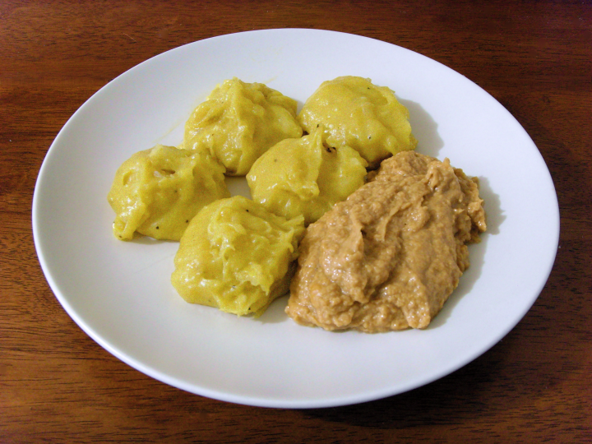
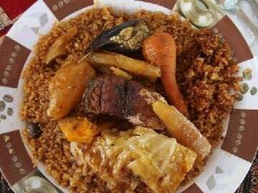
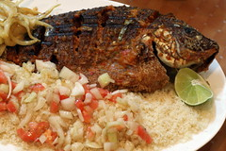
This Photo by Unknown author is licensed under CC BY-SA-NC.
This Photo by Unknown author is licensed under CC BY-NC-ND.
This Photo by Unknown author is licensed under CC BY-NC.

Slide 8
HOW this relates to my topic
MY midterm ppt slides relate to my topic because I talk about my African culture and my topic is on immigrants. There are many immigrants who come from Africa and are discriminated against because of how they look and what they sound like and what they speak.

Slide 9
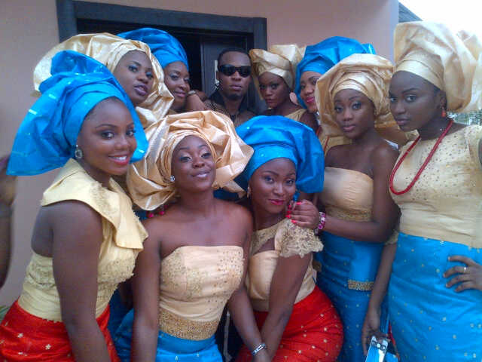
This Photo by Unknown author is licensed under CC BY-NC-ND.

Slide 10
Summary
Overall, my cross cultural experiences have taught me a lot about the world and others because I was born in the U>S, I feel as though you don’t see much of culture here.
IT was interesting to go to my home country and learn about their traditions and how much different it is from the U.S

Slide 11
THANK YOU
Aissatou Sidibe
CLDV 100
Midterm ppt

