Slide 1
Ghana Vs The United States My Cross-Culture Experience
Adrian Owusu
CDLV 100
Professor Remi Alapo

Slide 2
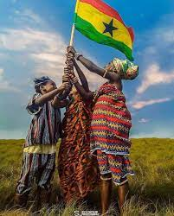
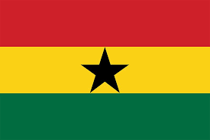
The Flag of Ghana
The flag of Ghana has the colors Red, Gold, and Green. It also has a black star in the middle of the flag
Red represents the blood shed for those who have died during the fight for independence
Gold represents the mineral wealth that the country has had for many years
Green represents the rich forests in the country
The black star in the middle of the flag represents a symbol of freedom. Of the people of Ghana

Slide 3
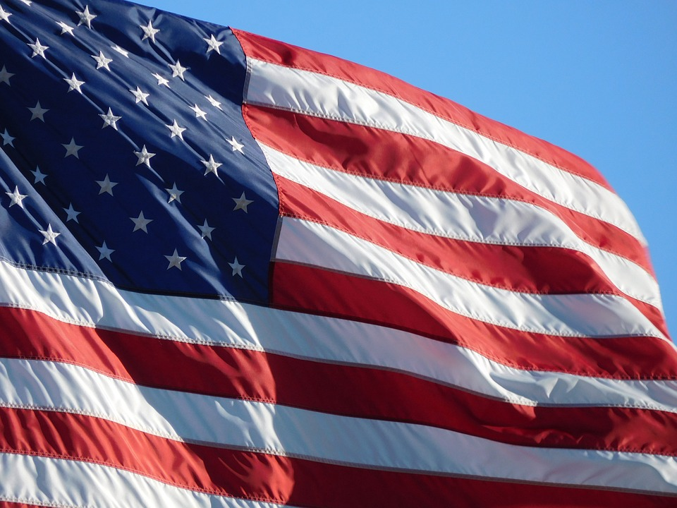
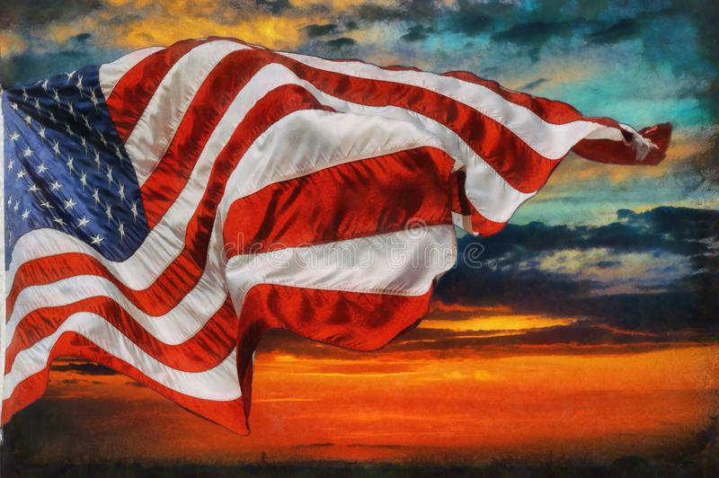
Flag of The United States
The 13 stripes represent the original 13 colonies.
The 50 stars represent all 50 states.
Red represents bravery
Blue represents Justice
White represents purity

Slide 4
Religions In Ghana
In Ghana there are several religions that are practice
Most of the population in Ghana is Christian.
There are other Ghanaians that are Muslim, Roman Catholic, Protestant, and other religions.
Most of the Religions that are practiced in Ghana are practiced in the United States.

Slide 5
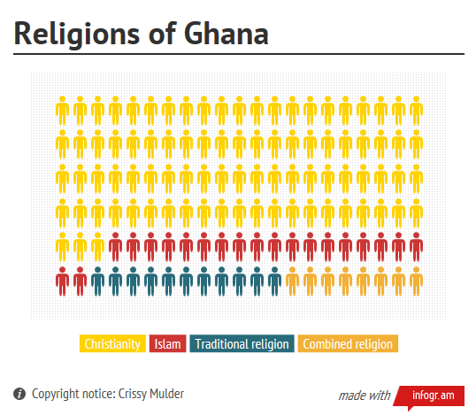

Slide 6
Religions In the United States
Like Ghana, Christianity is the main religion practiced in the United States
But there is a large percentage of people in the U.S that don’t follow or practice a religion.
The rest of the population who are not Christian but do believe in a religion are Muslim, Jewish, Hindu, and Buddhist.

Slide 7
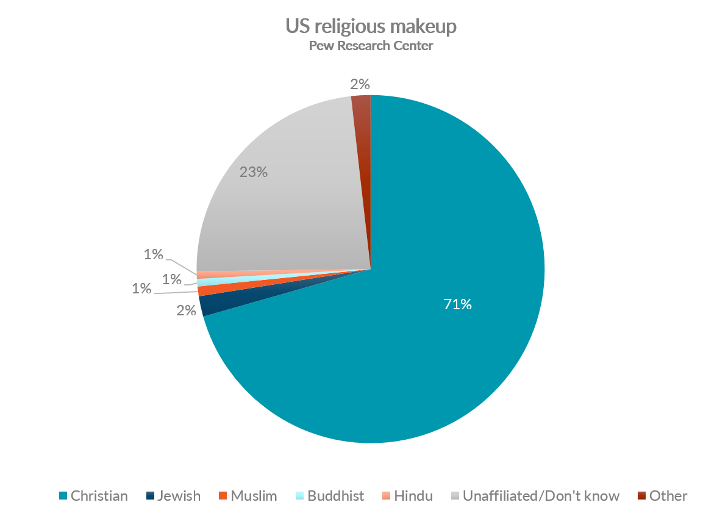

Slide 8
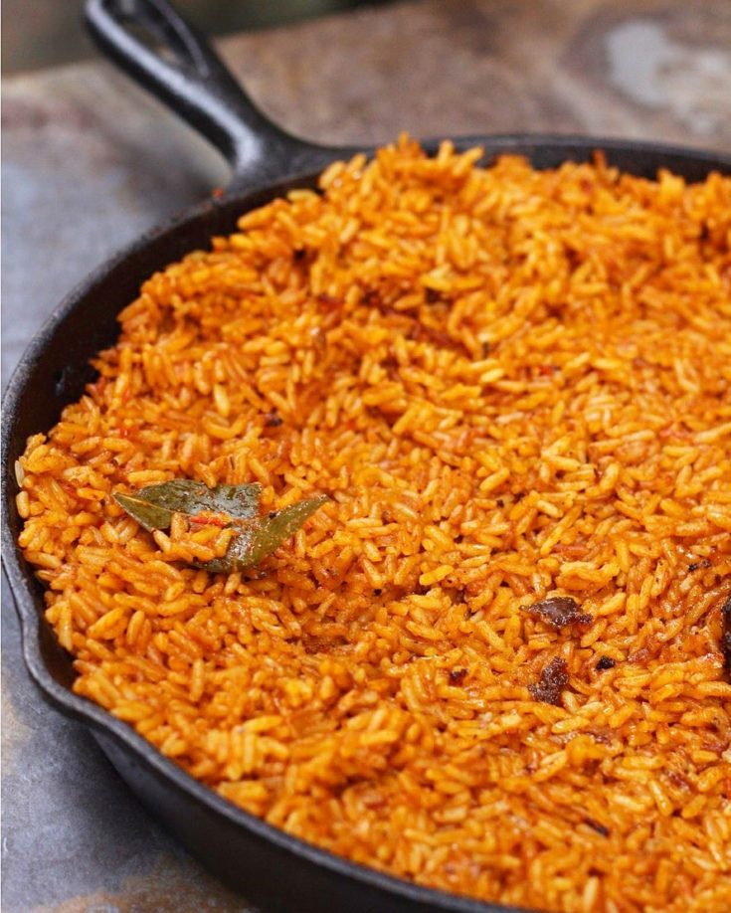
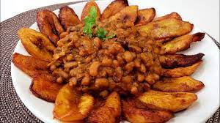
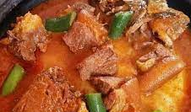
Ghanian Food
Types of Ghanian
Jollof Rice
Fried Plantains with Bean stew
Fufu
Yams with Spinach Stew
Rice with Chicken Stew

Slide 9
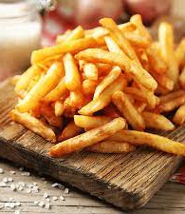
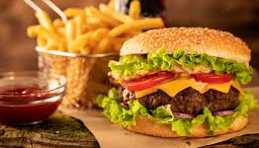
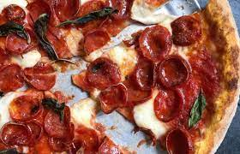
American Foods
Types of American Foods
Burgers
Fries
Hotdogs
Apple Pie
Grilled Cheese

Slide 10
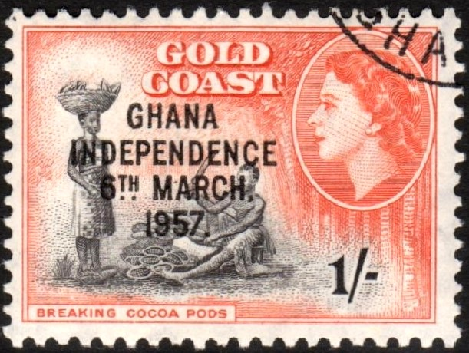
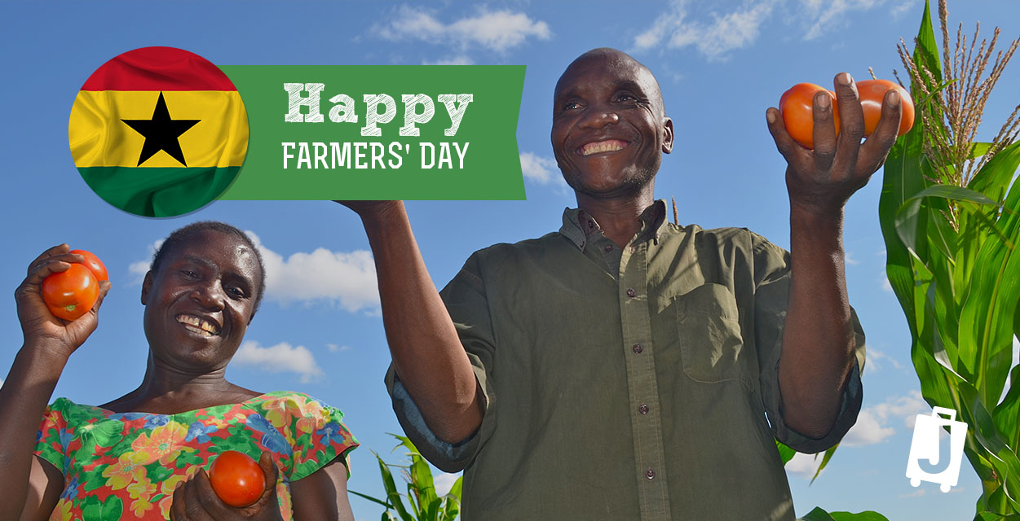
Ghana Holidays
Some Holidays that are celebrated in Ghana are
Independence Day of Ghana
Founders Day
Farmers Day
Christmas
New Years’ Eve/Day

Slide 11
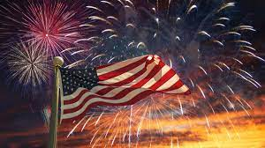
United States Holidays
Holidays celebrated In the United States
Christmas
New Years’ Eve/Day
4th Of July
Halloween
Presidents Day

