Slide 1
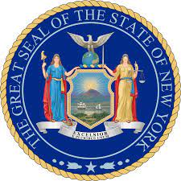
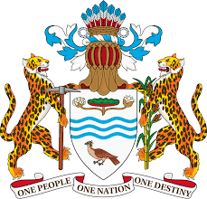
My Cross Cultural Experiences
Midterm
Professor Alapo
By: Saraswattie Bassant

Slide 2
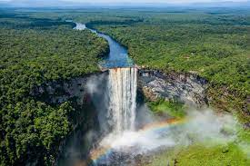
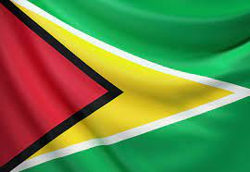
A little about me, my heritage and origin
~ My name is Saraswattie & I'm originally from Guyana
Currently, I'm living in Queens New York
~"Saraswati" is a Hindu goddess associated with knowledge, wisdom, music, arts, and learning. She is worshipped by students, scholars, and artists seeking her guidance and blessings for academic achievements, artistic pursuits, and intellectual growth.
~ My home country Guyana resides in South America. It is famously known for its diverse culture, stunning natural landscapes including the famous Kaieteur Falls, and its unique blend of Caribbean and South American influences.
~ My ancestors Indians arrived in Guyana as indentured laborers starting in the 19th century. They were brought by the British colonial authorities to work on sugarcane plantations, following the abolition of slavery.
~ Since I am a Hindu my culture is a mixture of Hinduism and Guyanse beliefs and traditions.

Slide 3
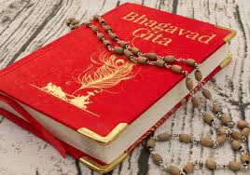
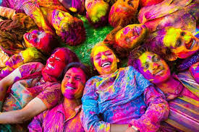
My Cultural & religious norms, values, and beliefs
~ Hinduism emphasizes strong family and community bonds. Guyanese Hindus often prioritize family gatherings, community service, and maintaining cultural traditions, fostering a sense of unity and cohesion within their communities.
~ We also celebrate Hindu festivals: Guyana's Hindu community celebrates major festivals such as Diwali (Festival of Lights) and Phagwah (Holi) with vibrant cultural displays and religious ceremonies, reflecting their deep-rooted traditions and beliefs.
Today is actually Holi celebrating spring, unity, and the victory of good over evil. People in the United States also participate in this holiday spending time with their family and friends.
~ A main belief in my culture/religion would be Karma. which is the idea that one's actions have consequences that affect their present and future lives. We believe in the principle of cause and effect, where good actions lead to positive outcomes and bad actions lead to negative consequences, either in this life or the next. This belief influences their moral conduct and shapes their understanding of personal responsibility and spiritual growth. Also stated in our religious text (Bhagavad-Gita: Chapter 3, verse 27)

Slide 4
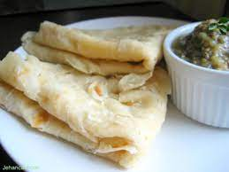
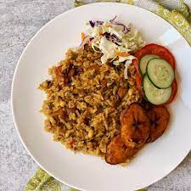
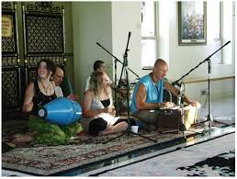
About our food, practices and traditions
~ Guyana's most famous foods include: Cook-up Rice which is a one-pot dish made with rice, beans or peas, and various meats (such as chicken, pork, or salted fish), cooked together with coconut milk and flavored with herbs and spices.Roti is also a very popular flatbread made from wheat flour, often served with curries or other savory dishes. It's a staple in Guyanese cuisine, enjoyed for breakfast, lunch, or dinner.
One of New York's famous food includes Pizza this is a different from my home country because it more of a laid back type of food.
~ As a Guyanse Hindu I can say that my practices and traditions plays a huge role in my life. Praying every day specifically in the morning is very import to our daily lives especially mine. In my tradition women play essential roles in maintaining cultural traditions, passing down religious teachings to the next generation, and fostering strong family and community bonds through their involvement in social and religious activities. Another equally important tradition would be playing Bhajans (religious music) this type of devotional music hold significant importance in Guyanese Hindu tradition. These devotional songs are sung during religious gatherings, ceremonies, and festivals, bringing in the divine and fostering a sense of spiritual connection among the community members.

Slide 5
Socializing
~ My socialization is impacted because of the way I grew up and how I followed through with my culture. This involves various cultural influences, including family dynamics, religious practices, and community traditions. From a young age, I was taught my by parents and grandparents the values of respect for elders, hospitality, and the importance of family cohesion. I sometimes may participate in religious activities within others Hindu, Christian, or Muslim communities, learning cultural rituals and customs associated with these faiths. Overall, the socialization process in Guyana reflects a blend of familial, religious, and cultural influences that contribute to the unique identity of Guyanese individuals even though I reside in New York.
~ Concerning traveling, I've only visited Guyana once and never went back. I could say that its VERY different from where I live now. Guyana differs from New York in several ways, including its smaller population, tropical climate, and primarily rural landscape compared to New York's urban environment, diverse population, and temperate climate. Additionally, Guyana has a distinct cultural blend influenced by Caribbean, South American, and Indian traditions, while New York is known for its cosmopolitan atmosphere and melting pot of cultures from around the world.

Slide 6
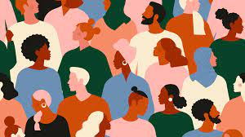
How the previous week of CLVD has impacted my Cross Culture experiences
~ Within the weeks of week 1 through 8, I do believe that I was able to really grasp the understanding of my culture and myself as a whole. I never really payed attention to how our culture, religion, gender etc played a serious role in our lives. I'm happy that we was able to talk about our artifacts in week 1 that we held dearly to ourselves and family. It really changed my perspective on others and what make them up as a person as well. Week 5 was also important to me because our class shared their thoughts on immigration and how they view it. I was able to see how biased the Naturalization process is. In America, asylum-seeking immigrants frequently face discriminatory treatment and rejection. As a result, this enhanced my cross-cultural experiences since it allowed me to talk with individuals of different ethnic backgrounds about a universally relevant subject. The week that impacted me the most would be week 7 because as I work with my group to understand stereotyping and prejudice I really learned that oversimplified beliefs or negative attitudes toward individuals or groups based on their religious affiliations. These biases can lead to discrimination, marginalization, and conflict within societies.

Slide 7
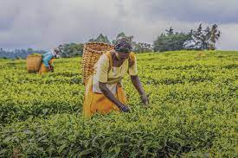
My Observations
~living almost my whole life in the United States and only visiting my home country only once I did observe a number of things that are similar and different from each other in the everyday life. I was able to see that both cultures boast a culinary scene influenced by a mix of cultures, resulting in a vibrant array of flavors and dishes. Guyanese cuisine, for example, reflects influences from African, Indian, European, and Indigenous cultures, while New York's food scene showcases a blend of international cuisines due to its melting pot nature.
Another thing would be having a strong sense of community. I learned that both Guyanese and New York cultures emphasize the importance of community and family ties, often seen in gatherings, celebrations, and mutual support networks within neighborhoods.
One of the main differences I did come in contact with would be how the pace of our lives are influenced by location. The New York culture is often associated with a fast-paced lifestyle, characterized by hustle and bustle, whereas Guyanese culture may be perceived as more relaxed and laid-back, reflecting the slower pace of life typical of many Caribbean countries.

Slide 8
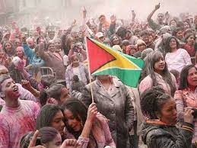
Conclusion
~As a A Guyanese Hindu in New York, I have experience a profound cross-cultural journey, encountering diverse perspectives, traditions, and beliefs. I also experienced adapting to a multicultural environment, navigating different customs, and encountering varying religious practices. Learning about culture, interaction, and beliefs becomes crucial in this context as it fosters understanding, empathy, and respect for others no matter what. By engaging with different cultures, I was able to broaden my worldview, challenge stereotypes, and build bridges across communities. Understanding cultural nuances also enhances my social interactions, promoted harmony, and cultivated a sense of global citizenship. Embracing diversity enriched my personal growth and contributed to creating inclusive societies where individuals from all backgrounds feel valued and accepted. Even with these previous weeks I learned so much unlike before taking this course. I can say that I am satisfied with my understanding and actions towards other individuals and their way of life no matter their gender, skin color, religion etc.

