Slide 1
My Acculturation story in America
By: Modupeola - Ologunleko
CDLDV 100 - Intro to cultural diversity
Prof- Alapo
Spring 2024

Slide 2
Intro : The clash of culture
Culture refers to the shared patterns of behaviors, beliefs, values, customs, traditions, and norms that characterize a particular group of people or society. It encompasses the way of life of a community, including its language, arts, cuisine, religion, rituals, social interactions, and more.
It is a way of life instill into you from birth
As a Nigerian moving To America there was a lot of cultural clash as different values and belief were been held in the process of Acculturation .

Slide 3
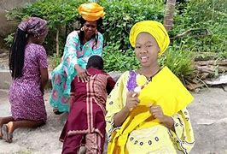
Clash of Culture: Respect
Nigerians show respect to their elders by bowing down from the waist, prostrating on the floor, kneeling down, or raising one or two hands in the air… avoiding rude behaviors such as interrupting and speaking loudly, and showing reverence to elders and authority figures
Americans usually greet people with informal greetings and first names12. When arriving at your destination or meeting people during the day, use the following phrases3:
Formal Hello
Good morning/afternoon/evening
How are you (doing)?
(It's) nice/good/great to see you.

Slide 4
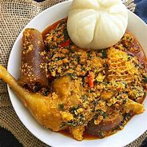
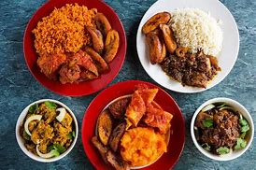
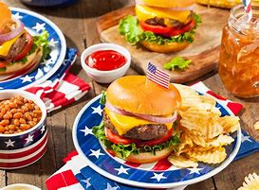
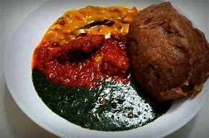
Clash of culture : Food
Nigerian cuisine consists of dishes or food items from the hundreds of Native African ethnic groups that comprises Nigeria.
American cuisine consists of the cooking style and traditional dishes prepared in the United States. It has been significantly influenced by Europeans, Indigenous Americans, Africans, Latin Americans, Asians, Pacific Islanders, and many other cultures and traditions.
Notes:
Nigerian cuisine: Jollof rice and plantain, amala and ewedu with stew, fufu with egusi, white rice with stew and plantain.

Slide 5
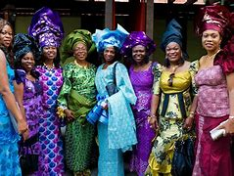
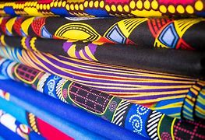
Clash of culture : Dressing
Traditional Nigerian dress varies depending on the ethnic group and region of the country. Some common types of traditional dress include the Buba and Sokoto for men and the iro and Buba for women. The Buba is a loose-fitting blouse, while the Sokoto is a pair of pants. The iro is a wraparound skirt, and the Buba is a blouse.
American clothing style is characterized by its versatility, individuality, and casual comfort. It's influenced by everything from popular culture to the country's unique demographics and varied climate. The style can range from casual streetwear to elegant high fashion.

Slide 6
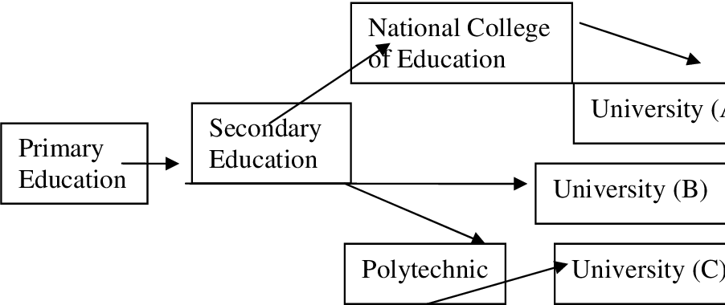
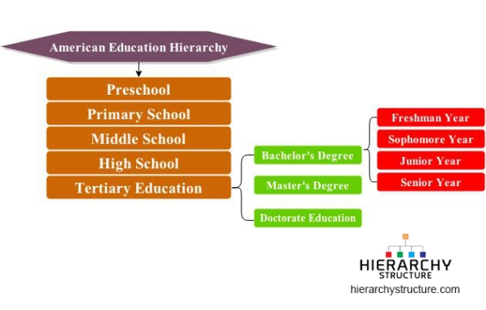
Clash of Culture : Education
The structure of U.S. education includes 12 years of regular schooling, preceded by a year or two of pre-school education, and followed by a four-stage higher education degree system (associate, bachelor's, master's, doctorate) plus various non-degree certificates and diplomas.
Nigeria’s education system is based on the (1)-6-3-3-4 formula: one year pre-primary education, six years primary, three years junior secondary, three years senior secondary, and a minimum of four years tertiary education.

Slide 7
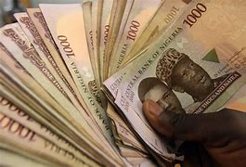
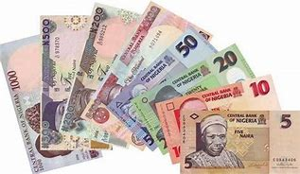
Clash of culture: Currency
The naira is the currency of Nigeria. One naira is divided into 100 kobo. The Central Bank of Nigeria is the sole issuer of legal tender money throughout the Federal Republic of Nigeria. It controls the volume of money supplied in the economy in order to ensure monetary and price stability.
The USD (United States dollar) is the official currency of the United States of America. The United States dollar, or U.S. dollar, is made up of 100 cents. It is represented by the symbol $ or US$ to differentiate it from other dollar-based currencies.

Slide 8
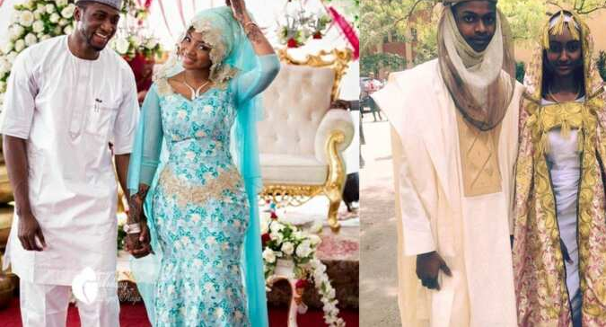
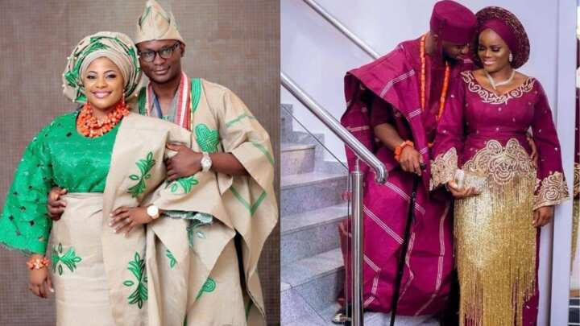
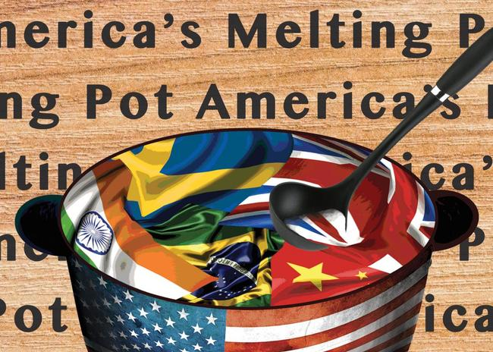
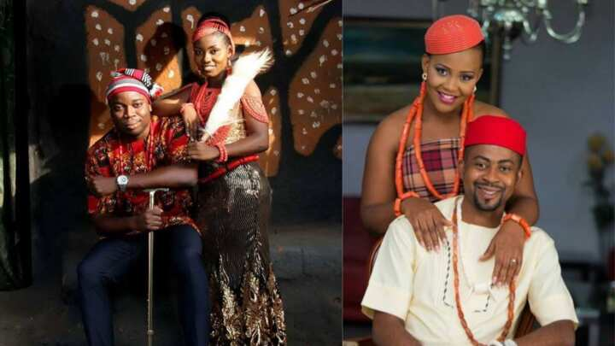
Clash of culture : Tribe
Nigeria is Africa’s most populous country and has one of the largest aggregation of ethnic groups in Africa. There are more than 300 Nigerian tribes and among them 1. Hausa. 2. Yoruba. 3. Igbo. 4. Fulani (Fulbe) 5. Ibibio. 6. Kanuri. 7. Tiv. 8. Ijaw (Izon or Izon Otu) 9. Nupe. 10. Jukun (Njikum) Tribes in Nigeria and their states are the biggest ethnic grouos .
U.S. culture has also been shaped by the cultures of Indigenous Americans, Latin Americans, Africans and Asians.the United States is sometimes described as a "melting pot", according to Golden Beacon USA, in which different cultures have contributed their own distinct "flavors" to American culture

Slide 9
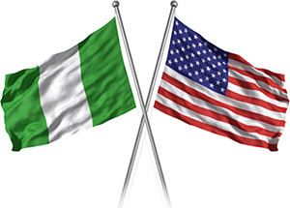
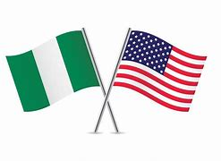
Conclusion: Acculturation
Acculturation is the phenomenon where individuals or groups from one culture come into contact with, and adopt elements of, another culture, while still retaining some of their original cultural traits.
My journey of Coming in from a Different country affected my views on the different values and prarivces held in America.
As timewent on I became more opened anddeveloped and adaptic naturewiththe willingness tolearn about the Country I was going to consider home

Slide 10
End

