Slide 1
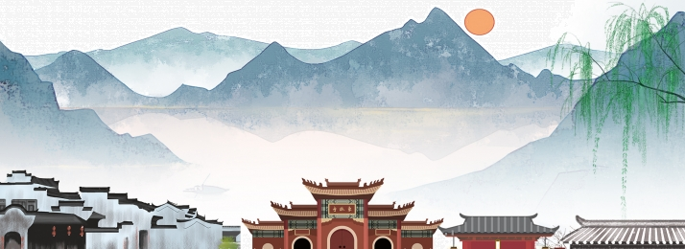
My cross-cultural experience
Tina zheng
CLDV 100
Professor alapo

Slide 2
INTRODUCTION
Hello my name is Tina Zheng, I’m a sophomore at York college. My nationality is American, and my Ethnicity is Chinese. I born and raised in Queens, the borough of New York City, which is considered one of the most ethnically diverse urban area in the world. Just by living here I am exposed to many cross-cultural experiences. I will present to you my cross-cultural experience as an American born Chinese (also known as ABC)

Slide 3
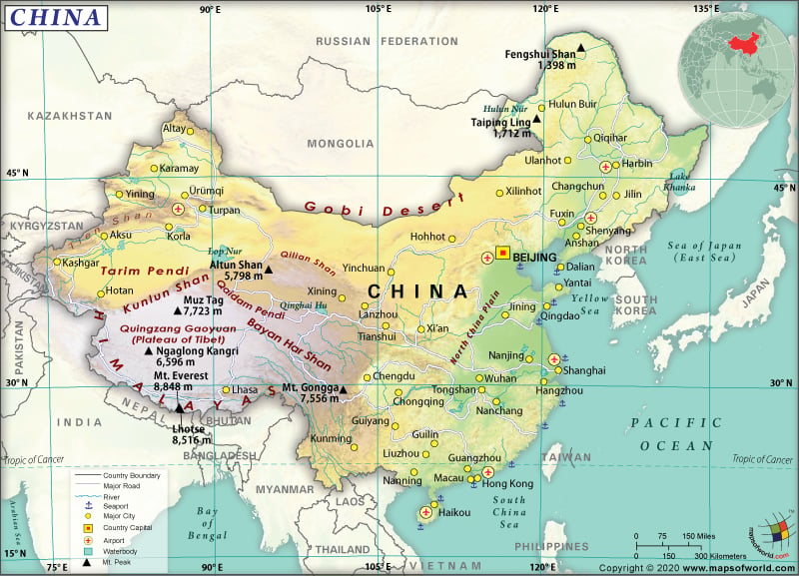
My home country
China is an east Asian country with the world’s oldest cultures and is recognized as one of the four great ancient civilization alongside ancient Egypt, Babylon, and Greece. It’s the third largest country with high population rates. The geography is diverse, ranging from deserts in the west, plains in the east, one third of land is mountains and three seas bordering the coast
Notes:
14 countries border china, (Afghanistan, Bhutan, India, Kazakhstan, North Korea, Kyrgyzstan, Laos, Mongolia, Myanmar (Burma), Nepal, Pakistan, Russia, Tajikistan, and Vietnam.
Three seas bording china (pacific ocean, east china sea, South China Sea, yellow sea

Slide 4
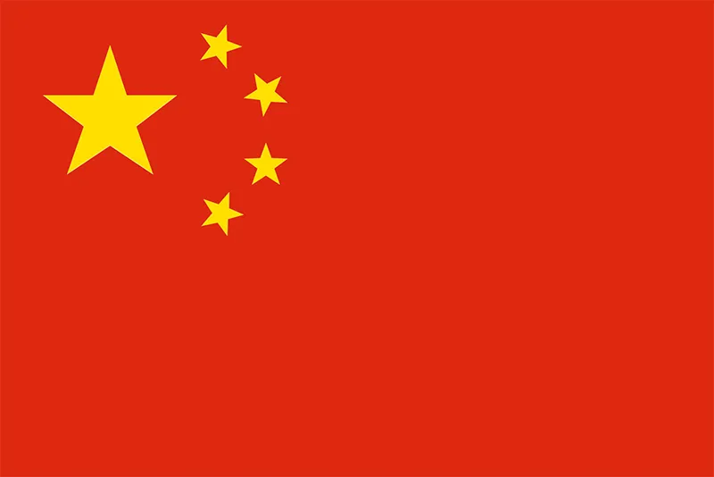
Flag of China
The flag is a red background with five yellow stars. The red color is used as a symbol of communism and the Chinese Nation, and the great yellow star represents the leadership of the communist party. The four smaller stars represent the four social classes. Yellow is a symbolic color in Chinese history, its an imperial color or the color of an emperor
Notes:
The four social classes, (the working class, the peasantry, the urban elite, and the national bourgeoisie)
Only the emperor can wear yelloe, the civilian were prohibited. Yellow represents power, royalty and prosperity.
Golden yellow is regarded the color of heaven since ancient times

Slide 5
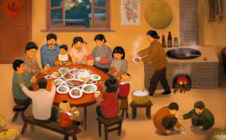
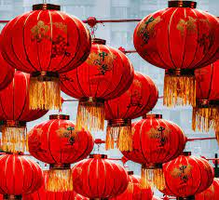
Chinese culture
- Chinese culture is one of the earliest ancient civilizations and they’ve been around for thousands of centuries.
- Family is regarded as the most important part of an individuals life’s
- Elders are viewed as a source of wisdom and spirituality. Its important to respect your elders!!
- Our cultural values of harmony, righteousness, courtesy, wisdom, honesty, etc

Slide 6
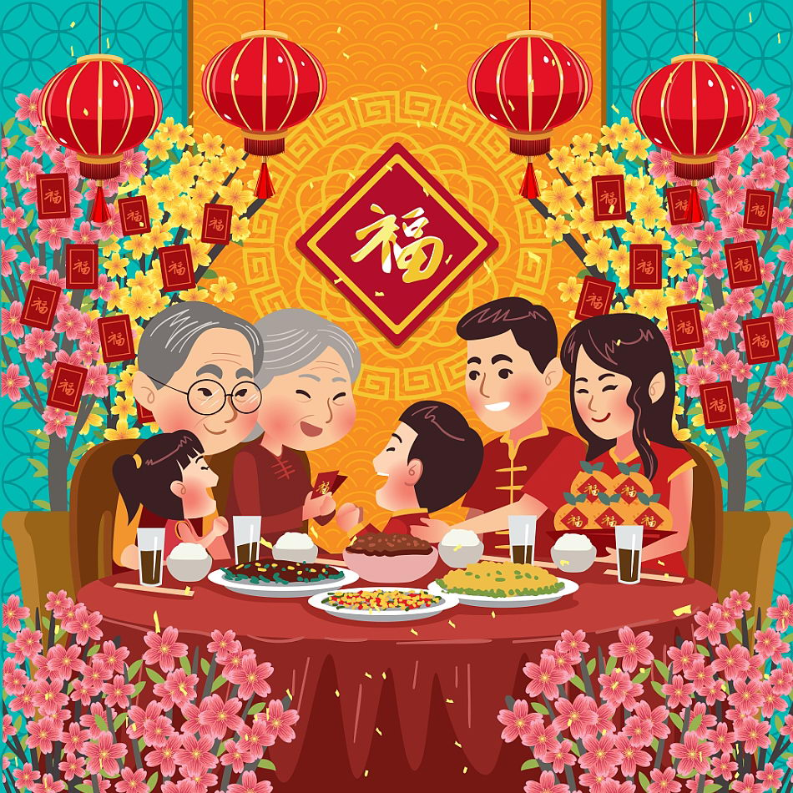
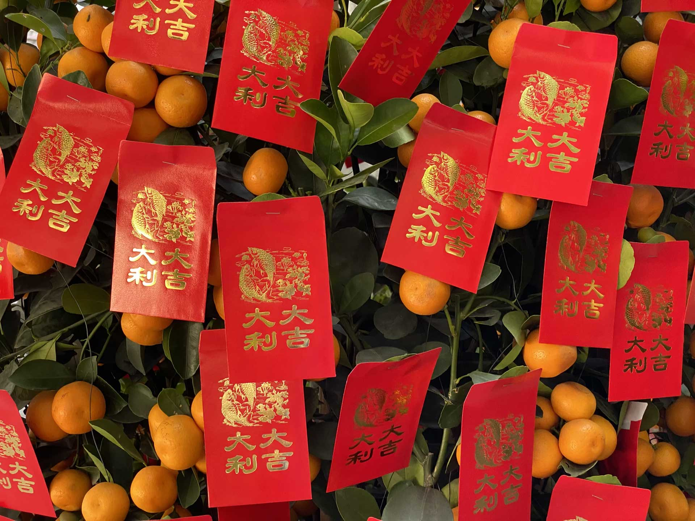
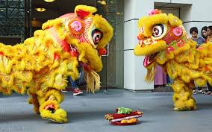
Holidays
- Holidays that we celebrate: New Year Day, Chinese New Year, QingMing Festival, Dragon Boat festival, Mid- autumn festival, Golden Week, etc
- Holidays are a celebration/reunion with families
- We eat traditional foods, give red envelopes, watch lion dances, watch dragon boat races, and gather around as a family.
-
Notes:
Chinese new year is also known as the spring festival, falls on different dates b/c on the lunar calendar, the first day of the month begans during the new moon. (fab 1, 2022 // jan 22, 2023)
Red envelopes are filled with cash and given to children or parents, (祝你新年快乐，身体健康”) for happiness, good luck and health.
Dragon boat festival is also know as duan wu jie which is also known as the dumpling festival. Eat Zongzi. People clean homes to start
Mid autumn festival is also known as the mooncake festival. (sep 10, 2022) a celebration of the rice harvest and fruits. people would travel back home to celebrate it with their families. a reunion time for families, a little like Thanksgiving.
- Qingming Festival: go and sweep tombs and commemorate their ancestors. Celbrates springs,

Slide 7
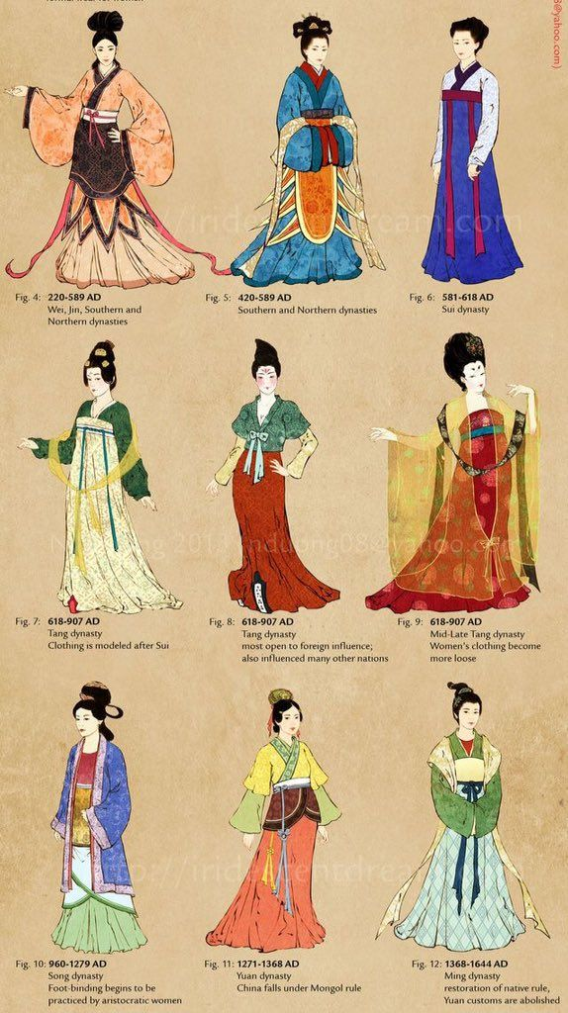
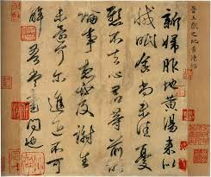
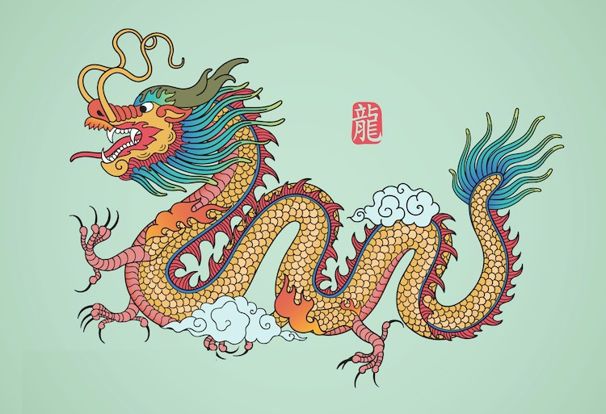
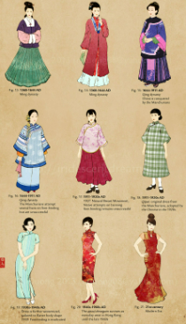
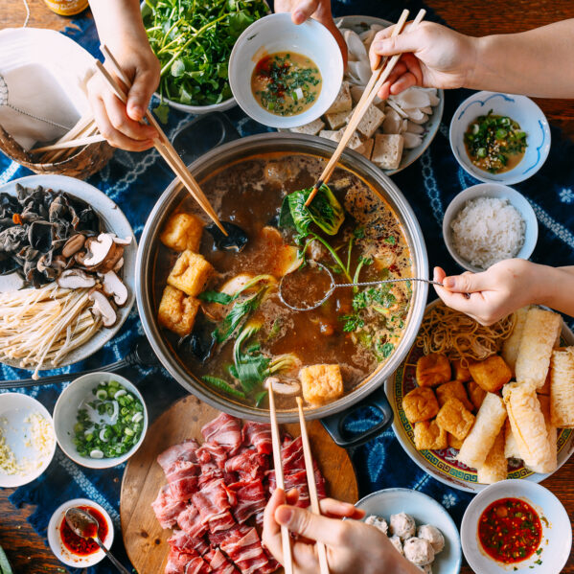
< Since Chinese history’s been around since ancient times, their fashion also changes
< Ancient Chinese text and writing
> Chinese dragon symbolizes strength health and good luck
^ The most popular and recognizable style is the Hanfu, Qipao and Tang dresses
< Hot pots are typically a celebration type of meal. Often during Chinese new year
Notes:
Chinese writing used to start from the right to down to left
Dragon is only mysical creature on zodiac
Hot pot symbolizes a prosperous new year.
Red symbolizing luck, joy, and happiness. // Red is the traditional color worn by Chinese brides, as it is believed to ward off evil.

Slide 8
MY Cultural norms
Some cultural norms I grew up with are to respect elders, take off my shoes before entering homes, don’t wear green on your head (it means infidelity), can't wear red clothing or accessories at funerals, don’t stick your chopsticks straight up in your food (spirits may think its an offering to them. During Chinese new years, you have to say your greetings before receiving an red envelope.
Notes:
Kowtow elders
Four is bad

Slide 9
My Cultural shock experiences
- Some cultural shock I've experienced is the sexism that runs rapid in Chinese culture. Women were seen below men and must always obey the man of the house, including their own son. There's a clear distinction in status and favoritism between a son and daughter. Daughters are often less desirable than sons, which is why there are more female infant deaths/abortions or "disappearance" than sons. If a family has too many girls, they were looked down upon. Maybe its because I live and grew up in America where there are modern views, that I’m so disgusted by this.
- Other experiences I've had with other cultures would be the fact that I live in queens where there are so many other cultures in this borough. A cultural shock that I often experience is how different each culture is. Each neighborhood I visit in Queens has a distinctive atmosphere. I feel as though I have stepped into a miniature version of that nation or culture. There are numerous shops in that region that sell goods like food and clothing. I am able to experience a small part of each culture within a single borough.

Slide 10
Living in New York
As mentioned before, Queens is considered one of the most ethnically diverse neighborhood. New York City has distinct patterns of residential concentration by race and ethnicity. Although a mix of racial groups live in some neighborhoods, each group predominates or is unevenly concentrated in many areas. In Jackson heights there are a lot of southeastern Asians, Corona has a lot of Hispanic people, Jamaica has a lot of Caribbean and African Americans. Each neighborhood is distinct to the predominant ethnic group that gathers there and forms a close-knit community as a result of familiarity. New York city is a good place for immigrants to get used to America. There are definitely community where they can reside in with other people of the same ethnicity. It’s a good starter city to get used to the different cultures that exist in the world.

Slide 11
How did week 1-8 impact my cross-cultural experience
How This class has impacted my cross-cultural experience from the first week to week 8 is that I am able to learn so much about other people’s culture. Despite coming from various backgrounds, everyone was able to share some characteristics, whether they were cultural or personal. It's amazing how everyone is actually so similar in many ways. This establishes a connection and a feeling of familiarity with everyone. I was able to bond with someone in this class who I've grown close to. I am learning new things about different cultures every time I go to class!

Slide 12
Conclusion
Overall this multicultural class has taught me so much about different cultures and how similar we actually are to them. There are many different between my Chinese culture and American ones but there are also so many differences. I am able to interact with so many people of different ethnicity and background in this class, that I learn new things. This class has been a insightful course. I was also able to learn about my own culture too!

Slide 13
Resources
- https://www.britannica.com/place/East-China-Sea
- https://globaledge.msu.edu/countries/china
- https://www.nspirement.com/2021/03/22/why-ancient-chinese-culture-was-a-world-filled-with-yellow.html#:~:text=Civilians%20were%20prohibited%20from%20wearing,royal%20inspection%20tours%20were%20yellow.
- https://www.deviantart.com/lilsuika/art/Evolution-of-Chinese-Clothing-and-Cheongsam-Qipao-353219884
- https://www.chinahighlights.com/festivals/china-public-holiday.htm
- https://www.chinahighlights.com/travelguide/chinese-family-values.htm#:~:text=In%20China%2C%20family%20is%20regarded,attributed%20to%20family%20remains%20strong.
- http://www.ediplomat.com/np/cultural_etiquette/ce_cn.htm

