Slide 1
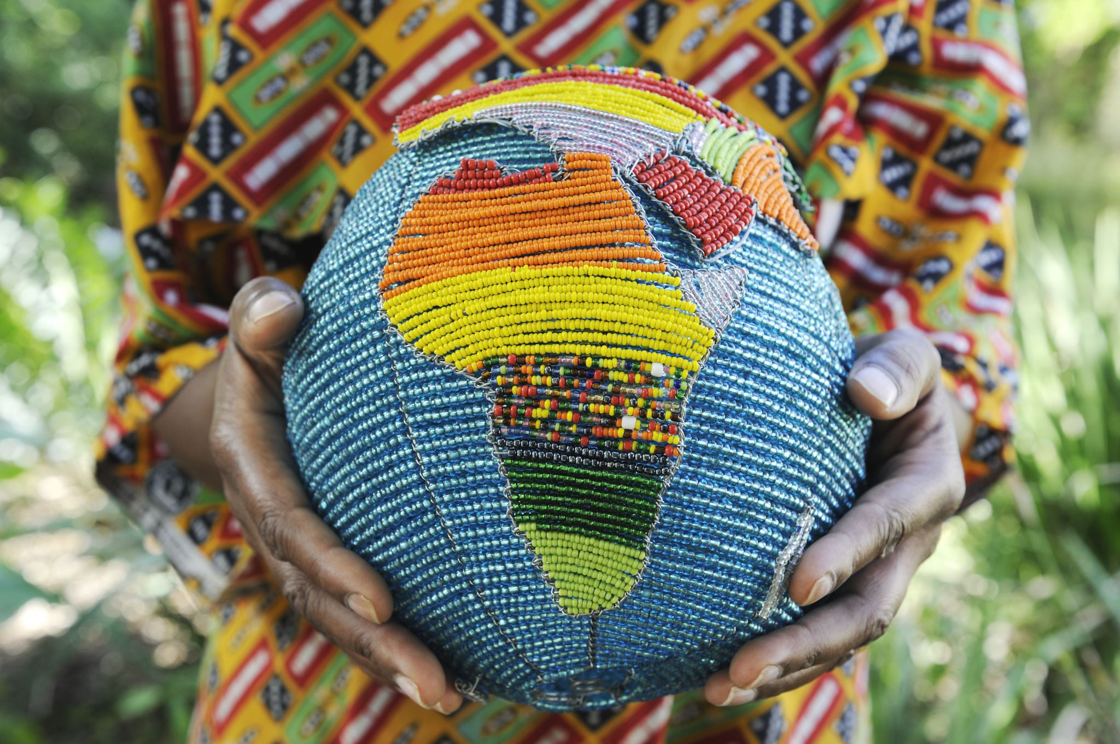
My Intergenerational Cross-Cultural in The Dominican Republic
By Mauricia Blake

Slide 2
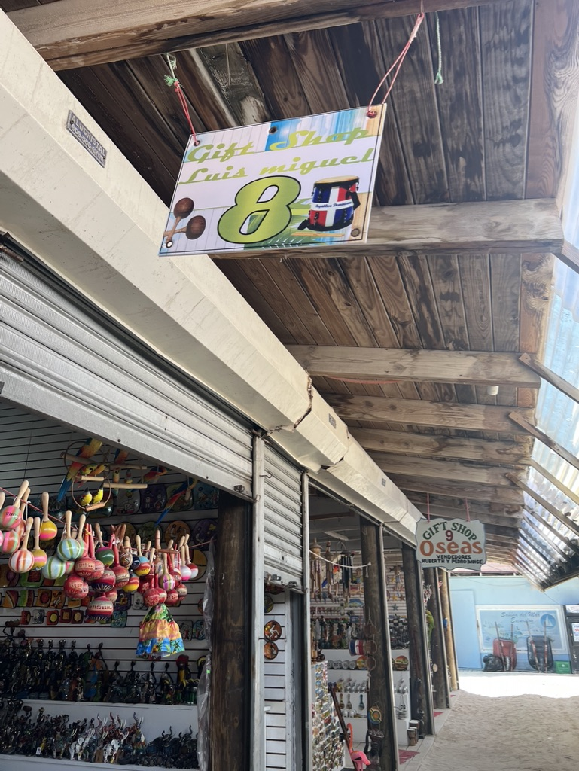
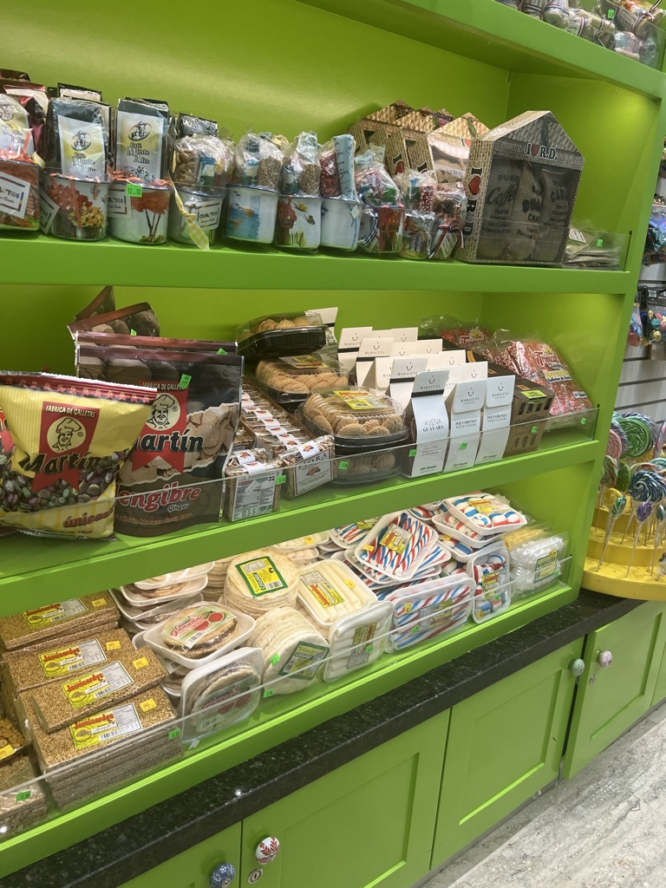
My personal Experience

Slide 3
Culture
Vibrant fusion of European, African, and Taino influences
Family and community relationships are important.
Rich cultural legacy portrayed in dance, music, and art

Slide 4
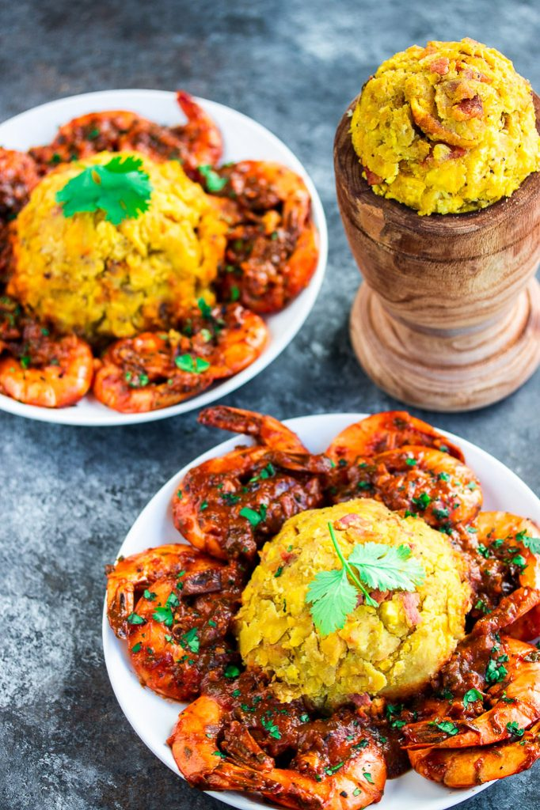
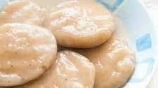
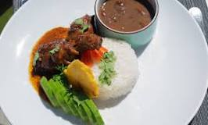
Food
Mofongo
Bandera Dominican
Cassava Dumplings
Plantains are picked green, cut into pieces and typically fried but can be boiled or roasted, then mashed with salt, garlic, broth, and olive oil in a wooden pilón
La Bandera is considered the national dish of the Dominican people. Consists of white rice, chicken or beef, and red beans, accompanied by tostones, green salad, or even avocado.
8 3/4 oz of cassava, grated, or 250g cassava flour.
8 3/4 oz of plain flour.
1 tbsp of salt.
1 tsp baking powder.
3/4 pint of water.

Slide 5
Dance & Music
The national dance of the Dominican Republic is called merengue.
Bachata: A sensual pair dance from the Dominican Republic; traditional
Instruments include the Tambora, guiro, and accordion

Slide 6
Location
Santo Domingo: Charming colonial capital city
Punta Cana: Well-known for its resorts and beaches
Santiago: a center of culture with a thriving nightlife

Slide 7
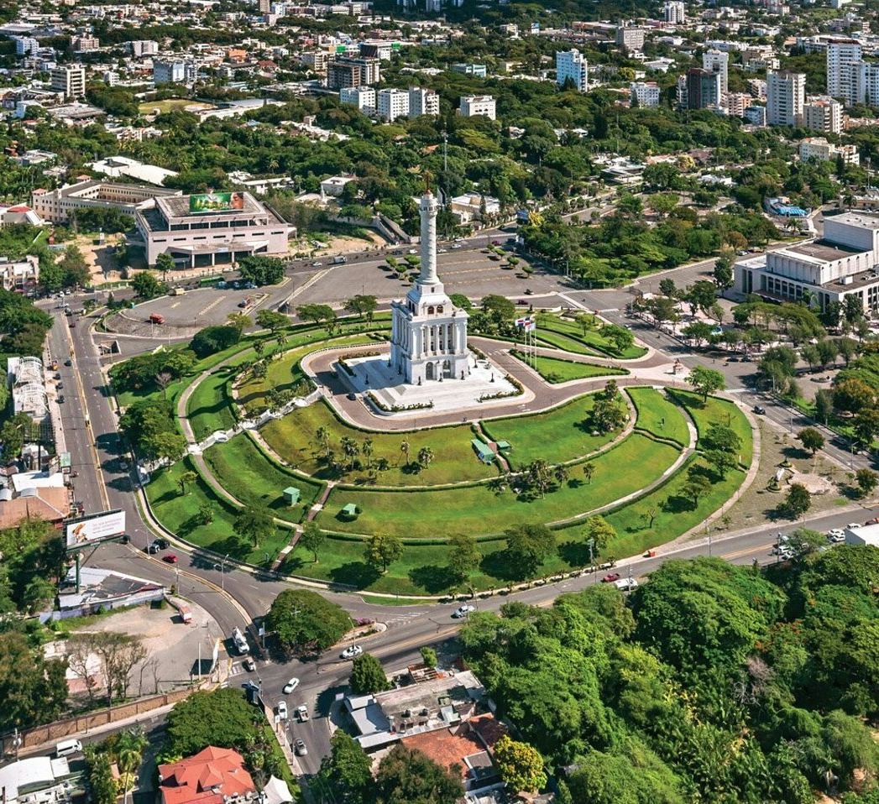
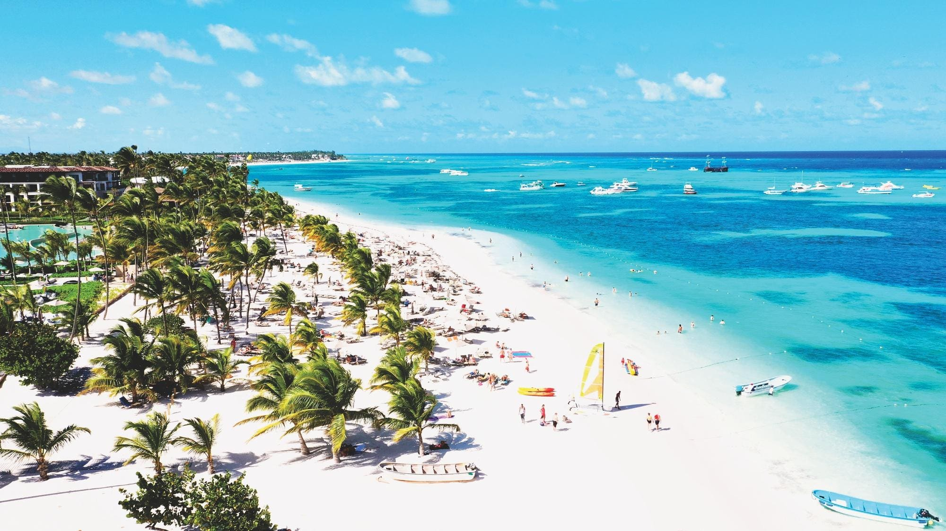
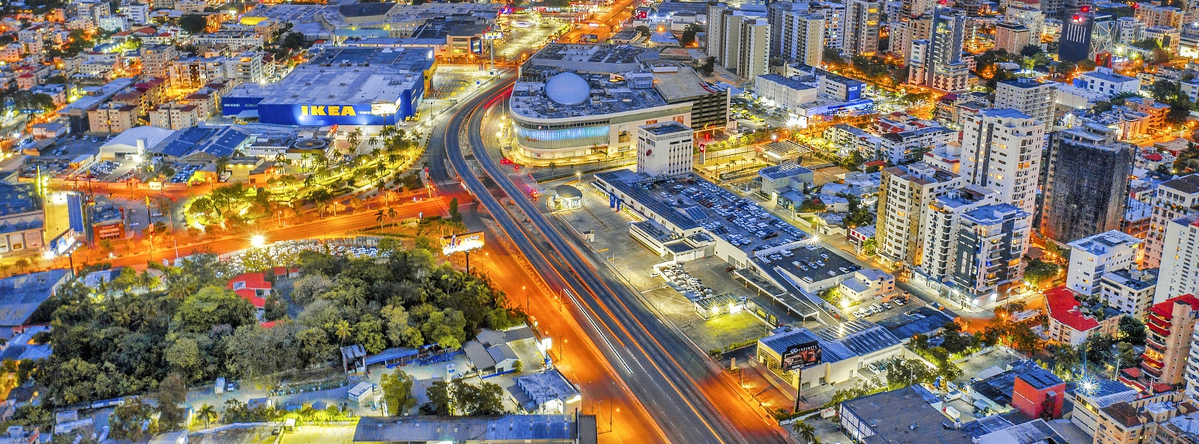
Punta Cana
Santiago
Santo Domingo

Slide 8
Stereotypes & Biases
Preconceived notions about Dominicans being "uneducated" or "lazy”
Prejudices towards immigrants from Haiti
Correcting misunderstandings via education and cultural exchange

Slide 9
Socioeconomics Issues
Differences in income between rural and urban locations
Obstacles in obtaining healthcare and education
Tourism's effects on regional economies

Slide 10
Conclusion
Emphasizing the importance of understanding and appreciating diverse cultures
In conclusion, the richness and diversity of this fascinating country have been highlighted by our cross-cultural, intergenerational experience in the Dominican Republic. I’ve learned so much about the value of variety by fully embracing Dominican culture, from its vivacious music and dance to its mouthwatering food and ingrained customs.
Acknowledging the significance of comprehending and valuing various cultures is vital, not only in the Dominican Republic but also globally.
Cultural exchange helps us to reduce obstacles, respect one another, and develop empathy. We improve our own lives and make the world a more harmonious and interdependent place when we accept variety.
Let's keep appreciating and learning from one another's cultures, accepting the distinctions that make each of us special while acknowledging the humanity that binds us all together. By working together, we can create a future in which variety is valued as a source of strength and enrichment rather than just accepted.

