Slide 1
My Diversity and Cross Cultural Story in New York City Embracing Diversity and Culture in New York Citynbbbbbbbbbb
March/25/2024
Monday.
Presented by
Sarswati Pathak Bhatta
CLDV 100
Professor Oluremi Alapo

Slide 2
Outlines of the Presentation
Introduction
Objectives
Differences
Benefits
Challenges
Experiences
Conclusion
Recommendation
Arrival in New York City
nnn

Slide 3
Introduction
Diversity and cross-cultural encounters in New York City provide a wealth of stories that illustrate the intricacies of interpersonal relationships and cohabitation in one of the most globalized cities on earth. NYC is a melting pot of cultures, languages, customs, and viewpoints, from the busy streets of Manhattan to the energetic districts of Brooklyn, Queens, the Bronx, and Staten Island. My own trip through this diverse environment includes interactions with people from a wide range of backgrounds, all of whom add to the colorful patchwork that forms the city's character. I want to shine a light on the wonders, difficulties, and important lessons that may be discovered when crossing the crossroads of diversity and cross-cultural interaction in the vibrant and always changing center of New York City through my own experiences and observations.

Slide 4
Objectives
To understand and appreciate the diversity and cross-cultural aspects of both Nepal and New York City.
To highlight the differences, benefits, and challenges encountered during the transition from Nepal to New York City.
To provide recommendations based on personal experiences for individuals undergoing similar cultural transitions.

Slide 5
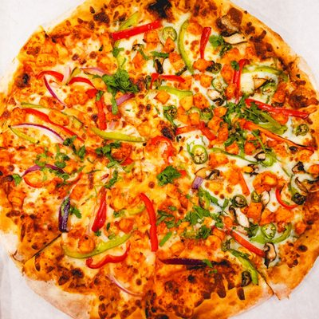
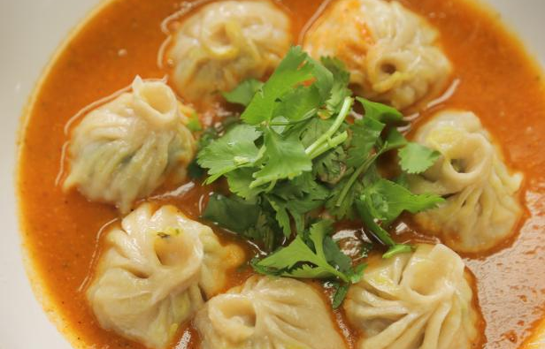
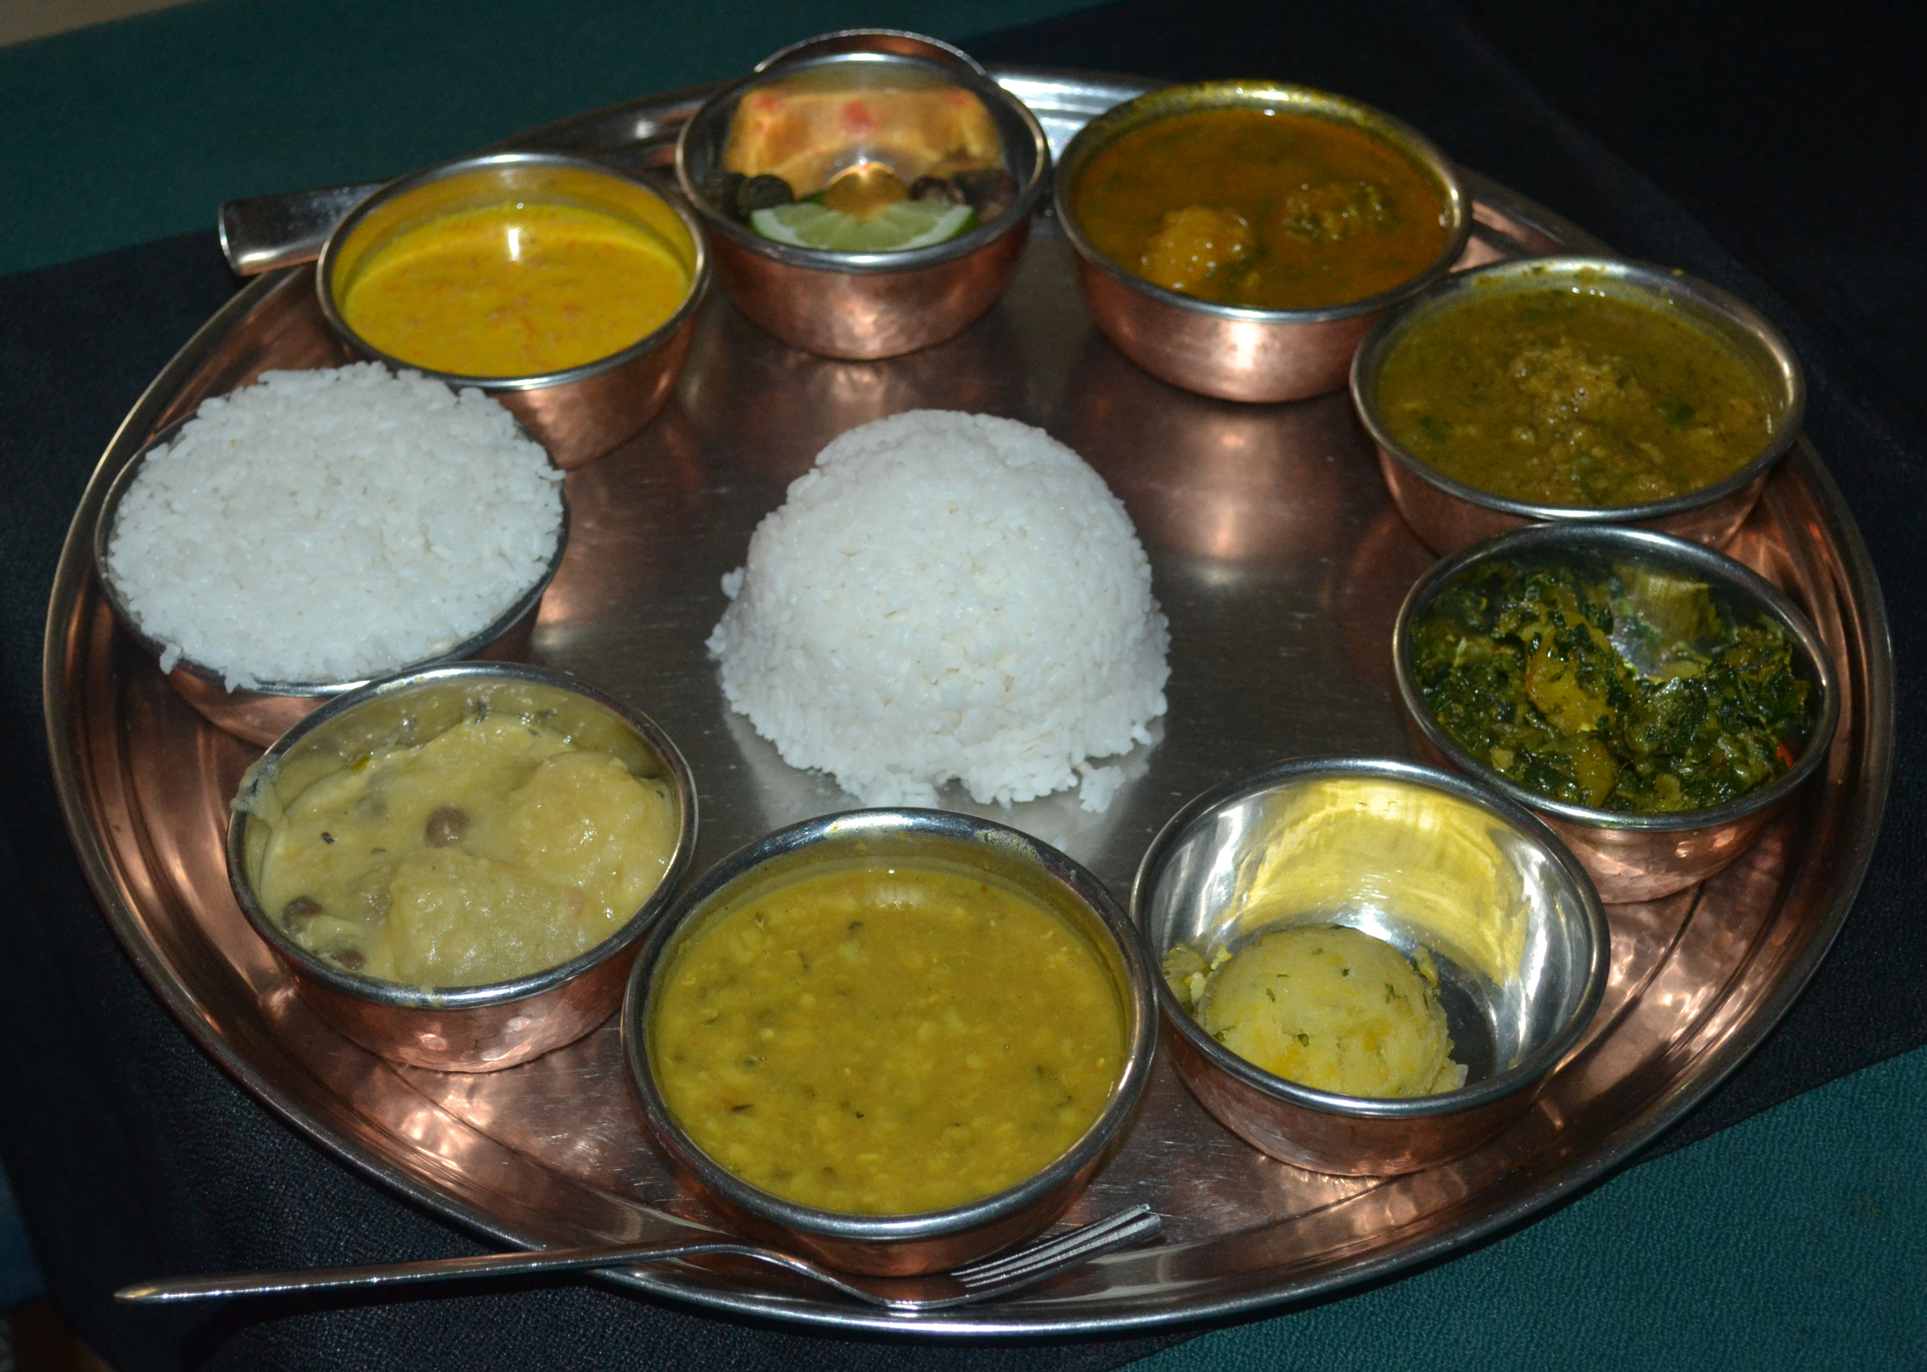
Differences
Language
Food
Social Value
Family Dynamics
Social Interactions
Cultural Diversity

Slide 6
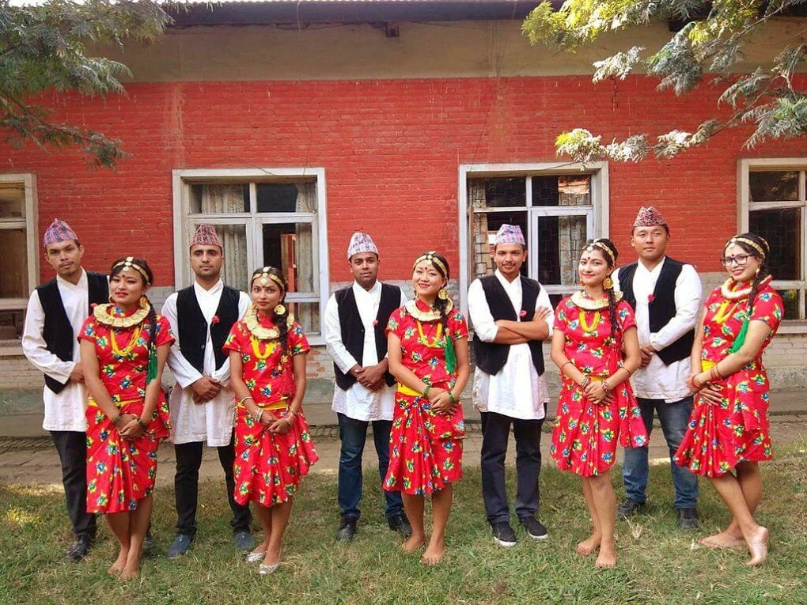
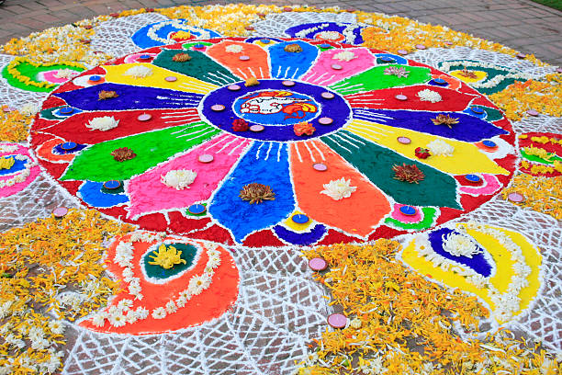
Benefits
1. Cultural Enrichment.
2. Learning and Adjustment.
3. Broadened Perspective.
4. Adaptation and Resilience.
5. Global Business Opportunity.

Slide 7
Challenges
1. Language Barriers.
2. Homesickness.
3. Cultural Shock.
4. Cultural Norms and Expectation.
4. Workplace Discrimination.

Slide 8
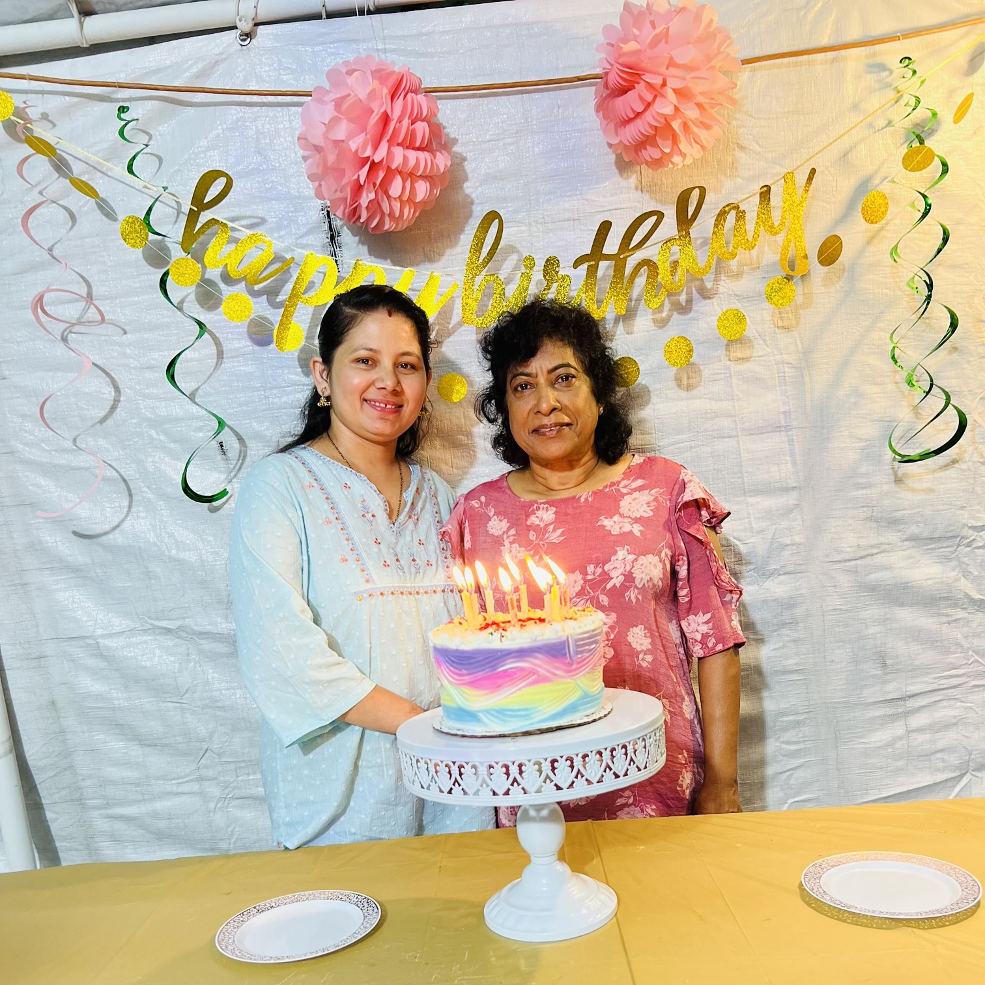
Experiences
I have a special story going to a birthday celebration that my neighbor from Guyana had. I was instantly drawn to their house by the upbeat music playing and the vivid decorations, which stood in stark contrast to the more somber ambiance of Nepali festivities. I excitedly tasted every dish on the table, relishing the distinct flavors and spices, even though the Caribbean cuisine was foreign to my Nepali palate. I had lively chats about Guyanese traditions and customs with guests from a variety of backgrounds throughout the evening. We exchanged incidents.I learned a lot from my neighbor's kind explanation of the cultural norms, which highlights the significance of cultural sensitivity and awareness in cross-cultural encounters. In addition to broadening my gastronomic horizons, this experience helped me better understand cultural quirks, which increased my empathy and helped me appreciate the wonderful tapestry of cultural diversity that exists in America.

Slide 9
Conclusion
We have examined the life-changing trip from Nepal to New York City in this presentation, going into the numerous obstacles and rewarding events that were faced along the route. There have been both difficult and positive times during this shift between these two very different cultures, from language hurdles and homesickness to cultural shock and adaption. Nevertheless, despite these difficulties, the value of cultural variety and cross-cultural interactions is evident. Immersion in foreign cultures broadens our horizons and cultivates empathy and understanding by providing us with priceless insights into the intricacies of the human experience. As we accept the vibrant tapestry of cultures, languages, and rituals that constitute our global community, the richness of cultural interchange becomes apparent. Through my journey, I've learned to value variety and the transforming potential of cross-cultural interactions, realizing that it's only via these relationships that we can genuinely flourish and advance as a society and as individuals.

Slide 10
Recommendation
For those who are navigating cultural shifts like I did, I provide some helpful advice. First, in order to find understanding and support among the difficulties of adjustment, look for community support networks through local community centers, religious organizations, or cultural organizations. Second, welcome cultural differences as chances for personal development and enrichment while maintaining an open mind and receptiveness to new experiences. To further enhance your comprehension and appreciation of diversity, actively participate in Nepali and American cultures through language learning, cultural activities, and gastronomic adventures. In order to effectively manage homesickness and culture shock and facilitate a more seamless transition into your new cultural surroundings, give priority to self-care and resilience-building activities. You can handle cultural shifts more easily and come away from the experience with a stronger understanding of the diversity of humankind if you pay attention to these tips.

Slide 11
Thank You

