Slide 1
Cross Cultural Experiences
Midterm PPT
Alyssa Rupnarine

Slide 2
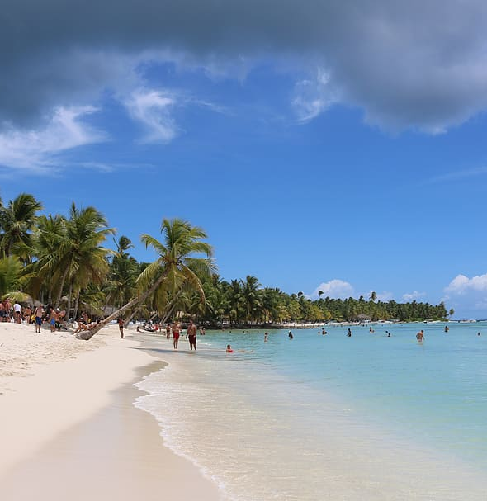
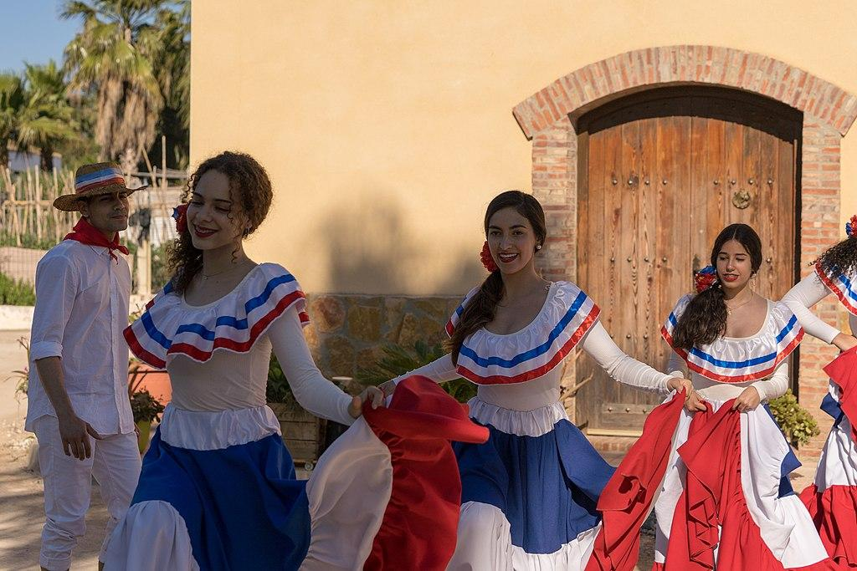
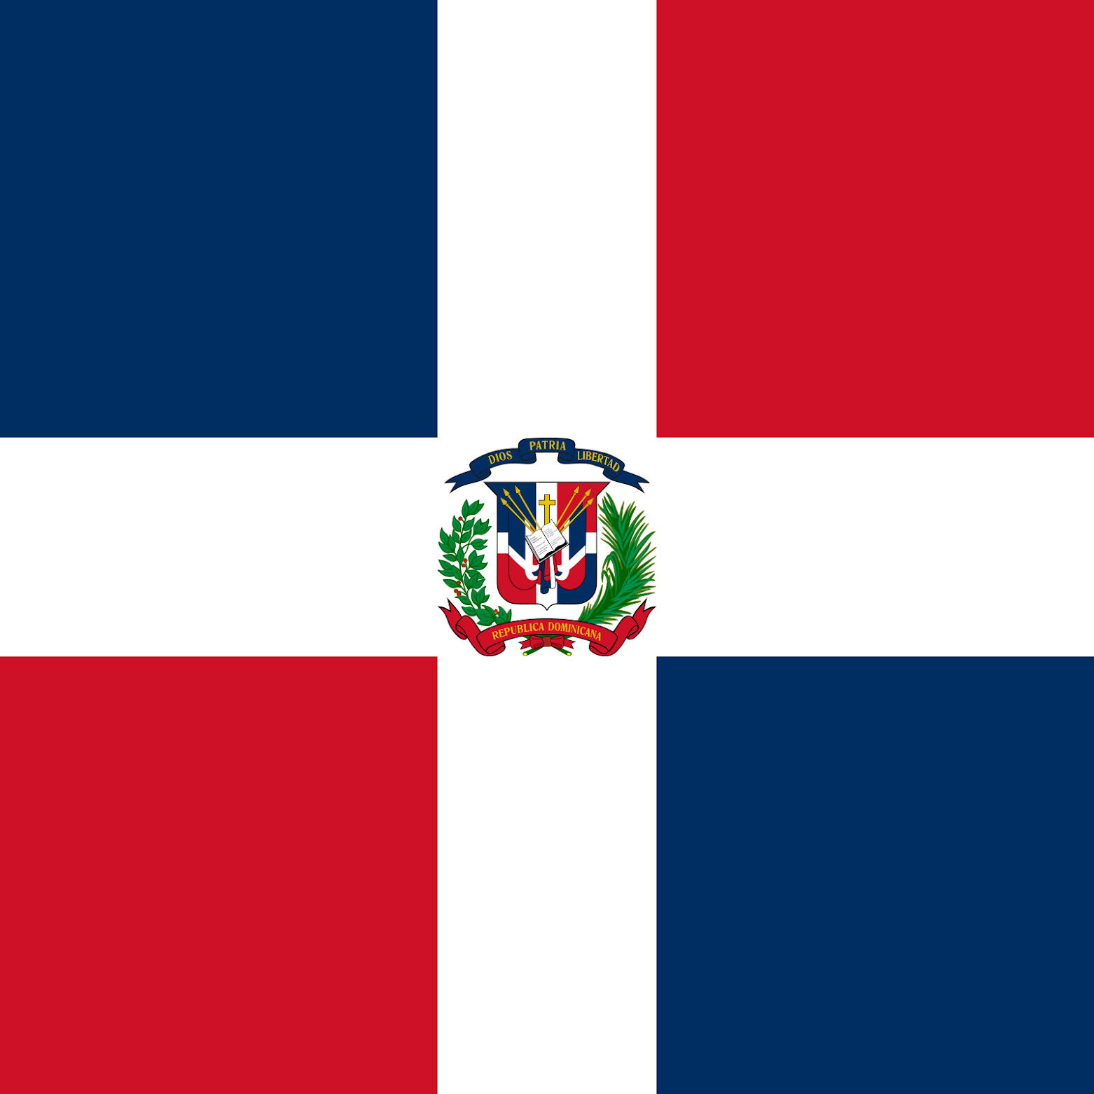
Dominican Culture
The majority of Dominicans have roots in both Europe and Africa. Spanish is prevalently spoken. Roman Catholics make up the majority of the population. In 1492, Christopher Columbus “found” Hispaniola. Santo Domingo, the initial European settlement in the Americas, was established by the Spanish in 1496. The majority of the native Carib as well as Taino peoples perished within a few decades. The Dominican Republic is known for their beautiful waters and tourism. Common foods that we eat are Sancocho, Mangu, and Mofongo. Bachata and Merengue are very popular music genres in dominican culture.

Slide 3
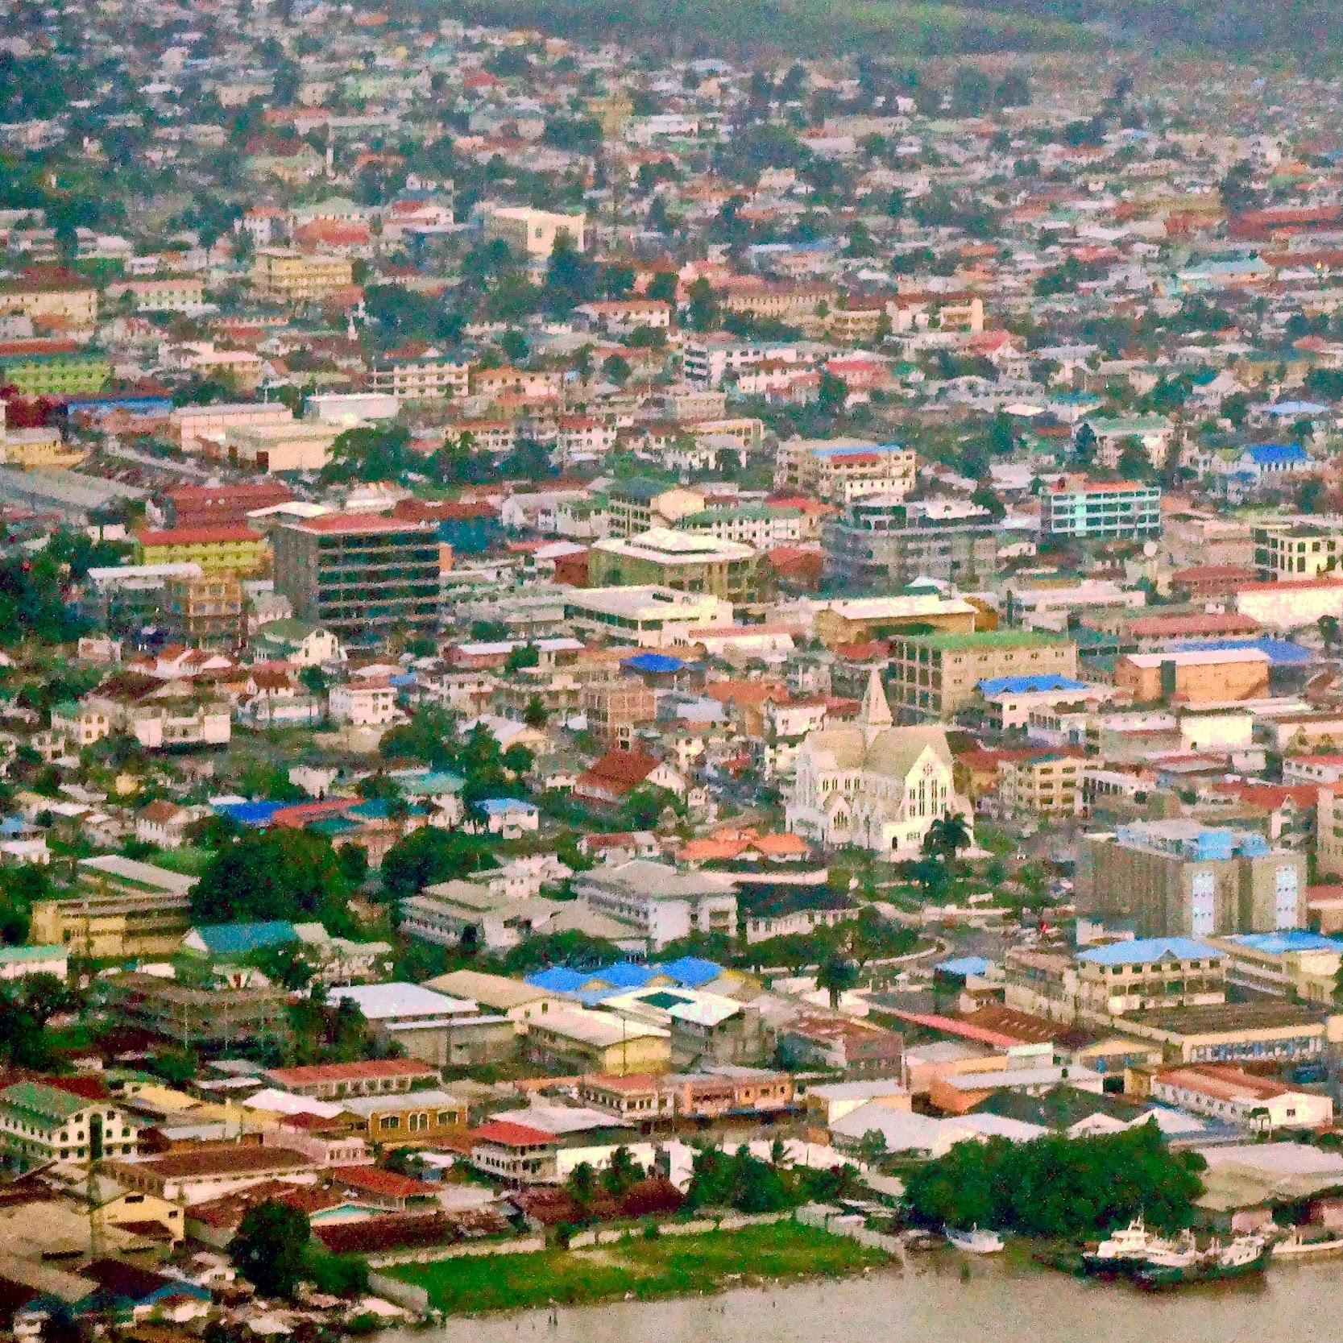
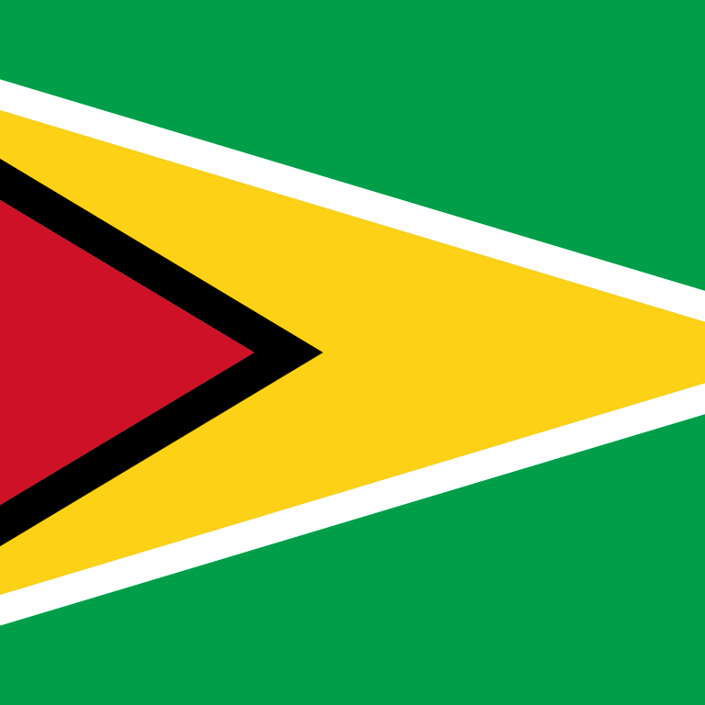
Guyanese Culture
Guyana is the only English-speaking nation in South America and is also referred to as the "land of water." Even though Guyana achieved its independence in 1966, its natural resources, particularly its pristine ecosystems, sugarcane plantations, rice fields, and gold assets, have been the nation's primary economic capital. This equatorial lowland's climate is characterized by high temperatures, heavy rainfall with little seasonal variation, high humidity, and high average cloud cover. The three main religions that are practiced are Islam, Hinduism, and Christianity. Common foods we eat are rice and curry, roti, and black cake.

Slide 4
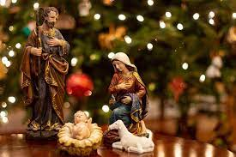
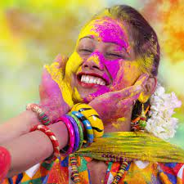
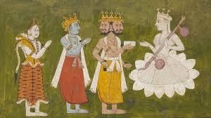
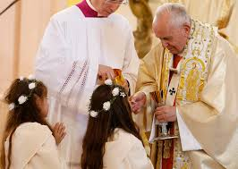
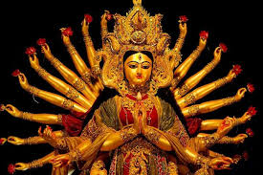
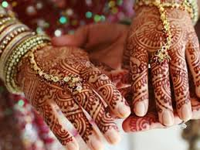
Beliefs
My mother grew up as a strict catholic however my father grew up exposed to both hinduism and Islam. We strictly practice christianity however we still celebrated hindi holidays out of respect. I was later on exposed to Islam and learned many of their traditions.

Slide 5
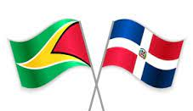
Cultural Norms and Values
No shoes in the house (ever)
Eat dinner as a family (when we can)
Pray together every sunday
Always respect your elders (close relative or not)
Older siblings become like second parents
Serve your older or male relatives first(food)
Dress modestly
Never question the home-made remedies
Never show that you’re upset in public (could seem disgraceful)

Slide 6
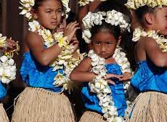
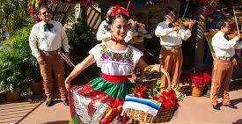
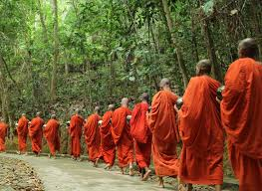
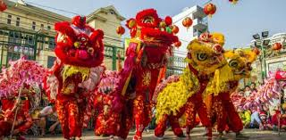
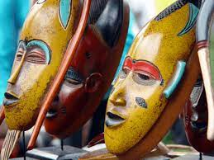
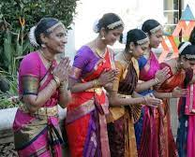
My cross cultural experiences
…In the US
I grew up in queens surrounded by many Indian, Chinese, Paki, Filipino, Guyanese, Trini, and Viet. from ages 0-10. I found we shared similarities when it came to upbringing, food, and norms.
We then moved to the Bronx (ages 11-18) I made many Jamaican, Venasuelen, Trini, Nigerian, Puerto Rican, Mexican, and Ghanian friends. I also found we shared many interests aswell such as food, and hobbies.

Slide 7
Culture Shock
New York is a very diverse city with all ethnicities and backgrounds however it was shocking when I learned:
Some don’t take off their shoes before entering the house
Not everyone believes in a religion
Some cultures don't prioritize the elderly
People eat a lot of fast food
Not all religions dress modestly
People who grow up as 2nd or 3rd gens don’t practice their culture as strongly

Slide 8
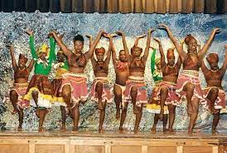
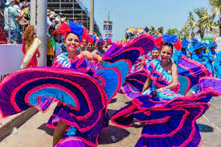
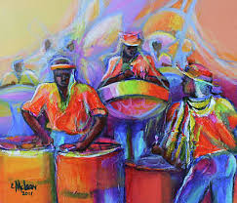
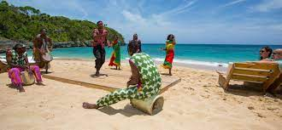
Cross Cultural Experience
Outside the US
Traveling outside the United States has made me realize the cultures that are practiced here and practiced in home countries are very different (at times).
Caribbean people from the the US (first gen) aren’t the same as the ones in the motherland.
People from the motherland practice their traditions and religions more seriously. They’re style of parenting is also very different (they are more strict and don’t tolerate any type of misbehavior)

Slide 9
Multicultural Education
Multicultural education is important because many people are not around diverse groups and need to be exposed to different perspectives. Diversity will lead to less prejudice, discrimination, and inequality.
Although New York has a wide range of ethnicities, many cultures live in small like communities instead of intermixing which is why schools are helping to achieve a multiculturalistic society. We can bridge these multicultural divides by enforcing workplace diversity, avoid offensive jokes, be open to differences, look into other cultures and beliefs.

Slide 10
Sources
https://www.forbes.com/sites/iese/2021/04/26/why-bridging-cultural-and-organizational-divides-is-key-to-the-future-of-work/
https://www.godominicanrepublic.com/
https://thecommonwealth.org/our-member-countries/guyana
https://globaldiversitypractice.com/what-is-diversity-inclusion/

