Slide 1
My Diversity and Cross Cultural Story
By john pelaez

Slide 2
Introduction
This presentation focuses on my cultural experiences in NYC. Specifically, this pertains mostly to my experiences with my Ecuadorian culture. I have never ventured much outside other than to gather groceries or go to college; however, that doesn’t mean I don’t have any cultural encounters. Henceforth, the sections afterward will be on religion, immigration, work culture, gratitude, and cultural neighborhoods.

Slide 3
My experience with religion
During my high school days, I went on a field trip to a mosque. I don’t remember which mosque, but the experience stayed relatively the same. It had pews like a church, ornate glass paintings, a Quran on the podium. Having seen all that, I didn’t feel any sense of spirituality. To explain this, my family isn’t overly religious. My parents come from Ecuador and Puerto Rico, where their country’s religions are Catholic and Roman Catholic, respectfully. Proof of their religious affiliation consists of crosses, a few paintings, and some figurines. Basically, my family possesses some catholic figures; otherwise, as of now, none of them attend church, or go to mass, or anything like that.

Slide 4
Culture neighborhoods
Tying back to the field trip story, the location of the mosque was positioned near a Chinatown. This was one of the few times I seen a neighborhood full of a majority group. Similar in that regard, I’ve also seen a few Jewish neighborhoods. The noticeable difference with those neighborhoods is that the people wear Jewish clothing. What I mean is that the men have big hats with twin curls at either side, and the young boys had those skullcaps on (called Kippah).

Slide 5
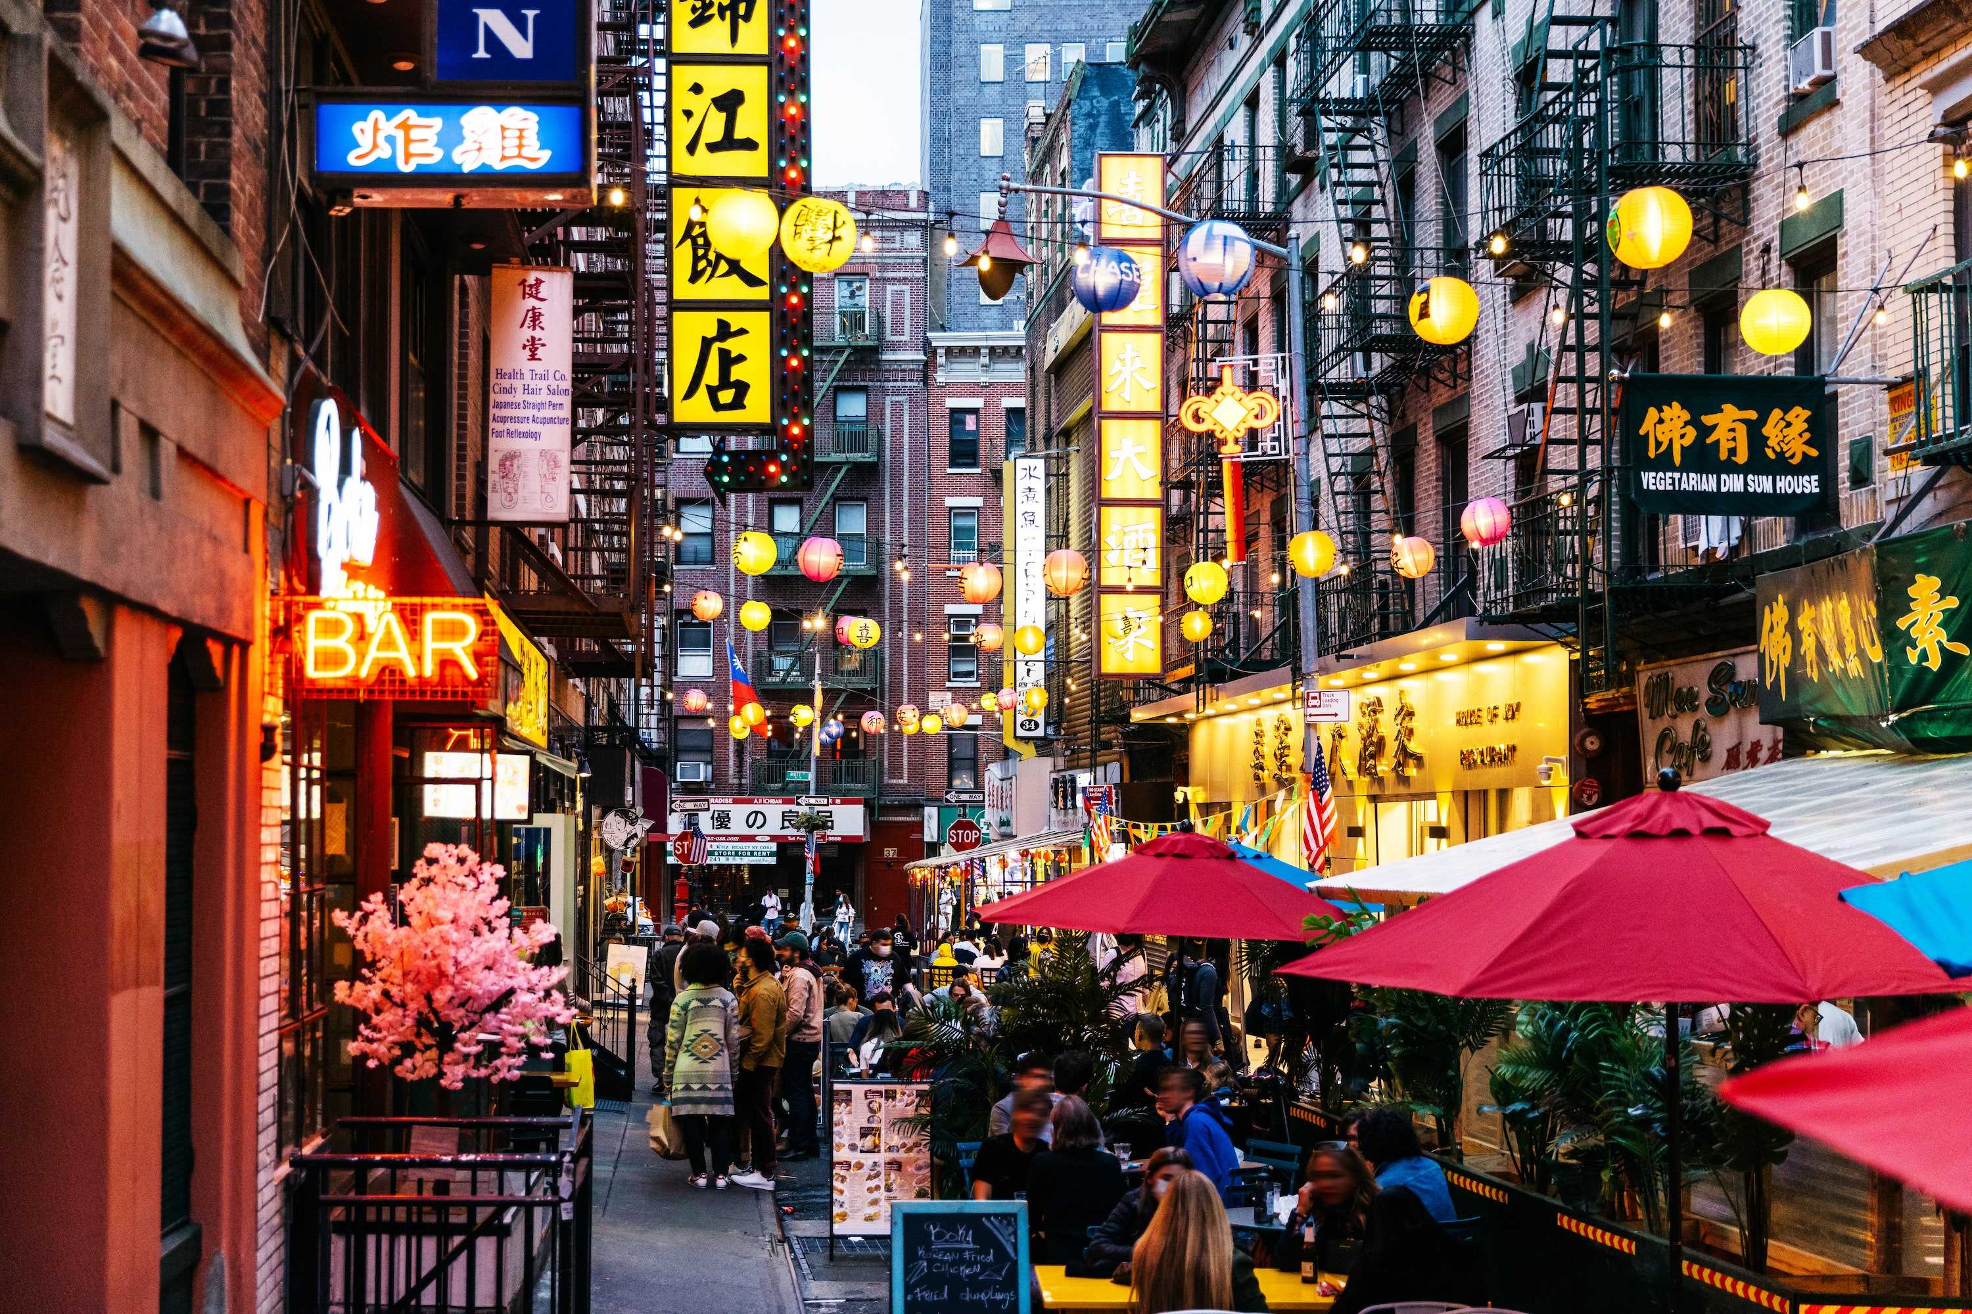

Slide 6
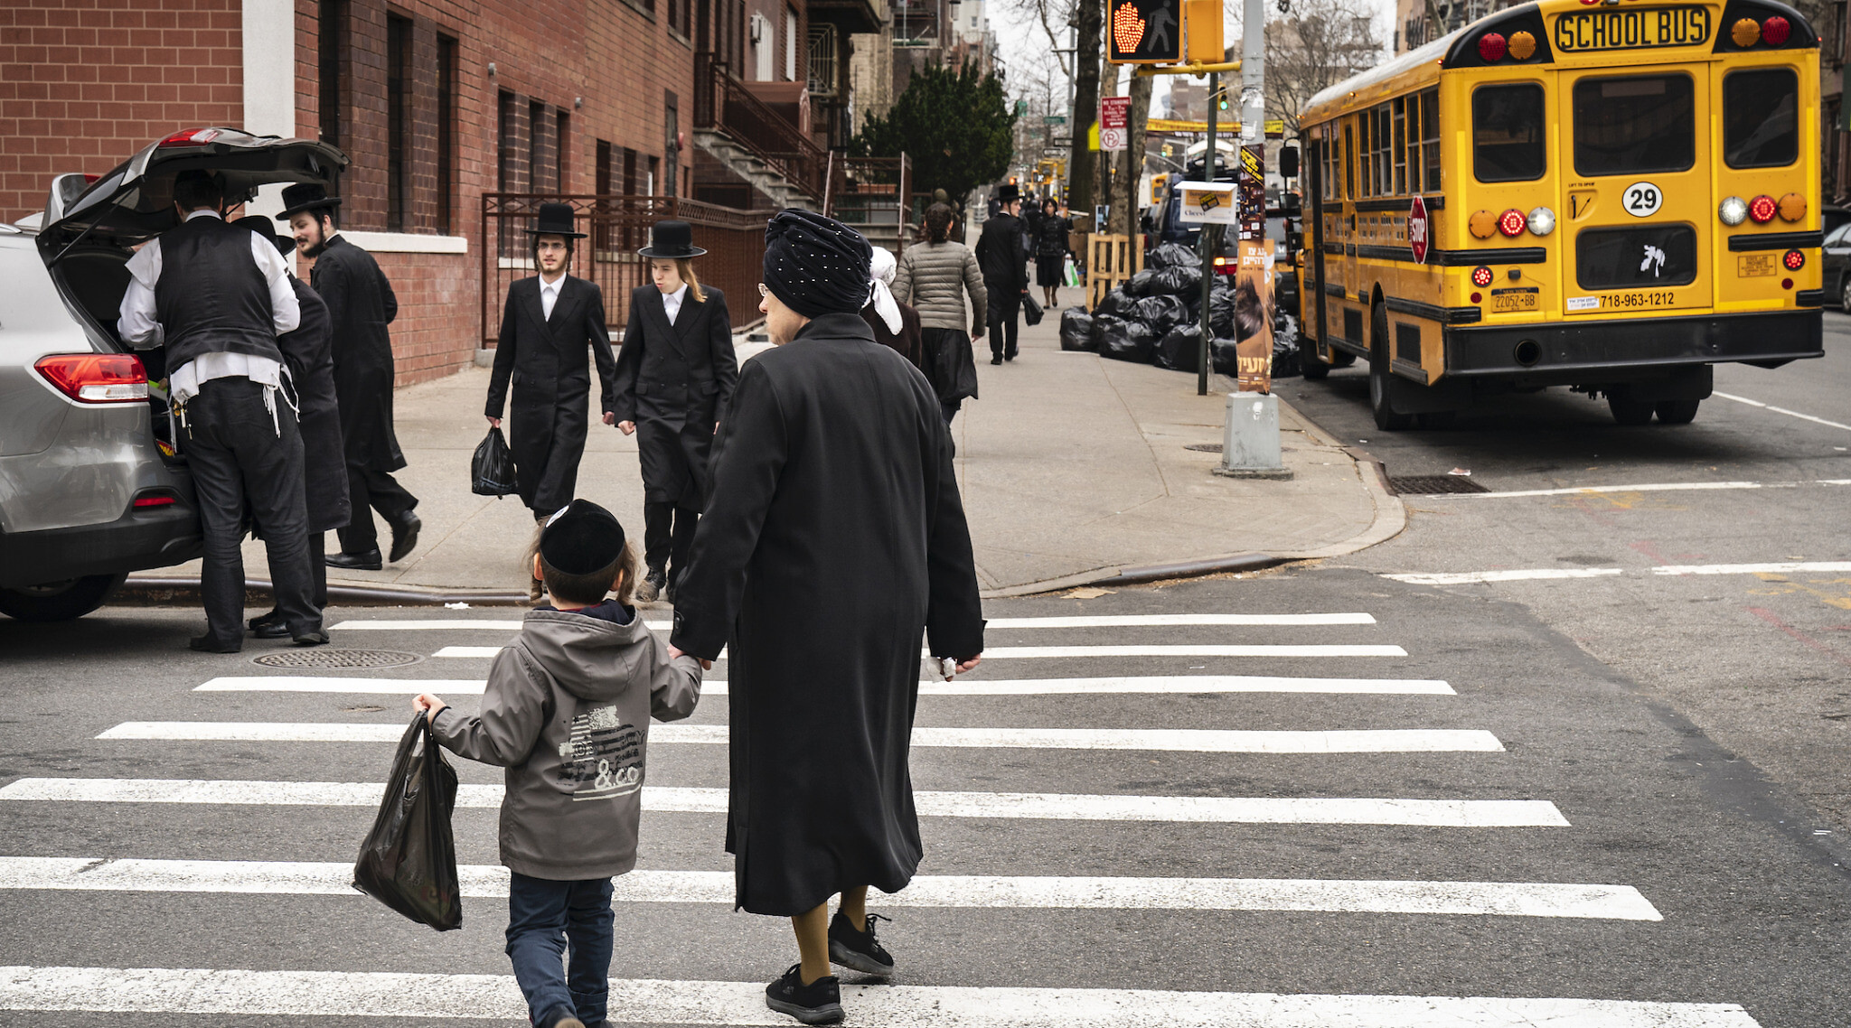

Slide 7
Immigration (in terms of my family and i)
In terms of immigration, there’s nothing unique for my immediate family. Being born here in America, I was already an American citizen by birthright. My mother is Puerto Rican, which is a territory of the US, so technically she is a citizen. However, my father wasn’t born here, he is from Ecuador (in South America). Unlike me and my mother, he had to work here for many years before he got his green card to live here. (In fact, he became an official US citizen recently.) The reason he came here could be economic instability. He said on the phone one time that Ecuador was bad to live in, mostly because of the lack of jobs there and the poverty.

Slide 8
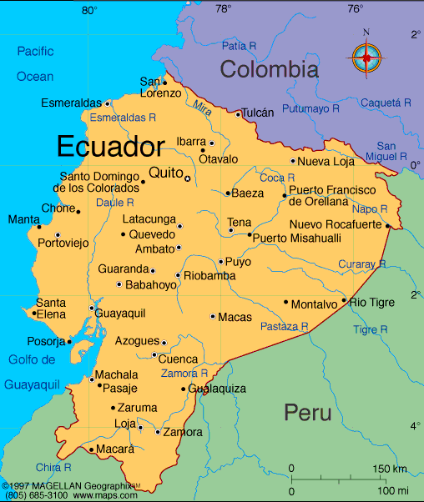

Slide 9
Experience with my extended family
I never meet my extended family much. But when I went there, it was different then what was I used to. Their neighborhood mostly consisted of small wooden houses, and a large empty yard in the middle. I can’t recall their names, but there were a lot of family members. They even had a pet named Toby, an old, dimwitted dog with white haired. They definitely cooked often as most of them were present at the table when dinner was ready. The food was very ethnic. One time, they had a common Ecuadorian chicken soup with a white greenish broth, with herbs, green peans, and small noodles. Vocally, they spoke Spanish, as they’re from Ecuador. In my household, we spoke mostly English, but over there they almost spoke it exclusively.

Slide 10
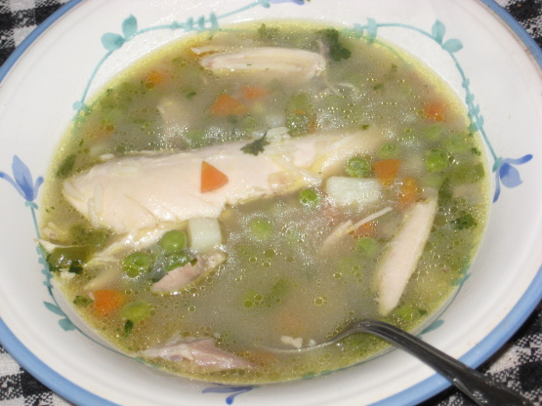

Slide 11
Ethnic food
Continuing on ethnic food, I experienced more diverse food, other than what my family cooked. It was during my times eating out with my father and his friend Minchala. There were two restaurants, one fancy and one modest. The atmospheres of both were familial. I say that as in there are many Hispanic people talking, and sometimes there were family parties. Anyway, the appetizers were usually consisting of that soup from before, or these little white vegetables (I couldn’t find it’s name). Other than a soup, this meal had these potato patties called “llapingachos”. They were on a pad of rice and beans, with avocadoes, sausage, a belt of pork, and a small salad.

Slide 12
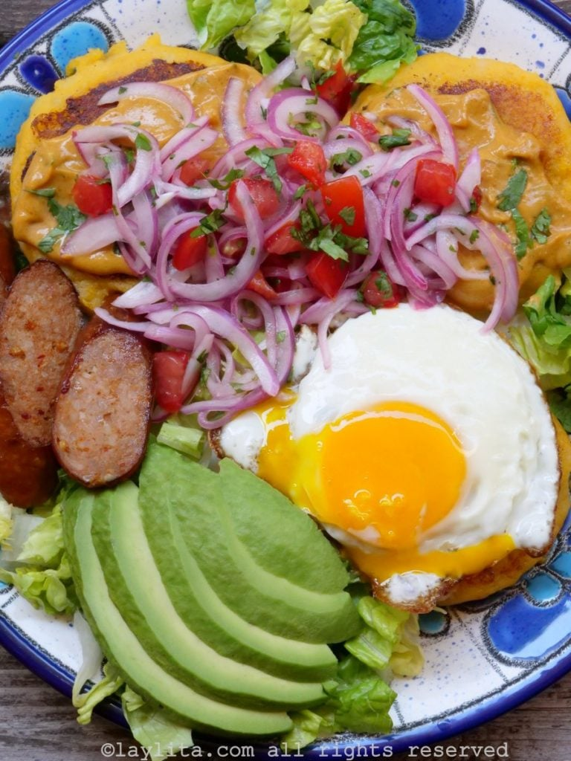

Slide 13
Work culture
When I was younger, I used to see my father go to a travel agency. He said he was sending money back to his mother back in Ecuador. In fact, when they landed, he actually picked them up from the airport. I never realized the importance of family to him. I only ever met my other, extended family when I was a child, but that was only for parties, birthdays, and rare visits. His work culture is fierce and attentive. He’s been working as an engineer for a good amount of years, without even having a degree.

Slide 14
Gratitude
My other experience with family emigrating to America was with my brother. This brother is someone I didn’t know very well. My father and I met picked him up somewhere in a mall and returned home. For a time, he lived in my house for a couple days (until things were set in place), and I experienced something I’ve never seen. In short, we were eating some store food; I didn’t want my muffin so I gave it to him. I didn’t expect any reaction but he actually gave me a slight bow (with his hands). Usually, if I gave something to someone, they just gave me a moot “thank you”. Here, he actually showed gratitude when he didn’t need to.

Slide 15
Conclusion
My story in New York mostly consists of what I saw from my high school days, and what I saw from my family. The food of Ecuador is very fascinating and tastes very good. I haven’t been around enough to know the various cultures around New York, but I still find comfort in knowing my Ecuadorian side of things.

