Slide 1
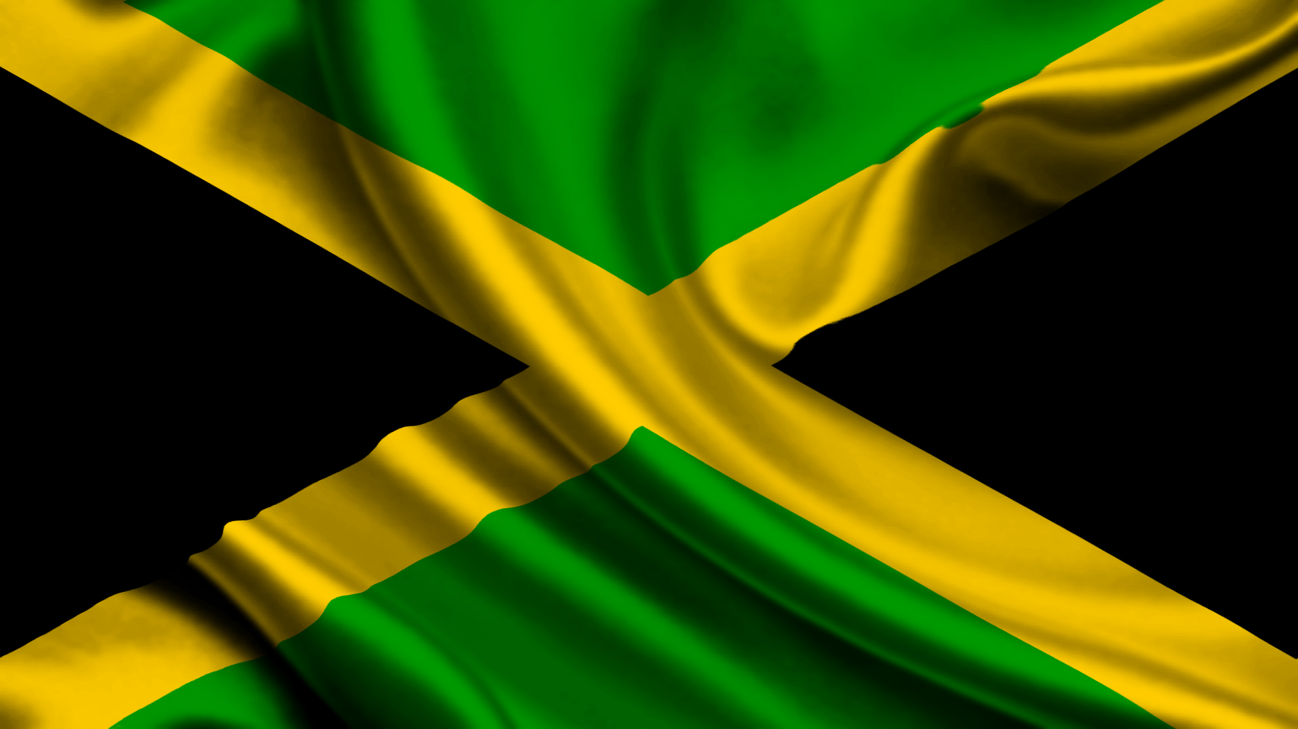
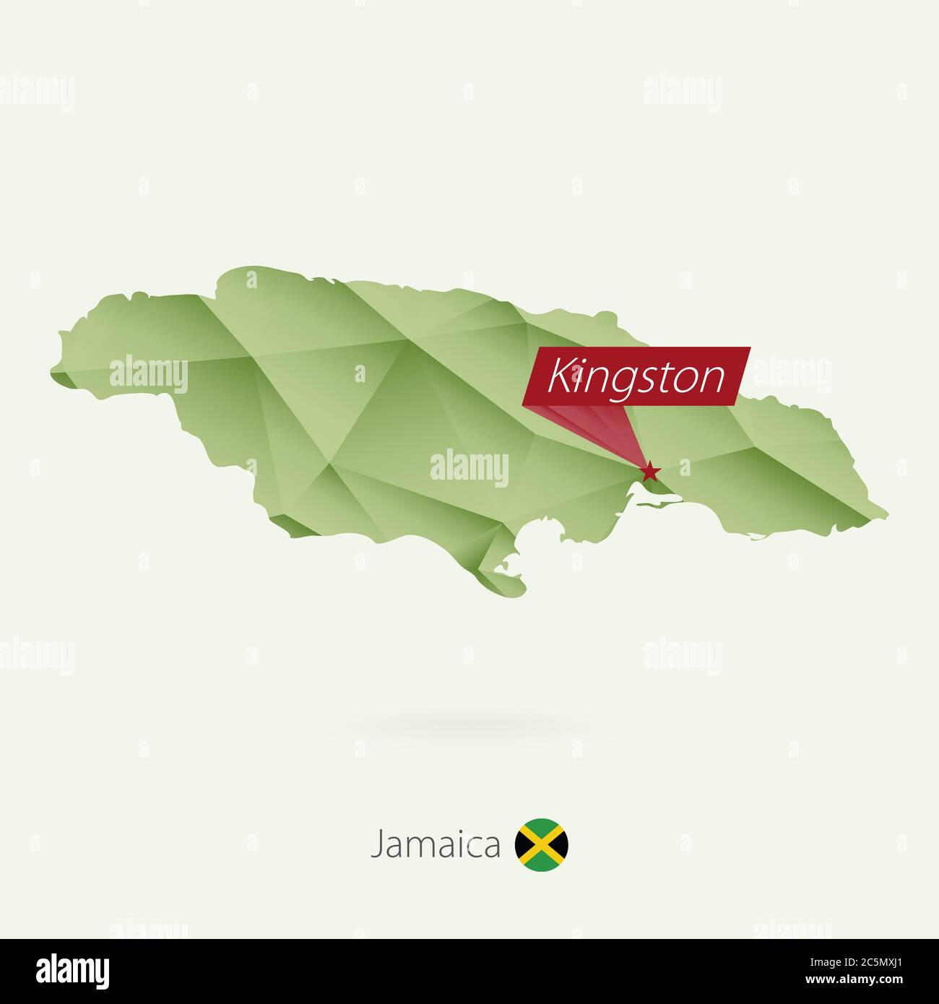
MY CROSS CULTURE EXPERIENCES FROM KINGSTON JAMAICA WI.
TO JAMAICA QUEENS NEW YORK

Slide 2
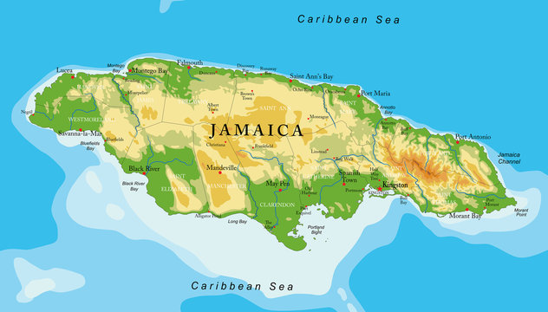
WHO AM I ?
MY NAME IS DANTAE BRIDGMANHEN
I AM FROM KINGSTON JAMAICA WEST INDES
I AM FROM AN EXTENTED FAMILY
JAMAICAN MAP
JAMAICAN FLAG

Slide 3
EASTER BUN AND CHEESE TRADITION IN JAMAICA
THE TRADITION OF EATING BUN AND CHEESE CAME FROM THE UNITED KINGDOM IN THE 17OOs
BUN PRODUCTION WAS LIMITED TO SPECIFIC PERIODS ONE OF WHICH WAS GOOD FRIDAY.
JAMAICA WAS UNDER THE BRITISH FLOOR, THUS THE ISLAND FOLLOWED THE BRITISH CUSTOMS
The cross on 1700s buns symbolize the crucifixion of Jesus

Slide 4
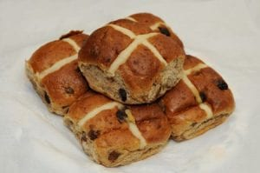
EASTER BUN AND CHEESE TRADITION IN JAMAICA
THE 1700s BUN AND CHEESE
JAMAICAN BUN AND CHEESE

Slide 5
VIDEO REFERENCE

Slide 6
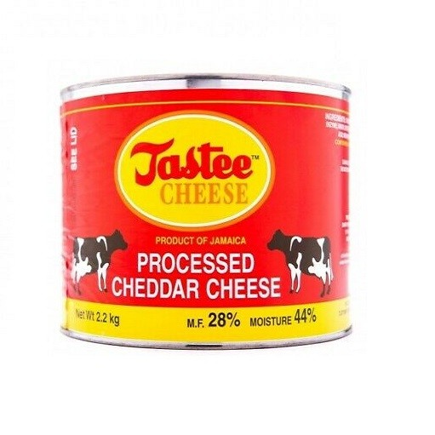
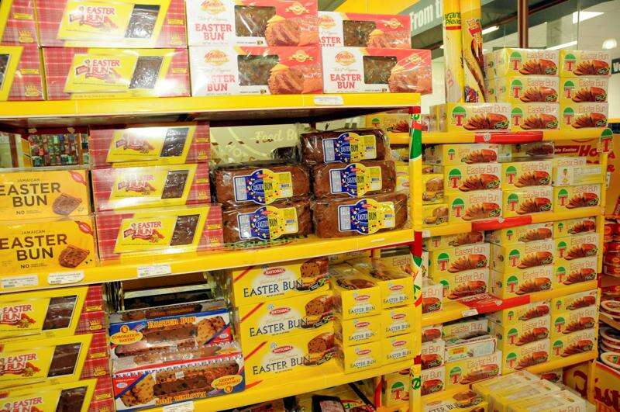
CONT’D
A week before Good Friday, the shelves of supermarkets in Jamaica are stacked with bun and tin cheese as residents begin to purchase in bulk, in preparation for the EASTER holidays

Slide 7
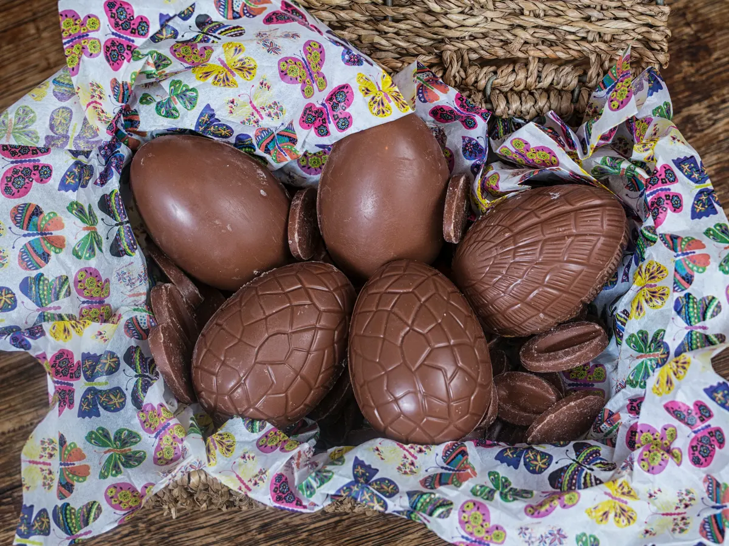
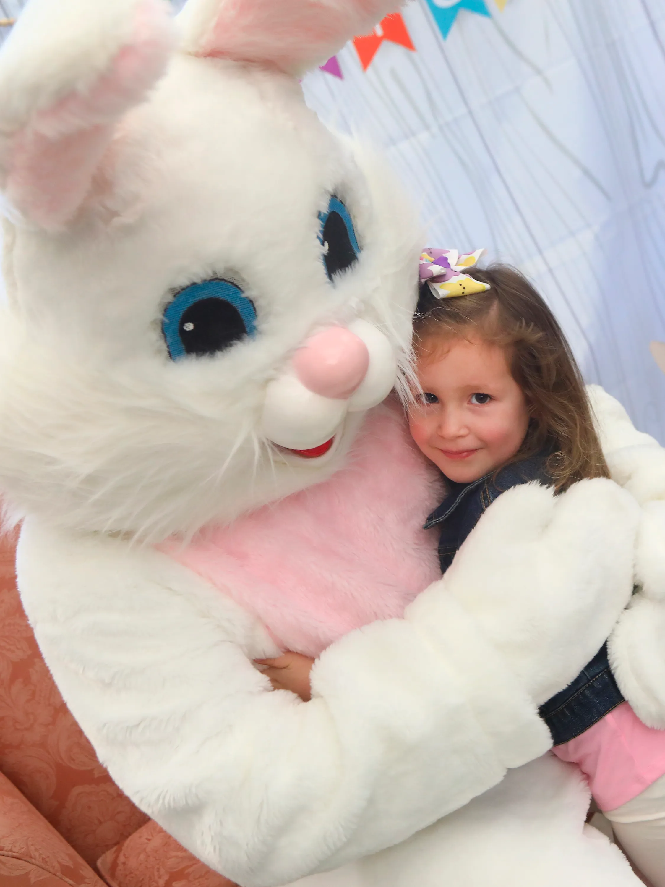
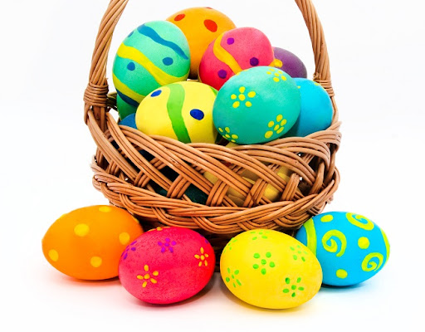
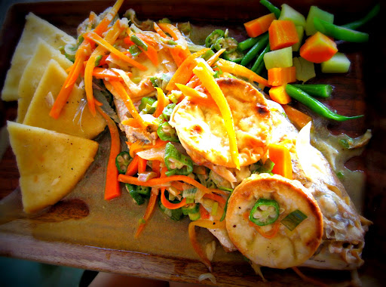
Contrast easter in the us versus Jamaica
In the United States
The Easter Bunny
Easter egg hunts
Easter Baskets
Wearing of light spring colors such as yellow pinks and baby blue
In Jamaica
Wearing black to church as mourning Jesus crucifixion
Eating Fish
Eating Bun and Cheese etc….

Slide 8
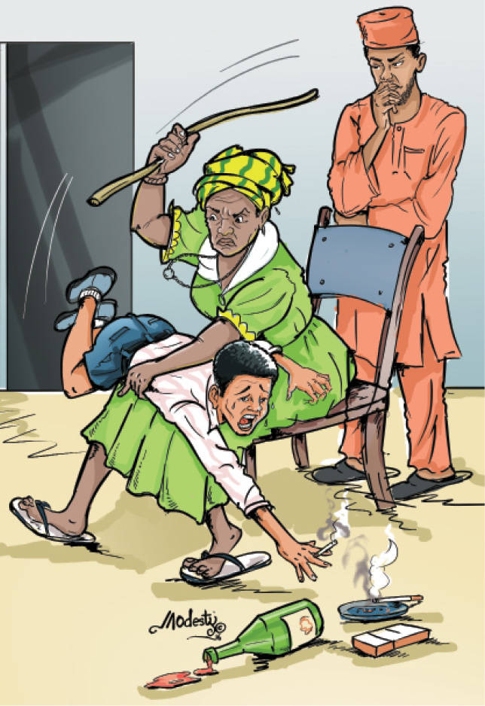
Child rearing practices in Jamaica
The Jamaican culture condones parents/ guardians beating children for being disobedient or misbehaving
Children are usually beaten with whips, garden hose, dried cane and more contemporary with belts.
Most older Jamaicans have attested to be grateful for the many beatings as they believe it shaped them into responsible moral person.
Children are also flogged my Jamaican teachers time wasting and disruptiveness etc.. Parents usually encourage this.

Slide 9
Child rearing/ disciplining in the united states
In the US to beat one’s child, even in the privacy of one’s home, is an illegal infraction, child abuse, which can result in a prison sentence.
Here in New York more gentle parenting and disciplinary strategies are practiced.
Some of these are:
Time outs/ Grounding
Allowing Children to express themselves freely
Setting Boundaries
desired items
THESE STRATEGIES ARE DEEMED MEDICORE BY MOST JAMAICANS

Slide 10
THE INTODUCTION TO HALAL FOOD IN NEWYORK
Halal is an Arabic word meaning permissible and it means meat prepared by Islamic laws..
In today’s society, halal food controls the streets of New York. It usually consist of rice, greens, halal meats and a lot of condiments such as white sauce etc.
The reason why people love halal carts is simple: the food is cheap and filling.

Slide 11
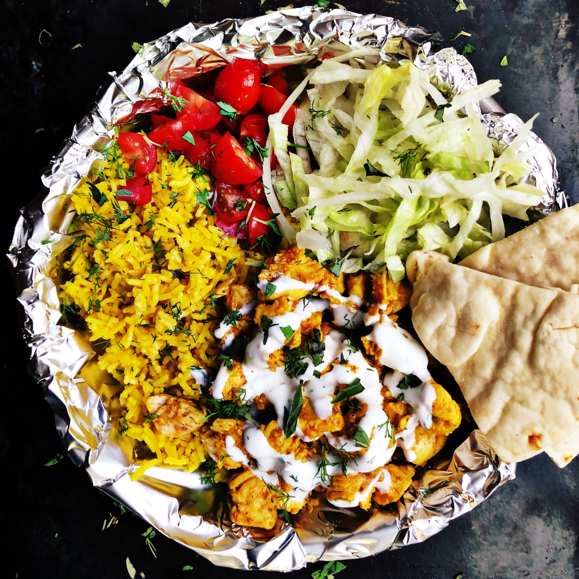
PICTURE REFERENCE
HALAL FOOD TRUCKS
HAFOODLAL STREET

Slide 12
culture shock of trying halal food in new York
TTRYING HALAL STREET FOOD WAS A CULTURE SHOCK FOR ME BEACAUSE IT WAS VERY DIFFERENT FROM STREET FOOD IN JAMAICA.
IN JAMAICA STREET FOODS TAKE THE FORM OF:-
BEEF PATIES, JERK CHICKEN/PORK, ROASTED YAMS, GOAT SOUP ETC…

Slide 13
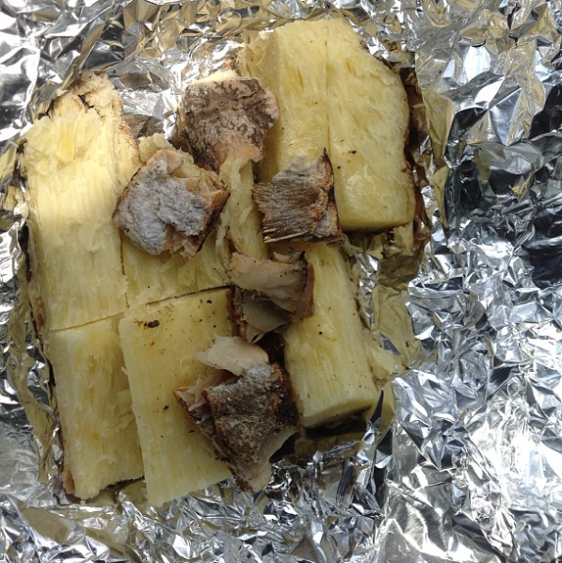
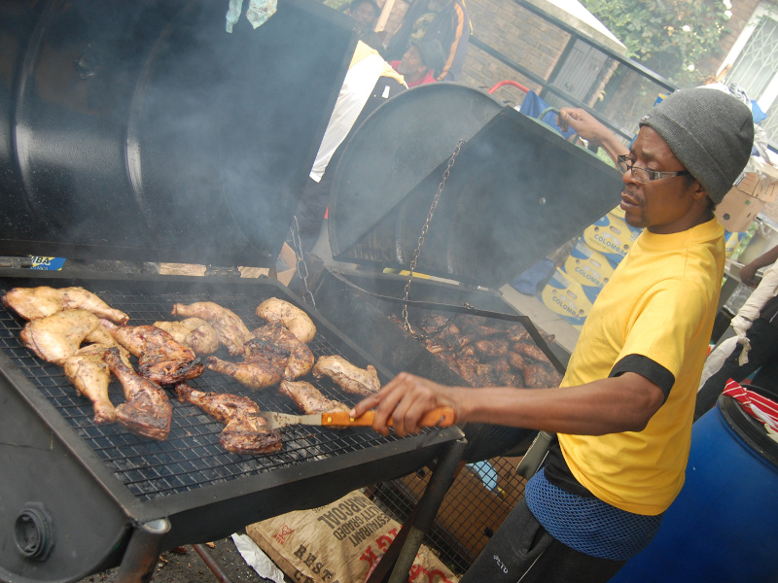
PICTURE REFERNCEs of ja street food
GOAT/ CHICKEN FOOT SOUP
ROASTED YAMS
JERK CHICKEN /PORK

Slide 14
PARTIES/CELEBRATIONS IN JAMAICA
JAMAICA HAS A VERY TROPICAL CLIMATE AS A RESULTS A LOT OF PARTIES/ CELEBRATIONS TAKES PLACE ON THE STREETS
BIRTHDAY TO CARNIVAL AND DANCEHALL CELEBRATION ALL OCCUR ON THE STREETS. NO FORMAL INVITATION ALL ARE USUALLY WELCOME!

Slide 15
Video reference of street parties in Jamaica

Slide 16
Parties/ celebration in new York
PARTIES HERE IN NEWYORK ARE USUALLY KEPT IN DOORS IN LOUNGES AND CLUBS DUE HARSH WEATHER CONDITIONS AND INVOLVEMENT IS BASED STRICTLY ON INVITATION. EXCEPT A FEW !

Slide 17
Groovin ‘ in the park
Groovin’ In the Park is one of the largest family-friendly Reggae and R&B concerts in the U.S. that provides an eclectic array of entertainment and popular music.
This was my first experience of the Jamaican culture in Queens New York . I
It felt great having a Jamaica event here in New York, it felt like home away from home!
This concert caters to a wide cross-section of American and Caribbean audiences.
It occurs once every Summer at The Roy Wilkins Park, Jamaica NY.

Slide 18
PICTURE REFERENCE OF GROOVING IN THE PARK

Slide 19
INTERVIEW WITH COWORKER from Guyana
.
Was the introduction to American foods after migrating a culture shock? Was it pleasant or unpleasant ?
Yes it was somewhat of a culture shock because the foods here are very salty and oily causing weight gain. She also noted that all foods from Guyana are available for sale here in New York but it doesn’t taste as good as the cuisine prepared homemade in Guyana

