Slide 1
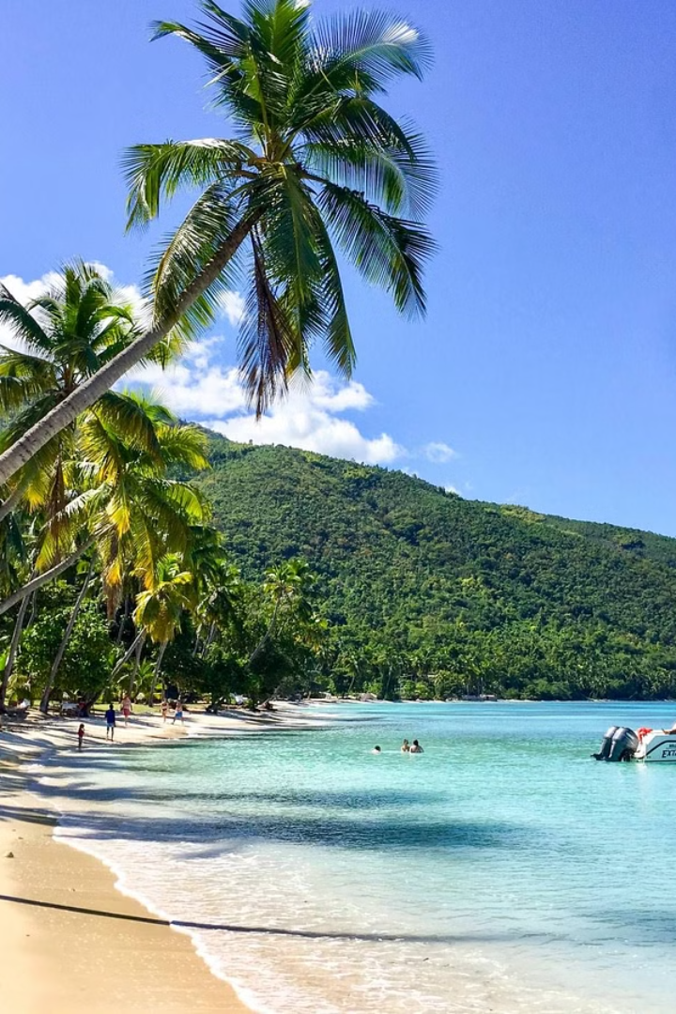
My Journey from Haiti to the US
My name is Gustensen Dabresil, and I come from Carrefour, a city in the capital Port-au-Prince, Haiti. Life in Haiti was initially pleasant, but the growing presence of gangs near our area raised concerns for our safety. It was then that my father made the decision for me, my mom, and my sister to relocate to the US in search of a better life and better opportunities. The main reason for moving to the US was to make sure I am safe and have a good environment to pursue my education and career goals.

Slide 2
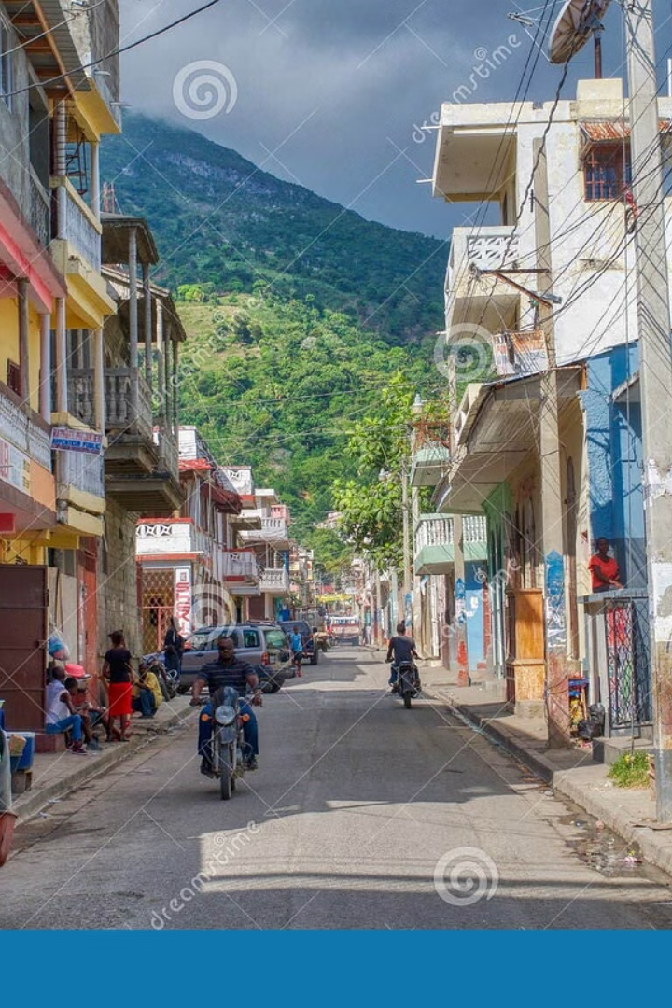
Leaving Haiti
Leaving Haiti was both happy and sad for me. I was excited to go to the US for a better and safer life, but I was also sad to leave my country and my father behind. Haiti had so many things that I loved, like the busy streets, the great music, and the yummy food, and I still miss it today.

Slide 4
Arriving in the US
Upon my arrival in the US, the difference was striking. The well-maintained roads, picturesque beaches, and grand architectural structures illustrated the affluence of the nation. The initial culture shock was less pronounced for me due to my previous visits to the US. However, it was still a remarkable shift from the familiarity of Haiti.
1
Cultural Contrast
The social customs and the way of life in the US differed significantly from what I was accustomed to in Haiti. The reserved and independent nature of Americans was very different than the vibrant and communal lifestyle in my homeland.
2
Challenges Faced
While adjusting to the US, the language barrier posed the most significant challenge. Attending high school and enrolling in ESL classes were pivotal in enabling me to communicate effectively and integrate into American society.

Slide 6
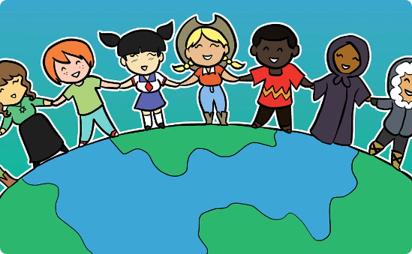
Adapting to a New Environment
The journey of learning English was transformative, and enrolling in ESL classes played a crucial role in my linguistic development. One big difference I noticed is that people in the US are more quiet than people in Haiti. In Haiti, people are more friendly and outgoing.
Learning English
Adapting to Cultural Nuances
Immersing myself in English classes and watching movies helped me in mastering the language for day-to-day communication.
Overcoming the reserved nature of social interactions in the US required an adjustment period, but it provided valuable insights into a new way of engaging with others.

Slide 7
Navigating a New Society
The social interactions in the US were marked by a more direct and individualistic approach compared to the communal and indirect communication style popular in Haiti. Additionally, the emphasis on individual freedom and personal responsibility in the US was a notable difference in values and beliefs.
1
Social Interaction
2
Values and Beliefs
In the United States, people tend to communicate directly and to the point. This is different from Haiti, where people tend to communicate in a more indirect and community-oriented way. In the US, people are more likely to value expressing themselves as individuals.
The emphasis on personal freedom and responsibility in the US presented a contrast to the collective values frequent in Haitian society.

Slide 8
Embracing New Opportunities
The journey from Haiti to the US has been transformative, broadening my horizons and offering new opportunities for personal and professional growth. While challenges were present, the experience of assimilating into American culture has enriched my perspective and outlook on life.
Learning Experience
Personal Growth
My journey has been an invaluable learning experience, challenging me to adapt and thrive in a vastly different environment.
The process of assimilation has facilitated personal growth, enabling me to navigate diverse cultural landscapes with resilience and adaptability.

Slide 9
Changing Perspectives
My journey from Haiti to the US has not only reshaped my life but has also provided profound insights into American society and culture. By bridging cultural differences and embracing new experiences, I've gained a deep understanding of the richness and diversity of the human experience.
Enhanced Awareness
The experience has elevated my awareness of various cultural contexts, fostering empathy and understanding across diverse societies.
Empowering Encounters
Embracing encounters with individuals from diverse backgrounds has empowered me to interact with the world with an open mind and inclusive spirit.

Slide 10
Embracing New Perspectives
Continuing the journey of personal growth, embracing new perspectives has been critical for transformative change. By opening our minds to different viewpoints, we expand our understanding of the world and promote empathy and compassion.

Slide 11
Reflecting on the Journey
My journey from Haiti to the US has been an example to the resilience of the human spirit and the transformative power of embracing new experiences. The invaluable insights gained from this transition have shaped not only my personal narrative but also my understanding of the mix of cultures from all over the world.
Resilience
Cultural Diversity
The journey has exemplified the resilience required to navigate and thrive in diverse cultural environments, evoking a sense of perseverance and adaptability.
Learning about different cultures has shown me how connected everyone in the world really is. It's made me appreciate how we can all celebrate our differences and be friends.

Slide 12
Conclusion
As I look back on my journey, I am reminded of the transformative power of resilience, adaptability, and open-mindedness. Each experience has shaped me into the person I am today, and I am grateful for the valuable lessons learned along the way.
This journey has taught me the importance of embracing diverse perspectives and engaging in meaningful conversations. By promoting an enriching dialogue that celebrates the diversity of experiences and perspectives, we create a world where everyone's story is valued.
Embracing Diverse Perspectives
Embracing diverse perspectives reinforces the spirit of inclusivity and fosters a deeper appreciation for the beauty and complexity of the human experience.
Celebrating Our Differences
When we share and learn about different experiences, we get along better and appreciate the many stories that make up our world.

Slide 13
Thank You
Thank you for joining me on this journey from Haiti to the US. It's been a pleasure sharing my experiences with you. I hope my story has inspired you to embrace diversity and new opportunities in your own life.

