Slide 1
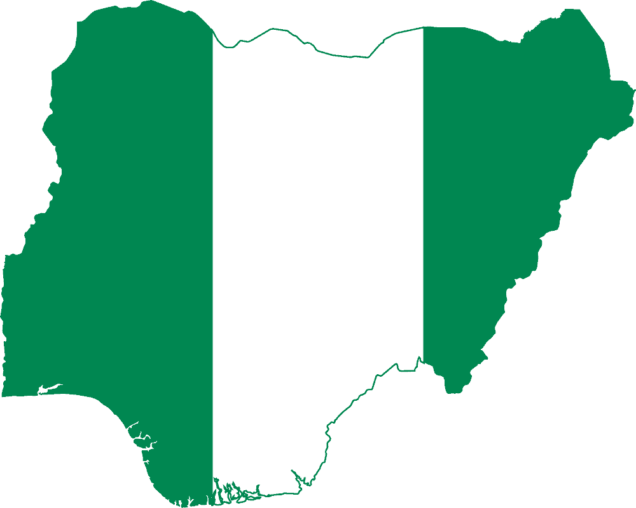
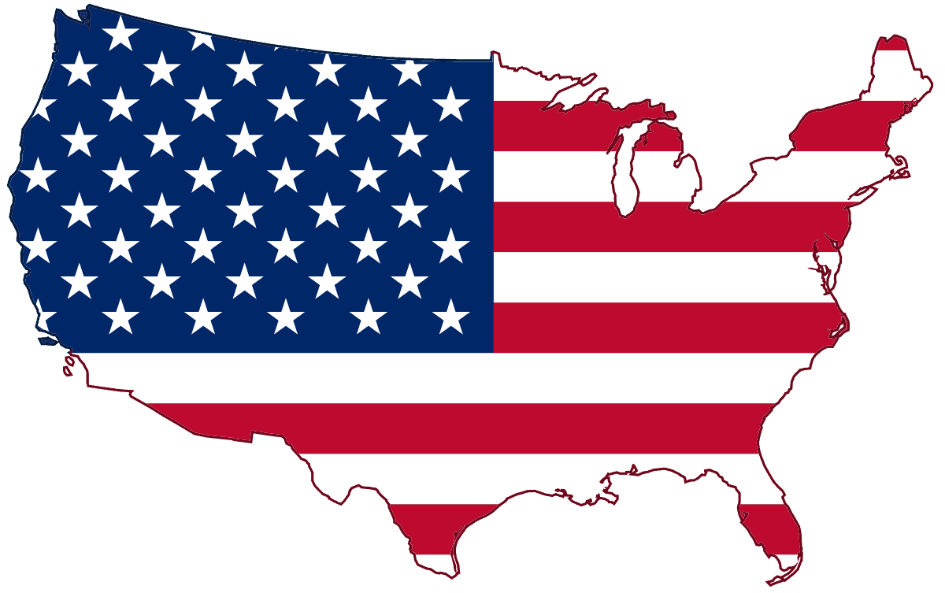
Family acculturation story in America
By Echeanu M
CLDV 100 – Intro to Cultural Diversity
Prof. Remi Alapo Spring 2024

Slide 2
Introduction:
This presentation will be on my father/family's migration to America and our acculturation journey. Today, I will explore the experiences my father has had from Nigeria to the United States. This will highlight our adaptation to American culture. Beginning with his decision to leave Nigeria due to economic challenges during the Biafran War, I'll share the initial impressions my father had upon arriving in America and the challenges he faced.

Slide 3
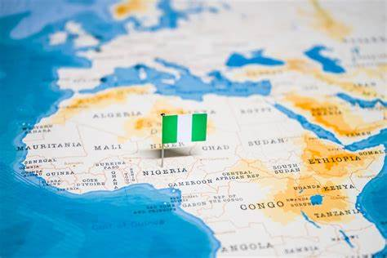
BackGround:
My father and I are from Nigeria, Nigeria is located in West Africa. It's the most populous nation in all of Africa with an estimated population of 227 million plus people. We are ranked the 6th most populous nation in the world. We boast a rich extensive cultural heritage tracing back to our ancient kingdoms from pre colonial times such as Oyo, Nok, Benin, Nri empires. Nigeria is known for a plethora of reasons but one of the main things is its vibrant Music and Art scene especially with the global rise of Afrobeat/Afrobeats. My father left Nigeria for a variety of challenges however it was primarily financial and hunger reasons during the biafran war.

Slide 4
Arrival In America:
Dads first impressions of America after emigrating from Nigeria were that America is that it's heaven on earth. America has the potential to be an actual utopia on earth. When he saw the escalator in the airport for the first time it was a shock to say the least.

Slide 5
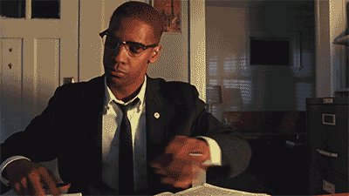
Early Challenges:
Some of the biggest challenges my father encountered when he came to America were primarily with academics. My father was always brilliant. The problem was the lack of funds he had to pay for his courses. He would save money for a semester before he could do another semester and practice that same pattern that alone probably took him like 8-10 years just to finish his bachelors. My father also had problems understanding the accents of his professors.

Slide 6
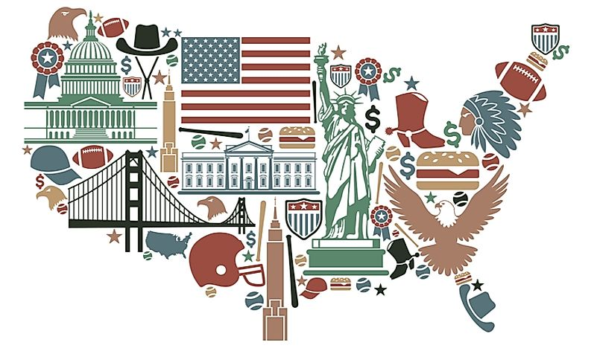
Adaptation Process:
When it comes to the adaptation process to american culture and lifestyle it was always something that was weird to my father. My father always viewed Nigerian Culture and American Culture as polar opposites. He would say Nigerian culture even african culture as a whole is more communal/collectivist whereas America is more individualistic. Nigeria and other Africans alike believe in mainly wisdom, America believes primarily in Knowledge. In America a child belongs to the mother and father, In Nigeria a child belongs to the village. Hence the term it takes a village to raise a child.

Slide 7
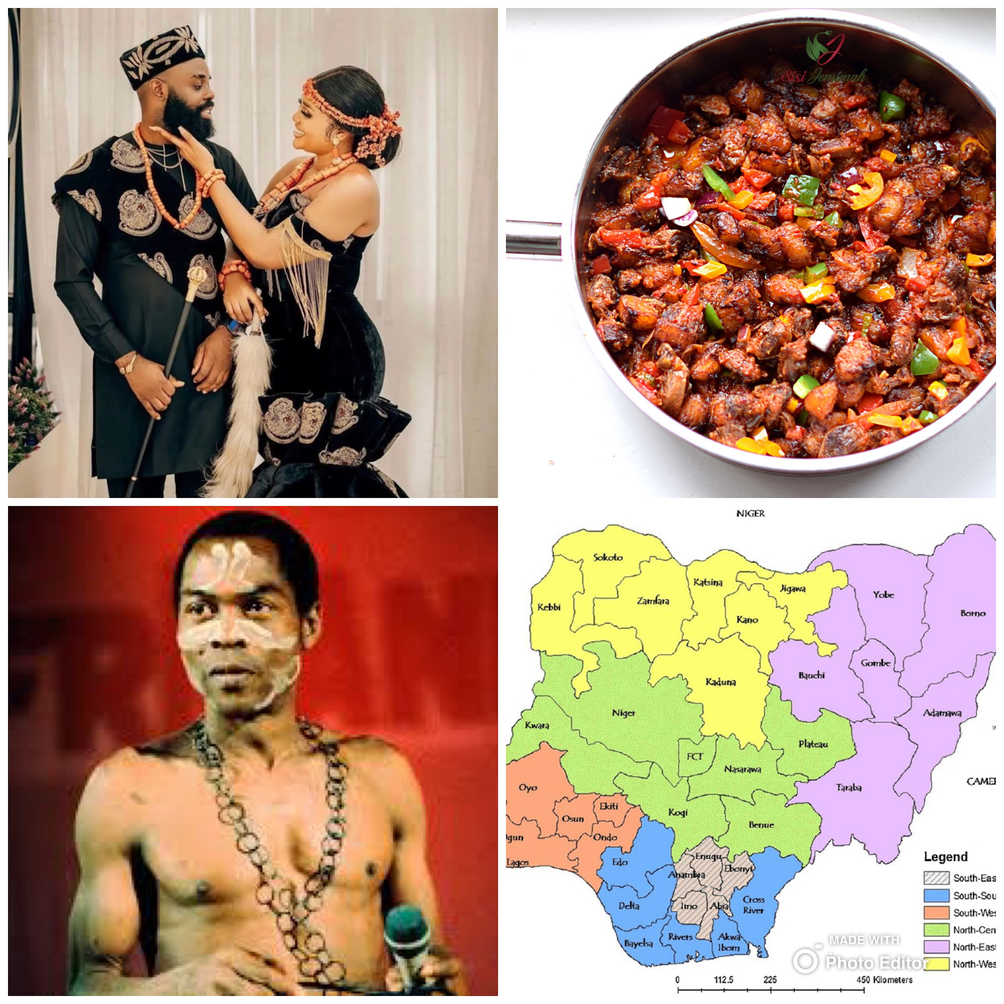
Cultural Identity:
My father and our culture has always been kept intact with us by listening to our musicians back home, eating the food, watching movies/shows from home, keeping up with news from back home, and a variety of things. My father's identity is still Nigerian however after living in America it's fair to say that he has become more open minded to certain things. His experience here has helped him avoid mistakes that other Africans alike would make. His experience here caused him to go back into re exploring our culture.

Slide 8
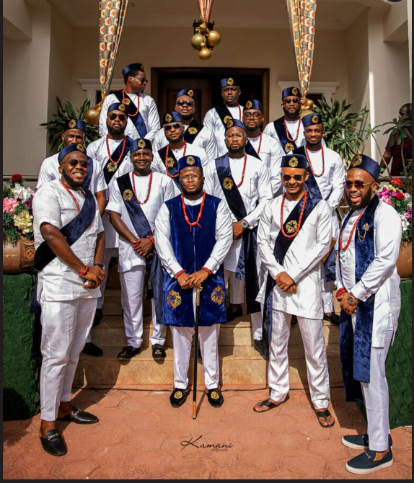
Community merging:
My father has integrated with the community around him by joining Nigerian churches, Nigerian activities, clubs etc. He did all of those to ensure that he wouldn't go insane. As an immigrant to lands unfamiliar to you it helps to know when you have brothers/country men in a similar position as you, it's easing in a sense.

Slide 9
Education/Work:
For my father, education was very important to put it lightly. Since Nigeria was colonized by Britain and English was the official language back home. The transition was essentially smooth in that area when it came to work. My fathers goals was always education oriented and he values that for his children as well.

Slide 10
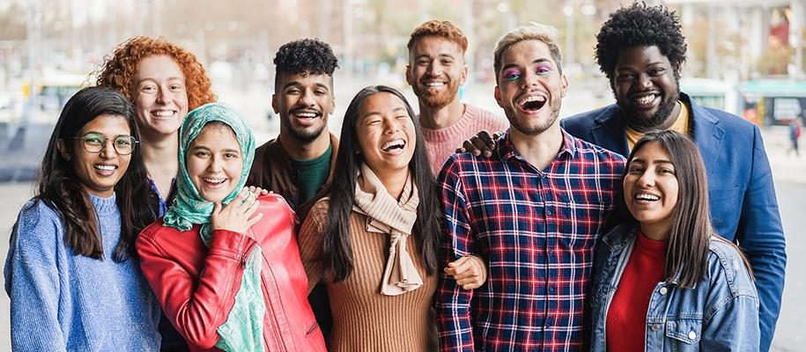
Diversity in America
In the words of my father it was very very clear to celebrate diversity you had no choice. Back in Nigeria and Africa as a whole diversity is in built. On average there are many Africans back home that can speak 3 or more languages. However back in America you see a group within a group of people that are being exposed to you.

Slide 11
Reflections:
My father has written 2 books, and gained a PhD, since coming to america. If he was back home in Nigeria he's not sure if he were able to accomplish nearly as much as he did. At the same time because my father is industrious and often times is referred to as an over worker he says that he perhaps would have done well.

Slide 12
Conclusion:
-Celebrating diversity in America was both a necessity and a joy, as it provided exposure to various cultures and perspectives.
-Reflecting on our journey, we are grateful for the opportunities and experiences gained in America, which have shaped us into more open-minded individuals.
-We migrated to America due to various challenges, primarily financial hardships during the Biafran War.
-Upon arrival in America, my father was amazed by the perceived opportunities and modern amenities, such as escalators in airports.
-We faced initial challenges, including financial struggles to afford education and difficulties understanding American accents and academic expectations.
-Despite cultural differences, we adapted to American life while preserving our Nigerian cultural identity through various means like music, food, and community involvement.
-Integration into the local Nigerian community helped alleviate feelings of isolation and provided a sense of belonging in a foreign land.
-Education was prioritized in our family, leading to academic achievements such as earning a PhD and publishing books.

Slide 13
References:
World Population by Country 2024 (Live) (worldpopulationreview.com)
United States of America National Symbols: National Animal, National Flower. (symbolhunt.com)
What is American Culture? - WorldAtlas

