Slide 1
My Cross Culture Experience
Alisha Jainarine

Slide 2
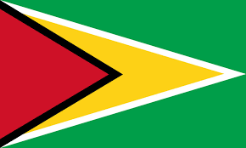
Origin
I am from Jamaica, Queens, NY and you might say how are you Guyanese? Well , my mom and dad is from East Berbice-Corentyne, Guyana, #59 and #57Village. I’ve visited Guyana many times when I was younger, and I absolutely loved it! Growing up in NY didn’t make me any different from growing up in Guyana. The same traditions, beliefs, etc. were set into place as I grew up and still set is. We celebrate most Guyanese holidays such as Mashramani (celebration of Guyana becoming republic), Easter Monday, Labour Day, Republic Day, Independence Day, Emancipation, New Years, Christmas, Holi(Phagwa), Boxing Day, CARICOM Day, etc. My Mom and I identify as Christian, and my Dad is Hindu, we might not be overly religious, but we do follow our customs (Believing in GOD) such as going to church every other Sunday, praying before bed, etc.

Slide 3
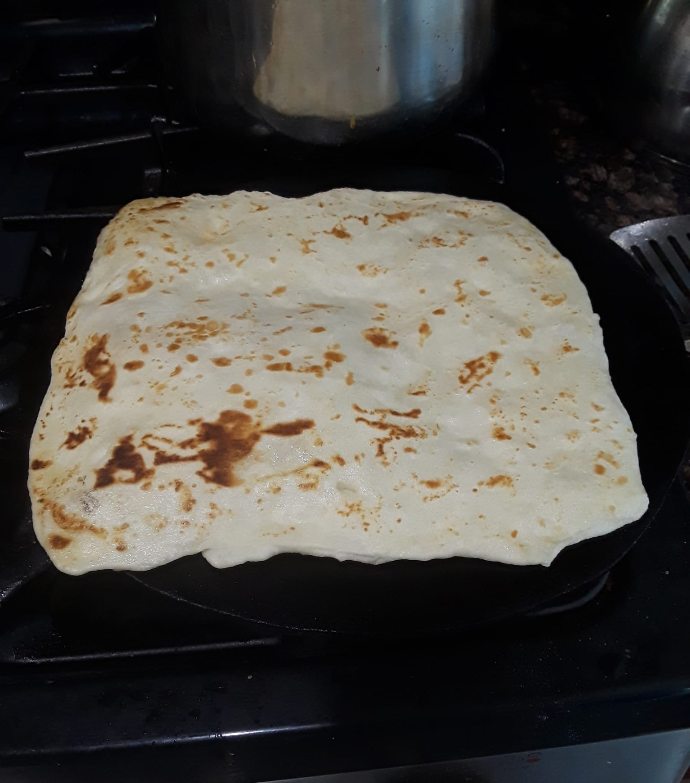
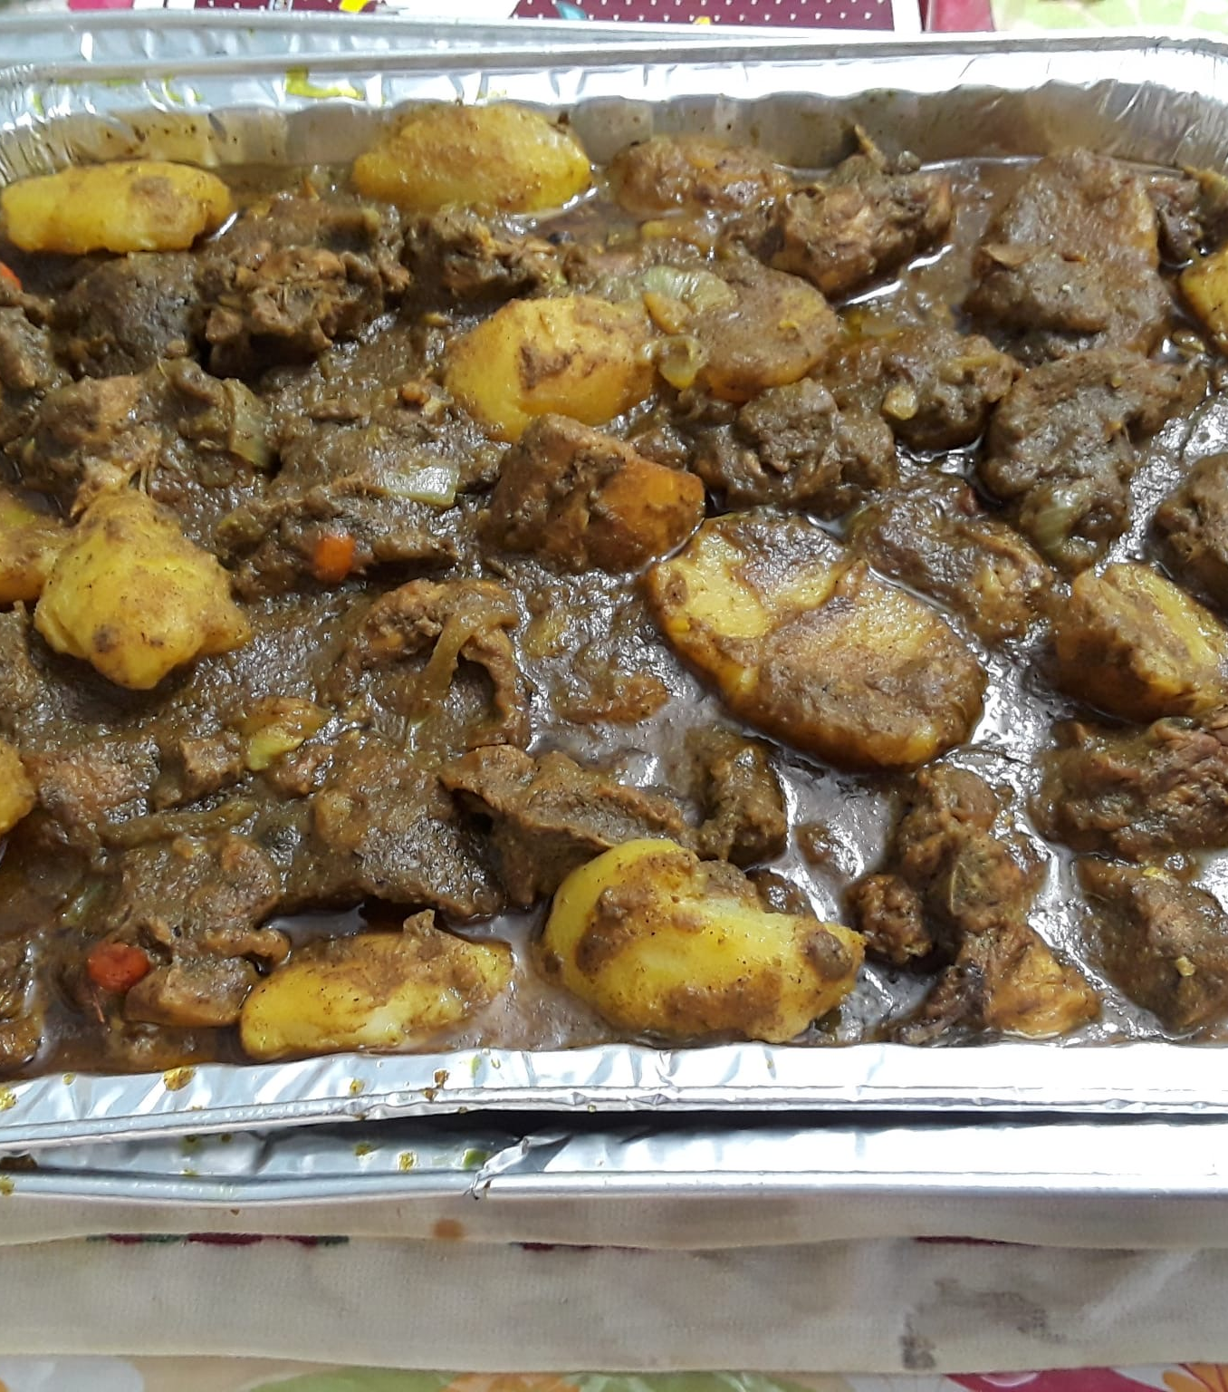
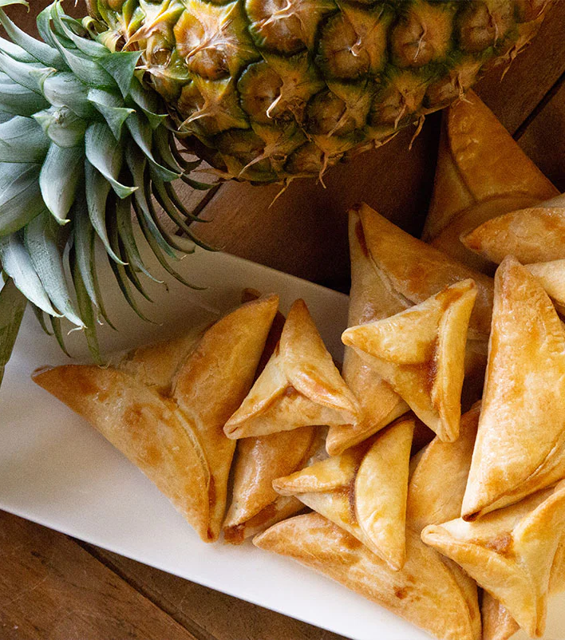
Experience
In New York, my experience with food is beyond words can express but I can try covering most with what I’ve experienced so far. In NY, there are at least over millions of cultures and each culture has their own way of making / serving their dishes whether it is Guyanese, Trinidadian, Indian, Chinese, Grenadian, Jamaican, Hispanic, even “White” has their own way of making food. But the food I grew up eating is my own Guyanese food. From Mom making Roti and the Curries you can think of (Chicken Curry / Curry Chicken, Lamb, Goat, Shrimp Curry, Fish Curry, Potato Curry, etc.) to delicious sweets (Cassava Pone (Yuca) , Black eye, Pinetart, Cheese Roll, Salara (Red Bread), cook up and so much more). I won’t lie I have tried different culture foods, like Chinese, Indian, and Spanish and they are great, but nothing beats your own home cooked food.

Slide 4
Experience
Weddings in Guyana, like in many cultures, can vary in duration depending on various factors such as cultural traditions, personal preferences, and the scale of the event. Typically, a wedding ceremony itself may last anywhere from 30 minutes to an hour, depending on the customs and rituals involved. However, the festivities surrounding the wedding can last much longer, often spanning several hours or even days, especially if there are pre-wedding rituals, receptions, and post-wedding celebrations involved. In Guyana, weddings often involve vibrant celebrations with music, dancing, and feasting, which can extend the joyous occasion for a significant amount of time. Whereas in New York, it is kind of simple, they have a few ceremonies and then there is the wedding. Traditional weddings in Guyana typically last for one day, but the celebrations leading up to the wedding day and sometimes afterward can extend the festivities over several days or even weeks, depending on the customs and preferences of the families involved. I don’t have a video for a wedding in Guyana but my DJ Team Member got married last year and it is like back home.

Slide 5
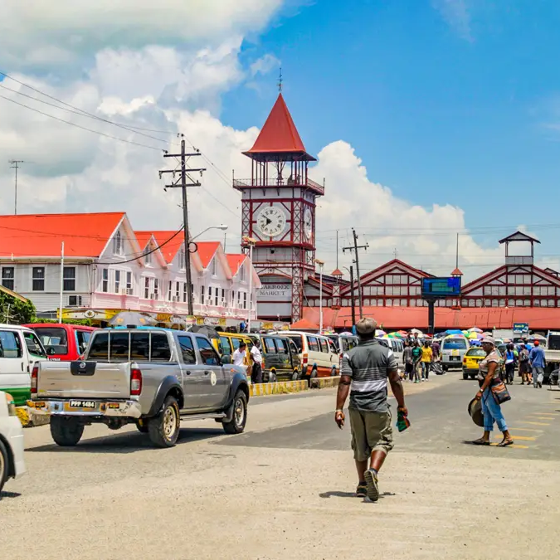
Travel Experiences
Growing up and even to now, I am always traveling not just around the corner but to different states, and countries, such as (Guyana, Trinidad, Jamaica, Dominican Republic, Florida, Canada, Lake George, Maryland, and so much more). Now you wouldn’t believe me but most of my travels were road trips meaning we drove but only to the easy places like Canada, Florida, Jersey, Maryland but other than that we took an airplane. There are many other places that I’d love to visit but all in due time.

Slide 6
What is Cross Culture?
Cross-culture refers to interactions or comparisons between different cultures, typically involving the exchange of ideas, traditions, values, behaviors, and customs. It involves understanding and navigating the similarities and differences between various cultural groups, whether they are regional, national, ethnic, or even organizational. Cross-cultural interactions can occur in various contexts such as business, education, travel, or social interactions, and they often require sensitivity, open-mindedness, and communication skills to bridge potential gaps and foster mutual understanding and respect.

Slide 7
What is Cross Culture IN New York?
In New York City, cross-cultural dynamics thrive due to its diverse population representing various cultures worldwide. The city's neighborhoods, businesses, educational institutions, and cultural events all contribute to the rich tapestry of cross-cultural interactions. From cuisine and language to art and music, New York embodies a melting pot where people from different backgrounds coexist and collaborate, making effective communication and understanding of cultural nuances essential for success.

Slide 8
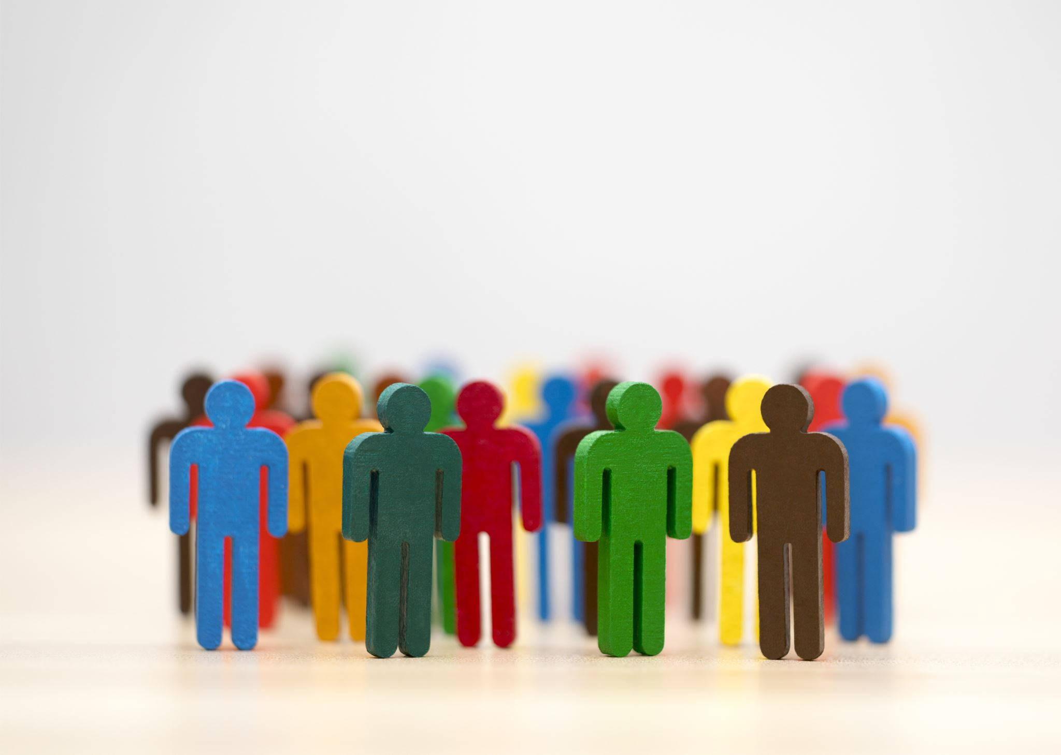
Socialization
Socialization is the process through which individuals learn and internalize the norms, values, behaviors, and social skills necessary to function effectively within a particular society or culture. It begins in infancy and continues throughout one's life, occurring through interactions with family members, peers, educators, media, and other social institutions. Socialization shapes an individual's identity, beliefs, attitudes, and behaviors, influencing how they perceive the world and interact with others. It plays a crucial role in the transmission of cultural heritage, the maintenance of social order, and the development of a sense of belonging and connection within communities.

Slide 9
Conclusion
The presentation on cross-cultural comparisons between Guyana and New York highlighted the diverse cultural aspects of both regions. Despite geographical distance, both places are characterized by multicultural influences, with New York showcasing a cosmopolitan blend and Guyana reflecting Caribbean, South American, and Indian heritage. Emphasizing the importance of understanding and respecting cultural differences, the presentation underscored the role of cultural exchange in fostering mutual appreciation and connection. Ultimately, it promoted the celebration of diversity to build a more inclusive and harmonious global community.

Slide 10
Ending
Thank you for viewing with me!
Alisha Jainarine
Multicultural Studies

